Slide 1

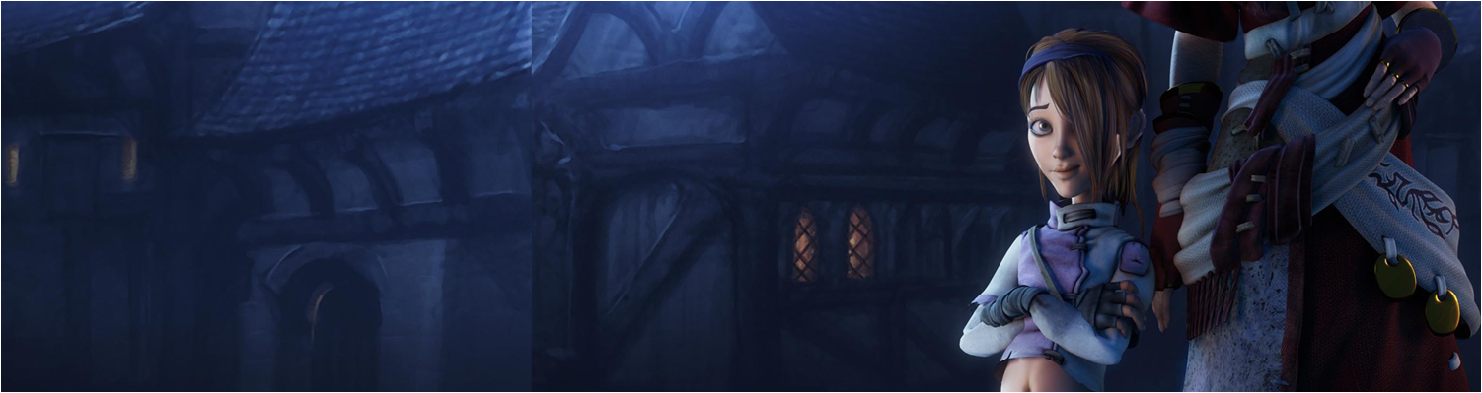

Workshop 2: History & State of Cybersecurity
COMP280: Creative Computing
BSc(Hons) Computing for Games
BA(Hons) Game Development: Programming

Slide 2
Workshop Session
Review the assignment
Develop your analytical skills
Present findings

Slide 3
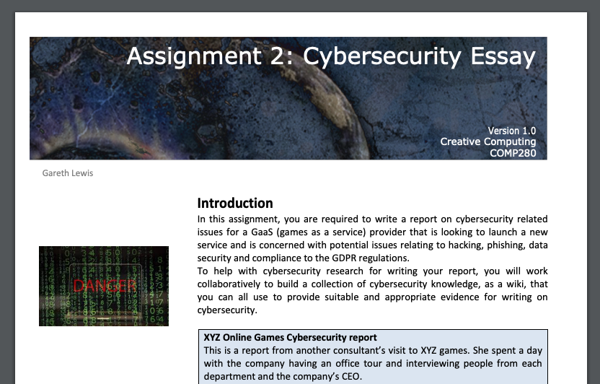
Review the assignment
https://github.com/Falmouth-Games-Academy/bsc-assignment-briefs/raw/2019-20/comp280/2/2019-20-comp280-assignment-2-brief.pdf

Slide 4
Review the assignment
https://github.com/Falmouth-Games-Academy/bsc-assignment-briefs/raw/2019-20/comp280/2/2019-20-comp280-assignment-2-brief.pdf
Create a repository of cybersecurity knowledge
This is workshop 3
https://github.com/Falmouth-Games-Academy/comp280-cyberworkshop.git
Write a report on XYZ Online Games
Potential Cybersecurity issues for the firm
How Controls and Control Strategies can mitigate cyber issues
Outline potential major GDPR issues for the organisation with regards to its current data management and security processes
Compare and contrast traditional encryption with modern AES cryptography
Read the Rubric

Slide 5
Develop your analytical skills
Pair up (1xBSc & 1xBA)
Take the first few articles in the repo (so you have one each)
Do 5Ws&H and 3A assessments of them
Put results into a 2 page presentation
Page 1: 5Ws&H
Page 2: 3As
Write up the results into the security wiki

Slide 6
Present findings
Present your findings

Slide 7
Questions

