Slide 1
Week 5: Mechanics II Part 3: Collision Response
COMP270: Mathematics for 3D Worlds and Simulations
Notes:
So far this week, we’ve looked at quite a lot of geometrical operations, to see how they can help us discover relationships between physical objects, such as whether they’re intersecting or colliding, and how close they are. We’re going to go back to the realm of physics now, and look at the next step of collision processing, which is what happens to the objects when they do intersect.

Slide 2
Objectives
Apply the physical laws that predict the behavior of colliding objects
Outline methods to compensate for the fact that virtual objects aren’t solid
Notes:
We’ll start by going back to our consideration of forces and object motion from Newtonian mechanics to see how we can apply the appropriate laws that predict the behaviour of interacting objects in our simulations to create plausible-looking physical responses to collisions, and then we’ll look at some techniques we might need to use to compensate for virtual objects not being solid – remember that we detected collisions by seeing if part of one object is actually inside another, which is not something that happens in the real world, so we want to avoid having it look like it does in our simulations.

Slide 3
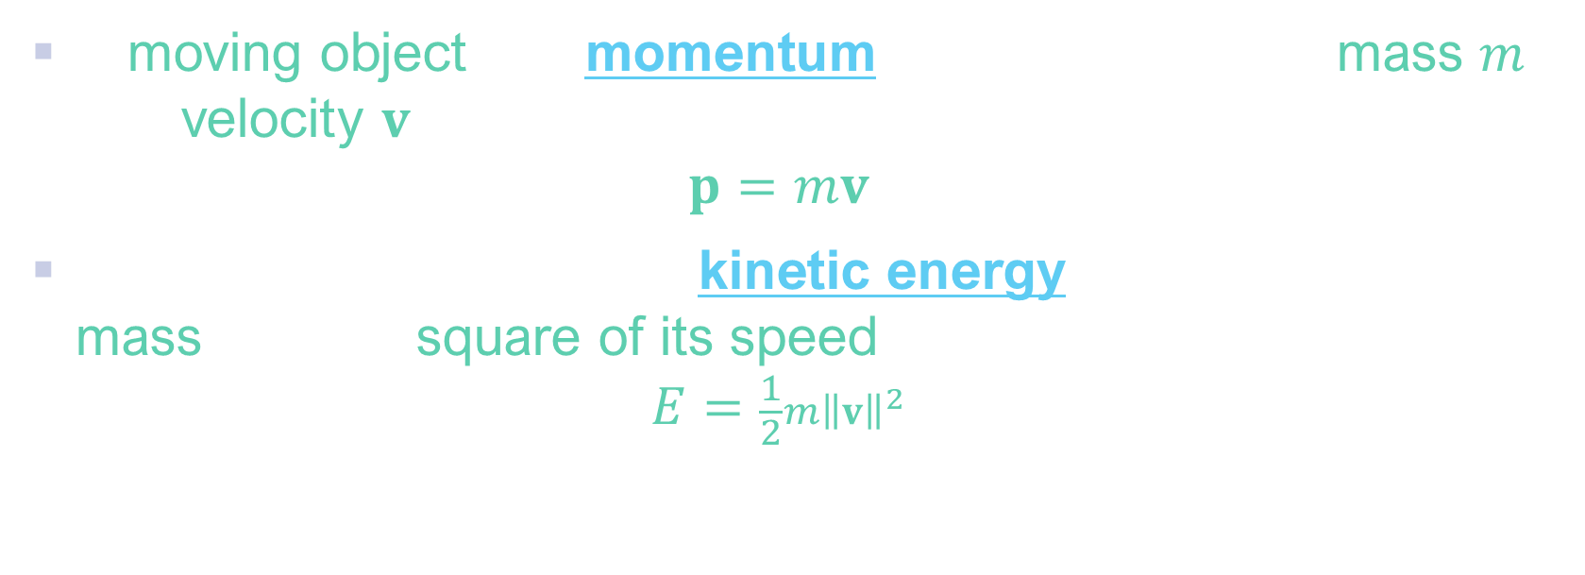
Momentum and energy
A moving object has momentum proportional to its mass $m$ and velocity $v$ $p=mv$
A moving object also has kinetic energy proportional to its mass and the square of its speed $E=\frac{1}{2}m{\left\|v\right\|}^{2}$
Unit: kgm/s or kgms⁻¹
Unit: Joule (J), representing kg(m/s)² or kg(ms)⁻²
Notes:
To determine how an object will behave when it interacts with others, we need to consider two key physical properties. The first is
Momentum, which is often used metaphorically to describe something that seems to be keeping going without any external influences, and which it would require an effort to stop. In physics, the momentum of an object is equal to its mass times its velocity, so it’s a measure of “how much stuff” is moving, and “how quickly” (as well as in which direction, from the velocity being a vector). As you might guess from the formula, the unit for momentum is
Kgm/s.
Any object that’s moving also has kinetic energy, which comes in various forms and can be due to a variety of motions, including vibrations and rotations. The one we’re concerned with here is translational kinetic energy, which is the energy an object has because it is moving from one position to another. Like momentum, this is also proportional to the mass, and this time to the squared magnitude of the velocity; as energy is a scalar rather than directional quantity, it doesn’t matter which direction the object is travelling in, but increases quadratically as the object speeds up. If we combined the units in the usual way, we’d get something like
Kg-metre/s-allsquared, which is a little cumbersome, so it’s referred to as a Joule after the English physicist James Prescott Joule. Note that this isn’t the same as a Newton, which was kgm/s^2 as it involved the acceleration; in this case, the ‘squared’ comes from the squaring of the speed rather than the fact that it’s a second derivative.

Slide 4
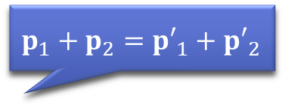
Conservation
$p_{1}+p_{2}=$ ${p′}_{1}+{p′}_{2}$
When two objects collide, the total momentum is conserved
In an elastic collision, the total kinetic energy is also conserved
In an inelastic collision, some kinetic energy is ‘lost’ (e.g. as sound, heat etc)
These can be used to calculate the velocities of the objects after collision
Example here
Notes:
These two properties are useful because of what happens to them during collisions. You might have heard of the principles of conservation of momentum and conservation of energy; these tell us that
When two objects collide, the total momentum is conserved. This doesn’t necessarily mean that each object will have the same momentum coming out of the collision as it did going in, but that the combined momentum of both will be the same before and afterwards; we could write
P1 + p2 = p’1 + p’2, where p1 and p2 are the momentums of the objects before the collision, and p’1 and 2 are their momentums afterwards.
Kinetic energy may also be conserved in the same way, in which case the collision is called ‘elastic’; often, though,
Some of the energy is converted to a different form, such as sound or heat, which results in an inelastic collision; we refer to the converted energy as ‘lost’ because it’s no longer within the system we’re modelling. Usually, the energy loss is very small, so we can reasonably model most collisions as elastic,
Which helps us to calculate the velocities of the objects after they’ve collided; there’s a
video demonstrating how to do this linked from this slide and on LearningSpace.

Slide 5


Contact normal
Reaction force acts along the contact normal – perpendicular to both surfaces
Component of velocity parallel to the normal changes; component perpendicular to the normal does not (disregarding friction)
$$v_{2}$$
$$v_{1}$$
Notes:
If you watch the examples in the videos, you’ll notice that he assumes that the two objects are travelling directly towards each other, which isn’t always going to be the case. So
what happens if objects collide at an angle, or offset, for instance these two circles moving with velocities before impact of v1 and v2… It’s actually not as complex as we might think, as
The force from the collision acts along a single line, called the contact normal, which is perpendicular to both surfaces at the point of impact. This is the force described by Newton’s third law as being “equal and opposite”; it has the same magnitude for both objects, and acts along the contact normal away from the surface of each, so in opposite directions. As usual, we can
Split the objects’ velocities into components by resolving, or projecting, them in two perpendicular directions;
Since the component of the velocity perpendicular to the contact normal is not affected by the force (and if we ignore the effects of friction, which is generally handled separately), then we only need to consider the objects’ velocities parallel to the force direction, which gives essentially the same setup as if the objects were travelling straight towards each other, with just the directional portion of the velocities.

Slide 6
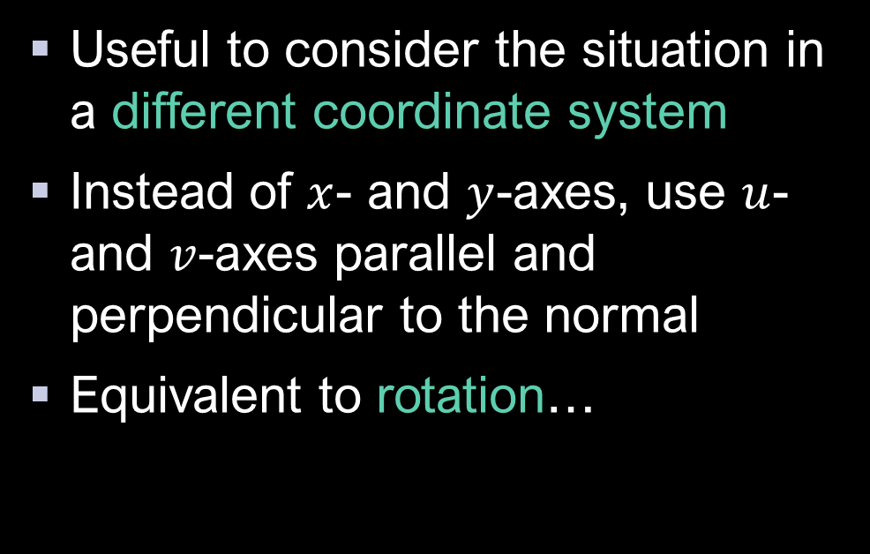




Change in coordinate systems
Useful to consider the situation in a different coordinate system
Instead of $x$- and $y$-axes, use $u$- and $v$-axes parallel and perpendicular to the normal
Equivalent to rotation…
$$v$$
$$y$$
$$u$$
$$x$$
Notes:
When we split the velocities along arbitrary vectors like this, we’re effectively performing a
Change in coordinate system, considering the object’s positions and velocities relative to a
local set of axes that are parallel to and perpendicular to the contact normal, which are often referred to as u and v to distinguish them from the world x and y.
Changing the coordinate system this way is actually the same operation as rotating the objects; if you imagine rotating the uv coordinate system so that it lines up with
the usual x y one,

Slide 7

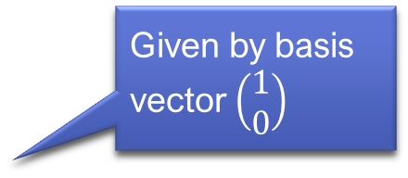
Change in coordinate systems
Given by basis vector $\left(\begin{matrix}1 \\ 0\end{matrix}\right)$
Under the new coordinates, reaction force acts along the $u$ axis
So can calculate collision response just by using $u$ components of vectors
This is a common trick – solving problems by transforming to a more convenient coordinate system
$$v$$
$$y$$
$$u$$
$$x$$
Notes:
Like so, and arrange things
so that the origins of the two coordinate systems coincide, then the object’s coordinates in the uv system are the same as they would be if the rotation that describes the
mapping between the two coordinate systems were applied to
rotate the objects in the xy coordinate space. Don’t worry if that doesn’t make much sense at the moment, as we’ll be looking at coordinate transformations in more detail in a couple of weeks; for now,
The key point is that it’s essentially what we’re doing when we resolve the vectors into their components and consider the reaction force as acting along the u axis, which is parallel to the contact normal,
So we find the collision response just using the u components, given by the projections of the velocities along the normal. Since we can imagine the direction of u as being horizontal,
Or defined by the basis vector (1, 0), this simplifies our calculations for the velocities, which we can just treat as the magnitudes of the projections of the actual velocities without having to worry about what direction they’re really in, and then apply the results back to the normal direction in xy space.
Transforming between coordinate systems is a trick you’ll come across frequently in computer graphics, where we often work in multiple spaces; while the space here, which you might call “collision space”, is temporary, since it’s linked to a force that only acts instantaneously, there are more persistent spaces defined by the world and the objects in it, including the camera or viewpoint, that we need to switch between to make our calculations more manageable.

Slide 8

Simulating collisions
Position is computed before forces: could be moved to intersect another object
For each object, store its position $x$ and velocity $v$
On each time step:
Apply numerical integration to the velocity to determine the new position, $x^{′}=x+v∆t$
Calculate the forces acting upon the object, and thus the acceleration $a$ from Newton’s 2nd law
Apply numerical integration to the acceleration to determine the new velocity, $v^{′}=v+a∆t$
Notes:
Speaking of tricks, the last thing to mention when it comes to collision response is how to make it look like our virtual objects are actually solid. The velocity calculations we’ve just covered are based on real physics, but if you remember our steps for simulation,
you’ll note that we’re calculating the external forces (including those from collisions) after we’ve moved the object to its new position
– so there’s a distinct possibility that two objects could end up intersecting, as a side-effect of the fact that we have to sample the time in discrete intervals so may not catch the exact moment that the edges of the objects touch. Our collision tests can handle this, but the physical models don’t factor it in, so if the intersection is large then the new velocities might not be enough to separate the object by the next timestep, which can look a little unconvincing, so we may need to step in and adjust things manually.

Slide 9
Correcting intersections
Depth of penetration: measures how much of one object is inside another.
Possible actions:
Adjust the positions
Adjust the velocities to achieve the required positions
Apply a penalty force to achieve the required velocities (to achieved the required positions)
Notes:
A common way to do this is to make use of the
depth of penetration, which we can calculate using similar geometric methods to those in the previous part of this lecture, to find the maximum distance between a vertex of one object and the surface of another that it’s inside. Once we have this information, there are a
few possible things we could do with it:
The most direct thing is to simply move one or both objects so that they no longer intersect, usually along the collision normal; this is simple, but means that our simulation is a little out of sync – we normally try not to interfere so directly as it can cause a knock-on reaction, including
risking moving the objects into others that are nearby, or just look a little jumpy.
Another option is to adjust the velocity, calculating what it would need to be to move the objects enough to separate them within the next timestep. This is a fairly common approach, as it doesn’t run the risks of upsetting the balance that directly setting the position does, but is still fairly simple and controllable.
The most physically realistic method is to apply a force that would produce the desired change in velocity, which is often known as a penalty force. This subtler tactic ought to give a smoother result, as it allows the required motion to happen “naturally” during the subsequent calculations, though it does require extra computation and it can be tricky to get the magnitude of the force balanced between too small to separate the objects and so large that it creates instabilities. The method chosen generally depends on the application and how the time stepping, or integration, is handled./ This depth correction and the change of coordinate systems are two of several techniques we need to apply to make our simulations more robust, straightforward and manageable; we’ll have a look at some more in the next video.

