Slide 1

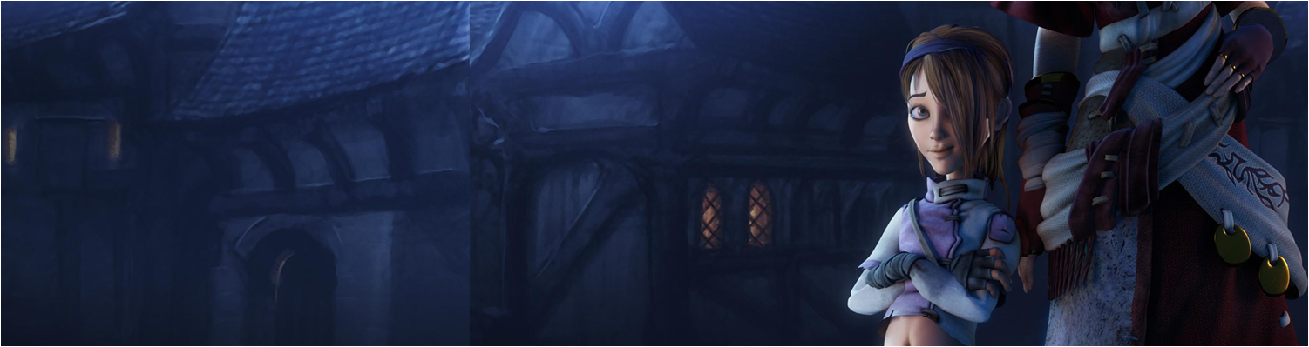

Workshop 2: History & State of Cybersecurity
COMP280: Creative Computing
BSc(Hons) Computing for Games
BA(Hons) Game Development: Programming

Slide 2
Workshop Session
Review the assignment
Develop your analytical skills
Present findings

Slide 3
Workshop Session
Review the assignment
Develop your analytical skills
Present findings

Slide 4
Workshop Session
Review the assignment
Develop your analytical skills
Present findings

Slide 5
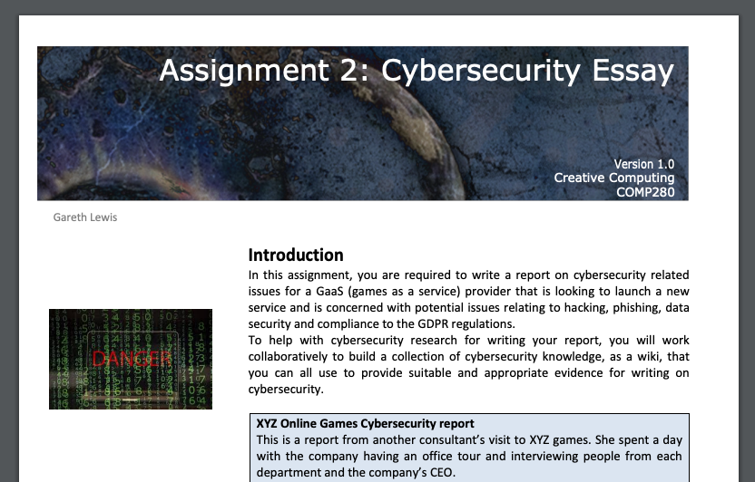
Review the assignment
https://github.com/Falmouth-Games-Academy/bsc-assignment-briefs/raw/2019-20/comp280/2/2019-20-comp280-assignment-2-brief.pdf

Slide 6
Review the assignment
https://github.com/Falmouth-Games-Academy/bsc-assignment-briefs/raw/2019-20/comp280/2/2019-20-comp280-assignment-2-brief.pdf
Create a repository of cybersecurity knowledge
Write a report on XYZ Online Games
Potential Cybersecurity issues for the firm
How Controls and Control Strategies can mitigate cyber issues
Outline potential major GDPR issues for the organisation with regards to its current data management and security processes
Compare and contrast traditional encryption with modern AES cryptography
Read at the Rubric

Slide 7
Develop your analytical skills
Pair up (1xBSc & 1xBA)
Take the first 10 articles in the repo
Do 5Ws&H and 3A assessments of them
Put results into a 2 page presentation
Page 1: 5Ws&H
Page 2: 3As

Slide 8
Present findings
Present your findings

Slide 9
Questions

