Slide 1

1: Module Introduction
COMP270: Mathematics for 3D Worlds & Simulations

Slide 2

Module Introduction

Slide 3
Aim
To empower you to leverage mathematics and mathematical modelling in the design and implementation of real-time 3D worlds and simulations.

Slide 4
Summary
On this module, you learn the fundamental mathematics involved in the design, development and maintenance of real-time 3D worlds and simulations. In doing so, you will leverage mathematics practically to generate and manipulate worlds and simulations relevant to a range of creative computing contexts. Indicatively, content spans topics such as linear algebra (vectors, matrices and quaternions), geometry, trigonometry, 3D transformation, collision detection, Newtonian mechanics, numerical control, calculus, and efficiency and optimisation of numerical methods.

Slide 5
Learning Outcome
ID | NAME | DESCRIPTION | ASSESSMENT CRITERIA CATEGORY
3 | Solve | Apply knowledge of algorithms, data structures, and mathematics to solve well-defined problems. | PROCESS

Slide 6
Assignments
Assignment 1: Worksheet Tasks [100%]
Four worksheets (roughly one every 2 weeks)
Worksheets test your mathematical problem solving and C++ programming
See LearningSpace for assignment brief, worksheets and formative deadlines
See MyFalmouth for summative deadline

Slide 7
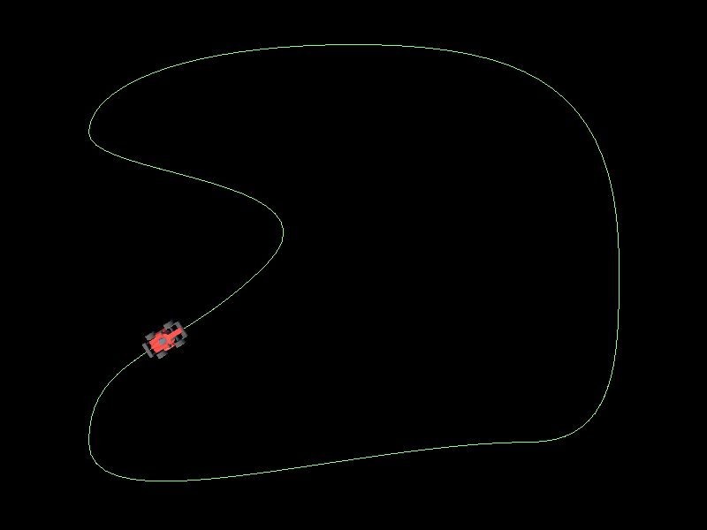
Worksheet A
Bézier Curves
Due Monday week 4 (14th October)

Slide 8
Vectors (a refresher)

Slide 9
2D Vectors
A 2D vector is an arrow on the 2D plane
Represents a quantity with direction and length
Can represent a point on the plane (relative to the origin)
Defined by a pair of numbers: the x component and the y component
By mathematical convention, positive x points to the right and positive y points up
In computer graphics we sometimes have positive y point down instead
y
x

Slide 10

Writing vectors
As a pair of numbers: $(x,y)$
As a column vector: $\left(\begin{matrix}x \\ y\end{matrix}\right)$
Variable representing a vector: written in bold i.e. $v=\left(\begin{matrix}x \\ y\end{matrix}\right)$
Other notations: $\vec{v},\underline{v}$

Slide 11
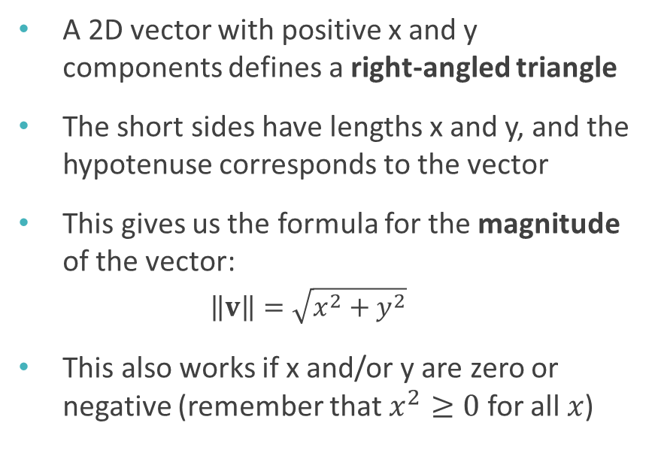
2D vectors and triangles
A 2D vector with positive x and y components defines a right-angled triangle
The short sides have lengths x and y, and the hypotenuse corresponds to the vector
This gives us the formula for the magnitude of the vector:
$$\left\|v\right\|=\sqrt{x^{2}+y^{2}}$$
This also works if x and/or y are zero or negative (remember that $x^{2}≥0$ for all $x$)
y
x

Slide 12

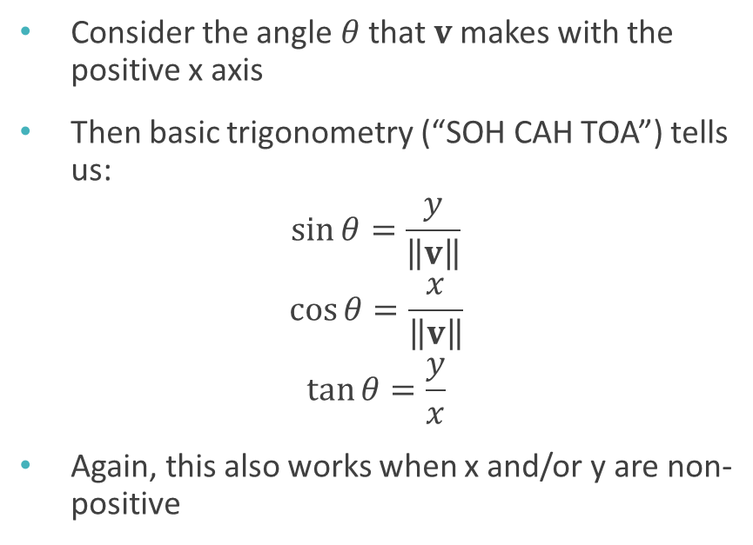

2D vectors and trigonometry
Consider the angle $θ$ that $v$makes with the positive x axis
Then basic trigonometry (“SOH CAH TOA”) tells us:
$$\sin{θ}=\frac{y}{\left\|v\right\|}$$
$$\cos{θ}=\frac{x}{\left\|v\right\|}$$
$$\tan{θ}=\frac{y}{x}$$
Again, this also works when x and/or y are non-positive
$$\left\|v\right\|$$
y
$$θ$$
x

Slide 13
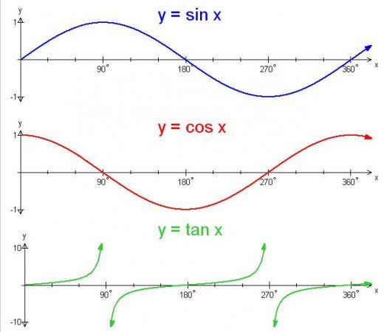
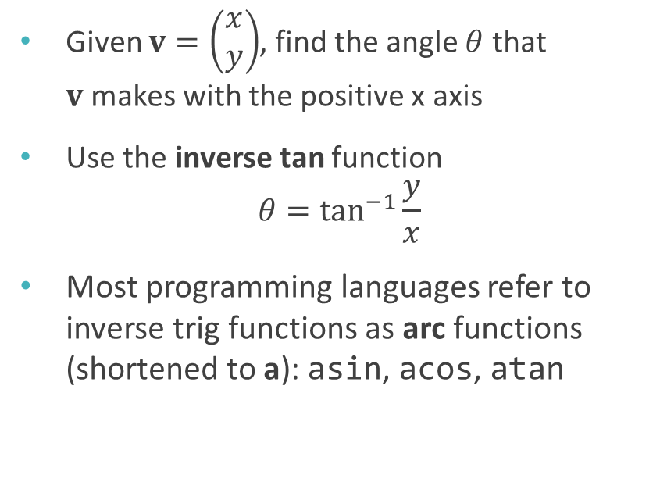
Finding the angle
Given $v=\left(\begin{matrix}x \\ y\end{matrix}\right)$, find the angle $θ$ that $v$makes with the positive x axis
Use the inverse tan function $θ=\tan^{−1}{\frac{y}{x}}$
Most programming languages refer to inverse trig functions as arc functions (shortened to a): asin, acos, atan

Slide 14
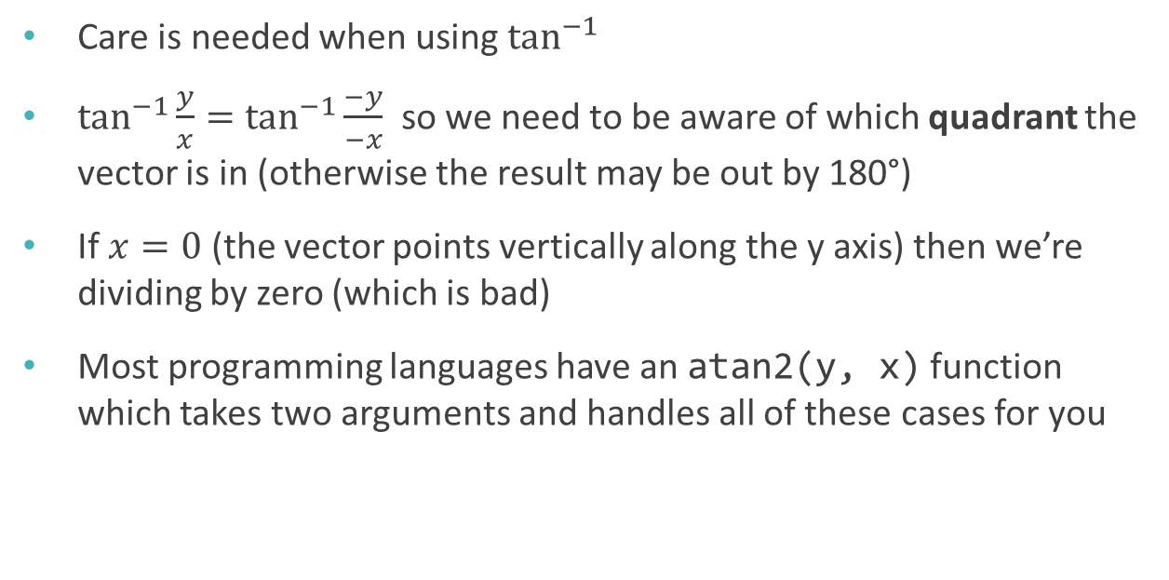
Inverse tangent
Care is needed when using $\tan^{−1}{}$
$\tan^{−1}{\frac{y}{x}}=\tan^{−1}{\frac{−y}{−x}}$ so we need to be aware of which quadrant the vector is in (otherwise the result may be out by 180°)
If $x=0$ (the vector points vertically along the y axis) then we’re dividing by zero (which is bad)
Most programming languages have an atan2(y, x) function which takes two arguments and handles all of these cases for you

Slide 15
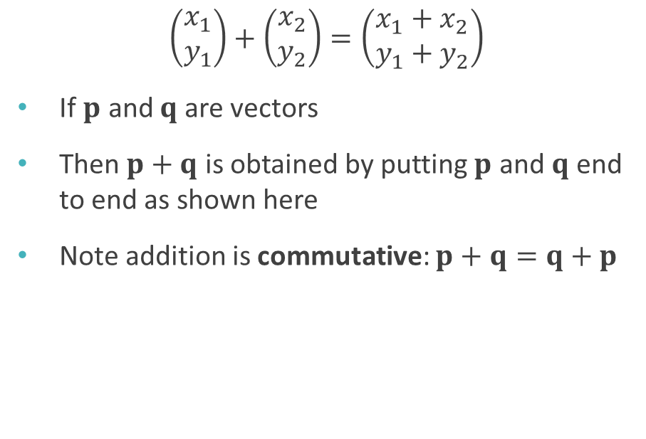
Vector addition
$$\left(\begin{matrix}x_{1} \\ y_{1}\end{matrix}\right)+\left(\begin{matrix}x_{2} \\ y_{2}\end{matrix}\right)=\left(\begin{matrix}x_{1}+x_{2} \\ y_{1}+y_{2}\end{matrix}\right)$$
If $p$ and $q$ are vectors
Then $p+q$ is obtained by putting $p$ and $q$ end to end as shown here
Note addition is commutative: $p+q=q+p$
q
p
p+q
p
q

Slide 16
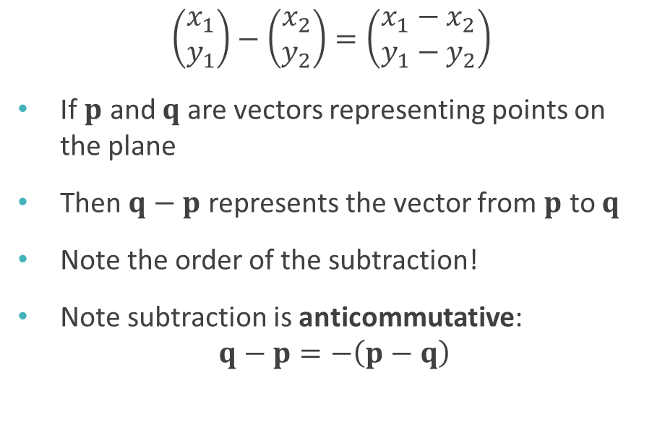
Vector subtraction
$$\left(\begin{matrix}x_{1} \\ y_{1}\end{matrix}\right)−\left(\begin{matrix}x_{2} \\ y_{2}\end{matrix}\right)=\left(\begin{matrix}x_{1}−x_{2} \\ y_{1}−y_{2}\end{matrix}\right)$$
If $p$ and $q$ are vectors representing points on the plane
Then $q−p$ represents the vector from $p$ to $q$
Note the order of the subtraction!
Note subtraction is anticommutative: $q−p=−\left(p−q\right)$
p
q-p
q
0

Slide 17
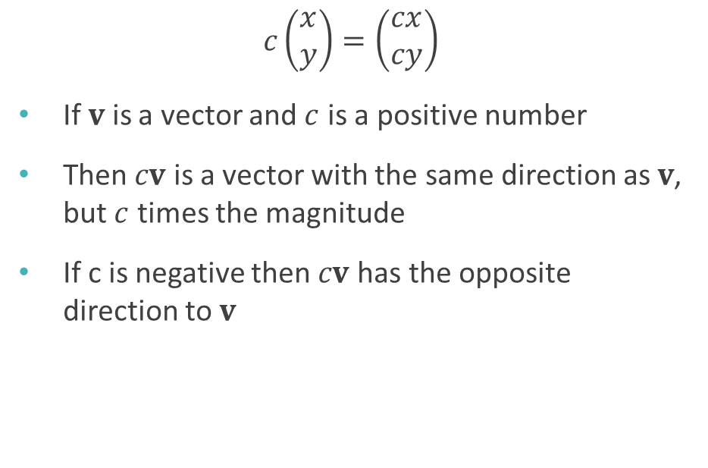
Scalar multiplication
$$c\left(\begin{matrix}x \\ y\end{matrix}\right)=\left(\begin{matrix}cx \\ cy\end{matrix}\right)$$
If $v$ is a vector and $c$ is a positive number
Then $cv$ is a vector with the same direction as $v$, but $c$ times the magnitude
If c is negative then $cv$ has the opposite direction to $v$
2v
v
-2v

Slide 18

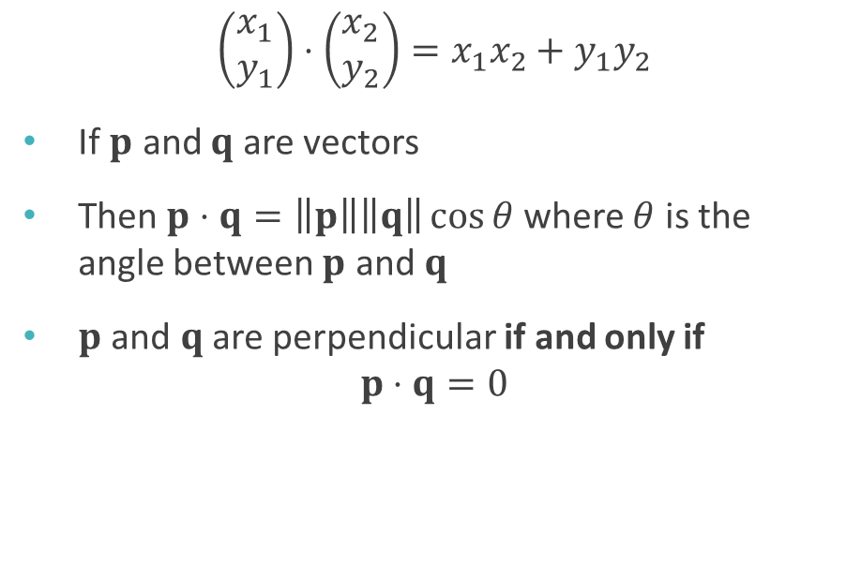
Dot product
$$\left(\begin{matrix}x_{1} \\ y_{1}\end{matrix}\right)⋅\left(\begin{matrix}x_{2} \\ y_{2}\end{matrix}\right)=x_{1}x_{2}+y_{1}y_{2}$$
If $p$ and $q$ are vectors
Then $p⋅q=\left\|p\right\|\left\|q\right\|\cos{θ}$ where $θ$ is the angle between $p$ and $q$
$p$ and $q$ are perpendicular if and only if $p⋅q=0$
p
$$θ$$
q

