Slide 1
Logic and Pseudocode
COMP110

Slide 2
Part I: CONDITIONS

Slide 3
Learning Objectives
By the end of this section you should be able to:
Write different types of loops
Manipulate the outcome of a function using boolean logic
Determine the output of a conditional function by comprehension

Slide 4
For Loop
for x in range(0, 3):
print “We're on time” + str(x)
For loops are traditionally used when you have a piece of code which you want to repeat n number of times.

Slide 5
For Each Loop
collection = “aeiou”
for x in collection:
print x
Foreach loops are traditionally used when you have a collection you wish to iterate through.

Slide 6


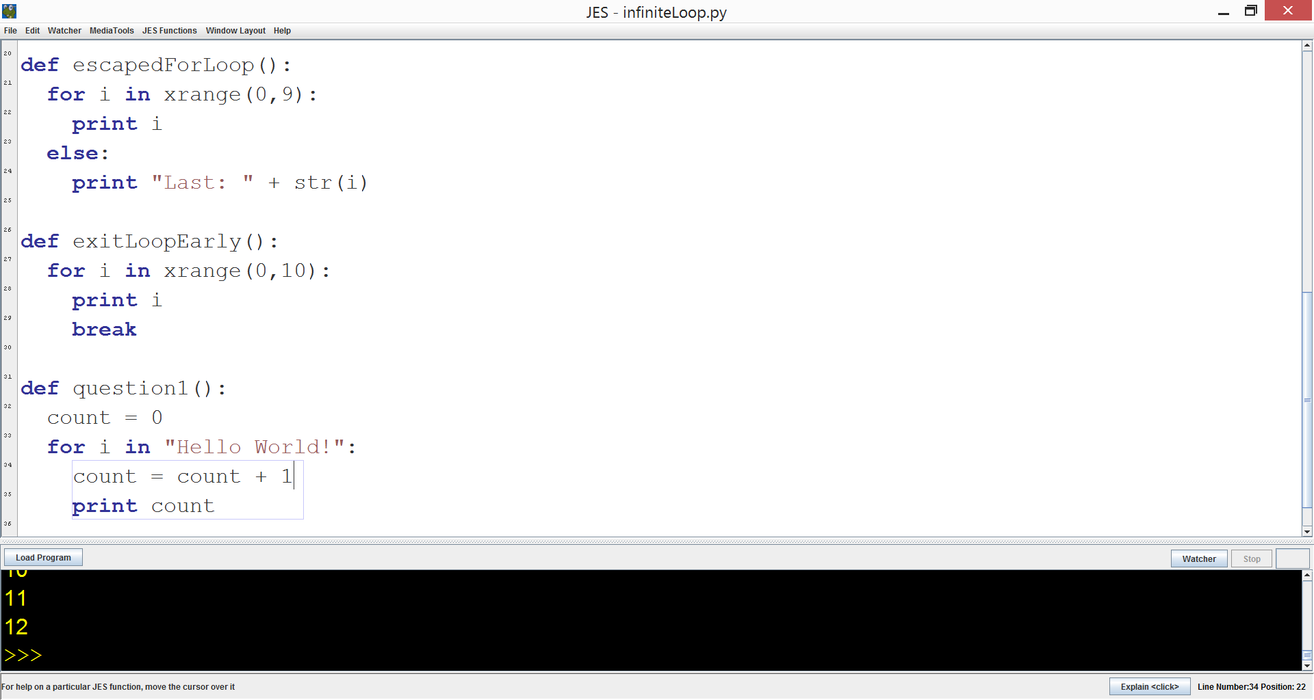


What will the output
be?
1 … 11
1… 12
0 … 11
0 … 12
Notes:
#3

Slide 7
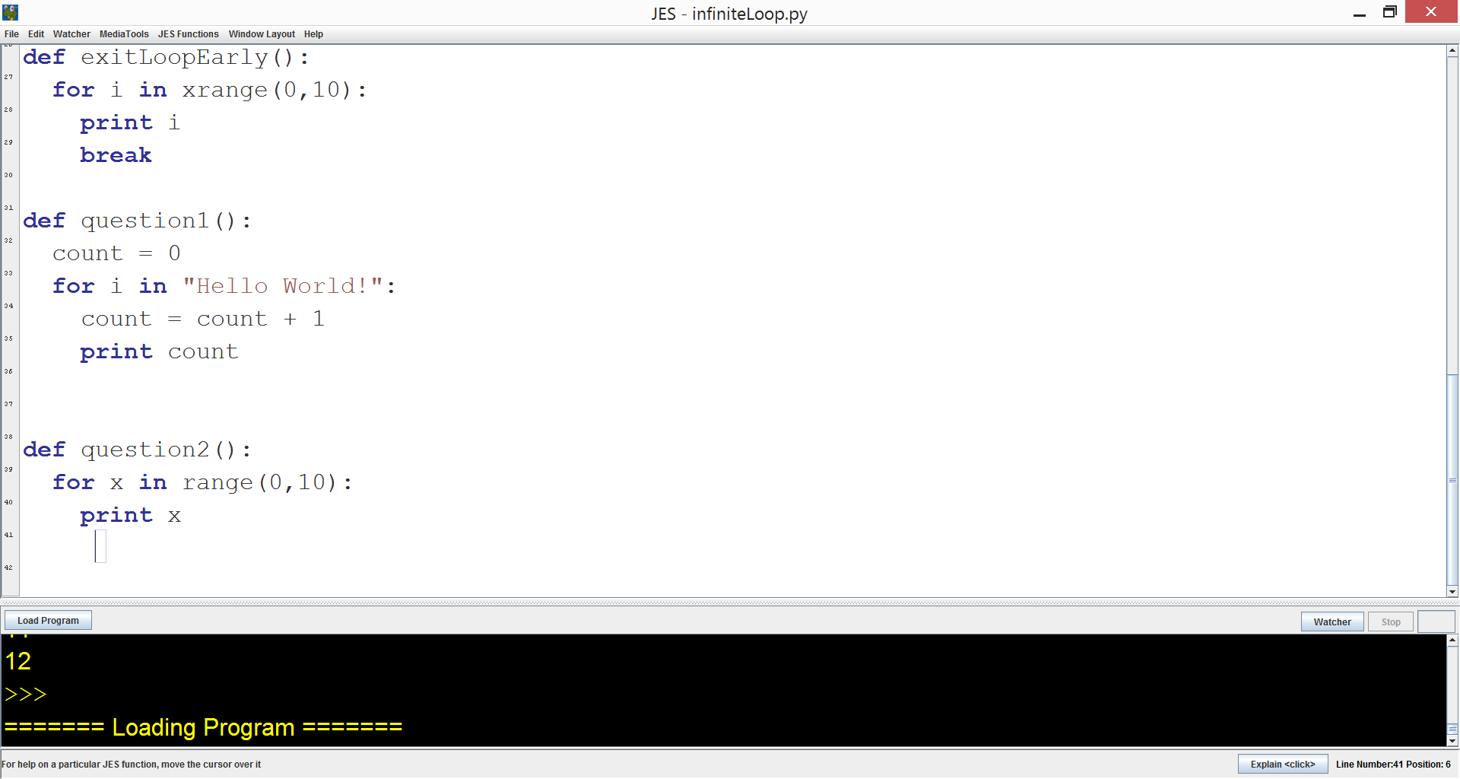
What will the output
be?
0 … 9
0… 10
1 … 9
1 … 10
Notes:
#3

Slide 8
For and For Each
In Python, the syntax for for and foreach are the same.
The range() function creates a temporary collection of sorts which loads the next value of x as directed
The range() also includes a third argument, step, which allows numbers to be skipped if needed.

Slide 9
For and For Each
def escapedForLoop():
for i in xrange(0,9):
print i
else:
print “Finished”
Use xrange to prevent the creation of a list
Use an else clause to run a terminating statement if needed (i.e., i is not found).

Slide 10
While Loop
x = 1
while x < 100:
print "To infinity and beyond! We're getting close, on " + str(x) + " now!"
x = x + 1
The while loop, however, is used when a condition is to be met; this is particularly useful if a collection is of unknown state or unknown size

Slide 11
Exiting a Loop
for i in xrange(0,10):
print i
break
The ‘break’ keyword can be used to exit a loop early.

Slide 12
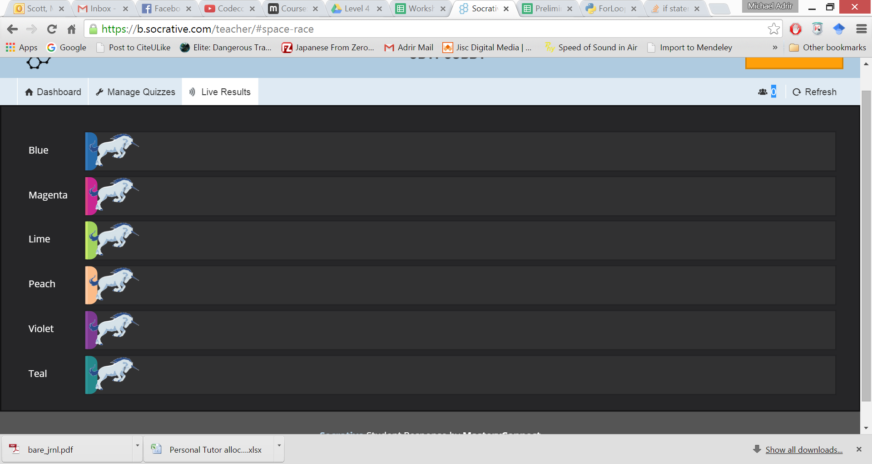
Activity
Please login to Socrative and join your pair:
harriet / jodie
emiljano / dean
madeline / rory
warwick / samantha
thomas/alastair
james / angus

Slide 13
Part II: CONDITIONS

Slide 14
Python Relational Operators

Slide 15
Primitive Conditions
Conditions are expressions which evaluate to true or false.
One kind of condition is the comparison of two numerical values of the same type.
Examples:
Payrate > 10
(x+10) == (y*z -8)

Slide 16
Conditional Operation: If-Statement
Syntax if <condition> : <list of statements>
<condition> would be replaced by actual condition, etc.
The colon is required
The list of statements, must be indented – part of the syntax for Python

Slide 17
The If-Statement
Semantics:
the condition is evaluated
if the condition is true, the list of statements is executed
T
Cond
F

Slide 18
If-Statement examples
if yearsWorked > 10 : bonus = 1000
if age >= 65 : total = 0.85 * total numSeniors = numSeniors + 1
Notes:
Do example Discount now.

Slide 19
The If-else-Statement
Syntax if <condition> : <list of statements> else : <list of statements>
Note colon after else
Both lists must be indented.

Slide 20
Conditional Operation: if-then-else
Semantics:
the condition is evaluated
if the condition is true, the list of statements is executed
F
T
Cond

Slide 21
If-Else-Statement examples
if yearsWorked > 10 :
bonus = 1000 else : bonus = 500
if age >= 65 : price = 0.85 * price numSeniors = numSeniors + 1 else : nonSeniors = nonSeniors + 1
Notes:
Do example Order now.

Slide 22
If-ElIF-Else-Statement
if yearsWorked > 20 :
bonus = 1000
elif yearsWorked > 10:
bonus = 750 else : bonus = 500
if age >= 65 : price = 0.85 * price numSeniors = numSeniors + 1 else : nonSeniors = nonSeniors + 1
Notes:
Do example Order now.

Slide 23
Input() Function
Conditions are useful when the state of a variable is unknown.
For example,
When using the input function!

Slide 24
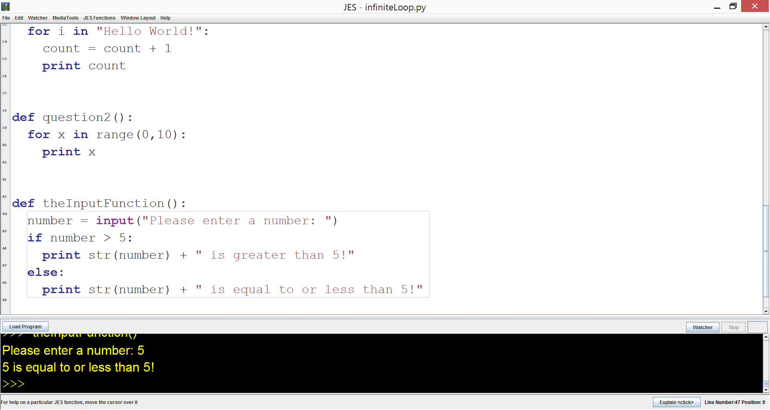
Input() Function

Slide 25
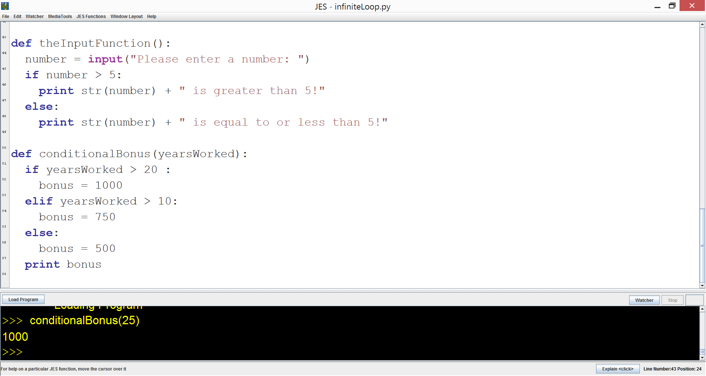
If the input is 10, what will the output be?
Error
500
750
1000
Notes:
#3

Slide 26
If the input is 20, what will the output be?
Error
500
750
1000
Notes:
#3

Slide 27
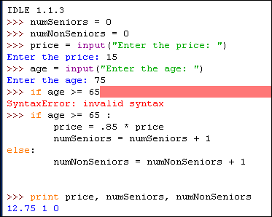
Python Session

Slide 28
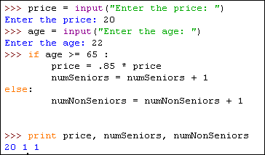
Python Session (cont)

Slide 29
Activity
Please login to Socrative and join your pair:
harriet / jodie
emiljano / dean
madeline / rory
warwick / samantha
thomas/alastair
james / angus

Slide 30
SECTION III: Pseudo-code

Slide 31
Flowcharts Vs Pseudocode
Flowcharts were the first design tool to be widely used, but unfortunately they do not reflect some of the concepts of structured programming very well.
Pseudocode, on the other hand, has features that make it more reflective of the structured concepts. The drawback is that the narrative presentation is not as easy to understand and/or follow.

Slide 32
Pseudo Code Rules
Write only one statement per line
Capitalize initial keyword
Indent to show hierarchy
End multiline structures
Keep statements language independent

Slide 33
One Statement Per Line
Each statement in pseudocode should express just one action for the computer. If the task list is properly drawn, then in most cases each task will correspond to one line of pseudocode.
Task List
Read name, hours worked, rate of pay
Perform calculations
gross = hours worked * rate of pay
Write name, hours worked, gross
Pseudocode
READ name, hoursWorked, payRate
gross = hoursWorked * payRate
WRITE name, hoursWorked, gross

Slide 34
Capitalize Initial Keyword
In the example below note the words: READ and WRITE. These are just a few of the keywords to use, others include:
READ, WRITE, IF, ELSE, ENDIF, WHILE, ENDWHILE
Pseudocode
READ name, hoursWorked, payRate
gross = hoursWorked * payRate
WRITE name, hoursWorked, gross

Slide 35
Indent to Show Hierarchy
Each design structure uses a particular indentation pattern
Sequence:
Keep statements in sequence all starting in the same column
READ name, grossPay, taxes
IF taxes > 0
net = grossPay – taxes
ELSE
net = grossPay
ENDIF
WRITE name, net

Slide 36
End Multiline Structures
READ name, grossPay, taxes
IF taxes > 0
net = grossPay – taxes
ELSE
net = grossPay
ENDIF
WRITE name, net
See the IF/ELSE/ENDIF as constructed above, the ENDIF is in line with the IF.
The same applies for WHILE/ENDWHILE etc…

Slide 37
Language Independence
Resist the urge to write in whatever language you are most comfortable with, in the long run you will save time. Remember you are describing a logic plan to develop a program, you are not programming!

Slide 38
The Selection Structure
amount < 100
yes
no
interestRate = .06
interestRate = .10
IF amount < 100
interestRate = .06
ELSE
Interest Rate = .10
ENDIF
Pseudocode ➔

Slide 39
The Looping Structure
In flowcharting one of the more confusing things is to separate selection from looping. This is because each structure use the diamond as their control symbol. In pseudocode we avoid this by using specific keywords to designate looping
WHILE/ENDWHILE
REPEAT/UNTIL

Slide 40
WHILE / ENDWHILE
Start
count = 0
WHILE count < 10
ADD 1 to count
WRITE count
ENDWHILE
WRITE “The End”
count = 0
count
<10
Mainline
count = 0
WHILE count < 10
DO Process
ENDWHILE
WRITE “The End”
Process
ADD 1 to count
WRITE count
⬅ Modular
Write
“The End”
add 1 to
count
write count
Stop

Slide 41
REPEAT / UNTIL
Start
count = 0
REPEAT
ADD 1 to count
WRITE count
UNTIL count >= 10
WRITE “The End”
count = 0
Mainline
count = 0
REPEAT
DO Process
UNTIL count >= 10
WRITE “The End”
Process
ADD 1 to count
WRITE count
add 1 to
count
⬅ Modular
write count
count
<10
Write
“The End”
Stop

Slide 42
Pseudo-Code Activity
Create a flow chart and associated pseudo-code for uploading code to GitHUB.
Post your solutions on Slack when you are ready.

