Slide 1
Further Object Oriented Programming
COMP110: Principles of Computing

Slide 2
Learning objectives
By the end of this lecture, you will
Understand the OOP concepts of instantiation, composition and inheritance
Know how (and why) to create a Python class which inherits from another class
Understand the concept of polymorphism
Learn how to mark class members as public, protected and private, and how doing so helps achieve encapsulation

Slide 3
OOP: Inheritance
COMP110: Principles of Computing

Slide 4
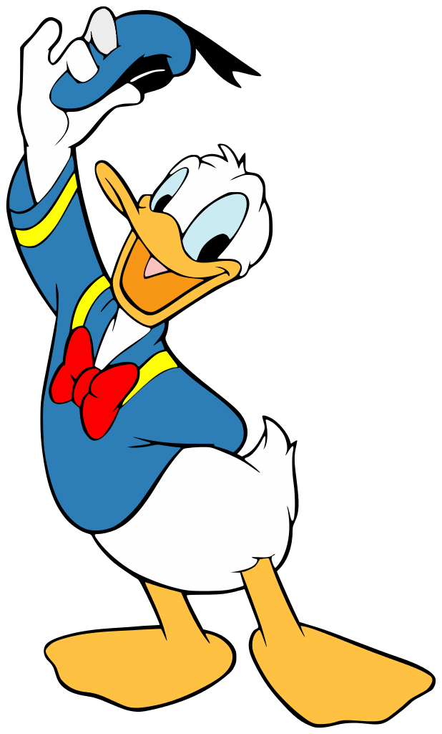
Relationships
OOP models three types of real-world relationships: is‑a, has‑a and is‑a‑type‑of
Donald is a duck
A duck has a bill
A duck is a type of bird

Slide 5
Is-a → Instantiation
“X is a Y” means “the specific object X is an object of the type Y”
Is-a is modelled by classes and instances:
“Donald is a duck” → “Donald is an instance of the class Duck”
class Duck: ...
donald = Duck()

Slide 6
Has-a → Composition
“X has a Y” means “an object of type X possesses an object of type Y”
OOP models this by having a field on X which holds a reference to an instance of Y
“A duck has a bill” → “The class Duck has a field which points to an instance of the class Bill”
class Bill: ... class Duck: def __init__(self): self.bill = Bill()

Slide 7
Is-a-type-of → Inheritance
“X is a type of Y” means “If an object is of type X, then it is also of type Y”
“A duck is a type of bird” → “If something is a duck, then it is also a bird”
“Every duck is a bird”
“If something is true for all birds, then it must be true for ducks”
In OOP terms, this is called inheritance

Slide 8
Inheritance
Recall: an object is a collection of fields (data) and methods (code)
Recall: the class defines which fields and methods an object possesses
“X is a type of Y” → class X inherits from class Y
Class X inherits all of the fields and methods from class Y, as well as any fields and methods of its own

Slide 9
When to inherit?
When modelling an is-a-type-of relationship from the real world
When several classes can share some fields and/or methods
I.e. to minimise code duplication
When several classes should have methods with the same names, but which do different things
This is called polymorphism – more on this later

Slide 10
Inheritance in Python
class Shape: def __init__(self, centre_x, centre_y): self.centre_x = centre_x self.centre_y = centre_y def move(self, offset_x, offset_y): self.centre_x += offset_x self.centre_y += offset_y class Circle(Shape): def __init__(self, centre_x, centre_y, radius): Shape.__init__(self, centre_x, centre_y) self.radius = radius def get_area(self): return math.pi * self.radius ** 2 c = Circle(10, 10, 5) c.move(5, -5) print c.centre_x, c.centre_y, c.get_area()

Slide 11
Inheritance in Python
class Shape: def __init__(self, centre_x, centre_y): self.centre_x = centre_x self.centre_y = centre_y def move(self, offset_x, offset_y): self.centre_x += offset_x self.centre_y += offset_y class Circle(Shape): def __init__(self, centre_x, centre_y, radius): Shape.__init__(self, centre_x, centre_y) self.radius = radius def get_area(self): return math.pi * self.radius ** 2 c = Circle(10, 10, 5) c.move(5, -5) print c.centre_x, c.centre_y, c.get_area()
Class Circle inherits from class Shape

Slide 12
Inheritance in Python
class Shape: def __init__(self, centre_x, centre_y): self.centre_x = centre_x self.centre_y = centre_y def move(self, offset_x, offset_y): self.centre_x += offset_x self.centre_y += offset_y class Circle(Shape): def __init__(self, centre_x, centre_y, radius): Shape.__init__(self, centre_x, centre_y) self.radius = radius def get_area(self): return math.pi * self.radius ** 2 c = Circle(10, 10, 5) c.move(5, -5) print c.centre_x, c.centre_y, c.get_area()
__init__ calls through to the base class’s __init__

Slide 13
Inheritance in Python
class Shape: def __init__(self, centre_x, centre_y): self.centre_x = centre_x self.centre_y = centre_y def move(self, offset_x, offset_y): self.centre_x += offset_x self.centre_y += offset_y class Circle(Shape): def __init__(self, centre_x, centre_y, radius): Shape.__init__(self, centre_x, centre_y) self.radius = radius def get_area(self): return math.pi * self.radius ** 2 c = Circle(10, 10, 5) c.move(5, -5) print c.centre_x, c.centre_y, c.get_area()
Circle has all the fields and methods defined in Shape…

Slide 14
Inheritance in Python
class Shape: def __init__(self, centre_x, centre_y): self.centre_x = centre_x self.centre_y = centre_y def move(self, offset_x, offset_y): self.centre_x += offset_x self.centre_y += offset_y class Circle(Shape): def __init__(self, centre_x, centre_y, radius): Shape.__init__(self, centre_x, centre_y) self.radius = radius def get_area(self): return math.pi * self.radius ** 2 c = Circle(10, 10, 5) c.move(5, -5) print c.centre_x, c.centre_y, c.get_area()
… as well as its own fields and methods

Slide 15
Chains of inheritance
“A mallard is a type of duck, which is a type of bird, which is a type of vertebrate, which is a type of animal…”
Is-a-type-of is transitive
If A is-a-type-of B and B is-a-type-of C, then A is-a-type-of C
Likewise: class A inherits from class B, which inherits from class C, …
“Inherits from” is also transitive

Slide 16
class A: def __init__(self, x): self.x = x def get_x_squared(self): return self.x ** 2 class B(A): def __init__(self, x, y): A.__init__(self, x) self.y = y class C(B): def __init__(self, x, y, z): B.__init__(self, x, y)
self.z = z class D(A): def __init__(self, y): A.__init__(self, 20) self.y = y def get_x_cubed(self): return self.x ** 3 class E: def __init__(self, x): self.x = x
def first_function(): c = C(10, 20, 30) print c.z def second_function(): b = B(10, 20) print b.z def third_function(): b = B(10, 20) print b.get_x_squared() def fourth_function(): b = B(10, 20) print b.get_x_cubed() def fifth_function(): d = D(10) print d.get_x_squared()
Socrative room code: 6E8NSW3IN

Slide 17
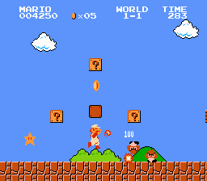
A possible inheritance hierarchy
Actor
PlayerCharacter
Enemy
Block
BreakableBlock
Mario
Luigi
Goomba
KoopaTrooper
QuestionBlock
Collectible
Coin
Mushroom
Star
Projectile
Fireball
Sprite

Slide 18
OOP: Polymorphism
COMP110: Principles of Computing

Slide 19
Polymorphism
From Greek: “many-shape-ism”
Different classes can have the same public interface
Thus we can write code that uses this interface, but doesn’t need to worry about the implementation behind it

Slide 20
Method overriding
class Foo: def __init__(self): self._x = 10 self._y = 20 def get_sum(self): return self._x + self._y class Bar(Foo): def __init__(self): Foo.__init__(self) self._z = 30 def get_sum(self): return Foo.get_sum(self) + self._z
A class can override methods defined in the class from which it inherits
The overridden method can call the method from the base class, but it doesn’t have to

Slide 21
Without polymorphism
class Shape: ... class Circle(Shape): ... class Rectangle(Shape): ... class Triangle(Shape): ... shape_list = [Circle(...), Triangle(...), Triangle(...), Rectangle(...), ...] for shape in shape_list: if isinstance(shape, Circle): draw_circle(...) elif isinstance(shape, Rectangle): draw_rectangle(...) elif isinstance(shape, Triangle): draw_triangle(...)
We have a list of shapes, and want to draw them all
This approach is messy and difficult to maintain

Slide 22
Polymorphism to the rescue!
class Shape: def draw(self): raise NotImplementedError() class Circle(Shape): def draw(self): ... class Rectangle(Shape): def draw(self): ... class Triangle(Shape): def draw(self): ... shape_list = [Circle(...), Triangle(...), Triangle(...), Rectangle(...), ...] for shape in shape_list: shape.draw()
All subclasses of Shape implement draw
We can call shape.draw() without worrying which type of shape it is

Slide 23
Abstract classes and methods
Some classes should never be instantiated directly, as they only exist to be inherited from
Shape is an example
Such classes are called abstract
Abstract methods are methods of an abstract class which are left unimplemented, so must be implemented in subclasses
draw is an example

Slide 24
OOP: Access control
COMP110: Principles of Computing

Slide 25
Access control
For encapsulation, it is a good idea to restrict access to certain attributes and methods from outside the class
Private members are only accessible from the class’s own methods
Protected members are accessible from the class’s own methods, and methods defined in subclasses
Public members are accessible from outside the class

Slide 26
Access control
The public interface of an object is how it interacts with other objects and the rest of the program
The protected interface of an object is what allows subclasses to change the way the base class behaves
The private members of an object are implementation details, hidden from the outside world

Slide 27
Access control in Python
A field or method whose name begins with _ is protected
A field or method whose name begins with _ _ is private
Names which begin and end with _ _ (like __init__) are special – don’t use trailing underscores in your own names
Everything else is public

Slide 28
class Foo: def __init__(self): self.x = 10 self._y = 20 self.__z = 30 def get_sum(self): return self.x + self._y + self.__z class Bar(Foo): def __init__(self): Foo.__init__(self) def get_product(self): return self.x * self._y * self.__z def test(): b = Bar() print b.x, b._y, b.__z
Socrative room code: 6E8NSW3IN

Slide 29
Bar
Foo
The outside
world
Public
Private
Protected

Slide 30

Pedantic detail
Access control is merely a convention in Python
The interpreter won’t stop you from accessing protected members from outside the class or its subclasses, but PyCharm will warn you
Private members are “name mangled”, but you can still access them if you know how
Almost all other languages enforce access control with compile-time errors

Slide 31
Summary
OOP models three main types of real-world relationships
Is-a → instantiation
Has-a → composition
Is-a-type-of → inheritance
Inheritance allows polymorphism: different classes with the same public interface
Access control is an important tool in designing reusable, encapsulated objects

Slide 32
An example of an OO program
Download robot.py from Slack and open it in PyCharm
Suggested exercises:
Add a new shape class (e.g. Pentagon) and give the robot a nose
Use inheritance to minimise code duplication
Add move() and scale() methods to Shape and its subclasses, and give the robot a little friend
The program currently uses Python’s built-in turtle graphics module. Change it so that it can also be run in JES with only a minor modification
Hint: define your own Turtle class, with a subclass that wraps Python’s turtle and one that wraps JES’s turtle

Slide 33
PyCharm license server
http://TRLiceFAL

Slide 34
What is a literature review?
COMP110: Principles of Computing

Slide 35

“Review” according to the OED
A literature review is not the same as a review of a game/film!
From Oxford Advanced Learners Dictionary, http://www.oxforddictionaries.com/definition/learner/review

Slide 36
Literature review
A review of research papers should
Summarise the methods and results presented in the papers
Compare the methods and results, both quantitatively and qualitatively
Synthesise the key findings and/or ongoing research questions from the articles
A review of research papers should not
Critique the papers themselves
Give personal opinions

Slide 37
How to understand papers
Research papers are written by, and usually for, researchers in a specialist field
They often assume at least a postgraduate level of knowledge in computing, which you don’t have yet…
Even experienced researchers sometimes have to work hard to understand a paper

Slide 38
Background reading is key
If you don’t understand something in a paper:
Follow the citations – most papers build on earlier work, so are easier to understand if you can put them in context
Google it – Wikipedia has decent explanations of a lot of CS topics, and can point you to relevant textbooks
Keep reading, and try to figure it out from context

Slide 39
Which papers to cite?
You may find two or more papers by the same (or almost the same) authors, with similar titles and contents
Often the earlier paper is a conference paper, and the later paper is an expanded version published in a journal
Rule of thumb: cite the journal version, as it has undergone more rigorous peer review

Slide 40

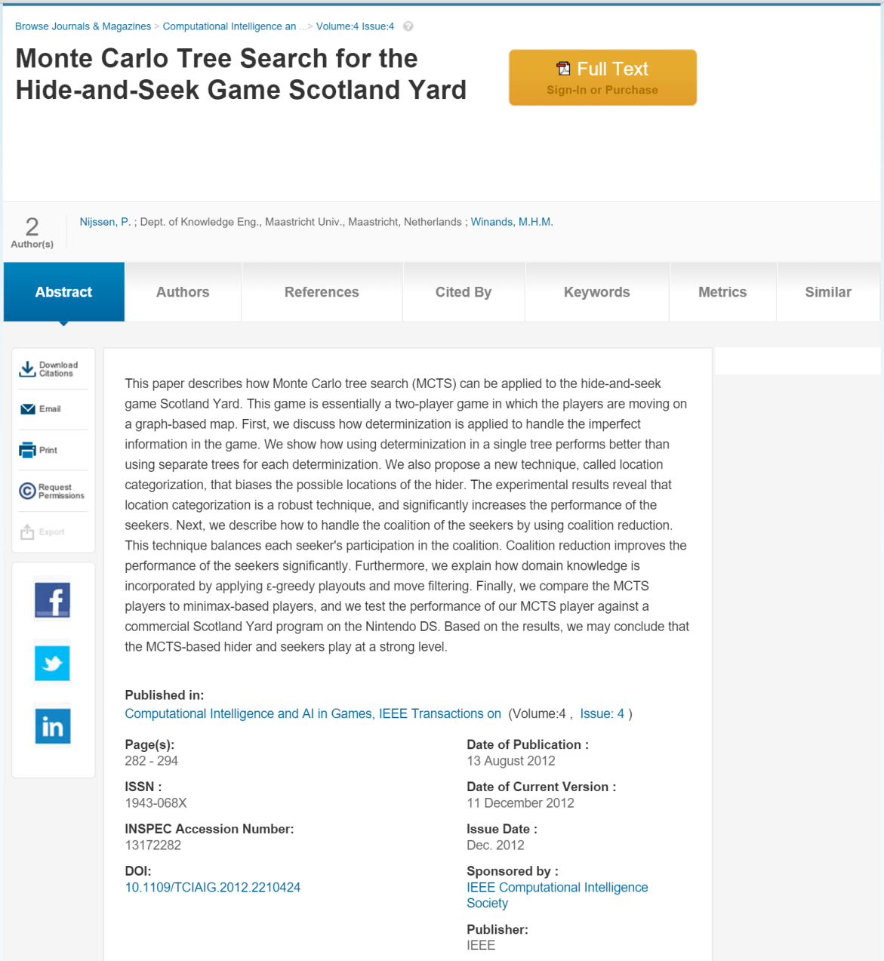


Slide 41
Which papers to cite?
Beware of choosing multiple papers by the same authors – they may be variants of the same research
However, prolific PhD supervisors will be co-authors on many papers by different researchers – it’s generally OK to cite work by different researchers under the same supervisor
Often (but not always!) the first author on a paper is the one who did the actual research

Slide 42
Reminder
Your architecture essay proposal should be submitted as a GitHub pull request by 6pm this Wednesday (11th November)
For more details, see the slides for COMP110 week 6 on LearningSpace

