Slide 1
Architecture essay
COMP110: Principles of Computing

Slide 2
Reading academic papers
Activity

Slide 3
Structuring your essay

Slide 4
What are you being assessed on?
Analysis
Specificity, reliability and accuracy of claims
Adequacy of recommendation and justification
Technical insight
Appropriateness of sources
Style, structure, spelling, grammar etc.

Slide 5
Analysis and technical insight
It is not enough to merely summarise the papers
Make inferences beyond what is written
Demonstrate some knowledge of the wider field (i.e. show that you’ve read more than three papers)
Draw the papers together into a coherent argument

Slide 6
Making a recommendation
Which technique is best?
There are many definitions of “best” – speed, memory use, flexibility, accuracy, ease of implementation, ...
Which metric(s) you choose is up to your discretion
Your personal tutor is the product owner, and can help you define “best” if necessary

Slide 7
What now?
By now you should have chosen which three papers you will write about, and found the full texts of the papers (both with help from your personal tutor)
You should now be reading your chosen papers and drafting your essay (using the LaTeX template on GitHub)
Peer review session in two weeks’ time!

Slide 8
The other COMP110 assessment
Online leaderboard for your COMP130 game
This is being assessed in COMP110, but taught mostly in COMP130
Soon to appear on LearningSpace – more details to come

Slide 9
Data structures
COMP110: Principles of Computing

Slide 10
Learning objectives
By the end of this session, you will
Have a basic understanding of how data is stored in computer memory
Know the conceptual differences between the list, tuple, dictionary and set data structures in Python
Know when it is appropriate to use each

Slide 11
Memory
Computer memory is essentially a bank of on/off switches
1 switch = 1 bit
8 bits = 1 byte = a number from 0 to 255 stored in binary
Each byte has an address
On a 64-bit machine, this is a number from 0 to 2⁶⁴-1
(The real story on modern machines is somewhat more complex than this…)

Slide 12
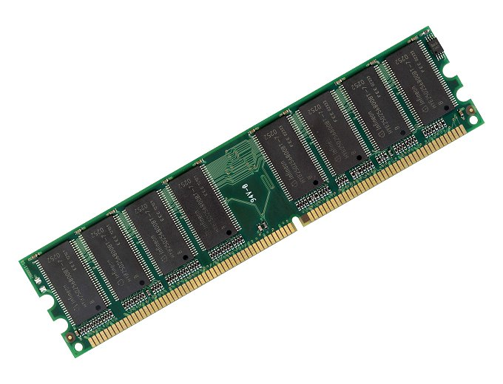
Memory
Address | Data
00000000 | 01001000
00000001 | 01100101
00000002 | 01101100
00000003 | 01101100
00000004 | 01101111
00000005 | 00100001
… | …

Slide 13
Memory allocation
Memory is allocated in blocks
The program specifies the size, in bytes, of the block it wants
The OS allocates a contiguous block of that size
The program owns that block until it frees it
Forgetting to free a block is called a memory leak
Blocks can be allocated and deallocated at will, but can never grow or shrink

Slide 14
Data structures
Memory management is hard and programmers are lazy
Data structures are an abstraction
Hide the details of memory allocation, and allow the programmer to write simpler code
Data structures are an encapsulation
Bundle together the data’s representation in memory along with the algorithms for accessing it

Slide 15
Arrays
An array is a contiguous block of memory in which objects are stored, equally spaced, one after the other
Each array element has an index, starting from zero
Given the address of the 0th element, it is easy to find the i^{th} element:
address_{i} = address₀ + (i * size_of_element)

Slide 16
Lists
An array is a block of memory, so its size is fixed once it’s created
Python’s version of an array is the list
Lists work like regular arrays, but can grow and shrink

Slide 17
Expanding a list
Function list.add_element(el)
If list_count + 1 > size_of_array
Allocate a new array of size size_of_array * 2
Copy the old array into the first half of the new one
Free the old array
EndIf
Write el into the list_count index in the array
Increment list_count
EndFunction

Slide 18
Tuples
Tuples are like lists, but are immutable
Immutable = read-only = can’t be changed once created
Useful for storing sequences of values where adding, inserting, deleting or changing values does not make sense

Slide 19
Another immutable data structure
my_string = "Hello" my_string += "world"
This isn’t changing the string!
It’s creating a new string and throwing the old one away
A subtle but important difference
Some languages have mutable strings

Slide 20
Aside: tuple unpacking
Neat Python feature of the week!
If the thing on the RHS of an assignment is a tuple of length n, then you can write a list of n variables on the LHS and they get filled in automatically
This works on for-loop variables and function arguments too
my_tuple = (1, 2, 3, 4) a = my_tuple[0] b = my_tuple[1] c = my_tuple[2] d = my_tuple[3]
Is equivalent to
my_tuple = (1, 2, 3, 4) a, b, c, d = my_tuple

Slide 21
Aside: tuple unpacking
What does this code do?
In every other language on the planet, you’ll be writing this:
a = 10 b = 20 a,b = b,a print a print b
a = 10 b = 20 temp = a a = b b = temp print a print b

Slide 22
Dictionaries
Lists and tuples are ordered sequences: they have 0th, 1st, 2nd, 3rd, … elements
Dictionaries are associative maps
A dictionary maps keys to values
Keys have to be immutable (numbers, strings, tuples etc)
Values can be anything (including lists or other dictionaries)

Slide 23
Dictionaries
Every key in a dictionary is mapped to a single value
Dictionary entries can be removed using the del keyword
age = {"Alice": 23, "Bob": 36, "Charlie": 27} age["Bob"] = 40 print age["Bob"] # prints "40"
age = {"Alice": 23, "Bob": 36, "Charlie": 27} del age["Bob"] print age["Bob"] # raises KeyError

Slide 24
Iterating over dictionaries
Can iterate over keys, values, or (key,value) tuples
for key in my_dict.iterkeys(): print key for value in my_dict.itervalues(): print value for key, value in my_dict.iteritems(): print key, value

Slide 25
Dictionaries are unordered
What does the following code print?
Dictionaries are unordered – never write code that relies on the order of their elements, because the order isn’t guaranteed!
square_root = {} for i in xrange(30): square_root[i*i] = i for key, value in square_root.iteritems(): print "The square root of", key, "is", value

Slide 26
Sets
Sets are like dictionaries without the values
Sets are unordered collections of unique elements
I.e. no element can appear more than once
Why use sets instead of lists?
If elements need to be unique, sets enforce this automatically
Sets are faster for checking if they contain a particular value – more on this next week

Slide 27
Summary
Lists
Used for ordered collections of elements which are frequently changed, added to or deleted
Tuples
Used for ordered collections of elements which are never changed
Dictionaries
Used for mapping keys to values
Sets
Used for unordered collections of elements, where each element can only appear once

Slide 28
Modular program design
Writing a piece of software as a single long source file is generally a bad idea
Better to split the program into several files, i.e. modules
Makes code more manageable and easier to navigate
Allows related classes and functions to be grouped together
Modules can often be reused between programs
Can allow for faster recompilation

Slide 29
Modules
Every Python source file is a module, and can be loaded using the import statement just like built-in modules
# mymodule.py def test(): print "Hello, world!"
# program.py import mymodule mymodule.test()

Slide 30
Modules and programs
Every Python program is also a module, and vice versa
You can check whether you are running as a program or as an imported module
if __name__ == "__main__": print "I am a program" else: print "I am an imported module"

