Slide 1
Structuring Python programs
COMP110: Principles of Computing

Slide 2
Learning objectives
By the end of this section you will
Understand how and why to split your Python programs up into several modules
Understand how to use the raise, try and except keywords in Python to create and handle exceptions
Understand the Python philosophy that “it’s easier to ask forgiveness than permission”

Slide 3
Modular program design
Writing a piece of software as a single long source file is generally a bad idea
Better to split the program into several files, i.e. modules
Makes code more manageable and easier to navigate
Allows related classes and functions to be grouped together
Modules can often be reused between programs
Can allow for faster recompilation

Slide 4
Modules
Every Python source file is a module, and can be loaded using the import statement just like built-in modules
# mymodule.py def test(): print "Hello, world!"
# program.py import mymodule mymodule.test()

Slide 5
Modules and programs
Every Python program is also a module, and vice versa
You can check whether you are running as a program or as an imported module
if __name__ == "__main__": print "I am a program" else: print "I am an imported module"

Slide 6
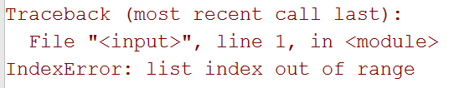
Exceptions
You’ve seen them already…
Some operations in a program can fail
Exceptions are a way of signalling that failure

Slide 7
Raising exceptions
def factorial(n): if n < 0: raise ValueError("Argument must be positive") ...
ValueError is a built-in class
Its initialiser takes one argument: a string describing the error condition
The exception is an instance of the class

Slide 8
Defining your own exception types
class MyError(Exception): def __init__(self, message): Exception.__init__(self, message) raise MyError("A bad thing happened")
Inherit from Exception
Exceptions are just like any other class
They can have any fields and methods you wish

Slide 9
Catching exceptions
try: input_file = open("data.txt", "rt") except IOError as err: print "Failed to open data.txt:", err
If anything inside the try block raises an IOError, the code inside the except block will be executed

Slide 10
Exceptions and control flow
When used inside a function, the raise statement is like a super return statement
It breaks out of the current function, and the one that called it, and so on until it hits a try block with a matching except handler
This can be powerful in the hands of a good programmer…
… or confusing if used unwisely

Slide 11
“It’s easier to ask forgiveness than permission”
try: x = list[index] except IndexError: x = None
This is “more Pythonic” than this:
Which is better?
Depends on context – which is more readable?
if index >= 0 and index < len(list): x = list[index] else: x = None

Slide 12
Computational complexity
COMP110: Principles of Computing

Slide 13
Learning objectives
By the end of this section you will
Understand why scalability and computational complexity are important
Know how to interpret big O notation and name the most common complexity classes
Understand three different data structures for associative map data, and the computational complexity of each

Slide 14
Computation time
All programs use resources
Time, memory, bandwidth, …
Often time is the resource we care about the most

Slide 15
Basic time measurement in Python
import time start_time = time.clock() ... do something here ... end_time = time.clock() print "Computation took", end_time - start_time, "seconds"

Slide 16
Repeating for better accuracy
import time start_time = time.clock() repetition_count = 1000 for repetition in xrange(repetition_count): ... do something here ... end_time = time.clock() time_per = (end_time - start_time) / repetition_count print "Computation took", time_per, "seconds"

Slide 17
Scaling
Timing is dependent on hardware and software issues
We are often less interested in how many milliseconds a particular computation takes on today’s hardware, and more interested in how the execution time scales with the problem size

Slide 18
Scaling examples
def contains(list, element): for x in list: if x == element: return True return False
In the worst case, how many elements does this function have to consider?
Socrative room code: 6E8NSW3IN

Slide 19
Scaling examples
def contains_duplicates(list): for i in xrange(len(list)): for j in xrange(i): if list[i] == list[j]: return True return False
In the worst case, how many pairs of elements does this function have to consider?
Socrative room code: 6E8NSW3IN

Slide 20
Scaling examples
def starts_with(list, element): return list[0] == element
In the worst case, how many elements does this function have to consider?
Socrative room code: 6E8NSW3IN

Slide 21

Big O notation
Technical definition:
$f\left(x\right)=O(g\left(x\right))$ if and only if there are positive constants $x_{0}$ and $C$ such that, for all $x≥x_{0}$, $f\left(x\right)≤Cg(x)$

Slide 22
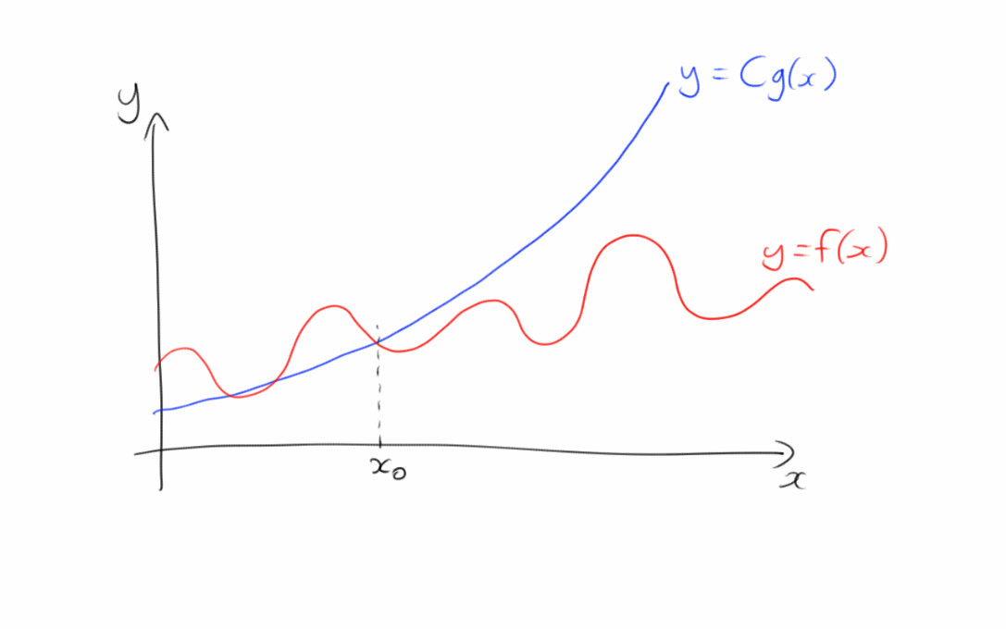

$$f\left(x\right)=O\left(g\left(x\right)\right)$$

Slide 23

Rules of thumb
Can ignore all but the dominant term
$$x^{3}+27x^{2}−13x+7=O\left(x^{3}\right)$$
“Dominant term” is the one that is largest when $x$ is large
Can ignore leading constants
$$13x^{2}+6=O\left(x^{2}\right)$$

Slide 24
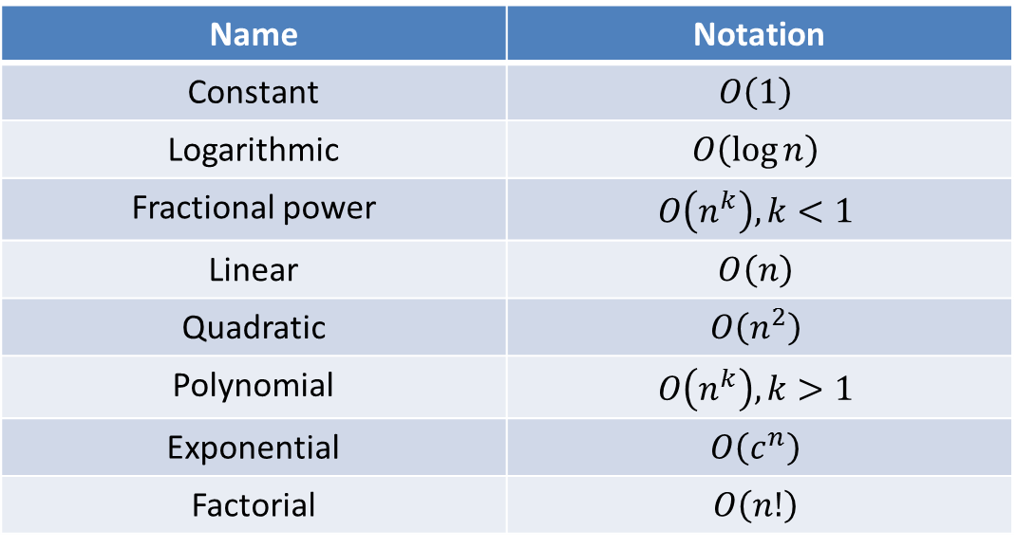
Common complexity classes
“Better”
Name | Notation
Constant | $$O\left(1\right)$$
Logarithmic | $$O\left(\log{n}\right)$$
Fractional power | $$O\left(n^{k}\right), k<1$$
Linear | $$O\left(n\right)$$
Quadratic | $$O\left(n^{2}\right)$$
Polynomial | $$O\left(n^{k}\right), k>1$$
Exponential | $$O\left(c^{n}\right)$$
Factorial | $$O\left(n!\right)$$
“Worse”

Slide 25
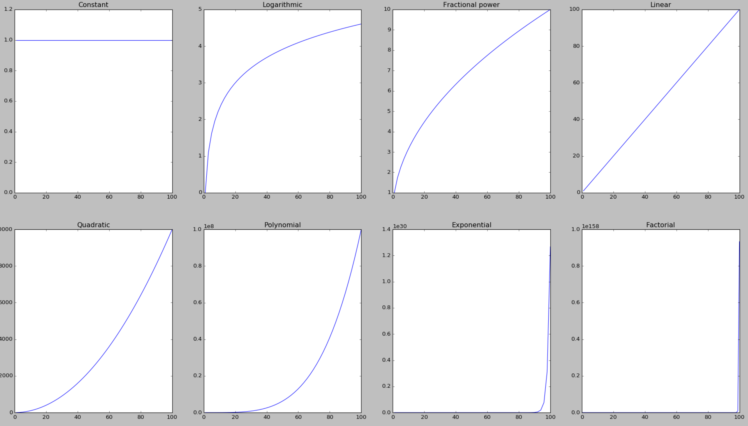
Common complexity classes

Slide 26
Caveat
Complexity tells you how well an algorithm scales, not how fast it is
If n is small, a factorial algorithm can be faster than a linear one
Programming is all about choosing the right tool for the job
Choose scalable algorithms when you need scalable algorithms
Otherwise choose simple ones

Slide 27

Aside: a famous unanswered question in computing
A problem is in $P$ if it can be solved with an algorithm running in $O\left(n^{k}\right)$ time
A problem is in $NP$ if a potential solution can be checked in $O\left(n^{k}\right)$ time
Equivalently, it can be solved with an algorithm running in $O\left(n^{k}\right)$ time on an infinitely parallel machine
Are there any problems in $NP$ but not in $P$?

Slide 28

P versus NP
If you can find a mathematical proof that $P=NP$ or $P≠NP$, there’s fame and glory for you (and a $1million prize…)
For now, large instances of $NP$-hard problems are not solvable without spending a lot of CPU time
This is the basis of most of cryptography

Slide 29
Associative maps revisited
COMP110: Principles of Computing

Slide 30
Dictionaries
Last time we met the dictionary: a data structure mapping keys to values
How does it work behind the scenes?
age = {"Alice": 23, "Bob": 36, "Charlie": 27} age["Bob"] = 40 print age["Bob"] # prints "40"

Slide 31
Pair list
Socrative room code: 6E8NSW3IN
One way of implementing a dictionary would be as a list of (key, value) tuples
What is the execution time?
FUNCTION lookup(key)
FOR EACH (k,v) in list
IF k = key
RETURN v
END IF
END FOR
RAISE ERROR key not found
END FUNCTION

Slide 32
Improving on the pair list
The problem is, a given key may be anywhere in the list
What if we constrain the list to be in a particular order?
Then we can do better than stepping through the list from start to finish
We can do a binary search

Slide 33
Binary search
“Divide and conquer” algorithm
Divide the list in half
Look at the middle element to find out which half the key is in
Repeat until we home in on a single element

Slide 34
Binary search
1
3
4
6
8
9
10
12
15
19
21
22
24
25
← start
FUNCTION binary_search(key)
LET start = 0
LET end = (length of list) - 1
WHILE end ≤ start
LET midpoint = (start + end) / 2
LET mid_key = key at midpoint
IF key = mid_key
RETURN value at midpoint
ELSE IF key < mid_key
LET end = midpoint - 1
ELSE IF key > mid_key
LET start = midpoint + 1
END IF
END WHILE
END FUNCTION
key = 19
← midpoint
← start
← midpoint
← end
start
midpoint
← midpoint
← end

Slide 35

Binary search
What is the execution time of binary search?
Each iteration divides the list in half
If we start out with double the elements, we have to do one extra iteration
$$O\left(\log{n}\right)$$

Slide 36
Improving on binary search
Binary search requires the list to be kept in sorted order
Insertion and deletion may be slow
Dictionaries in Python are actually implemented as hash maps

Slide 37
Arrays as associative maps
Suppose our dictionary keys are integers
We could just use an array…
… but this is wasteful of space
Key | Value
0 | -
1 | “One”
2 | -
3 | -
4 | “Four”
5 | -
Key | Value
1 | “One”
4 | “Four”
9 | “Nine”

Slide 38
Hash maps
Hash maps work on this principle, but map the keys through a hash function
Compresses the range of keys down to a more manageable size
Hash | Value
0 | -
1 | 36
2 | -
3 | 27
4 | 23
5 | -
Key
“Alice”
“Bob”
“Charlie”
Hash function

Slide 39
Hash functions
Problem: what happens if two keys have the same hash value?
Hash collision
The data structure has to allow for this possibility
Each hash bucket can store several key-value pairs
Better to design the hash function to minimise collisions
For built-in types and tuples, the developers of Python have taken care of this for you

Slide 40

Hash map execution time
In the worst case…
If the hash function is really bad and maps everything to the same value, it’s not really a hash map -- $O\left(n\right)$ linear search
If hash collisions never happened, retrieval would be $O\left(1\right)$
Usually hash collisions are rare enough to affect only a small proportion of operations

Slide 41

Amortised analysis
Worst case analysis is sometimes too pessimistic
If an operation is usually $O\left(g\left(n\right)\right)$ but has a tiny chance of being $O\left(h\left(n\right)\right)$ in some cases, then it’s the $O\left(g\left(n\right)\right)$ we care about
We say the amortised time is $O\left(g\left(n\right)\right)$

Slide 42

So…
Elements can be inserted, deleted and retrieved from a hash map in amortised constant time
This is a big improvement over $O\left(n\right)$ for the naïve “list of key-value pairs” implementation!

Slide 43

Another example
Consider a 2D physics engine with a large number of objects
Which objects are close enough that they should be checked for collisions?
Naïve approach: check every pair of objects -- $O\left(n^{2}\right)$
Other approaches (nearest neighbour lists, spatial hash map, quadtrees) have lower (amortised) time complexity

Slide 44
Summary
Big O notation gives us a way of discussing how well algorithms scale with the size of the input
Wise choice of data structures can make a big difference to scalability

Slide 45
Reminder
The COMP110 peer review session will be this time next week Wednesday 2nd December, 9am-12pm
Please submit your essay as a GitHub pull request by 6pm on Tuesday 1st December
Please bring two printed copies of your essay to next Wednesday’s class

Slide 46
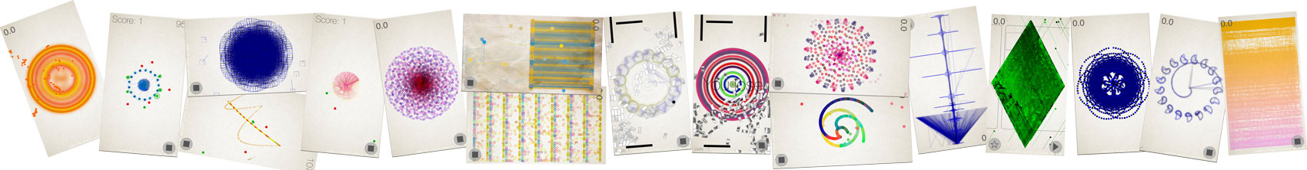
Free pizza!
Prof Simon Colton and I are developing a game design app
We’re running a testing session tomorrow 12pm and we have a couple of spaces left – please let me know if you’re interested
There will be delicious freshly baked pizza all the way from Koofi!

