Slide 1
Tinkering Audio III: Construction of Melodies
Creative Computing: Tinkering – Lecture 10 – Ed Powley

Slide 2
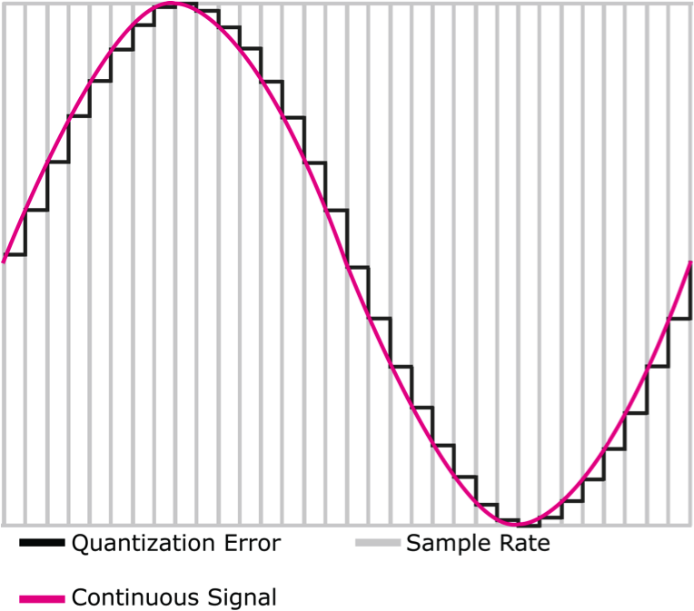
Recap on Last Week
Bit-depth is important for representing displacement
Amplitude is displacement at a certain point (usually the crest and the trough)
Available range of volume often depends on the available hardware
Distance between two levels, however, depends on how bits are allocated

Slide 3
Recap on Last Week
Bit-depth is important for representing displacement
Error arises when a displacement cannot be represented
Clipping occurs when maximum volume is exceeded, but this can be avoided with a sufficient bit-depth and normalization procedure

Slide 4
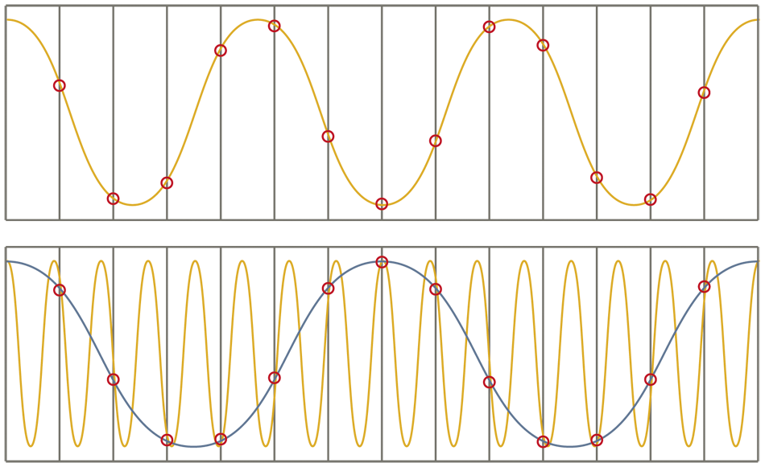
Recap on Last Week
Sample rate is important for representing frequency
Aliasing occurs when sample rate is too low to represent the intended frequency
The wrong frequency is produced
Use Nyquist Theorem to determine the sample rate needed for a particular frequency

Slide 5
Recap on Last Week
Signals can be combined through simple summation to create more complex signals
These sin() signals approximate a square wave

Slide 6
Recap on Last Week
We can mix sounds
We even know how to change the volumes of the two sounds, even over time (e.g., fading in or fading out)
We can add sine (or other) waves together to create kinds of instruments / sounds that do not physically exist, but which sound interesting and complex

Slide 7
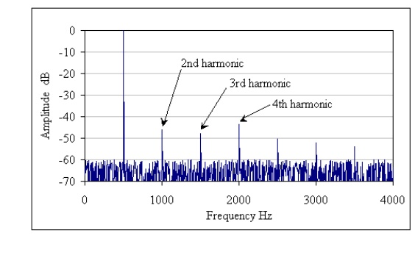
Recap on Last Week
The Harmonics of 500 Hz

Slide 8
Recap on Last Week
Splicing gets its name from literally cutting and pasting pieces of magnetic tape together
Use generalisable clip and copy functions to construct sounds from other sounds
def clip(source, start, end):
target = makeEmptySound(end - start)
tIndex = 0
for sIndex in range(start, end):
value = getSampleValueAt(source, sIndex)
setSampleValueAt(target, tIndex, value)
tIndex = tIndex + 1
return target
def copy(source, target, start):
tIndex = start
for sIndex in range(0, getLength(source)):
value = getSampleValueAt(source, sIndex)
setSampleValueAt(target, tIndex, value)
tIndex = tIndex + 1

Slide 9
Learning Objectives
By the end of this session, you will be able to:
Explain how to implement echoes, envelopes, and a basic additive synthesiser
Recognise the parallels between sampling and scaling sound with sampling and scaling images
Write a basic function to manipulate and combine sine waves according to their frequency, amplitude, attack-time, sustain-time, and decay-time
Explain parsing and how to integrate notation into a synthesiser
Integrate randomness into Python code using the random library

Slide 10
Echoes
Tinkering Audio

Slide 11
A Function for Adding Two Sounds
def addSoundInto(sound1, sound2):
for sampleNmr in range(0, getLength(sound1)):
sample1 = getSampleValueAt(sound1, sampleNmr)
sample2 = getSampleValueAt(sound2, sampleNmr)
setSampleValueAt(sound2, sampleNmr, sample1 + sample2)
Notice that this adds sound1 and sound2 by adding sound1 into sound2

Slide 12
Adding Sounds with a Delay
def makeChord(sound1, sound2, sound3):
for index in range(0, getLength(sound1)):
s1Sample = getSampleValueAt(sound1, index)
setSampleValueAt(sound1, index, s1Sample )
if index > 1000:
s2Sample = getSampleValueAt(sound2, index - 1000)
setSampleValueAt(sound1, index, s1Sample + s2Sample)
if index > 2000:
s3Sample = getSampleValueAt(sound3, index - 2000)
setSampleValueAt(sound1, index, s1Sample + s2Sample + s3Sample)
Add in sound2 after 1000 samples
Add in sound3 after 2000 samples
Note that in this version we're adding directly into sound1!
Notes:
Play with the delay here.

Slide 13
Creating an Echo
def echo(sndFile, delay):
s1 = makeSound(sndFile)
s2 = makeSound(sndFile)
for index in range(delay, getLength(s1)):
echo = 0.6*getSampleValueAt(s2, index-delay)
combo = getSampleValueAt(s1, index) + echo
setSampleValueAt(s1, index, combo)
play(s1)
return s1
This creates a delayed echo sound, multiplies it by 0.6 to make it fainter and then adds it into the original sound.

Slide 14
How the Echo Works
Top row is the samples of our sound. We're adding it to itself, but delayed a few samples, and multiplied to make it softer.
100 | 200 | 1000 | -150 | -350 | 200 | 500 | 10 | -500 | -1000 | -350 | 25 | -10 | 1000 | ...
Delay
100 | 200 | 1000 | -150 | -350 | 200 | 500 | 10 | -500 | -1000 | -350 | 25 | -10 | 1000 | ...
* 0.6
60 | 120 | 600 | -90 | -210 | 120 | 300 | 6 | -300 | -600 | -210 | 15 | -6 | 600 | ...
100 | 200 | 1000 | -90 | -230 | 800 | 410 | -200 | -380 | 290 | -344 | -275 | -610 | 890 | ...

Slide 15
Exercise
Implement a double-echo algorithm, adapting the code in the previous slide
echo(sndFile, initialDelay, nextDelay)

Slide 16
Echo with Feedback
def echo(sndFile, delay):
s1 = makeSound(sndFile)
s2 = makeSound(sndFile)
for index in range(delay, getLength(s)):
This function loads the sample in twice, then mixes the second instance into the first
What happens if we load it once and mix it into itself?

Slide 17
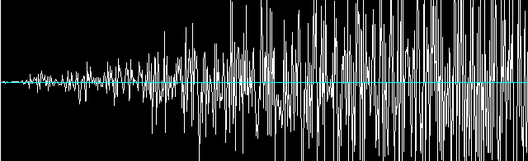
Echo with Feedback
def echo(sndFile, delay):
s = makeSound(sndFile)
for index in range(delay, getLength(s)):
echo = 0.6*getSampleValueAt(s, index-delay)
combo = getSampleValueAt(s, index) + echo
setSampleValueAt(s, index, combo)
play(s)
return s

Slide 18
RESAMPLING
Tinkering Audio

Slide 19
How sampling keyboards work
They have a huge memory with recordings of lots of different instruments played at different notes
When you press a key on the keyboard, the recording closest to the note you just pressed is selected, and then the recording is shifted to exactly the note you requested.
The shifting is a generalization of algorithms of doubling and halving frequency (as follows)

Slide 20
Doubling the frequency
Why +1 here? Socrative room code: 6E8NSW3IN
def double(source):
len = getLength(source) / 2 + 1
target = makeEmptySound(len)
targetIndex = 0
for sourceIndex in range(0, getLength( source), 2):
value = getSampleValueAt( source, sourceIndex)
setSampleValueAt( target, targetIndex, value) targetIndex = targetIndex + 1
play(target)
return target
Here's the piece that does the doubling

Slide 21
How doubling works
sourceIndex = 0, 2, 4, 6, 8, 10, ...
100 | 200 | 1000 | -150 | -350 | 200 | 500 | 10 | -500 | -1000 | -350 | 25 | -10 | 1000 | ...
100 | 1000 | -350 | 500 | -500 | -350 | -10 | ...
targetIndex = 0, 1, 2, 3, 4, 5, ...

Slide 22
Halving the frequency
def half(source):
target = makeEmptySound(getLength(source) * 2)
sourceIndex = 0
for targetIndex in range(0, getLength( target)):
value = getSampleValueAt( source, int(sourceIndex))
setSampleValueAt( target, targetIndex, value) sourceIndex = sourceIndex + 0.5
play(target)
return target
Here's the piece that does the halving

Slide 23
How halving works
sourceIndex = 0, 0.5, 1, 1.5, 2, 2.5, 3, ...
int(sourceIndex) = 0, 0, 1, 1, 2, 2, 3, 3, ...
100 | 200 | 1000 | -150 | -350 | 200 | 500 | 10 | -500 | -1000 | -350 | 25 | -10 | 1000 | ...
100 | 100 | 200 | 200 | 1000 | 1000 | -150 | -150 | -350 | -350 | 200 | 200 | 500 | 500 | ...
targetIndex = 0, 1, 2, 3, 4, 5, ...

Slide 24
Can we generalize shifting a sound into other frequencies?
def shift(source, factor):
target = makeEmptySound(getLength(source))
sourceIndex = 0
for targetIndex in range(0, getLength( target)):
value = getSampleValueAt(source, int(sourceIndex))
setSampleValueAt( target, targetIndex, value)
sourceIndex = sourceIndex + factor
play(target)
return target

Slide 25
Why doesn’t it work?
It works for shifting down, but not for shifting up
>>> hello = makeSound("helloworld.wav")
>>> lowerHello = shift(hello, 0.6)
>>> higherHello = shift(hello, 1.5)
You are trying to access the sample at index: 44034, but the last valid index is at 44032
The error value is:
Inappropriate argument value (of correct type).
An error occurred attempting to pass an argument to a function.
in file C:\Program Files (x86)\JES\jes\python\jes\core\interpreter\__init__.py, on line 157, in function run
in file C:\Program Files (x86)\JES\jes\python\jes\core\interpreter\__init__.py, on line 202, in function execute
in file <input>, on line 1, in function <module>
in file C:\Users\Ed\Desktop\jes\comp120_8_07_shift_broken.py, on line 6, in function shift
in file C:\Program Files (x86)\JES\jes\python\media.py, on line 346, in function getSampleValueAt
ValueError:
Please check line 6 of C:\Users\Ed\Desktop\jes\comp120_8_07_shift_broken.py
>>>

Slide 26
Why doesn’t it work?
def shift(source, factor):
target = makeEmptySound(getLength(source))
sourceIndex = 0
for targetIndex in range(0, getLength( target)):
value = getSampleValueAt(source, int(sourceIndex))
setSampleValueAt( target, targetIndex, value)
sourceIndex = sourceIndex + factor
play(target)
return target
What goes wrong when factor > 1?
Slack channel: #comp120

Slide 27
Three ways of fixing it: 1
def shift(source, factor): target = makeEmptySound(getLength(source)) sourceIndex = 0 for targetIndex in range(0, getLength( target)): value = getSampleValueAt( source, int(sourceIndex)) setSampleValueAt( target, targetIndex, value) sourceIndex = sourceIndex + factor if sourceIndex > getLength(source): sourceIndex = 0 play(target) return target
What would shift(sound, 3) do?
Socrative room code: 6E8NSW3IN

Slide 28
Three ways of fixing it: 2
def shift(source, factor): target = makeEmptySound(getLength(source)) sourceIndex = 0 for targetIndex in range(0, getLength( target)): value = getSampleValueAt( source, int(sourceIndex)) setSampleValueAt( target, targetIndex, value) sourceIndex = sourceIndex + factor if sourceIndex > getLength(source): break play(target) return target
What would shift(sound, 3) do?
Socrative room code: 6E8NSW3IN

Slide 29
Three ways of fixing it: 3
def shift(source, factor): target = makeEmptySound(int(getLength(source) / factor) + 1) sourceIndex = 0 for targetIndex in range(0, getLength( target)): value = getSampleValueAt( source, int(sourceIndex)) setSampleValueAt( target, targetIndex, value) sourceIndex = sourceIndex + factor play(target) return target
What would shift(sound, 3) do?
Socrative room code: 6E8NSW3IN

Slide 30
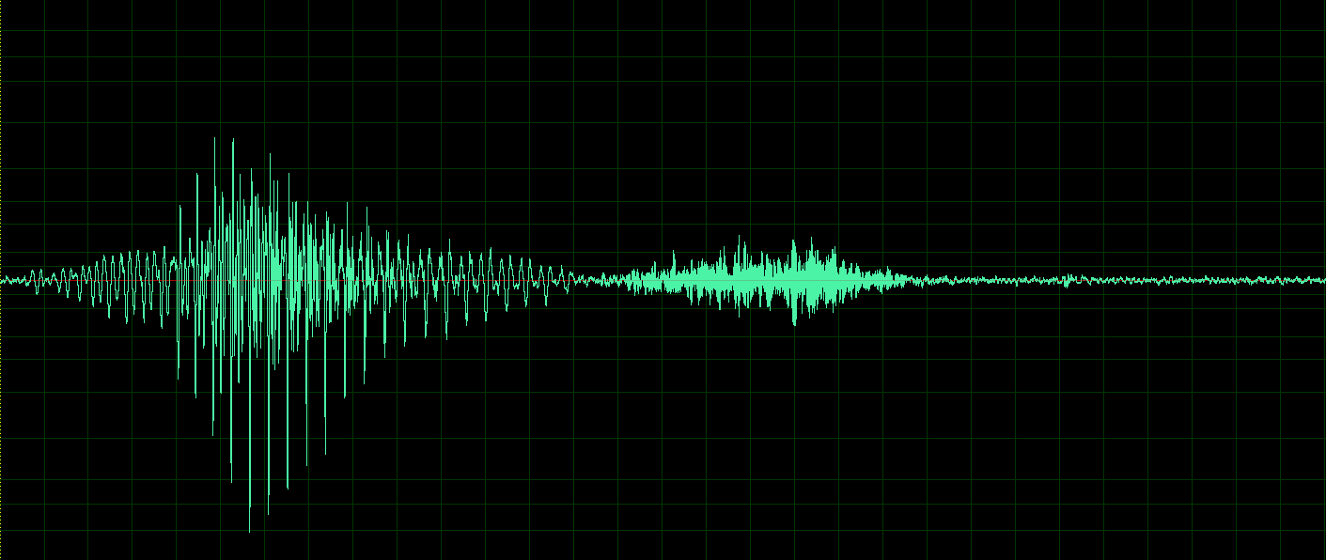
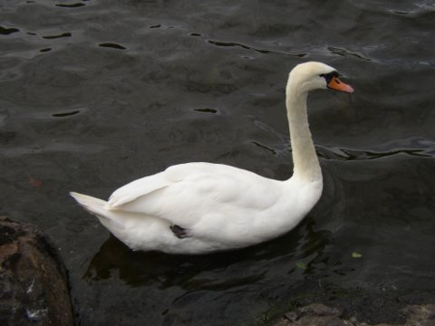
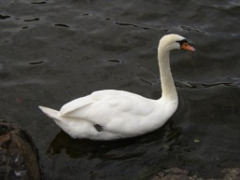
Sampling as an Algorithm
Think about the similarities between:
Halving the frequency of a sound
Scaling a picture up to twice the size
Think about the similarities between:
Doubling the frequency of a sound
Scaling a picture down to half the size

Slide 31
Recall the Picture Copying Functions from Lecture 6
def copyBarbsFaceLarger():
# Set up the source and target pictures
barbf=getMediaPath("barbara.jpg")
barb = makePicture(barbf)
canvasf = getMediaPath("7inX95in.jpg")
canvas = makePicture(canvasf)
# Now, do the actual copying
sourceX = 45
for targetX in range(100,100+((200-45)*2)):
sourceY = 25
for targetY in range(100,100+((200-25)*2)):
color = getColor(
getPixel(barb,int(sourceX),int(sourceY)))
setColor(getPixel(canvas,targetX,targetY), color)
sourceY = sourceY + 0.5
sourceX = sourceX + 0.5
show(barb)
show(canvas)
return canvas
def half(source):
target = makeEmptySound(getLength(source) * 2)
sourceIndex = 0
for targetIndex in range(0, getLength( target)):
value = getSampleValueAt( source, int(sourceIndex))
setSampleValueAt( target, targetIndex, value) sourceIndex = sourceIndex + 0.5
play(target)
return target

Slide 32
Both of these functions implement a sampling algorithm
INITIALISE source index to 0
FOR EACH target index
CONVERT source index to an integer
GET the element at the integer source index
PUT the element at the target index
INCREMENT source index by 0.5
END FOR
RETURN target

Slide 33
SYNTHESISERS
Tinkering Audio

Slide 34
Synthesizers
We now have a very basic sampling synthesizer
There are several other types of sound synthesis
Additive: works by adding together several sine waves or other waves
Subtractive: works by generating harmonically rich waves and then filtering them to shape their frequency content
Frequency modulation (FM): works by rapidly altering the frequency of a generated tone
Physical modelling: works by simulating the vibrations in real-world objects such as strings, wind instruments, even human vocal cords
... Plus many others

Slide 35
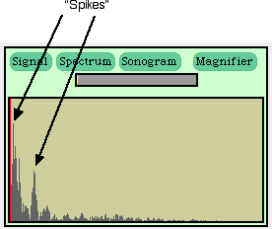
Adding sine waves to make something completely new
We saw earlier that complex sounds (like the sound of your voice or a trumpet) can be seen as being a sum of sine waves
Any sound can be made by summing sine waves – Fourier’s Theorem
We can create complex sounds by summing sine waves
These are sounds made by mathematics, by invention, not based on anything in nature

Slide 36
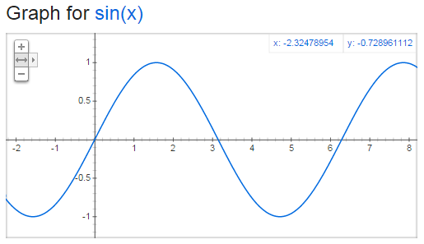
Basic idea: Build a sine wave
“Hz” = “Cycles per second”
If we want a 440 Hz sound wave, then we need one of these cycles every 1/440th of a second.

Slide 37
Our algorithm
First some calculations...
frequency = 440Hz
interval = length of 1 cycle in seconds = 1/frequency = 1/440 seconds
samplesPerCycle = length of 1 cycle in samples
= 1/440 seconds * 22050 samples/sec = 50.11 samples
Now for each output sample:
Calculate sampleIndex / samplesPerCycle – this quantity increases by 1 on each cycle, i.e. every 1/440 seconds
Multiply this by 2*pi to get an angle in radians
Take the sine – this gives a value between -1 and +1
Multiply by the desired amplitude and put it at sampleIndex

Slide 38
Our Code
def sineWave(freq, amplitude, length): # Create a blank sound buildSin = makeEmptySoundBySeconds(length) # Set constants samplingRate = getSamplingRate(buildSin) interval = 1.0 / freq samplesPerCycle = interval * samplingRate maxCycle = 2 * pi # Generate the sound for pos in range(getLength(buildSin)): rawSample = sin((pos / samplesPerCycle) * maxCycle) sampleVal = int(amplitude * rawSample) setSampleValueAt(buildSin, pos, sampleVal) return buildSin

Slide 39
Adding pure sine waves together
>>> f440=sineWave (440 ,2000, 1)
>>> f880=sineWave (880 ,4000, 1)
>>> f1320=sineWave (1320 ,8000, 1)
>>> addSoundInto(f880 ,f440)
>>> addSoundInto(f1320 ,f440)
>>> play(f440)
>>> explore(f440)
>>> just440=sineWave (440 ,2000, 1)
>>> play(just440)
>>> explore(f440)
Adding together 440Hz, 880Hz, and 1320Hz, with increasing amplitudes.
Comparing to a 440Hz wave

Slide 40
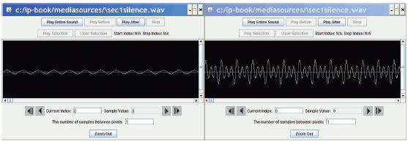
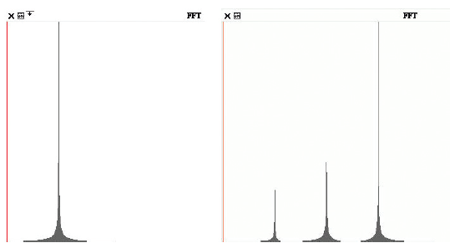
Comparing the waves
Left, 440 Hz; Right, combined wave.
In Explorer
In the Spectrum view in MediaTools
440, 880, 1320

Slide 41
Subtractive synthesis
The most widely used type of synthesis in electronic music production
A subtractive synthesizer has oscillators which generate tones, and filters which shape the frequencies – both of which can be controlled by envelopes
Many classic synthesizers from the 1960s/1970s were based on analogue oscillators and filters
Modern synthesizers are digital, although many aim to model the characteristic sound of analogue components

Slide 42
A challenge (for the adventurous!)
Incorporate subtractive synthesis (filtering) into your tinkering audio project
Use the formulae here
http://www.musicdsp.org/files/Audio-EQ-Cookbook.txt
Don’t be put off by the jargon – you don’t need to understand the maths behind it to use it
See also http://blog.bjornroche.com/2012/08/basic-audio-eqs.html

Slide 43
ENVELOPES
Tinkering Audio

Slide 44
Envelopes
Static sounds are not very interesting
Almost all synthesizers allow the musician to manipulate envelopes
Envelopes allow characteristics of the sound (volume, pitch, timbre etc) to vary over time

Slide 45
ADSR envelopes
The most common type of envelope is the ADSR envelope
Attack time: how quickly the sound reaches full amplitude when a note is played
Decay time: how quickly the sound goes from full amplitude to...
Sustain level: the amplitude that the sound maintains until the note stops playing
Sustain time: how long the sustain level is maintained (this can be a parameter, or can be determined by how long the musician holds the key down)
Release time: how quickly the note fades away when it stops playing

Slide 46
ADSR envelope
Amplitude
Sustain level
Time
Attack time
Decay time
Sustain time
Release time
Key held down

Slide 47
Exercise
Adapt the sineWave function to create an attack-sustain-release envelope (add decay for a full ADSR envelope if you’re feeling adventurous!)
sineWave(frequency, volume, attack_time,
sustain_time, release_time)

Slide 48
PARSING A NOTATION FOR TONES
Tinkering Audio

Slide 49
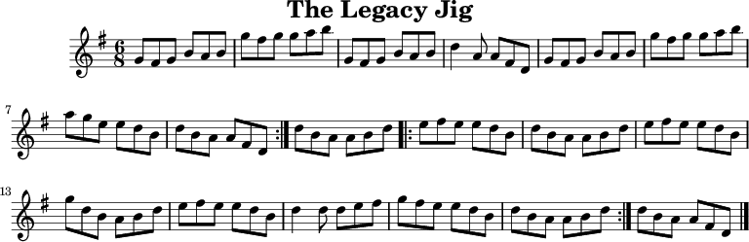
Parsing a Notation

Slide 50
Parsing a Notation: ABC Notation
X:1 T:The Legacy Jig M:6/8 L:1/8 R:jig K:G GFG BAB | gfg gab | GFG BAB | d2A AFD | GFG BAB | gfg gab | age edB |1 dBA AFD :|2 dBA ABd |: efe edB | dBA ABd | efe edB | gdB ABd | efe edB | d2d def | gfe edB |1 dBA ABd :|2 dBA AFD |]

Slide 51
Parsing a Notation: ABC Notation
Lines in the first part of the tune notation, beginning with a letter followed by a colon, indicate various aspects of the tune such as:
the index, when there are more than one tune in a file (X:),
the title (T:),
the time signature (M:),
the default note length (L:),
the type of tune (R:)
and the key (K:).
Lines following the key designation represent the tune. This example can be translated into traditional music notation using one of the abc conversion tools.

Slide 52
Further Notes on ABC
http://abcnotation.com/examples

Slide 53
Live Coding: A Simpler Parser
Reading notes and note durations from a string

Slide 54
Live Coding: A Simpler Parser – Key Concepts
Token – a collection of symbols with a particular meaning (e.g., a note and its duration)
Delimiter – the symbol that separates the tokens (e.g., a blank space – remember this is still encoded in the computer!)

Slide 55
Useful Python operations for parsing
>>> s = "Hello world"
>>> s.split(' ')
['Hello', 'world']
>>> s[4]
'o'
>>> s[3:7]
'lo w'
>>> s[:3]
'Hel'
>>> s[7:]
'orld'
Splitting by delimiter
Getting a single character
Slicing

Slide 56
Converting notes to frequencies
C
C#
Db
D
D#
Eb
E
F
F#
Gb
G
G#
Ab
A
A#
Bb
B
C
C#
Db
D
D#
Eb
E
F
F#
Gb
G
G#
Ab
A
A#
Bb
B
C
The A above middle C on a piano is 440Hz
Notes double in frequency every octave up, and halve in frequency every octave down
A = 55Hz, 110Hz, 220Hz, 440Hz, 880Hz, 1760Hz, ...
1 octave = 12 semitones
A, A#, B, C, C#, D, D#, E, F, F#, G, G#, A

Slide 57

Converting notes to frequencies
Use this formula:
note_number is the offset of the note, in semitones, from A=440Hz
frequency = 440.0 * 2.0 ** (note_number / 12.0)
-9
-8
-7
-6
-5
-4
-3
-2
-1
0
1
2
3
4
5
6
7
8
9
10
11
12
13
14
15

Slide 58
Exercise
Write a parser for your synthesizer to convert notes input as chars into actual sounds
Use it to play a melody

Slide 59
RANDOM NUMBER GENERATION
Tinkering Audio

Slide 60
Adding new capabilities: Modules
Sometimes we need to add capabilities to Python beyond those built into the basic interpreter
We do this by importing external modules
A module is a file with function and class definitions
By importing the module, we make the module's capabilities available to our program
The module is loaded as if its contents had been typed into your program file

Slide 61
Python's Standard Library
Python comes with an extensive library of modules
Includes modules for mathematics, random number generation, file reading and writing, networking, operating system functions, parsing, data compression, cryptography, even interpreting Python code

Slide 62
Accessing Pieces of a Module
We access the additional capabilities (functions, constants, classes) of a module using dot notation, after we import the module
How do you know what’s there?
Check the documentation: https://docs.python.org/2/library/index.html
Some IDEs (like PyCharm, but unfortunately not JES) have auto-completion and built-in documentation
There are a couple of books (Lundh, Hellmann) that describe the modules in more detail than the online documentation

Slide 63
An Interesting Module: Random
>>> import random
>>> for i in range(1,10):
... print random.random()
...
0.8211369314193928
0.6354266779703246
0.9460060163520159
0.904615696559684
0.33500464463254187
0.08124982126940594
0.0711481376807015
0.7255217307346048
0.2920541211845866

Slide 64
Useful random functions
random.uniform(a, b): get a random floating point number between a and b
random.randrange(a, b): get a random integer between a and b-1
random.choice(list): choose a random element from a list
random.shuffle(list): randomise the order of a list
random.seed(x): can be used to make your program generate the same sequence of random numbers each time it is run
Many others – see the documentation for details

Slide 65
Randomly Choosing Notes from a List
>>> for i in range(1,5):
... print random.choice([“C1", “D1", “E1", “F1", “G1", “A1", “B1",“C2",“D2“, “D3”])
... print random.randrange(1, 8)
...
C1
4
E1
6
...

Slide 66
Exercise: Randomly Generating Melodies
Given a list of notes and note durations, we can randomly take one from each to make a simple melody.
Integrate a random number generator into the synthesizer that you have just created to randomly produce a simple melody.

Slide 67
White noise
import random def makeNoise(amplitude, length): # Create a blank sound buildNoise = makeEmptySoundBySeconds(length) # Make some noise! for pos in range(getLength(buildNoise)): rawSample = random.uniform(-1, 1) sampleVal = int(amplitude * rawSample) setSampleValueAt(buildNoise, pos, sampleVal) return buildNoise

Slide 68
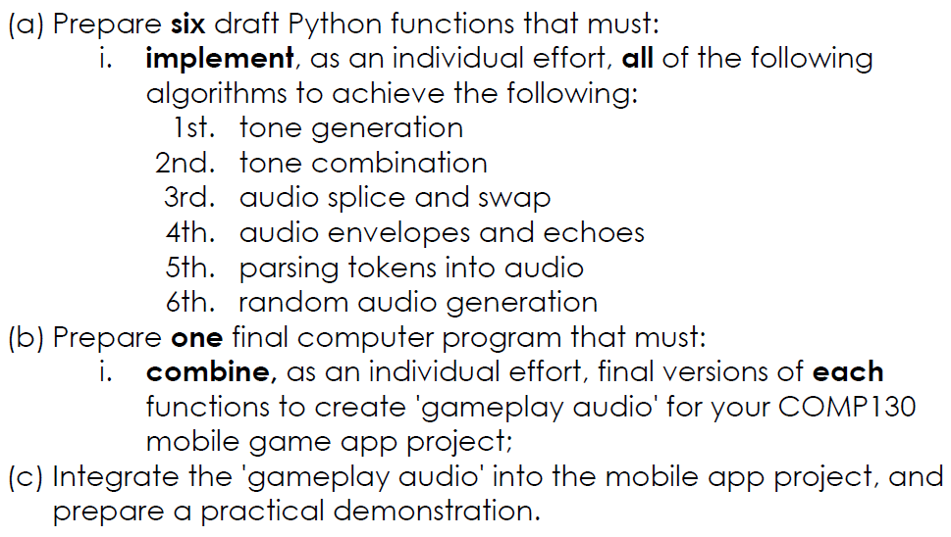
Tinkering Audio assignment
✓
✓
✓
✓
✓
✓

Slide 69
FINAL REMARKS
Introduction to Digital Sound

Slide 70
Additional Resources
Royalty-Free Digital Sound Clips http://incompetech.com/
Digital Sound Manipulation http://www.superflashbros.net/as3sfxr/

Slide 71
Thank You For Listening
Michael Scott

