Slide 1
Getting Started with JES
COMP120: Creative Computing

Slide 2
Part I: Introduction

Slide 3
Learning Objectives
By the end of this section you should be able to:
Explain what computer science is
Explain some reasons why media is digitized
Explain the creative value of computing
Explain the concept of encoding
Recognise the basic components in a computer

Slide 4
What Is Computer Science?
Computer science is the study of recipes
Computer scientists study…
How the recipes are written (algorithms, software engineering)
The units used in the recipes (data structures, databases)
What can recipes be written for (systems, intelligent systems, theory)
How well the recipes work (human-computer interfaces)

Slide 5
Specialized Recipes
Some people specialize in crepes or barbeque
Computer scientists can also specialize on special kinds of recipes
Recipes that create pictures, sounds, movies, animations (graphics, computer music)
Still others look at emergent properties of computer “recipes”
What happens when lots of recipes talk to one another (networking, non-linear systems)

Slide 6
Defining terms
Beyond “recipes”
A program is a description in a programming language of a process that achieves some result.
An algorithm is a description of a process in a step-by-step manner.
The same algorithm could be written in many languages.

Slide 7
Key concept: The COMPUTER does the recipe!
Make it as hard, tedious, complex as you want!
Crank through a million genomes? No problem!
Find one person in a 30,000 campus? Yawn!
Process a million dots on the screen or a bazillion sound samples?
That’s media computation

Slide 8
What computers understand
It’s not really multimedia at all.
It’s unimedia (said Nicholas Negroponte)
Everything is 0’s and 1’s
Computers are exceedingly stupid
The only data they understand is 0’s and 1’s
They can only do the most simple things with those 0’s and 1’s
Move this value here
Add, multiply, subtract, divide these values
Compare these values, and if one is less than the other, go follow this step rather than that one.
Done fast enough, those simple things can be amazing.

Slide 9
Python
Python is a popular programing language, which is designed to be easy to read.
Used by many companies.
Also used to make application software flexible and expendable.
For example, can be used to program GIMP or Blender

Slide 10
A word about Jython
Jython is Python
Python is a language implemented in C.
Jython is the same language implemented in Java.
Is the pizza different if a different company makes the flour? If so, not by much.

Slide 11
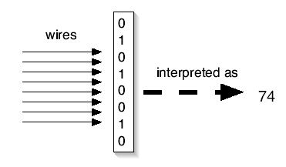
Key Concept: Encodings
We can interpret the 0’s and 1’s in computer memory any way we want.
We can treat them as numbers.
We can encode information in those numbers
Even the notion that the computer understands numbers is an interpretation
We encode the voltages on wires as 0’s and 1’s, eight of these defining a byte
Which we can, in turn, interpret as a decimal number

Slide 12
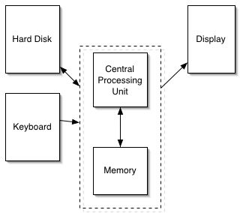
How a computer works
The part that does the adding and comparing is the Central Processing Unit (CPU).
The CPU talks to the memory
Think of it as a sequence millions of mailboxes, each one byte in size, each of which has a numeric address
The hard disk provides 10 times or more storage than in memory (20 billion bytes versus 128 million bytes), but is millions of times slower
The display is the monitor or LCD (or whatever)

Slide 13
Layer the encodings as deep as you want
One encoding, ASCII, defines an “A” as 65
If there’s a byte with a 65 in it, and we decide that it’s a string, POOF! It’s an “A”!
We can string together lots of these numbers together to make usable text
“77, 97, 114, 107” is “Mark”
“60, 97, 32, 104, 114, 101, 102, 61” is “<a href=“ (HTML)
Notes:
Notice that lowercase “a” is different than uppercase “A”

Slide 14
What do we mean by layered encodings?
A number is just a number is just a number
If you have to treat it as a letter, there’s a piece of software that does it
For example, that associates 65 with the graphical representation for “A”
If you have to treat it as part of an HTML document, there’s a piece of software that does it
That understands that “<A HREF=“ is the beginning of a link
That part that knows HTML communicates with the part that knows that 65 is an “A”

Slide 15
Multimedia is unimedia
But that same byte with a 65 in it might be interpreted as…
A very small piece of sound (e.g., 1/44100-th of a second)
The amount of redness in a single dot in a larger picture
The amount of redness in a single dot in a larger picture which is a single frame in a full-length motion picture

Slide 16
Software (recipes) defines and manipulates encodings
Computer programs manage all these layers
How do you decide what a number should mean, and how you should organize your numbers to represent all the data you want?
That’s data structures
If that sounds like a lot of data, it is
To represent all the dots on your screen probably takes more than 3,145,728 bytes
Each second of sound on a CD takes 44,100 bytes
Notes:
We’ll explain more about layers next time

Slide 17
The Power of Moore’s Law
Gordon Moore, one of the founders of Intel, made the claim that (essentially) computer power doubles for the same dollar every 18 months.
This has held true for over 30 years.
Make your computer do the same thing to everyone of the 2,073,600 dots on your screen? It won’t take much time!

Slide 18
Why digitize media?
Digitizing media is encoding media into numbers
Real media is analogue (continuous).
To digitize it, we break it into parts where we can’t perceive the parts.
By converting them, we can more easily manipulate them, store them, transmit them without error, etc.

Slide 19
How can it work to digitize media?
Why does it work that we can break media into pieces and we don’t perceive the breaks?
We can only do it because human perception is limited.
We don’t see the dots in the pictures, or the gaps in the sounds.
We can make this happen because we know about physics (science of the physical world) and psychophysics (psychology of how we perceive the physical world)

Slide 20
Why should you need to study “recipes”?
To understand better the recipe-way of thinking
It’s influencing everything, from computational science to bioinformatics
Eventually, it’s going to become part of everyone’s notion of a liberal education – you’ll probably need it
That’s the process argument
AND…to communicate!
Writers, marketers, producers communicate through computation
We’ll take these in opposite order

Slide 21
Computation for Creativity
All media are going digital
Digital media are manipulated with software
You are limited in your expression by what your software allows
What if you want to say something that Microsoft or Adobe or Apple doesn’t provide a tool/filter/feature to say?

Slide 22
Programming can be Creative
If you want to say something that your tools don’t allow, program it yourself
If you want to understand what your tools can or cannot do, you need to understand what the programs are doing
If you care about preparing media for the Web, for marketing, for print, for broadcast… then it’s worth your while to understand how the media are and can be manipulated.
Knowledge is Power, Knowing how media work is powerful and freeing

Slide 23
We’re not going to replace PhotoShop
Nor ProAudio Tools, ImageMagick and GIMP
But if you know what these things are doing, you have something that can help you learn new tools

Slide 24
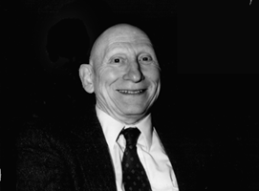
Knowing about programming is knowing about process
Alan Perlis
One of the founders of computer science
Argued in 1961 that Computer Science should be part of a liberal education: Everyone should learn to program.
Perhaps computing is more critical to a liberal education than Calculus
Calculus is about rates, and that’s important to many.
Computer science is about process, and that’s important to everyone.
Automating process changes everything.

Slide 25
Everyone will likely need this
A study a Carnegie-Mellon University found that there were at least 4 end-user programmers for every 1 professional software developer in the world.
End-user programmers create programs to solve problems of their own, not to create software products.
That number is increasing.
More and more professionals are going to need some aspect of programming as part of their work.

Slide 26
A Recipe is a Statement of Process
A recipe defines how something is done
In a programming language that defines how the recipe is written
When you learn the recipe that implements a Photoshop filter, you learn how Photoshop does what it does.
And that is powerful.

Slide 27
Programming is about Communicating Process
A program is the most concise statement possible to communicate a process
That’s why it’s important to scientists and others who want to specify how to do something understandably in as few words as possible

Slide 28
PART II: GETTING STARTED
COMP120: Creative Computing

Slide 29
Learning Objectives
By the end of this section you should be able to:
Recognise different ways of encoding of data
Make and display pictures in JES
Make and play sounds in JES
Use JES to execute basic programs
Create an use variables to store values and objects (such as pictures and sounds)
Define your own functions

Slide 30
Much of programming is naming
We name our data
Data: The “numbers” we manipulate
We call our names for data variables
We name our functions
Our basic recipes for doing things
Quality of names is important
Enough words to describe what you need to describe
Understandable

Slide 31
Naming our Encodings
We even name our encodings
Sometimes referred to as types
Numbers without decimals are called integers.
Numbers with decimal points are called floating point or floats.
Collections of letters are called strings.
Some programming languages are strongly typed
A name has to be declared to have a type, before any data is associated with it

Slide 32
Examples of Types
31,364
34,654.01
12
12.998
Floats
Integers
1.01
0.01
-12
Barbara Ericson
Mark
Inside the computer, these are all just bits
85 5th Street NW
Strings

Slide 33
Programs Work with Names
You will name your functions
Just like functions you knew in math, like sin and gcd (Greatest Common Divisor)
You will name your data (variables)
You will name the data that your functions work on
Inputs, like the 90 in sine(90)
Key: Names inside a function only have meaning while the function is being executed by the computer. (More on “scoping” later.)

Slide 34
Names for things not in memory
A common name that you’ll deal with is a file name
The program that deals with those is called the operating system, like Windows, MacOS, Linux
A file is a collection of bytes, with a name, that resides on some external medium, like a hard disk.
Think of it as a whole bunch of space where you can put your bytes
Files are typed, typically with three letter extensions
.jpg files are JPEG (pictures), .wav are WAV (sounds)

Slide 35
Jython Environment for Students
JES: Jython Environment for Students
A simple editor (for entering in our programs or recipes): We’ll call that the program area
A command area for entering in commands for Python to execute.

Slide 36
Jython Environment for Students

Slide 37
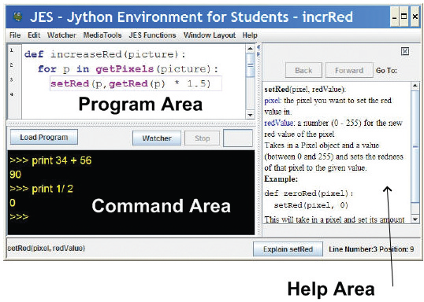
Jython Environment for Students
Use Window Layout to get the view you want

Slide 38
Python understands commands
We can name data with =
We can print values, expressions, anything with print

Slide 39
Naming Restrictions
Must start with a letter
Be careful not to use command names as your own names
print = 1 won’t work
Case matters
“Print” is not the same as “print”
“myPicture” is not the same as “mypicture”

Slide 40
Using JES
Adding integers
>>> print 34 + 56
90
>>> print 34.1/46.5
0.7333333333333334
>>> print 22 * 33
726
>>> print 14 - 15
-1
>>> print "Hello"
Hello
>>> print "Hello" + "Mark"
HelloMark
Dividing floats
Multiplying integers
Subtracting integers
Printing a string
Adding (concatenating)
two strings

Slide 41
Values and names with same value are interchangeable
>>> print 12 * 3
36
>>> value = 12
>>> print value
12
>>> print value * 3
36
>>> name = "Mike"
>>> print name
Mike
>>> print name * 3
MikeMikeMike
>>> print "Mark" * 3
MarkMarkMark

Slide 42
= is Assignment, not Equality
When you see “=“ in Python, read it as:
“Figure out the value on the right.”
“Give it the name on the left.”
So: size = 12.5
“Figure out the value on the right.” That’s 12.5
“Give it the name on the left.” That’s size
So: total = size * 34
“Figure out the value on the right.” That’s 425 (size * 34 is 12.5 * 34)
“Give it the name on the left.” That’s total

Slide 43

Maths can be Surprising
If you only use integers (numbers without decimal points), Jython thinks you only want integers.

Slide 44
Maths can be Surprising
Use floats when you want a decimal point!

Slide 45
Command Area Editing
Up/down arrows walk through command history
You can edit the line at the bottom
Just put the cursor at the end of the line before hitting Return/Enter.

Slide 46
JES Functions
A bunch of functions are pre-defined in JES for sound and picture manipulations
pickAFile()
makePicture()
makeSound()
show()
play()
Some of these functions accept input values

Slide 47
What to do to show a picture
1. Find a file with a picture.
2. Pick it.
3. Get the bytes from that file into memory and label it as a type: “picture”
4. Show the picture

Slide 48
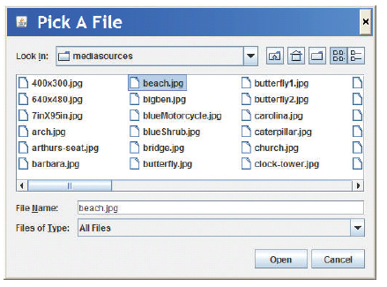
pickAFile() leads to The File Picker!

Slide 49
Picture Functions
makePicture(filename) creates and returns a picture object, from the JPEG file at the filename
show(picture) displays a picture in a window
We’ll learn functions for manipulating pictures later, like getColor, setColor, and repaint

Slide 50
Sound Functions
makeSound(filename) creates and returns a sound object, from the WAV file at the filename
play(sound) makes the sound play (but doesn’t wait until it’s done)
blockingPlay(sound) waits for the sound to finish
We’ll learn more later like getSample and setSample

Slide 51
Demonstration
>>> myfilename = pickAFile()
>>> print myfilename
/Users/guzdial/mediasources/barbara.jpg
>>> mypicture = makePicture(myfilename)
>>> print mypicture
Picture, filename /Users/guzdial/mediasources/barbara.jpg height 294 width 222
>>> show(mypicture)

Slide 52
Demonstration
>>> print pickAFile()
/Users/guzdial/mediasources/barbara.jpg
>>> print makePicture(pickAFile())
Picture, filename /Users/guzdial/mediasources/barbara.jpg height 294 width 222
>>> show(makePicture(pickAFile()))
>>> print show(makePicture(pickAFile()))
None
>>> print pickAFile()
/Users/guzdial/mediasources/hello.wav
>>> print makeSound(pickAFile())
Sound of length 54757
>>> print play(makeSound(pickAFile()))
None
pickAFile() returns a filename, which can be used as input to makePicture() to make a picture or makeSound() to make a sound.
Printing a picture just proves there’s a picture there.
show() and play() don’t return anything, so they print None.

Slide 53
COMPLETELY THE SAME: Values, names for those values, functions that return those values
>>> file=pickAFile()
>>> print file
C:\Documents and Settings\Mark Guzdial\My Documents\mediasources\barbara.jpg
>>> show(makePicture(file))
>>> show(makePicture(r"C:\Documents and Settings\Mark Guzdial\My Documents\mediasources\barbara.jpg"))
>>> show(makePicture(pickAFile()))

Slide 54
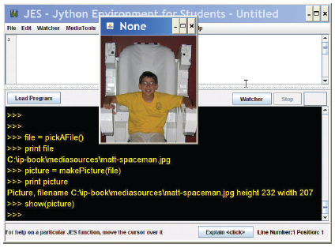
Picking, making, showing a picture

Slide 55
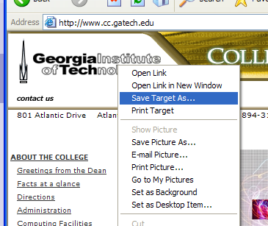
Grabbing media from the Web
Right-click (Windows) or Control-Click (Mac)
Save Target As…
Can only do JPEG images (.jpe, .jpg, .jpeg)

Slide 56
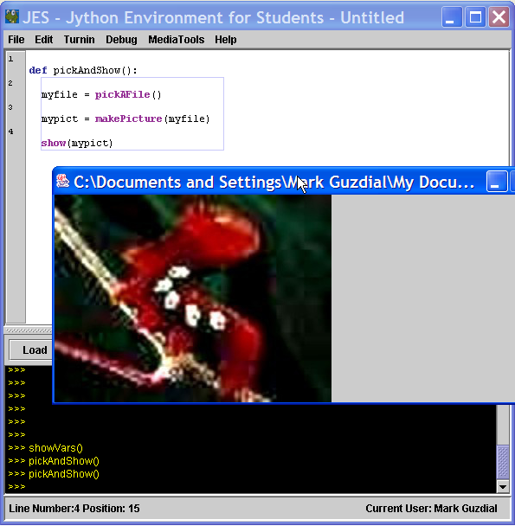
Writing a recipe: Making our own functions
To make a function, use the command def
Then, the name of the function, and the names of the input values between parentheses (“(input1)”)
End the line with a colon (“:”)
The body of the recipe is indented (Hint: Use two spaces)
That’s called a block

Slide 57
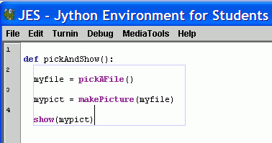
Blocking is indicated for you in JES
Statements that are indented the same, are in the same block.
Statements that are in the same block as where the line where the cursor is are enclosed in a blue box.

Slide 58
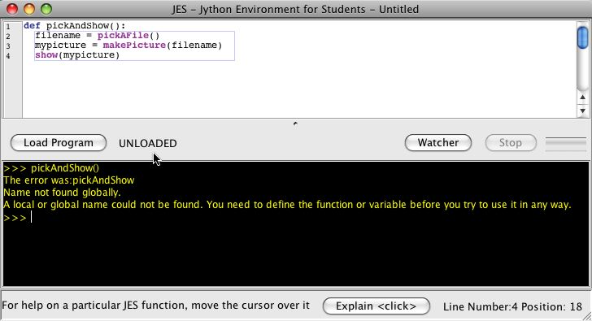
The Most Common JES Bug: Forgetting to Load
Your function does NOT exist for JES until you load it
Before you load it, the program is just a bunch of characters.
Loading encodes it as an executable function
Save and Save As
You must Save before Loading
You must Load before you can use your function
An “Unloaded” function doesn’t exist yet.

Slide 59
Making functions the easy way
Get something working by typing commands
Enter the def command.
Copy-paste the right commands up into the recipe

Slide 60
A recipe for playing picked sound files
def pickAndPlay():
myfile = pickAFile()
mysound = makeSound(myfile)
play(mysound)
Note: myfile and mysound, inside pickAndPlay(), are completely different from the same names in the command area.

Slide 61
A function for playing picked picture files
def pickAndShow():
myfile = pickAFile()
mypict = makePicture(myfile)
show(mypict)

Slide 62
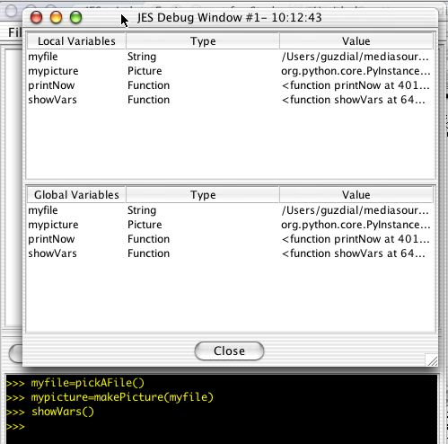
What if you forget your variable names? showVars()

Slide 63
A function for a specific sound or picture
def playSound():
myfile = "FILENAME"
mysound = makeSound(myfile)
play(mysound)
You can always replace data (a string of characters, a number, whatever) with a name (variable) that holds that data—or vice versa.
def showPicture():
myfile = "FILENAME"
mypict = makePicture(myfile)
show(mypict)
Put r in front of Windows filenames: r“C:\mediasources\pic.jpg”

Slide 64
What to do about Windows filenames?
Python doesn’t like you to use “\” in filenames, like “C:\mediasources\barbara.jpg”
What to do?
Option #1: Put r in front of Windows filenames: r“C:\mediasources\pic.jpg”
Option #2: Use forward slashes. Python will translate it for you: “C:/mediasources/pic.jpg”

Slide 65
A function that takes input
def playNamed(myfile):
mysound = makeSound(myfile)
play(mysound)
What functions do you need? What should be their input?
In general, have enough to do what you want, easily, understandably, and in the fewest commands.
We’ll talk more about what that means later.
def showNamed(myfile):
mypict = makePicture(myfile)
show(mypict)

Slide 66
What can go wrong?
Did you use the exact same names (case, spelling)?
All the lines in the block must be indented, and indented the same amount.
Variables in the command area don’t exist in your functions, and variables in your functions don’t exist in the command area.
The computer can’t read your mind.
It will only do exactly what you tell it to do.

Slide 67
What Next?
Read Chapter 2 and complete the related exercises.

