Slide 1
Creating and Modifying Text
COMP120: Creative Computing

Slide 2
Part I: Introduction

Slide 3
Learning Objectives
By the end of this section you should be able to:
To create human-usable text via programs.
To generate text patterns.
To manipulate strings.
To build strings with concatenation.
To use loops to iterate over characters in a string.
To covert strings into lists for manipulation.
To use array notation for accessing elements of strings and lists.

Slide 4
Strings
Strings are defined with quote marks.
Python actually supports three kinds of quotes:
>>> print 'this is a string'
this is a string
>>> print "this is a string"
this is a string
>>> print """this is a string"""
this is a string
Use the right one that allows you to embed quote marks you want
>>> aSingleQuote = " ' "
>>> print aSingleQuote
'

Slide 5
What type of data is in the variable filename after executing this statement?
File name
Picture
String
Float
Notes:
#3

Slide 6
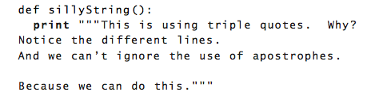
Triple Quotes
>>> sillyString()
This is using triple quotes. Why?
Notice the different lines.
And we can't ignore the use of apostrophes.
Because we can do this.

Slide 7
Adding Strings and Numbers
>>> print 4 + 5 9 >>> print "4"+"5"
45
>>> print 4 + "5"
The error was: 'int' and 'str'
Inappropriate argument type.
Adding strings together is called “concatenation”

Slide 8
Type Conversion
Using int() and float(), you can convert strings to numbers.
If the string is a valid integer or floating-point number.
Using str(), you can convert numbers to strings.
>>> print 4 + 1
5
>>> print str(4) + str(1)
41
>>> print int("4")
4
>>> print int("abc")
The error was: abc
Inappropriate argument value (of correct type).
An error occurred attempting to pass an argument to a function.
>>> print float("124.3")
124.3
>>> print int("124.3")
The error was: 124.3
Inappropriate argument value (of correct type).
An error occurred attempting to pass an argument to a function.

Slide 9

This will result in:
13
An error
“12”
“121”
Notes:
#4

Slide 10
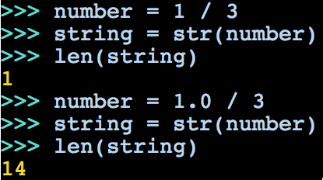




How could this be?
An error because string can’t be redefined.
string is “1.0000000000/3”
string is “0.333333333333”
string is “1/3.0000000000”
Notes:
#3

Slide 11
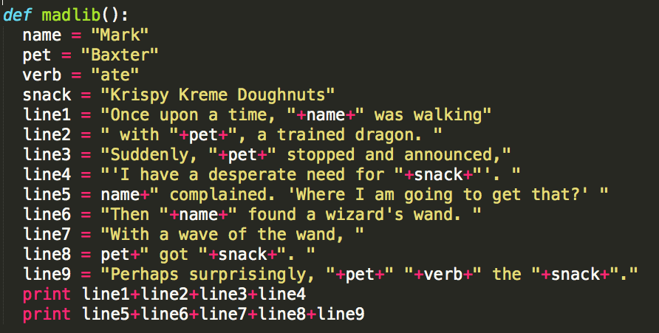
Using string concatenation to tell a MadLib story

Slide 12
Running our MadLib function
>>> madlib()
Once upon a time, Mark was walking with Baxter, a trained dragon. Suddenly, Baxter stopped and announced,'I have a desperate need for Krispy Kreme Doughnuts'.
Mark complained. 'Where I am going to get that?' Then Mark found a wizard's wand. With a wave of the wand, Baxter got Krispy Kreme Doughnuts. Perhaps surprisingly, Baxter ate the Krispy Kreme Doughnuts.

Slide 13
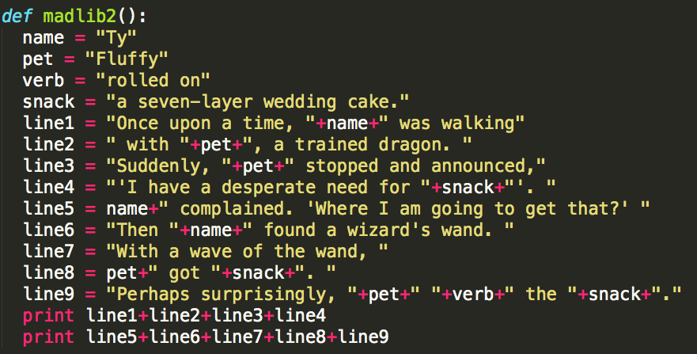
Telling a different MadLib Story
Notes:
Generating

Slide 14
Running new one
>>> madlib2()
Once upon a time, Ty was walking with Fluffy, a trained dragon. Suddenly, Fluffy stopped and announced,'I have a desperate need for a seven-layer wedding cake.'.
Ty complained. 'Where I am going to get that?' Then Ty found a wizard's wand. With a wave of the wand, Fluffy got a seven-layer wedding cake.. Perhaps surprisingly, Fluffy rolled on the a seven-layer wedding cake.

Slide 15
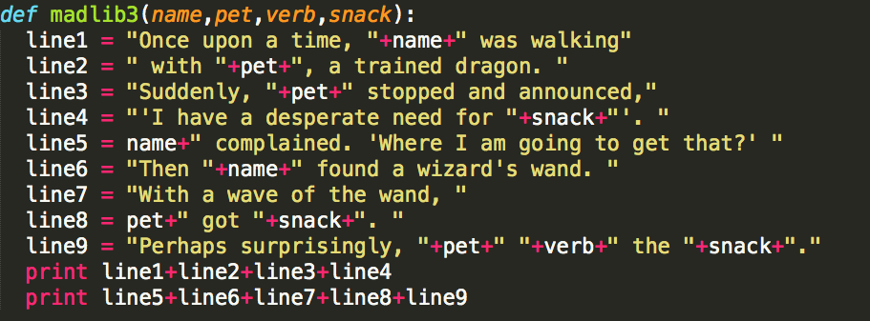
Using Parameters

Slide 16
Using Parameters
>>> madlib3("Lee","Spot","stomped on","Taco Bell nachos")
Once upon a time, Lee was walking with Spot, a trained dragon. Suddenly, Spot stopped and announced,'I have a desperate need for Taco Bell nachos'.
Lee complained. 'Where I am going to get that?' Then Lee found a wizard's wand. With a wave of the wand, Spot got Taco Bell nachos. Perhaps surprisingly, Spot stomped on the Taco Bell nachos.

Slide 17
Multiplication is repeated Addition: Strings, too
>>> print "abc" * 3
abcabcabc
>>> print 4 * "Hey!"
Hey!Hey!Hey!Hey!
Multiplication concatenates copies of the string

Slide 18
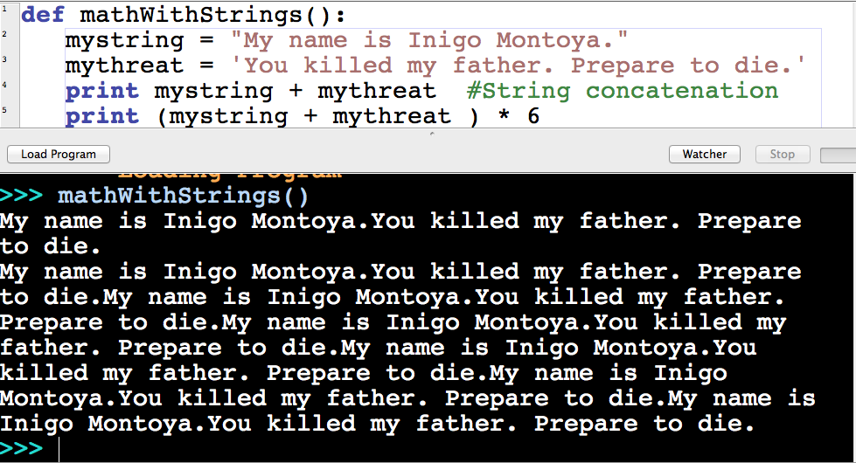
Princess Bride in Python

Slide 19
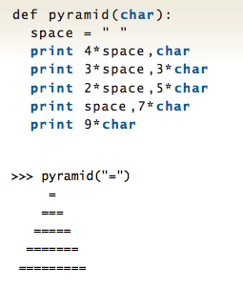
A Pyramid in Python

Slide 20
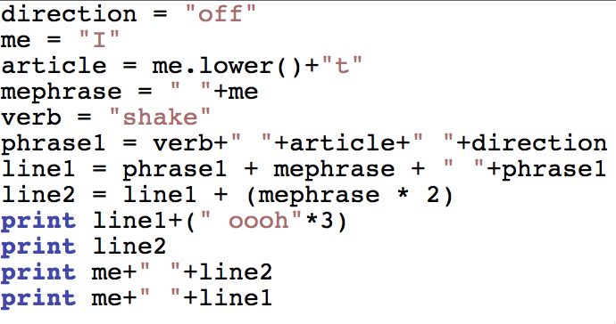
What does this print?
Notes:
Four lines of Taylor Swift’s “Shake it off”

Slide 21
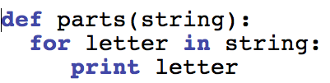
Taking strings apart
Read for as “for each”
“For each letter in the string…print the letter.”
>>> parts()
H
e
l
l
o

Slide 22
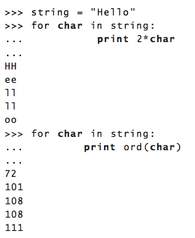
The for loop
The word for has to be there.
Next comes the index variable that will take on the value of each element of the collection.
The word in has to be there
The colon (“:”) says, “Next comes the body of the loop.”
The statements in the body of the loop must be indented.
Anything can be inside the for loop

Slide 23
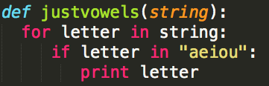
Using if to test the letters
>>> justvowels("hello there!")
e
o
e
e

Slide 24
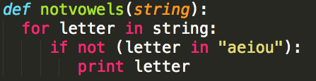
Using if to test the letters
>>> notvowels("hello there!")
h
l
l
t
h
r
!

Slide 25
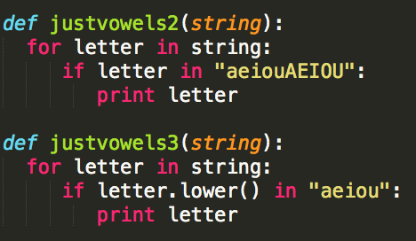
Two different ways to deal with case

Slide 26
Collecting characters into strings
>>> word = "Um"
>>> print word
Um
>>> word = word + "m"
>>> print word
Umm
>>> word = word + "m"
>>> print word
Ummm
>>> word = word + "m"
>>> print word
Ummmm

Slide 27
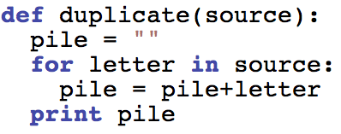
Return a new string from pieces
>>> duplicate("rubber duck")
rubber duck

Slide 28
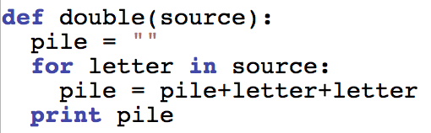
More interesting: Double
>>> double("rubber duck")
rruubbbbeerr dduucckk

Slide 29
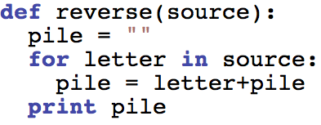
More interesting: Reverse
>>> reverse("rubber duck")
kcud rebbur

Slide 30
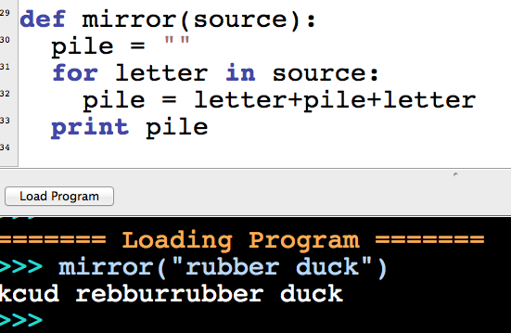
Mirroring
We can add the index variable to both sides of the pile

Slide 31
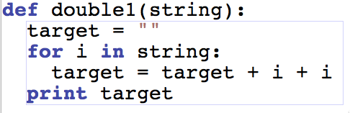
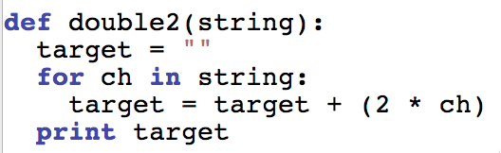
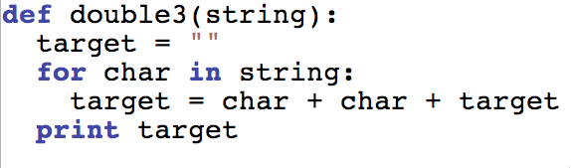
Two of these “double” programs produces this:
>>> double_("apple")
aappppllee
Which one doesn’t?
Notes:
#2

Slide 32
Only one of these programs prints more than one exclamation point.
Which one is it?
def exclaim1(somestring):
target = "!"
for char in somestring:
target = target + char
print target
def exclaim2(somestring):
target = "!"
for char in somestring:
target = char + target
print target
def exclaim3(somestring):
target = ""
for char in somestring:
target = target + char + "!"
print target
Notes:
#2

Slide 33
One of these, when you call it with the input of “Between” will print: >B<e<t<w<e<e<n<
Which one?
def between1(somestring):
target = ">"
for char in somestring:
target = target + char
print target+"<"
def between2(somestring):
target = "<>"
for char in somestring:
target = char + target + char
print target
def between3(somestring):
target = ">"
for char in somestring:
target = target + char + "<"
print target
Notes:
#2

Slide 34
Creating Language Patterns
def doubledutch(name):
pile = ""
for letter in name:
if letter.lower() in "aeiou":
pile = pile + letter
if not (letter.lower() in "aeiou"):
pile = pile + letter + "u" + letter
print pile
>>> doubledutch("mark")
mumarurkuk
>>> doubledutch("bill")
bubilullul

Slide 35
Using square bracket notation
>>> phrase = "Hello world!"
>>> phrase[0]
'H'
>>> phrase[1]
'e'
>>> phrase[2]
'l'
>>> phrase[6]
'w’
>>> phrase[-1]
'!'
>>> phrase[-2]
'd'
The first character is at index 0.
Negative index values reference the end of the list

Slide 36
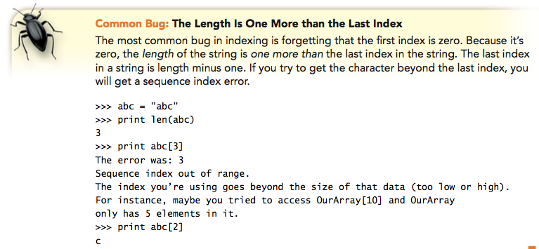
The function len() gives you the number of elements
Not the last index position.

Slide 37
Use the range() function to generate index values
>>> print range(0,5)
[0, 1, 2, 3, 4]
>>> print range(0,3)
[0, 1, 2]
>>> print range(3,0)
[]
>>> print range(0,5,2)
[0, 2, 4]
>>> print range(0,7,3)
[0, 3, 6]
>>> print range(5)
[0, 1, 2, 3, 4]
>>> for index in range(0,3):
... print index
...
0
1
2

Slide 38
Print the string, by index
def parts2(string):
for index in range(len(string)):
print string[index]
>>> parts2("bear")
b
e
a
r

Slide 39
Mirroring, by index
def mirrorHalfString(string):
pile=""
for index in range(0,len(string)/2):
pile = pile+string[index]
for index in range(len(string)/2,0,-1):
pile = pile+string[index]
print pile
>>> mirrorHalfString("elephant")
elephpel
>>> mirrorHalfString("something")
sometemo

Slide 40
Reversing, by index
def reverseString2(string):
pile=""
for index in range(len(string)-1,-1,-1):
pile = pile+string[index]
print pile
>>> reverseString2("happy holidays")
syadiloh yppah

Slide 41
Separating, by index
>>> separate("rubber baby buggy bumpers")
Odds: ubrbb ug upr
Evens: rbe aybgybmes
def separate(string):
odds = ""
evens = ""
for index in range(len(string)):
if index \% 2 == 0:
evens = evens + string[index]
if not (index \% 2 == 0):
odds = odds +string[index]
print "Odds: ",odds
print "Evens: ",evens

Slide 42
If I want to print the “e” which should I use?
print word[4]
print word[3]
3) print word[5]
4) print word[e]
Notes:
2 and 3

Slide 43
If I want to print the “g” which should I use?
print word[-1]
print word[‘g’]
print word[9]
print word[8]
Notes:
2 and 3

Slide 44
If I want to print “thing” which should I use?
print word[4:9]
print word[5:9]
print word[4:10]
print word[4:8]
Notes:
2 and 3

Slide 45
Getting an index for a string
>>> print "abcd".find("b")
1
>>> print "abcd".find("d")
3
>>> print "abcd".find("e")
-1

Slide 46
Splitting strings into words
>>> "this is a test".split()
['this', 'is', 'a', 'test']
>>> "abc".split()
['abc']
>>> "dog bites man".split()
['dog', 'bites', 'man']
>>> sentence = "Dog bites man"
>>> parts = sentence.split()
>>> print len(parts)
3
>>> print parts[0]
Dog
>>> print parts[1]
bites
>>> print parts[2]
man

Slide 47
Encodings for Strings
Strings are just arrays of characters
In most cases, characters are just single bytes.
The ASCII encoding standard maps between single byte values and the corresponding characters
More recently, characters are two bytes.
Unicode uses two bytes per characters so that there are encodings for glyphs (characters) of other languages
Java uses Unicode. The version of Python we are using is based in Java, so our strings are actually using Unicode.

Slide 48
Special Invisible Characters
Backslash escapes
\t is the tab character
\b is backspace
\n is newline
\r is return
\uXXXX is a Unicode character where XXXX is a hexadecimal number (digits 0-9 plus characters A-F).

Slide 49
What does this function print?
def clone2(astring):
newstring = ""
for i in range(0,len(astring)):
newstring = newstring+astring[i]
print newstring
(1) “newstring”
(2) It will print whatever was input (in astring)
(3) It will print whatever was input backwards
(4) It will generate an error
Notes:
#2

Slide 50
The Six Things Computers Can Do
They can store data with a name(s).
They can name parts of programs (instructions), and follow those instruction when commanded.
They can take data apart.
They can transform data into other forms.
They can follow a set of instructions repeatedly.
They can test data (is this true or not?), then take actions depending on what the result is.
That’s it!
Knowing how to tell the computer to do these six things is all there is to programming a computer.

