Slide 1
Essays, Classes, and Kivy
COMP130: Game Platform History

Slide 2
MORE ON Academic Structure
Game Platform History Essay

Slide 3
More On Structure
A clear structure is evident from a clear question
With only 1000-words, you must focus your essay on a very specific question
Depth over breadth
There must be enough evidence to convince
The question must be answerable

Slide 4
More On Structure
Parallels with storytelling
Similar rules of writing will apply
Beginning, middle, and end
Who is the story about? Who are the characters? What do you need to understand to follow the story? What is the larger challenge that is being addressed?
What actions are taken to address the challenge? What do the characters accomplish?
How have the characters and their world changed as a result of the action?

Slide 5
More On Structure
Schimel, J. (2012) presents an interesting overview of the structures that can be found in academic papers:
OCAR Structure
Opening, Challenge, Action, Resolution
ABDCE Structure
Action, Background, Development, Climax, Ending
LDR Structure
Lead, Development, Review

Slide 6
More On Structure
Schimel, J. (2012) presents an interesting overview of the structures that can be found in academic papers:
OCAR Structure
Opening, Challenge, Action, Resolution
ABDCE Structure
Action, Background, Development, Climax, Ending
LDR Structure
Lead, Development, Review

Slide 7
OCAR Structure
Opening
Challenge
Action
Resolution

Slide 8
OCAR Structure
Opening
Resolution
Action
Challenge

Slide 9
OCAR Structure and IMRAD
Nobody uses OCAR directly in academic papers
It is a general framework
It is compatible with other frameworks, such as IMRAD (as used to describe experiments)
Introduction
Methods
Results
Analysis
Concluding Discussion

Slide 10
Activity
Identify the OCAR elements in this abstract, labelling them in Slack:
Computer programming is notoriously difficult to learn. To this end, regular practice in the form of application and reflection is an important enabler of student learning. However, educators often find that first-year B.Sc. students do not readily engage in such activities. Providing each student with a programmable robot, however, could be used to facilitate application and reflection since, potentially, robots facilitate engaging learning experiences whilst providing immediate and intuitive feedback. This paper explores whether an introductory course centred upon programming personal robots in preparation for an end-of-course event day---a Robot Olympics---can help students to firstly, engage in programming practice more frequently and secondly, improve the quality of their code. A survey was conducted to examine the students' programming practice behaviour and students' final coursework submissions were also reviewed for aspects of program quality. The findings from this cohort were compared to a reference-group from a previous cohort that shared similar learning objectives and entry requirements, yet had focused on web programming as opposed to using robots. The results reveal statistically significant increases in programming practice compared to the reference-group. Furthermore, being enrolled on the course culminating in the Robot Olympics was a significant predictor of two aspects of program quality: functional coherence and sophistication. This suggests that robot-centred courses can promote engagement with, and enhance some aspects of, programming practice.

Slide 11
More On Academic Style
Game Platform History Essay

Slide 12
More On Academic Style
At University Level your writing is expected to be:
Clear, concise and neutral
Broadly and well researched
Demonstrating critical thinking
Use of appropriate sources (e.g. journals)
Selection of relevant theories
Criticism used to build arguments
Supported by relevant evidence
Acknowledging sources of evidence as well as the thoughts, ideas, and work of others

Slide 13
More On Academic Style
Academic writing follows a range of conventions, in that it must be:
Based on appropriate evidence and sound reasoning
Presented as a concise and accurate argument.
Incorporating enough detail so that other researchers can understand and replicate your work

Slide 14
More On Academic Style
These goals are achieved by:
Aiming for precision
Get straight to the point and make every word count
Avoid long sentences
Using cautious language when there are any assumptions or other uncertainties
Cautious language includes ‘may’, ‘might’, ‘could’, ‘potentially’, etc.

Slide 15
More On Academic Style
These goals are achieved by:
Being succinct
Remove repetition or redundancy
Focus only on what is important
Using simple words in place of jargon that has the same meaning
Elaborate language makes your writing seem pretentious
Except when these words have a technical or subject-specific meaning where appropriate

Slide 16
More On Academic Style
These goals are achieved by:
Avoiding abbreviations where possible
e.g. ‘Department’ should be used instead of the abbreviation ‘dept’.
Avoiding contractions
‘Is not’ should be used in place of the contraction ‘isn’t’.
Defining acronyms before using them

Slide 17
More On Academic Style
These goals are achieved by:
Avoiding colloquialisms, conversational terms and the use of street ‘slang’
‘The individual was sentenced for nicking a bike’
‘The individual was sentenced for stealing a bike’
‘This totally changed people’s lives’
‘This fundamentally changed people’s lives’

Slide 18
More On Academic Style
These goals are achieved by:
Avoiding vague terms
‘A nice addition to the collection’
What does the writer mean by ‘nice’?
Better expressed as ‘a popular addition to the collection’

Slide 19
More On Academic Style
These goals are achieved by:
Use impersonal language
First person is too subjective and personal
We have considered...
I observed that...
Change the style
Consideration has been given to...
It has been observed that...

Slide 20
More On Academic Style
These goals are achieved by:
Citing evidence to support any statements or arguments
Never make sweeping statements
Always back-up what you write
Acknowledge the efforts and thoughts of other writers

Slide 21
Activity
Analyse the following paragraph and identify poor academic writing:
Today being fat is totally bad for your health. About 30,000 fat people die every year in the UK and loads more fat people die in the USA. By 2005 more people will die of being fat than smoking and it doesn’t have to be this way, this could easily be prevented, couldn't it?
Post what you identify in Slack, with justification.

Slide 22
Activity
Rewrite this section in a different, more academic style, and post it in Slack:
Today being fat is totally bad for your health. About 30,000 fat people die every year in the UK and loads more fat people die in the USA. By 2005 more people will die of being fat than smoking and it doesn’t have to be this way, this could easily be prevented, couldn't it?

Slide 23
Classes
Cross-Platform Mobile App Project

Slide 24
A Note On Priorities
From Reading Week onwards, you will need to prioritise your workload. Currently, I suggest:
#1 – COMP130 Essay
#2 – COMP110 Worksheet
#3 – COMP120 Tinkering Graphics
#4 – Learning Kivy

Slide 25
A Note On Priorities
Today’s session is intended to be a light introduction
You should not expect to understand everything covered here
These concepts will be covered in more detail in the following weeks in COMP110
We are highlight them today to ensure you are mastering the basics in a timely manner, as there are more to come and the pace will likely increase

Slide 26
Learning Objectives
By the end of this session you should be able to:
Differentiate between primitive and object types
Define an object using a class
Use the ‘.’ operator in your Python code
Recognise where to use the ‘self’ variable
Import classes from the Python library

Slide 27
Primitive and Object Types
So far we used variables to contain basic values
Integers, Floats, Characters, etc.
But we have also used variables to contain more complex types
Strings, Lists and Arrays, Pictures, Sounds, Turtles, Pixels, Colours, etc.

Slide 28
Primitive and Object Types
We refer to the former as primitive types
Primitives are often designed by computer scientists (as international standards) and compiler designers
They are defined as part of the language
We refer to the former as object types
Objects are often a particular arrangement of primitive types (and other object types) defined by programmers
They can be defined in source code

Slide 29
Our First: Logo Turtle
We’ve always been using objects!
Dr. Seymour Papert at MIT invented the Turtle as a graphical and mathematical object to think with for the children's programming language, Logo
A turtle is an object.
Every turtle understands the same methods.
Every turtle has the same fields or instance variables.
Heading, body color, pen color, X and Y position.
Yet each turtle can have its own values for these fields.

Slide 30
Objects
Unlike primitive types, objects can have more/more complex states:
byte is limited to 256 states
turtle has position, colour, orientation, etc.
E.g. turtle.colour = black
They can also have functions:
E.g. turtle.doSomething()

Slide 31
The ‘.’ Operator
We use the ‘.’ operator to access variables within an object as well as to access its functions:
turtle.colour
Turtle.doSomething()

Slide 32
Objects and Instances
Object types need to be instantiated
It is often the case that multiple instances of a particular object will be available in memory
Turtles = [makeTurtle(w), makeTurtle(w)]

Slide 33
Objects and Instances
State is independent between these different instances of Turtle:
forward(turtles[0], -100)
forward(turtles[1], 100)

Slide 34
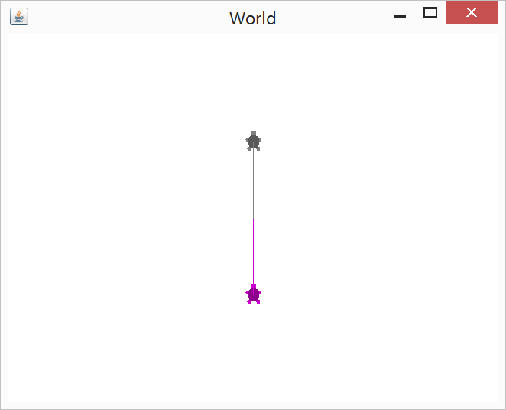
Objects and Instances

Slide 35
Using Classes to Define Objects
class Vector:
def __init__(self, x, y, z):
self.x = x
self.y = y
self.z = z
def add(self, otherVector):
self.x += otherVector.x
self.y += otherVector.y
self.z += otherVector.z
return self

Slide 36
Initialising Objects Using __init__
Vector = Vector(0, 0, 0)
----------------------------------
Will invoke:
----------------------------------
__init__(self, 0, 0, 0)
----------------------------------
And will create a new instance of Vector
----------------------------------

Slide 37
The ‘Self’ Variable
When using classes in Python, the variable ‘self’ is used extensively
It refers to the particular instance of the class (i.e., the object loaded into memory) that is being referred to
e.g., turtles[0].color vs turtles[1].color

Slide 38
Import
We often refer to classes written by other programmers
Most languages have native (or readily available) libraries
E.g., time and random classes in Python
Import time
Import random
time.sleep()
random.randomint()

Slide 39
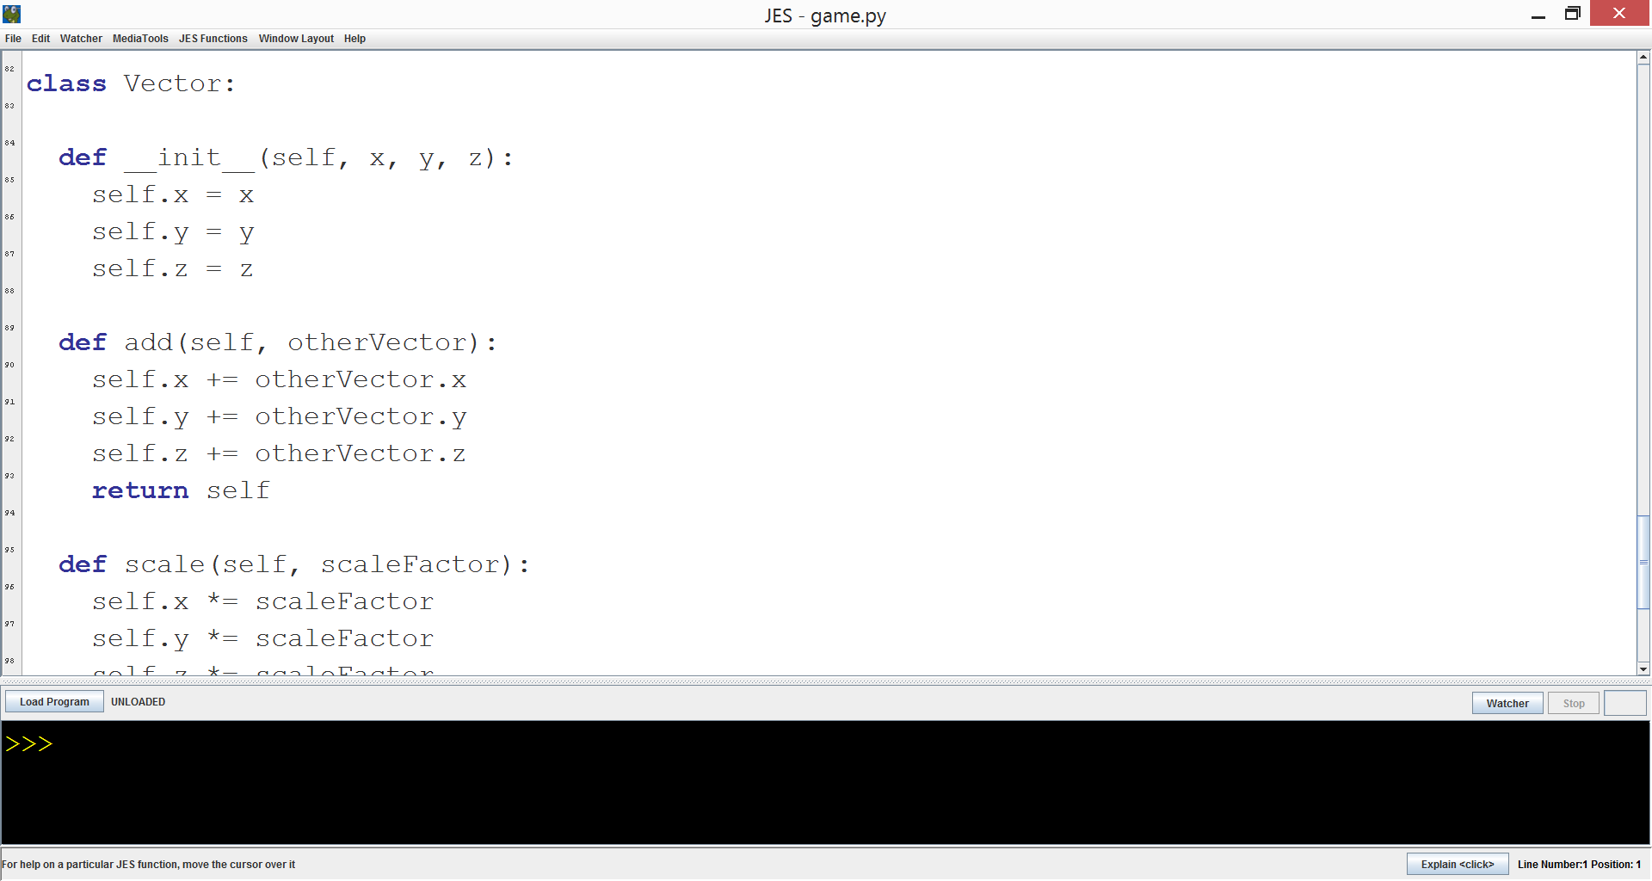
Object-Orientated Turtle Walkthrough

Slide 40
A PONG CLONE
Cross-Platform Mobile App Project

Slide 41
Demo
We will now follow the first Kivy tutorial which is available here:
http://kivy.org/docs/tutorials/pong.html

