Slide 1
Databases and Kivy II
COMP130: Game Platform Studies

Slide 2
Demo Day
All games academy students will be present their projects and works-in-progress on the demo day scheduled for:
Thursday 26th November, 9am – 11am
Both BA and BSc Students are required to attend
Not assessed
An opportunity to network with each other

Slide 3
Open Programming Lab
In response to request for more programming support:
Thursday 26th November, 12noon – 3pm
General Help and Support with Programming
Both BA and BSc Students invited
We are a community – I expect stronger students to attend as well to help support weaker students

Slide 4
GENERAL COMP130 FEEDBACK

Slide 5
General COMP130 Feedback
Most of you are on-track and where we expect you to be
The next assignment has tougher criteria and a smaller formative component – everyone has challenges to overcome
Please book meetings with me for feedback on COMP130

Slide 6
KIVY DEVELOPMENT
Kivy

Slide 7
Learning Objectives
Recognise the different components within the ‘pong’ tutorial that was completed several weeks ago
Extend the ‘pong’ tutorial to introduce new game play behaviour without explicit guidance

Slide 8
Pong Tutorial
http://kivy.org/docs/tutorials/pong.html

Slide 9
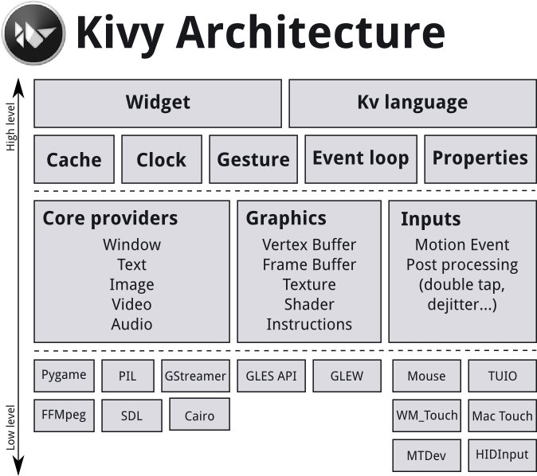
(c) PyCon 2015

Slide 10
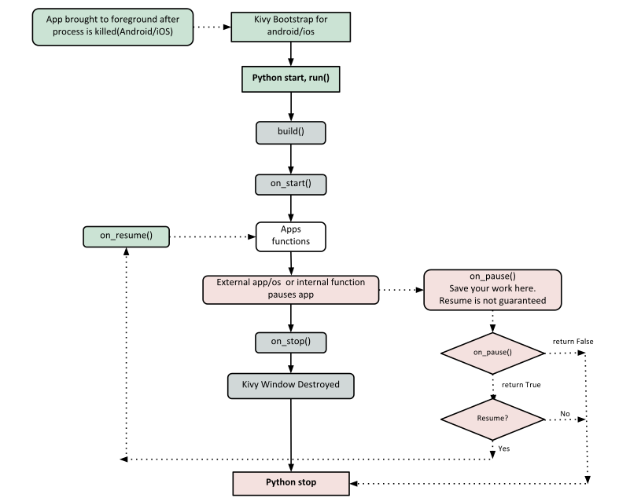
(c) PyCon 2015

Slide 11
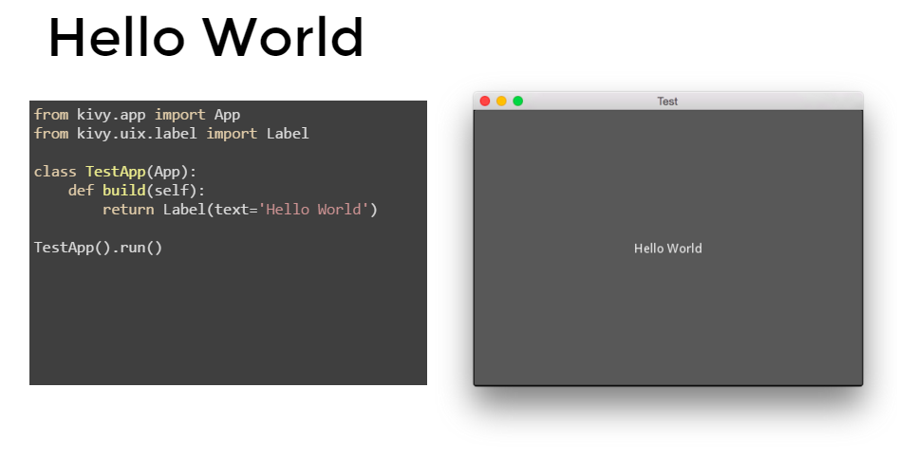
(c) PyCon 2015

Slide 12
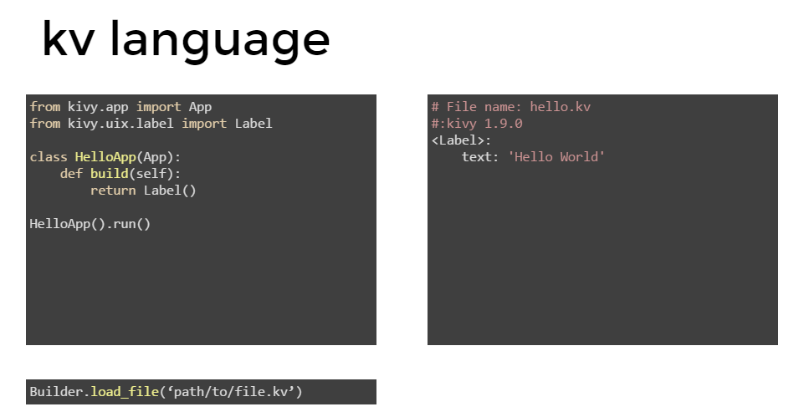
(c) PyCon 2015

Slide 13
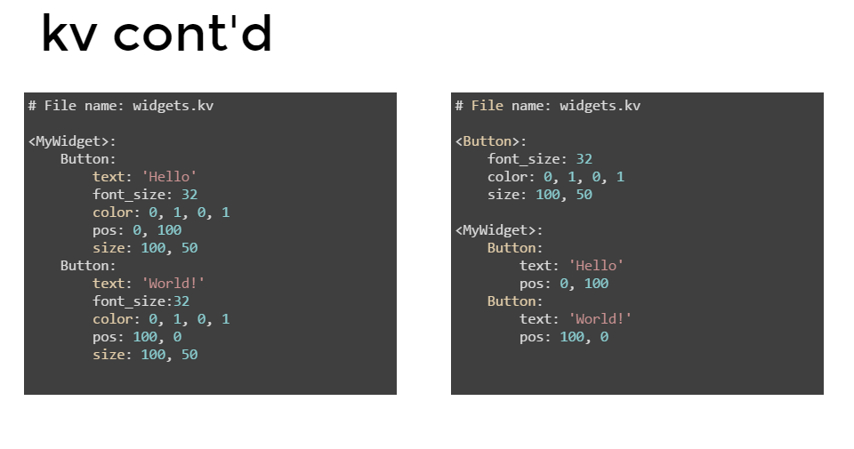
(c) PyCon 2015

Slide 14
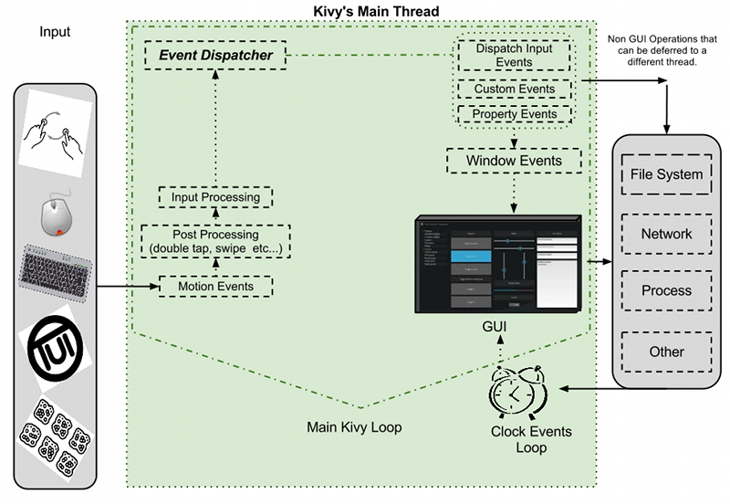
(c) PyCon 2015

Slide 15
(c) PyCon 2015

Slide 16
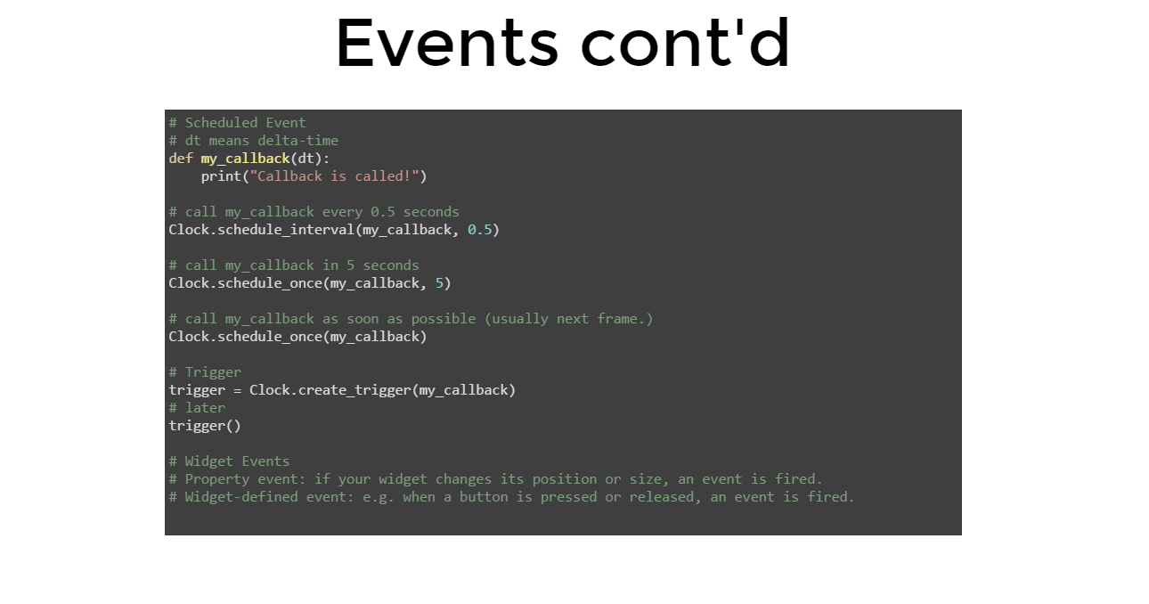
(c) PyCon 2015

Slide 17
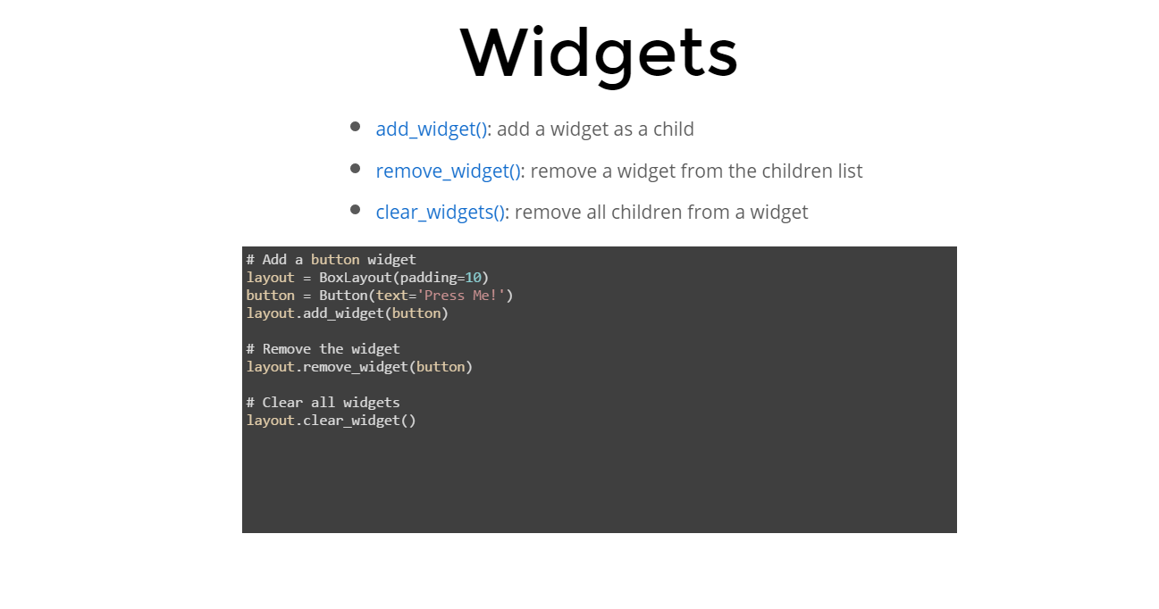
(c) PyCon 2015

Slide 18
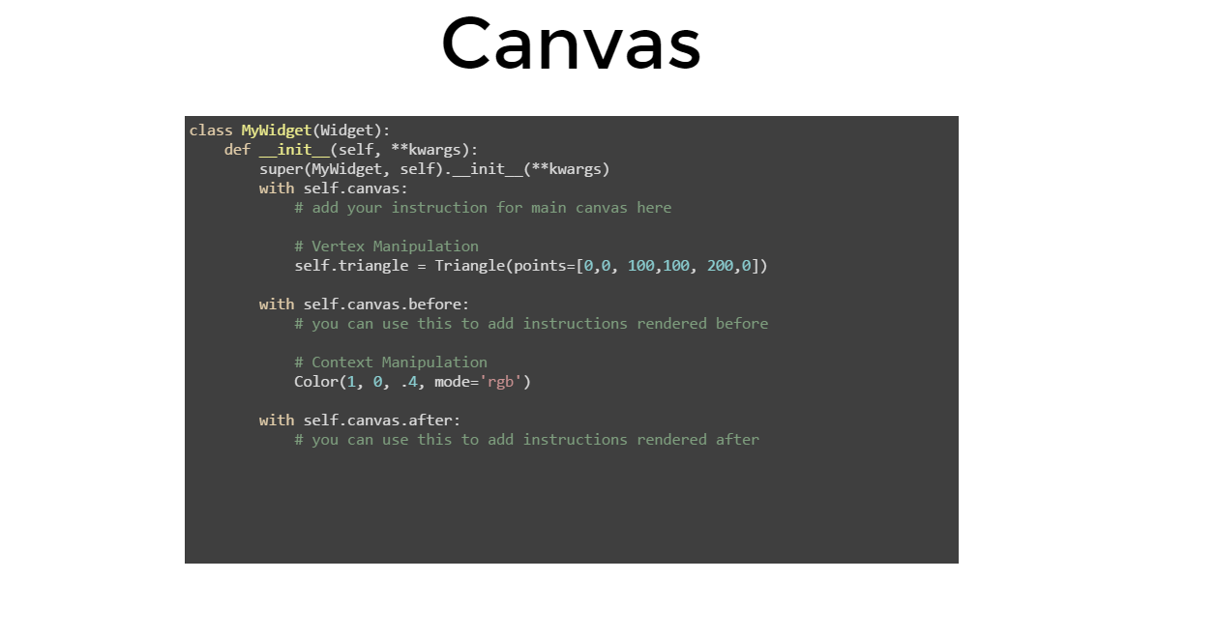
(c) PyCon 2015

Slide 19
Task
Complete the Pong tutorial if you have not already done so
Extend the behaviour of the pong tutorial to introduce a new mechanic of your choice
Continue designing your mobile app

Slide 20
Additional Guidance
Refer to the recommended textbook: Ulloa (2015)
Chapter 1 and 2 are particularly helpful
Online videos
https://www.youtube.com/playlist?list=SPdNh1e1kmiPP4YApJm8ENK2yMlwF1_edq
Wiki
https://github.com/kivy/kivy/wiki

Slide 21
Mobile App Project
Mobile App Project Review

Slide 22
Interacting with Databases
UNIX, mySQL, Apache, Python3, and Ubuntu Droplets

Slide 23
Learning Objectives
Use PuTTy to setup a database and web server on a remote cloud service using UNIX commands
Setup a database in mySQL
Be able to write code in Python that retrieves data from SQL and output on the web

Slide 24
UNIX Commands
Read Through
http://mally.stanford.edu/~sr/computing/basic-unix.html

Slide 25
UNIX Commands
Read Through
https://www.digitalocean.com/community/tutorials/how-to-set-up-an-apache-mysql-and-python-lamp-server-without-frameworks-on-ubuntu-14-04/

Slide 26
Task
Download PuTTy
Login to your Ubuntu Droplet
Your tutor will give you your URL, username, and password
Install apache, mySQL, and Python3 as instructed in the DigitalOcean tutorial
Setup a table with some basic data, and display that data on a web page

Slide 27
Coding Task I
Client-Server Project

Slide 28
Worksheet 3
Client and Server Design

