Slide 1
Web Applications and Databases with Kivy
COMP130: Game Platform Studies

Slide 2
Essay Review
Next week, we will be conducting an essay review on your architecture essay
Wednesday 2nd December, 9am – 12noon
Focusing on the Architecture essay
Forms part of your assessment
Ensure you go through a draft with tutor during Monday’s meeting to benefit from the session

Slide 3
Code Review
Next week, we will be conducting a code review on your programming projects
Friday 4th December, 2pm – 5pm
Focusing on the Tinkering projects
Forms part of your assessment
An opportunity to provide each other with feedback

Slide 4
GitHub
You must be using GitHub to deposit your code on a regular basis
It is assessed part of your work
This is because it is an important part of your workflow
You must be programming regularly, so you all must have code to deposit: it is extremely concerning that little code has been deposited so far

Slide 5
Learning Objectives
By the end of this session, you will be able to:
Recognise the structure of basic web applications
Use entity-relationship notation to describe a database system
Normalise a database system
Integrate a HTTP request and response into your Kivy app
Recognise the difference between a GET HTTP Request and a POST HTTP Request

Slide 6
WEB APPLICATIONS
Game Platform Studies

Slide 7
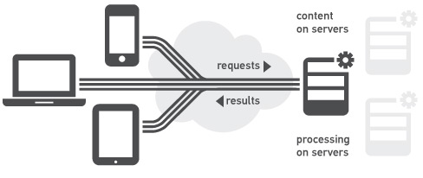
Web Application Architecture
https://www.mufin.com/products/audioid-server/

Slide 8
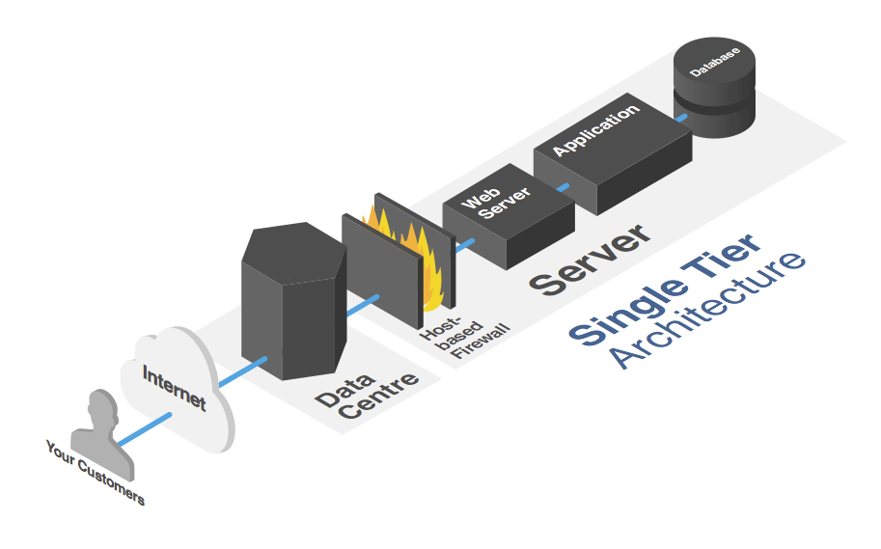
Web Application Architecture
http://www.anchor.com.au/custom-hosting-solutions/

Slide 9
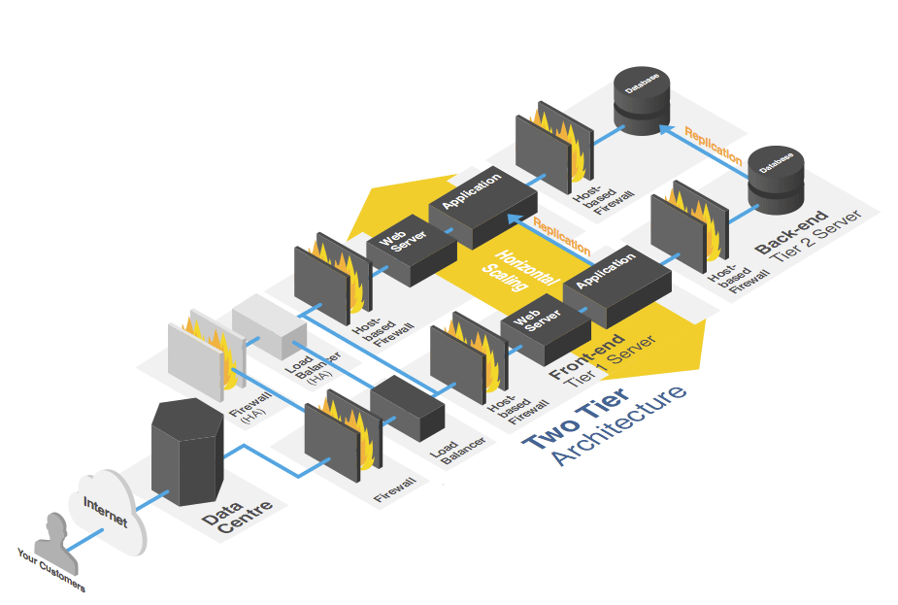
Web Application Architecture
http://www.anchor.com.au/custom-hosting-solutions/

Slide 10
Web Application Architecture
Basic interaction between a client and a server using HTTP over the Internet
Architectures can be made increasingly complex, depending on the requirements
Vertical scaling
Horizontal scaling
Additional tiers

Slide 11

Web Applications
https://www.youtube.com/watch?v=RsQ1tFLwldY

Slide 12
Exercise
Draw a diagram illustrating how your high score server will interact with your mobile app
5 minutes
Post your solution on Slack

Slide 13
Entity-relationship diagrams
Game Platform Studies

Slide 14
Definition
The Relational Database Model forms on the basis of an ERD. The ERD represents the conceptual database as viewed by users.
ERDs depict the database’s main components: entities, attributes, and relationships.

Slide 15
Basic Components of ERD
Entities:
An entity is an object of interest to the end user.
At the ER modeling level, an entity actually refers to the entity set and not to a single instance of an entity. In other words, the word entity in the ERM corresponds to a table—not to a row—in the relational environment.

Slide 16
Basic Components of ERD
Attributes:
Attributes are characteristics of entities. For example, firstname, lastname, age, etc.
Attributes always belong to an entity.

Slide 17
Basic Components of ERD
Relationships:
A relationship is an association between entities. The entities that participate in a relationship are also known as participants, and each relationship is identified by an active and passive verb that describes the relationship.
Relationships between entities always operate in both directions:
A CUSTOMER may generate many INVOICEs.
Each INVOICE is generated by one CUSTOMER.

Slide 18
ERD Representations
There are three main notations to represent and ERD
The Chen notation favors conceptual modeling.
The Crow’s Foot notation favors a more implementation-oriented approach.
The UML notation can be used for both conceptual and implementation modeling.
Because of its implementation emphasis, the Crow’s Foot notation can represent only what could be implemented.

Slide 19
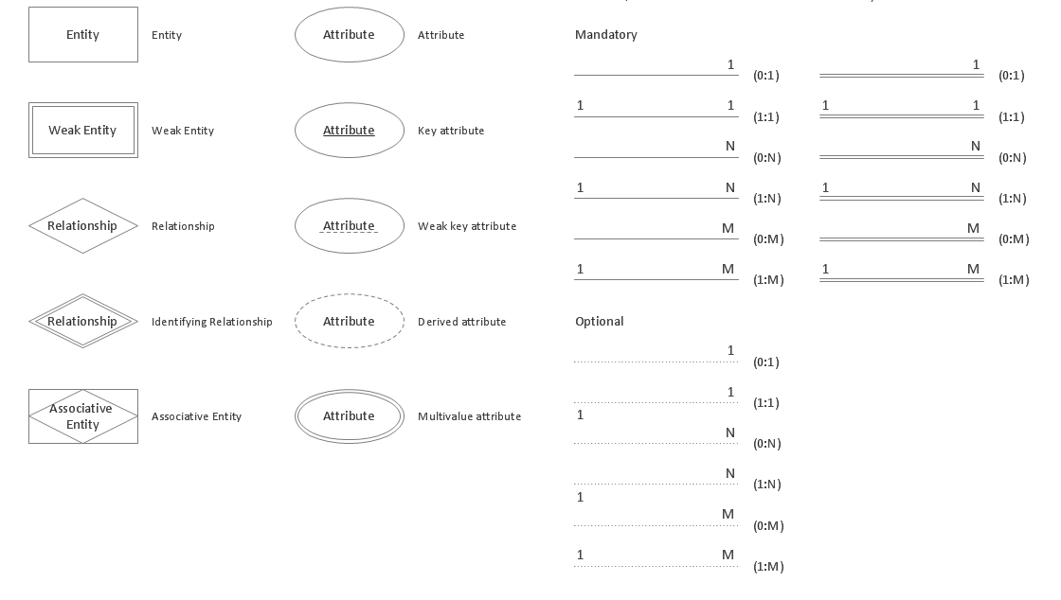
Chen Notation Symbols

Slide 20
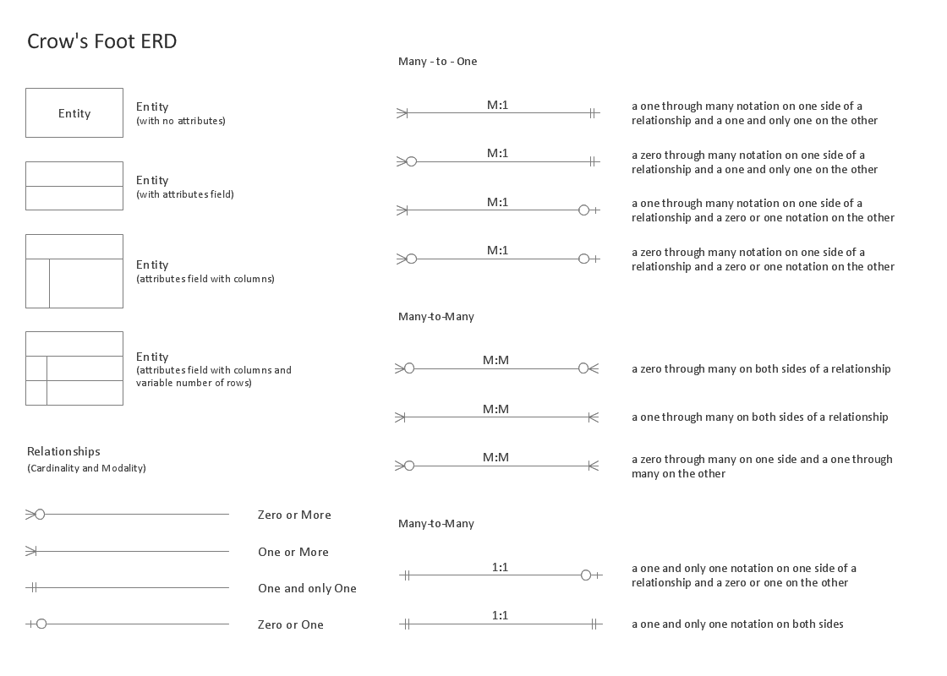
Crows Foot Notation Symbols

Slide 21
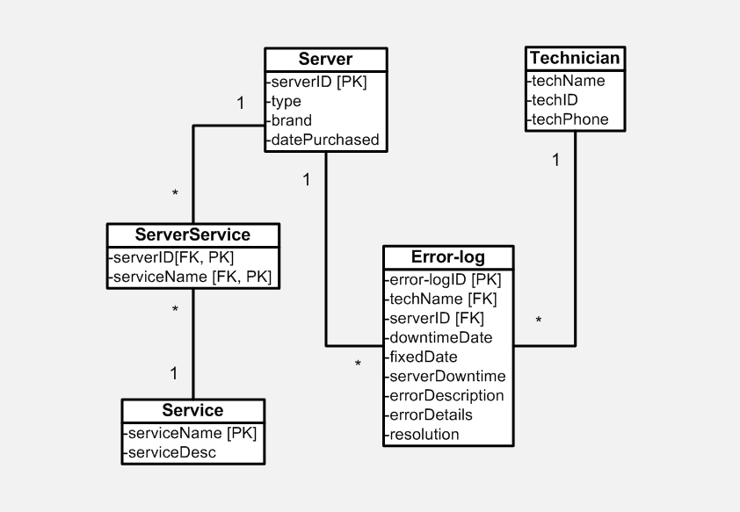
UML Notation Symbols
Primary Keys are followed by [PK]
Foreign Keys are followed by [FK]
Relationships:
Cardinality 1 for ‘One’.
Cardinality * for ‘Many’.

Slide 22
Advantages
Advantages:
ERD tells us that how many tables you need and what would be the relationship between them (you also have to do Normalization to know finally how many tables would be in your database but still first step is ERD).
ERD is simple and understandable representation of a database. It helps a lot to understand the whole database.

Slide 23
Usage
Usage:
An ERD leads to ERM, means when ever you need to build a database with tables, firstly, you need to create an ERD.
Crow’s foot notation is used most of all because its easy to understand in implementation point of view.

Slide 24
How to Solve Multi-Valued attributes (1)
Although the conceptual model can handle M:N relationships and multivalued attributes, you should not implement them in the RDBMS.
The relational table, each column/row intersection represents a single data value. So if multivalued attributes exist, the designer must decide on one of two possible courses of action:
Within the original entity, create several new attributes, one for each of the original multivalued attribute’s components.
Create a new entity composed of the original multivalued attribute’s components.

Slide 25
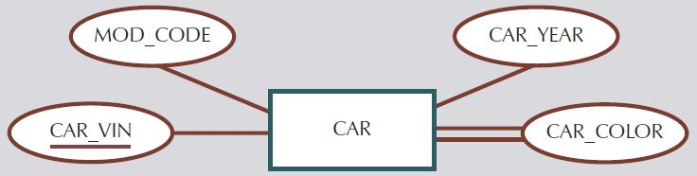
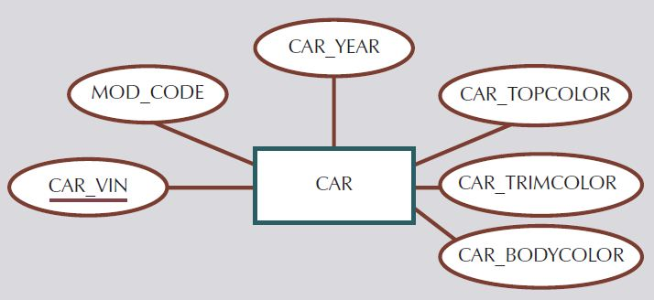
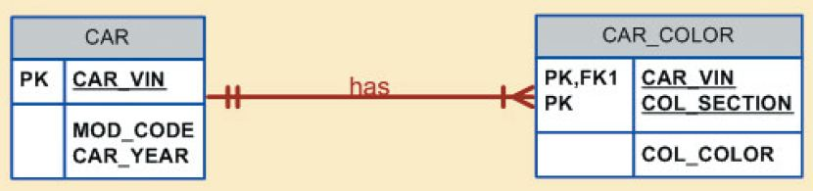
How to Solve Multi-Valued attributes (2)
Entity CAR contains a multivalued attribute CAR_COLOR.
Solution 1: (Not good)
Solution to Multi-Valued attribute by adding new attributes to CAR entity.
Solution 2: (Best)
Solution to Multi-Valued attribute by adding new entity with 1:M relation to CAR entity.

Slide 26
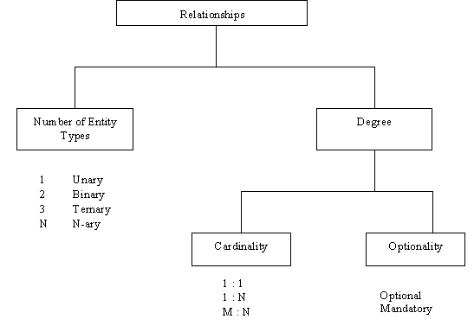
Relationships
Ways of Classifying Relationships Types
A relationship type can be classified by the number of entity types involved, and by the degree of the relationship type.
Following is a brief picture showing all types of relationships.

Slide 27
Connectivity and Cardinalities
Connectivity:
The term connectivity is used to describe the relationship classification. Just to show the relation existence and type of relation between entities.

Slide 28
Connectivity and Cardinalities
Cardinalities:
Cardinality expresses the minimum and maximum number of entity occurrences associated with one occurrence of the related entity. In the ERD, cardinality is indicated by placing the appropriate numbers beside the entities, using the format (min , max).
Cardinality / mandatory: maximum cardinality.
Modality / optional: minimum cardinality or optionality.

Slide 29
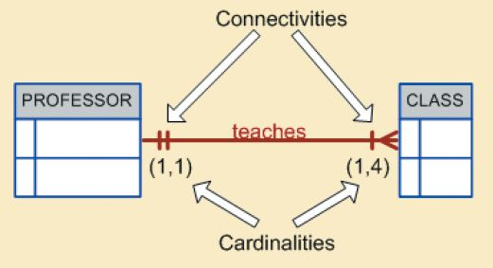
Connectivity and Cardinalities
One PROFESSOR can teach one (min 1) or more (max 4) CLASSes but each single (min 1) CLASS can be taught by one (max 1) PROFESSOR at time.

Slide 30
Database normalisation
Game Platform Studies

Slide 31
Normalization
Main objective in developing a logical data model for relational database systems is to create an accurate representation of the data, its relationships, and constraints.
To achieve this objective, must identify a suitable set of relations.

Slide 32
Normalization
Four most commonly used normal forms are first (1NF), second (2NF) and third (3NF) normal forms, and Boyce–Codd normal form (BCNF).
Based on functional dependencies among the attributes of a relation.
A relation can be normalized to a specific form to prevent possible occurrence of update anomalies.

Slide 33
Data Redundancy
Major aim of relational database design is to group attributes into relations to minimize data redundancy and reduce file storage space required by base relations.
Problems associated with data redundancy are illustrated by comparing the following Staff and Branch relations with the StaffBranch relation.

Slide 34
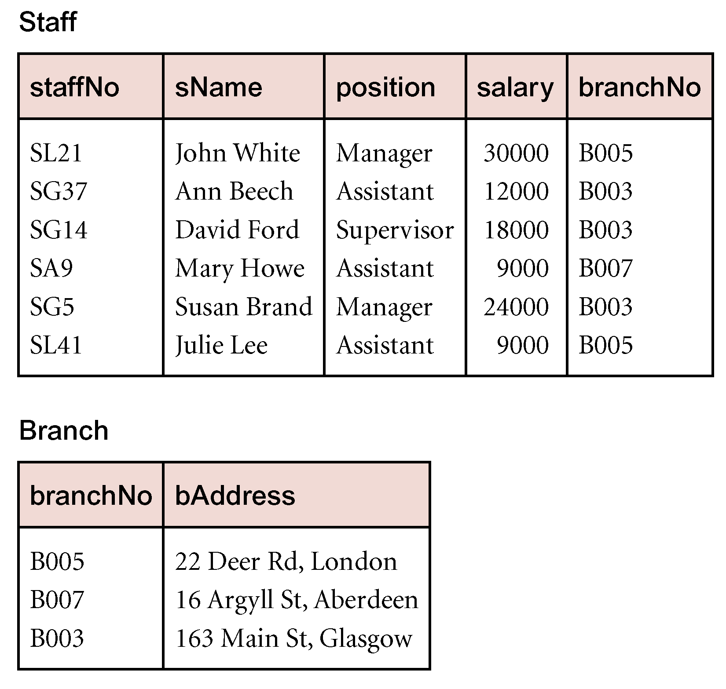
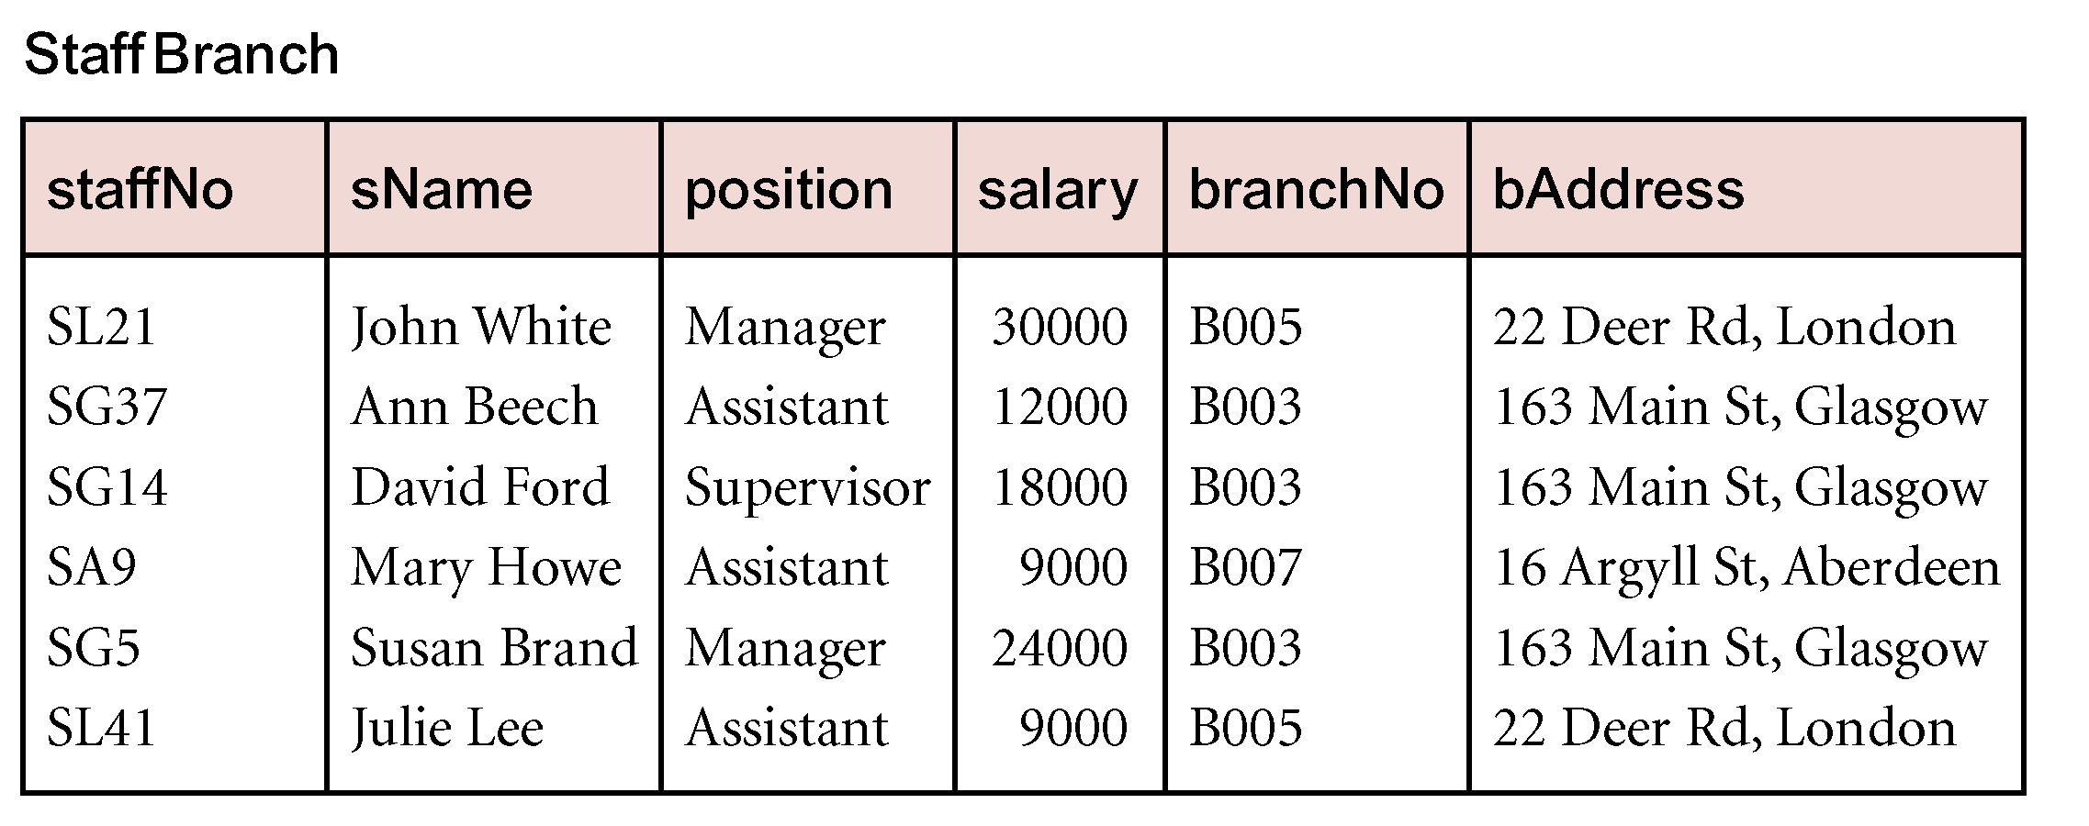
Data Redundancy

Slide 35
Data Redundancy
StaffBranch relation has redundant data: details of a branch are repeated for every member of staff.
In contrast, branch information appears only once for each branch in Branch relation and only branchNo is repeated in Staff relation, to represent where each member of staff works.

Slide 36
Update Anomalies
Relations that contain redundant information may potentially suffer from update anomalies.
Types of update anomalies include:
Insertion
Deletion
Modification.

Slide 37
Properties of Decomposition
Two important properties of decomposition:
- Lossless-join property enables us to find any instance of original relation from corresponding instances in the smaller relations.
- Dependency preservation property enables us to enforce a constraint on original relation by enforcing some constraint on each of the smaller relations.

Slide 38
Functional Dependency
Main concept associated with normalization.
Functional Dependency
Describes relationship between attributes in a relation.
If A and B are attributes of relation R, B is functionally dependent on A (denoted A  B), if each value of A in R is associated with exactly one value of B in R.

Slide 39
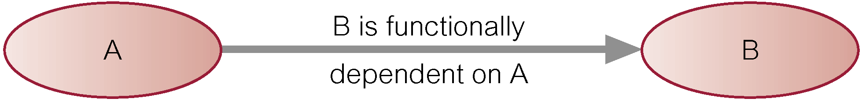
Functional Dependency
Property of the meaning (or semantics) of the attributes in a relation.
Diagrammatic representation:
Determinant of a functional dependency refers to attribute or group of attributes on left-hand side of the arrow.

Slide 40
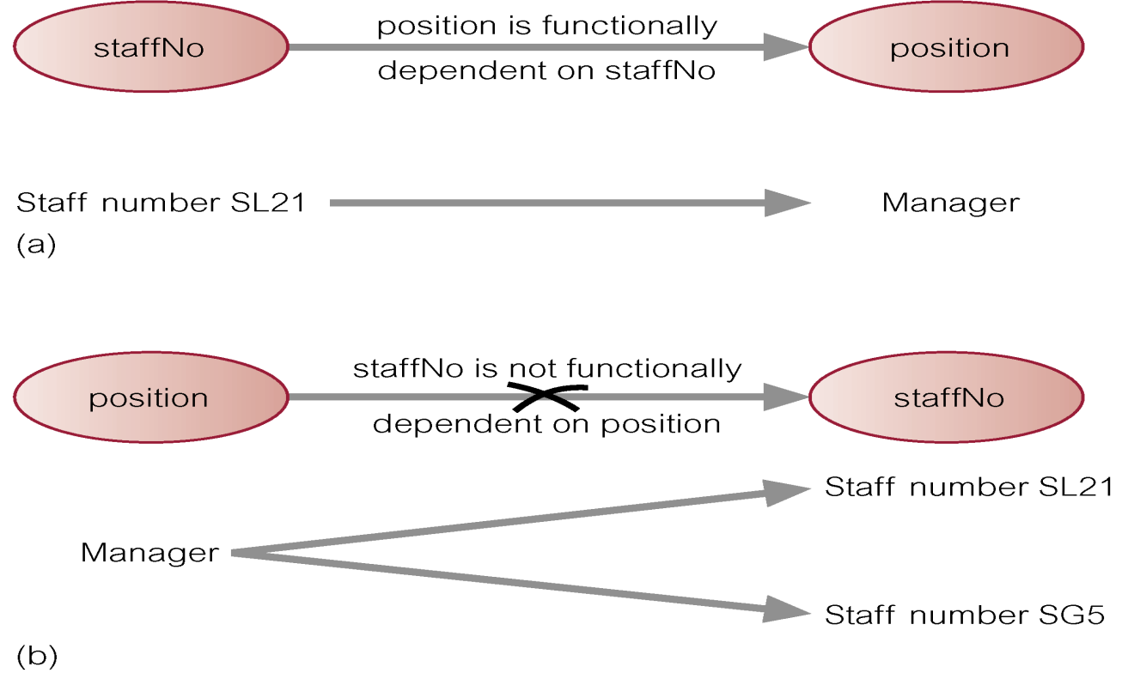
Example - Functional Dependency

Slide 41
Functional Dependency
Main characteristics of functional dependencies used in normalization:
have a 1:1 relationship between attribute(s) on left and right-hand side of a dependency;
hold for all time;
are nontrivial.

Slide 42
Functional Dependency
Complete set of functional dependencies for a given relation can be very large.
Important to find an approach that can reduce set to a manageable size.
Need to identify set of functional dependencies (X) for a relation that is smaller than complete set of functional dependencies (Y) for that relation and has property that every functional dependency in Y is implied by functional dependencies in X.

Slide 43
Functional Dependency
Set of all functional dependencies implied by a given set of functional dependencies X called closure of X (written X⁺).
Set of inference rules, called Armstrong’s axioms, specifies how new functional dependencies can be inferred from given ones.

Slide 44
Functional Dependency
Let A, B, and C be subsets of the attributes of relation R. Armstrong’s axioms are as follows:
1. Reflexivity
If B is a subset of A, then A → B
2. Augmentation
If A → B, then A,C → B,C
3. Transitivity
If A → B and B → C, then A → C

Slide 45
The Process of Normalization
Formal technique for analyzing a relation based on its primary key and functional dependencies between its attributes.
Often executed as a series of steps. Each step corresponds to a specific normal form, which has known properties.
As normalization proceeds, relations become progressively more restricted (stronger) in format and also less vulnerable to update anomalies.

Slide 46
Unnormalized Form (UNF)
A table that contains one or more repeating groups.
To create an unnormalized table:
transform data from information source (e.g. form) into table format with columns and rows.

Slide 47
First Normal Form (1NF)
A relation in which intersection of each row and column contains one and only one value.

Slide 48
UNF to 1NF
Nominate an attribute or group of attributes to act as the key for the unnormalized table.
Identify repeating group(s) in unnormalized table which repeats for the key attribute(s).

Slide 49
UNF to 1NF
Remove repeating group by:
entering appropriate data into the empty columns of rows containing repeating data (‘flattening’ the table).
Or by
placing repeating data along with copy of the original key attribute(s) into a separate relation.

Slide 50
Second Normal Form (2NF)
Based on concept of full functional dependency:
A and B are attributes of a relation,
B is fully dependent on A if B is functionally dependent on A but not on any proper subset of A.
2NF - A relation that is in 1NF and every non-primary-key attribute is fully functionally dependent on the primary key.

Slide 51
1NF to 2NF
Identify primary key for the 1NF relation.
Identify functional dependencies in the relation.
If partial dependencies exist on the primary key remove them by placing them in a new relation along with copy of their determinant.

Slide 52
Third Normal Form (3NF)
Based on concept of transitive dependency:
A, B and C are attributes of a relation such that if A → B and B → C,
then C is transitively dependent on A through B. (Provided that A is not functionally dependent on B or C).
3NF - A relation that is in 1NF and 2NF and in which no non-primary-key attribute is transitively dependent on the primary key.

Slide 53
2NF to 3NF
Identify the primary key in the 2NF relation.
Identify functional dependencies in the relation.
If transitive dependencies exist on the primary key remove them by placing them in a new relation along with copy of their determinant.

Slide 54
General Definitions of 2NF and 3NF
Second normal form (2NF)
A relation that is in 1NF and every non-primary-key attribute is fully functionally dependent on any candidate key.
Third normal form (3NF)
A relation that is in 1NF and 2NF and in which no non-primary-key attribute is transitively dependent on any candidate key.

Slide 55
Get and post with kivy
Kivy

Slide 56
Live Coding: Processing Arguments in CGI
https://docs.python.org/2/library/cgi.html#using-the-cgi-module

Slide 57
Exercise: Kivy HTTP Requests
http://kivy.org/docs/api-kivy.uix.button.html

Slide 58
Exercise: Kivy HTTP Requests
http://kivy.org/docs/api-kivy.network.urlrequest.html

Slide 59
Task
Create a basic Kivy app with a button and a label
When you press the button, insert something into your database and then display the output
You have 20 minutes.

Slide 60
FINAL REMARKS
COMP130

Slide 61
Additional Guidance
Refer to the recommended textbook: Connolly and Begg (2015)
Chapters 2 and 3 are particularly helpful
Online videos
https://www.youtube.com/watch?v=9o_4lsOkQ3gWiki
https://www.youtube.com/watch?v=576WwU7xlWU
Web Resources
http://www.w3schools.com/tags/ref_httpmethods.asp

