Slide 1
Workshop Week 2 Rule-based Agents
COMP250: Artificial Intelligence

Slide 2
TL;DW
This week’s video lectures cover:
Agent-based abstractions of AI tasks
Rule-based AI
Finite state machines
If you haven’t watched them yet, please do soon!
(Future workshops will assume you have watched the video lectures in advance)

Slide 3
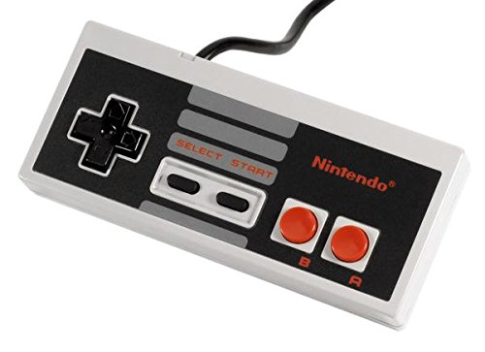
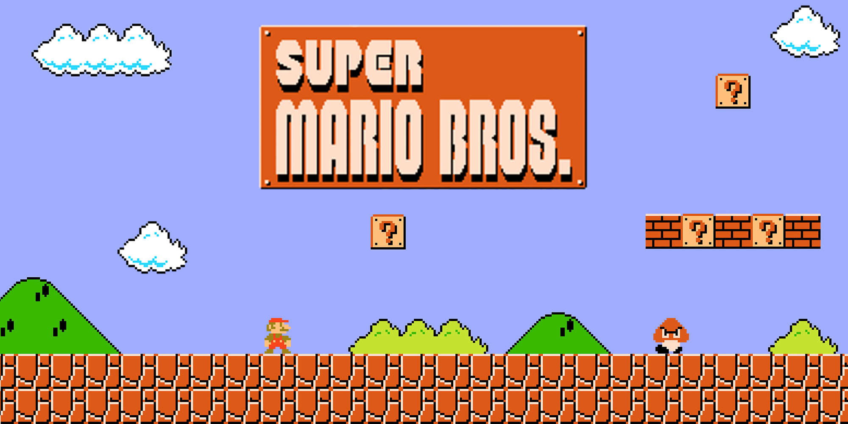
Actuators
Move left/right
Jump
Sprint
Crouch
Shoot fireball
Performance
Reach the end of the level
Environment
Game world
Sensors
Position of ground, enemies, coins, …

Slide 4
Sensing the world
A common way for game agents to sense the world is using raycasts
Cast a ray (straight line) from the agent out into the world
Test if the ray hits a collider
Unity: Physics.Raycast (for 3D), Physics2D.Raycast (for 2D)

Slide 5
Distance
Direction
Origin
Layer mask

Slide 6
Designing AI to play Mario
What might a rule-based AI for Mario look like?
E.g. a list of if-then rules like “if (enemy to the right) then {move right and jump}”
Discuss in breakout groups
Return in 10 minutes and share your thoughts

Slide 7
Implementing AI to play Mario
Let’s put your ideas into action!
Fork and clone the sample project (link on LearningSpace and in chat)
Rejoin your breakout groups
One of you share your screen, the rest of you mob program
Code your AI logic into the Update method on the AIMarioController.cs script
Reconvene here at 5:30pm and we’ll see whose Mario can get the furthest!
I’ll be popping into your breakout rooms to see how you’re getting on

