Slide 1
Research PRACTICE
COMP320
Statistical Data Analysis II

Slide 2
Information Presentation
Illustrating Your Findings

Slide 3
Information Presentation
There are various techniques for reformatting and reducing data to make the analysis more interpretable or to illustrate a key point
Graphical representations will also assist in decision making and reinforce the justification for those decisions --- e.g., has a hypothesis been falsified? To what extent is it clearly falsified?
An overall picture of the data can be gleaned and initial conclusions drawn
Notes:
3

Slide 4
Information Presentation
It is important to select the most effective ways to illustrate your findings in the dissertation
Your communication skills are under assessment --- keep all graphical depiction meaningful to justifying your analysis and/or your intellectual decisions
Provides an overall picture of the data underlying your findings to reach and support your conclusions
Be wary of delegating charts solely to important data:
Depictions can distort message of original data
Concise, but often lacks precision
Ensure adequate support in body of text
Leverage explicit references (e.g., “as shown in Figure 1”)
Notes:
4

Slide 5
Information Presentation
There are many ways of creating graphs in R and Rstudio!
We will use a library called ggplot2, which you may need to install and load
> install.packages("ggplot2", dependencies=TRUE)
> library(ggplot2)
Among its functions should be a qplot(), which covers most of the common charts.
Notes:
5

Slide 6
Information Presentation
Common formats for presenting information include:
Bar Chart
Histogram
Frequency Polygon & Ogive
Pie Chart
Scatter Plot
Box Plot

Slide 7
Do You Know Your Charts and Graphs?
Which chart or graph is associated with which description?
Frequency distribution |  | A circular chart with slices presenting percentage breakdown
Histogram |  | A summary of data presented as classes and frequencies
Ogive |  | A two-dimensional graph of data from two variables
Pie chart |  | A cumulative frequency polygon
Scatter plot |  | A vertical bar chart presenting a frequency distribution
Notes:
7

Slide 8
Bar Chart
A bar chart or bar graph is a chart or graph that presents categorical data with rectangular bars with heights or lengths proportional to the values that they represent.
The bars can be plotted vertically or horizontally.
Bar charts are useful for displaying data that are classified into nominal or ordinal categories in order to make comparisons.

Slide 9
Bar Chart
To a simple bar chart:
> qplot(dat$GENDER, geom="bar", stat="identity")
The geom argument refers to the type of chart that qplot will produce.
The stat argument is depreciated, but useful when no statistical analysis or summary statistic like a mean is needed. For a bar chart, “identify” defaults to a count.

Slide 10
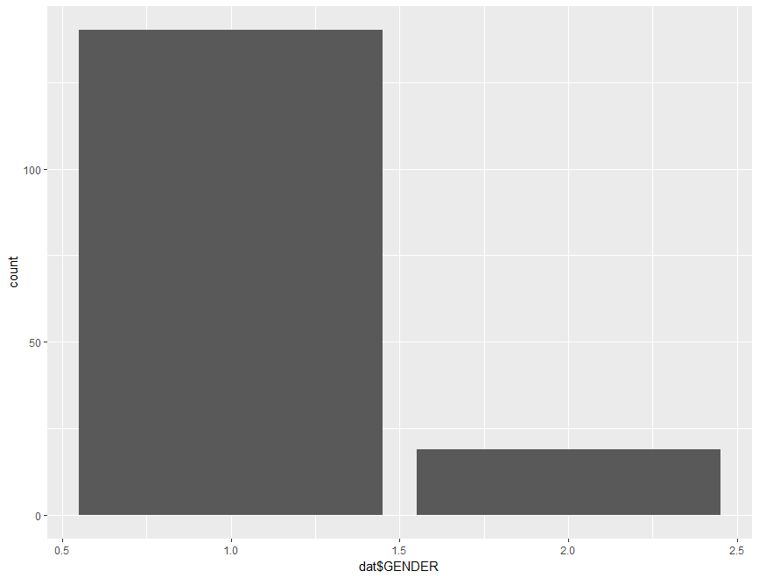
Bar Chart

Slide 11
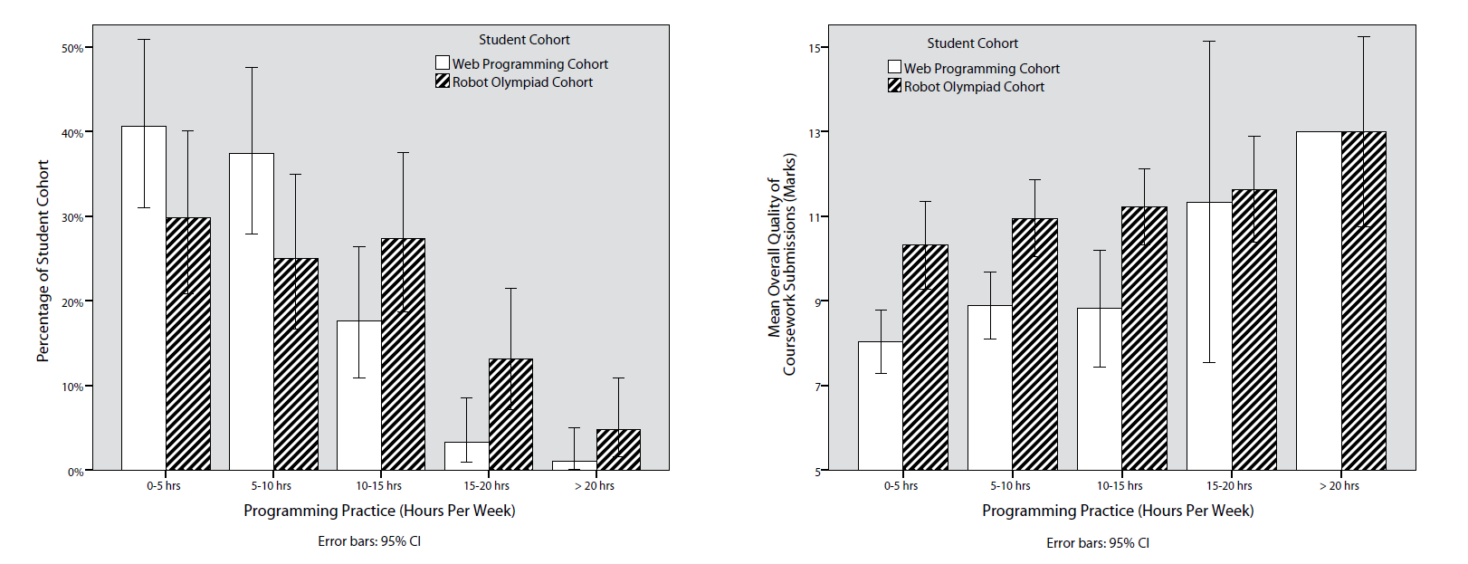
Bar Chart
Bar charts can be made much more complex using other ggplot functions:
http://www.cookbook-r.com/Graphs/Bar_and_line_graphs_(ggplot2)/

Slide 12
Histogram
A type of vertical bar chart used to depict a frequency distribution
Construction steps:
Label the x axis with the class endpoints
Label the y axis with the frequencies
Label the chart with an appropriate title, i.e. not ‘bar chart’
A quick look at the histogram reveals which class intervals produce the highest frequency totals
E.g. which age group most often enrols in undergraduate computing courses?
Notes:
12

Slide 13
Histogram
To display a frequency table, examining birth years from 1975 to 2000 in 5-year intervals, use the following command:
> summary(cut(dat$BIRTH_YEAR, c(1975,seq(1980,2000,5)), include.lowest=T,right=FALSE))
To display a histogram based on this data:
> hist(dat$BIRTH_YEAR, xlab="Year of Birth", ylab="Count", main="Breakdown of Birth Years", breaks=5)
Notes:
13

Slide 14
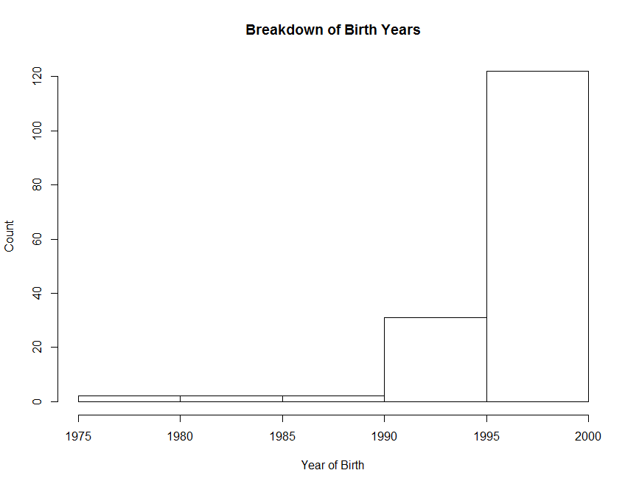
Histogram
Notes:
14

Slide 15
Frequency Polygon
A graph in which line segments connecting the dots depict a frequency distribution
Construction steps:
Label the x axis with the class endpoints
Label the y axis with the frequencies
Plot a dot for the frequency value at the midpoint of each class interval (different to Ogive)
Connect these dots with a line
Notes:
15

Slide 16
Frequency Polygon
To display a histogram of students’ conscientiousness, use the following command:
> ggplot(dat, aes(CONSCIENTIOUSNESS), stat="count") +
geom_freqpoly(binwidth = 20)
Notes:
16

Slide 17
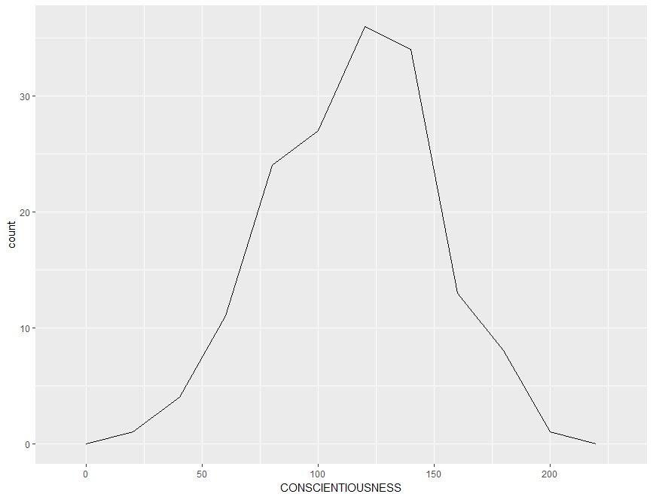
Frequency Polygon
Notes:
17

Slide 18
Ogive
A Cumulative Frequency (CF) polygon
Construction steps:
Label the x axis with the class endpoints
Label the y axis with the cumulative frequencies
A dot of ‘0’ is placed at the beginning of the first class
Mark a dot for the CF value at the end of each class interval
Connect these dots with a line
Notes:
18

Slide 19
Ogive
To construct an ogive, you need to format the data into cumulative frequencies:
> cumfreq0 <- c(0, cumsum(table(cut(dat$CONSCIENTIOUSNESS, seq(0, 240, by=20), right=FALSE))))
Then plot the chart based on this data:
> plot(seq(0, 240, by=20), cumfreq0, main="Range of Conscientiousness", xlab="Level of Conscientiousness", ylab="Cumulative Frequency") + lines(seq(0, 240, by=20), cumfreq0)
Notes:
19

Slide 20
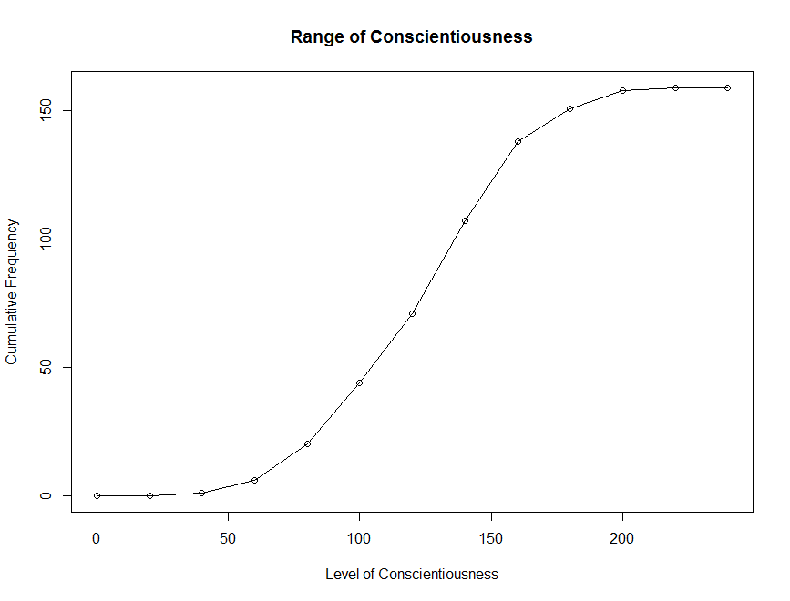
Ogive
Notes:
20

Slide 21
Pie Chart
A circular depiction of data where the area of the whole pie = 100% of the data being studied. Slices represent a % breakdown of each of the values
Business uses: e.g. for depicting budget categories, market share, time and resource allocation
Generally more difficult to interpret the size of the slices compared to the bars in a histogram. But- usage of ‘%’ can clarify slice size
Notes:
21

Slide 22
Pie Chart
Construction steps:
Convert each toothpaste brand amount to a proportion by dividing each individual amount by the total
E.g. 102 / 200 = 0.51
Convert each proportion to degrees by multiplying by 360°
E.g. 0.51 * 360° = 183.6°
Notes:
22

Slide 23
Pie Chart
To construct a pie chart, you first need to label the categories:
> Lbls <- c("Prior Experience with \na Pre-University Qualification", "Prior Experience without \na Pre-University Qualification", "No Prior Experience")
Then plot the pie chart based on this data:
> pie(table(dat$PRIOR_EXP), labels = lbls)
Notes:
23

Slide 24
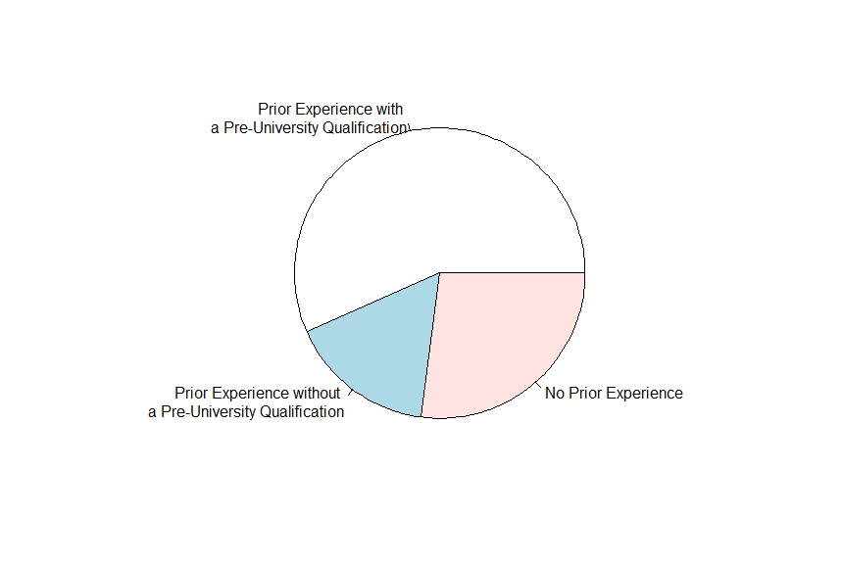
Pie Chart
Notes:
24

Slide 25
Scatter Plot
Illustrates the relationship between two variables based on its underlying data points
E.g. the link between neurotic personality traits and programming anxiety
Scatter graph - a two-dimensional graph plot of pairs of points from two variables
Relationships will vary in strength, line of best fit used to indicate magnitude through slope
Notes:
25

Slide 26
Scatter Plot
For the line of best fit, going to use the rlm() function for a robust linear model to mitigate the influence of dataset outliers:
> library(MASS)
Then using the qplot() command with a combination of geom arguments including “point” (the scatter dots) and “smooth” (the line of best fit.
> qplot(dat$ANXIETY, dat$NEUROTICISM, geom = c("point", "smooth"), method="rlm", main="Correlation between Anxiety and Neuroticism", xlab="Anxiety", ylab="Neuroticism")
Try without the method argument. What happens?
Notes:
26

Slide 27
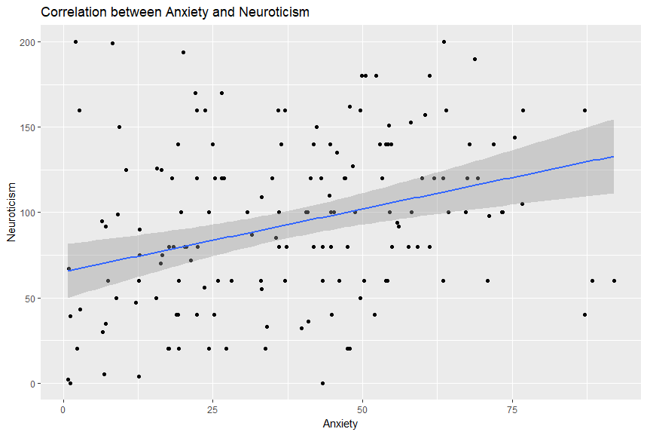
Scatter Plot
Notes:
27

Slide 28
Box Plot
Illustrates proportions of a distribution, and useful for comparing groups
Looking “down” on the distribution from the top, like viewing hills on a plane
Lines outside the box represent range
Box represents the lower and upper quartiles
Line inside the box represents the median
Notes:
28

Slide 29
Pie Chart
Wrapping up commands into a single line:
> qplot(factor(dat$PRIOR_EXP, labels=c("Prior Experience with \na Pre-University Qualification", "Prior Experience without \na Pre-University Qualification", "No Prior Experience")), dat$ANXIETY, geom = "boxplot", main="Anxiety of Students from Different Backgrounds", xlab="Background", ylab="Level of Programming Anxiety")
Take note of the factor() command --- useful for distinguishing between different nominal characteristics or members of experimental and non-experimental groups!
The labels struct is setup in ascending order.
Notes:
29

Slide 30
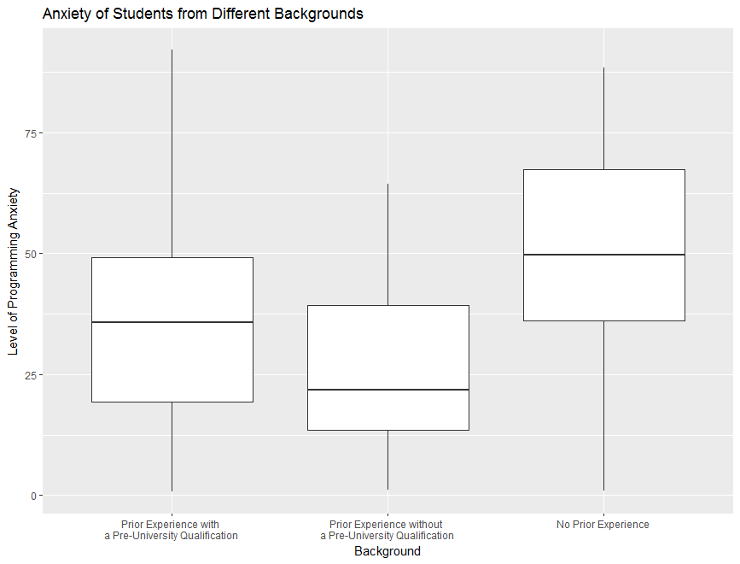
Box Plot
Notes:
30

