Slide 1
Week 3: Geometry II Part 4: Combining Transformations
COMP270: Mathematics for 3D Worlds and Simulations
Notes:
In this final part of this week’s lecture, we’re going to be putting together what we looked at in the last two sections, and combining the transformations we’ve been discussing.

Slide 2
Objectives
Calculate the result of applying successive transformation matrices using matrix multiplication
Recall the concept of an inverse and understand how it relates to matrices
Notes:
We’ll see how to apply successive transforms using matrices without having to do them one at a time to each point, using matrix multiplication. We’ll also consider what it means to invert a matrix, and revisit the idea of an identity that we met in week 1.

Slide 3

Recap: affine transformations
Translation: $T=\left(\begin{matrix}1 & 0 & t_{x} \\ 0 & 1 & t_{y} \\ 0 & 0 & 1\end{matrix}\right)$
Rotation: $R_{θ}=\left(\begin{matrix}\cos{θ} & −\sin{θ} & 0 \\ \sin{θ} & \cos{θ} & 0 \\ 0 & 0 & 1\end{matrix}\right)$
Scale: $S=\left(\begin{matrix}s_{x} & 0 & 0 \\ 0 & s_{y} & 0 \\ 0 & 0 & 1\end{matrix}\right)$
Shear: $H_{x}=\left(\begin{matrix}1 & λ_{x} & 0 \\ 0 & 1 & 0 \\ 0 & 0 & 1\end{matrix}\right),H_{y}=\left(\begin{matrix}1 & 0 & 0 \\ λ_{y} & 1 & 0 \\ 0 & 0 & 1\end{matrix}\right)$
Notes:
In the last video, we met the four main kinds of affine transformation, which are:
Translation, for which we had to add an extra dimension to our matrix and use homogeneous coordinates to apply the transformation;
Rotation about an angle theta from the x axis, written here also in homogeneous form for consistency,
Scale, which can be either uniform or non-uniform,
And shear, which can be applied parallel to the x or y axis.

Slide 4
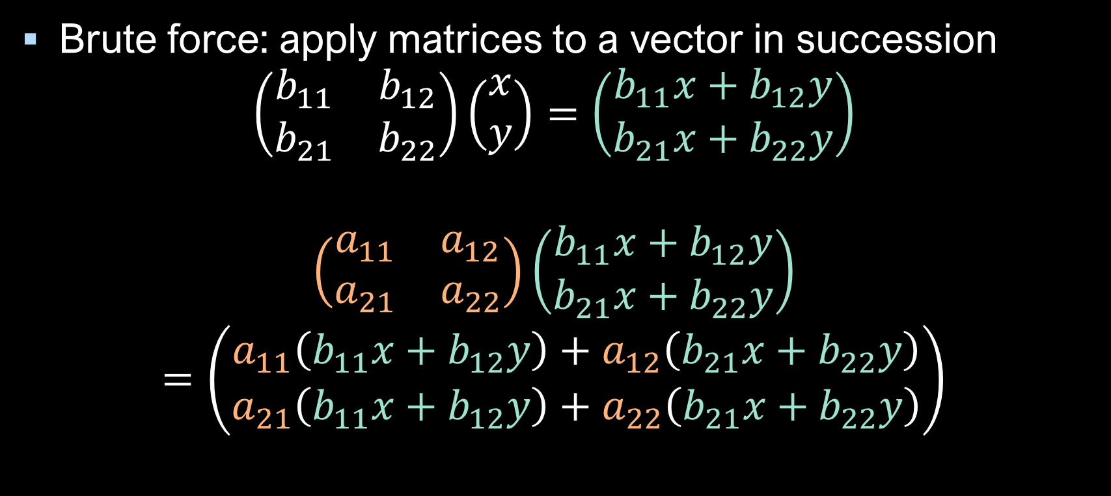
Combining transformations
Brute force: apply matrices to a vector in succession
$$\left(\begin{matrix}b_{11} & b_{12} \\ b_{21} & b_{22}\end{matrix}\right)\left(\begin{matrix}x \\ y\end{matrix}\right)=\left(\begin{matrix}b_{11}x+b_{12}y \\ b_{21}x+b_{22}y\end{matrix}\right)$$
$$\left(\begin{matrix}a_{11} & a_{12} \\ a_{21} & a_{22}\end{matrix}\right)\left(\begin{matrix}b_{11}x+b_{12}y \\ b_{21}x+b_{22}y\end{matrix}\right)$$
$$=\left(\begin{matrix}a_{11}\left(b_{11}x+b_{12}y\right)+a_{12}\left(b_{21}x+b_{22}y\right) \\ a_{21}\left(b_{11}x+b_{12}y\right)+a_{22}\left(b_{21}x+b_{22}y\right)\end{matrix}\right)$$
Notes:
Now, what if we wanted to apply more than one transform to a vector? We could take the brute force approach,
And simply apply the matrices to the vector one by one, starting with a matrix B,
And then applying another matrix, A, to the result of that,
like so (I’m using 2x2 matrices here as they take up less space, but the same principle applies in any dimension). This works, but it’s rather labour intensive and involves a lot of calculations, especially if we want to apply the same combination of transforms to multiple points or vectors, as we generally do when dealing with geometry. We can actually accumulate all the separate transforms in a single matrix;

Slide 5

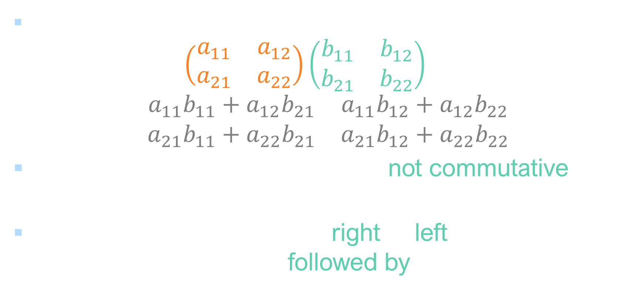







Matrix multiplication
2×2 matrices: $\left(\begin{matrix}a_{11} & a_{12} \\ a_{21} & a_{22}\end{matrix}\right)\left(\begin{matrix}b_{11} & b_{12} \\ b_{21} & b_{22}\end{matrix}\right)$
$$=\left(\begin{matrix}a_{11}b_{11}+a_{12}b_{21} & a_{11}b_{12}+a_{12}b_{22} \\ a_{21}b_{11}+a_{22}b_{21} & a_{21}b_{12}+a_{22}b_{22}\end{matrix}\right)$$
Note that matrix multiplication is not commutative: in general $AB≠BA$
Transform order goes from right to left: $AB$ represents doing $B$ followed by $A$
$$b_{11}$$
$$b_{12}$$
$$b_{21}$$
$$b_{22}$$
$$a_{11}b_{11}+a_{12}b_{21}$$
$$a_{11}b_{12}+a_{12}b_{22}$$
$$a_{21}b_{11}+a_{22}b_{21}$$
$$a_{21}b_{12}+a_{22}b_{22}$$
Notes:
To do this, we use the matrix multiplication operation.
This works essentially the same way as multiplying a vector with a matrix;
we just need to do it for each row of the left-hand matrix with each column of the right-hand one. This combined matrix can then be applied to a vector to give the same result as from applying the matrices in succession. You might have noticed that, on the previous slide, I applied the matrix b first and then a; that’s because, in general,
Matrix multiplication is not commutative, and applying them in different orders gives different results; we’ll take a look at an example on the next slide.
Also, because we apply the transformations by putting the vector on the right, the order in which transforms are applied when they’re combined using matrix multiplication goes from right to left; the calculations on this slide and the previous one both show matrix B applied first, then A.

Slide 6

Transformation order
Rotate
Translate
Translate
Rotate
Notes:
To see the order of transformations in action, let’s bring our sheep in, and first
rotate her (though roughly 45 degrees about the origin),
And then translate to the right.
Now, if we start again,
But this time first translate by the same amount as before,
And then rotate, you can see we get a slightly different result, because the rotation is still being applied about the origin. For this reason, it’s generally good practice to apply translations last; scaling is usually done first, as it doesn’t change the coordinate frame of the object – if you’re not sure what that means, then

Slide 7

Local coordinates
Define a set of axes relative to the object
Object position = translation of local origin relative to scene origin
Object rotation = angle between local and scene $x$-axes
Question: How can we rotate an object about its own centre if it’s not located at the origin?
Notes:
Basically, if you think of the object as having its own local axes,
relative to which all its points are specified, which will generally be the case for any game object you work with,
Then its position in the scene will be given by the position of the origin of these local axes relative to the scene origin,
And the rotation will be the angle that the local x-axis makes with the scene x-axis. Clearly, changing either of these will change the alignment of the local axes with the scene axis, even if the object starts at the scene origin, but
applying a scale doesn’t.
Here’s a question: what do we do if we want to rotate an object about its own axis when it’s not located at the origin, which will be quite likely given that things often tend to move around in games? I’m going to leave you to think about that for a little while and come back to it later in this video.

Slide 8

Matrix multiplication: general case
In order to multiply two matrices, $A$ and $B$, the number of columns in $A$ must equal the number of rows in $B$
If $A$ is $m×n$ and $B$ is $n×p$, $AB$is an $m×p$ matrix
Square matrices are closed under multiplication: if we multiply an $n×n$ matrix by an $n×n$ matrix, we get an $n×n$ matrix
Multiplying an $m×n$ matrix by a vector in $ℝ^{n}$ is equivalent to multiplying an $m×n$ matrix with an $n×1$ ‘matrix’
The result is a $m×1$ ‘matrix’, i.e. a vector in $ℝ^{m}$
Get the same type of object out as we put in.
Notes:
We can generalise matrix multiplication to matrices of any size, as long as
The number of columns in the left-hand one is the same as the number of rows in the right-hand one – otherwise we can’t actually perform the multiplication.
If the sizes match, then the result will have the same number of rows as the left-hand matrix, and the same number of columns as the right-hand one;
So multiplying square matrices will always give another square matrix of the same size;
this behaviour of returning the same type of object as the ones that were passed as input is known as being ‘closed’ under the operation.
Notice that applying an m by n matrix to an n-dimensional vector also fits this rule; we can think of a vector in Rn as an n by 1 matrix,
with the result being an m x 1 matrix.

Slide 9

Matrix multiplication and the dot product
If $A$ and $B$ are matrices, then the element at row $i$ column $j$ of $AB$ is the dot product of row $i$ of $A$ with column $j$ of $B$
$$\left(\begin{matrix}\left[\begin{matrix}a_{11} & a_{12}\end{matrix}\right] \\ \left[\begin{matrix}a_{21} & a_{22}\end{matrix}\right]\end{matrix}\right)\left(\begin{matrix}\left[\begin{matrix}b_{11} \\ b_{21}\end{matrix}\right] & \left[\begin{matrix}b_{12} \\ b_{22}\end{matrix}\right]\end{matrix}\right)$$
$$=\left(\begin{matrix}a_{1} \\ a_{2}\end{matrix}\right)\left(\begin{matrix}b_{1} & b_{2}\end{matrix}\right)$$
$$=\left(\begin{matrix}a_{1}∙b_{1} \\ a_{2}∙b_{2}\end{matrix}\right)$$
Notes:
There is another way to remember, or even to define, the formula for matrix multiplication, which is that
The element at row i and column j of the matrix product is the dot product of the ith row of A with the jth column of b.
What that means is, if we think of the matrices as being made up of row vectors on the left, and column vectors on the right,
We can write them with the rows and columns represented by vectors,
And the result as a column vector of the dot products, which is similar to what we saw when multiplying a matrix with a vector.

Slide 10

Identity matrix
Definition: an identity matrix $I$ is a square matrix with 1 on the main diagonal and 0 everywhere else:
$$I=\left(\begin{matrix}1 & 0 \\ 0 & 1\end{matrix}\right)$$
For any square matrix $A$, $AI=A=IA$
Equivalent to 1 for multiplication in $ℝ$
Equal to applying a uniform scale of 1, or rotating through 0°
Uniform scale matrix $\left(\begin{matrix}s & 0 \\ 0 & s\end{matrix}\right)=sI$
AKA the multiplicative identity
Notes:
Along with the concept of multiplying matrices comes the idea of an identity matrix, which is […]
Multiplying any square matrix by the identity in either order will leave the matrix unchanged; in other words,
The Identity matrix is the matrix equivalent of the number one in the real numbers; which is known as the
Multiplicative identity; notice that its properties are similar to the idea of the additive identity we met in week 1.
If we think of the matrix as representing a transformation, we can see that the identity matrix is the result of scaling by a factor of 1, or rotating through zero degrees. In fact,
The uniform scale matrix is just a scalar multiple of the identity matrix. You’ll also notice that the part of a translation matrix that isn’t the translation components is just the identity, so as not to have any additional effects.

Slide 11

Matrix inverse
Definition: for a square matrix $A$, the inverse of $A$ is a matrix $A^{−1}$ such that $AA^{−1}=I=A^{−1}A$
For 2×2 matrices, the inverse is given by ${\left(\begin{matrix}a & b \\ c & d\end{matrix}\right)}^{−1}=\frac{1}{ad−bc}\left(\begin{matrix}d & −b \\ −c & a\end{matrix}\right)$
If $ad−bc=0$ then the matrix has no inverse
For larger matrices the inverse is harder to find, but methods do exist…
The determinant
Notes:
If you recall the discussion of additive identities from week 1, you may remember that it was closely linked with the concept of an inverse – that is, an element which, when applied to another, gives the identity as the result. This concept exists for matrices, too;
the inverse of a matrix A is denoted as A to the power minus one, and multiplying it on either side of A gives the identity matrix I. Note that only square matrices can fully satisfy this condition, as non-square matrices can only be multiplied one way round.
For 2 by 2 matrices, the inverse is pretty straight forward to find, using this formula;
Note that not every matrix has an inverse; if the denominator of the fraction (which is a quantity known as the
Determinant of the matrix) is zero, then no inverse exists.
For larger matrices, there is no simple generalised formula, though there are ways to find the inverse – however, we don’t really care about the general case here, because we’re dealing with the set of matrices that represent affine transforms, which have some special properties.

Slide 12
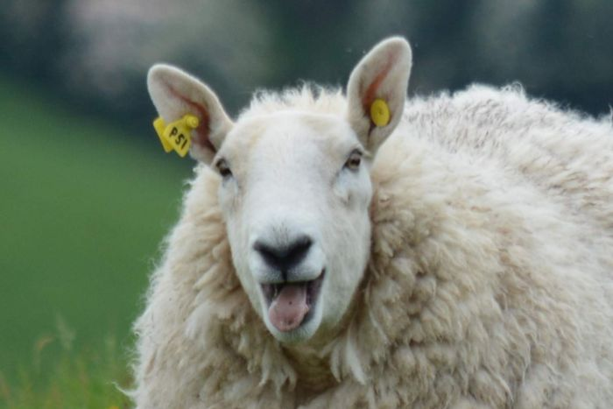
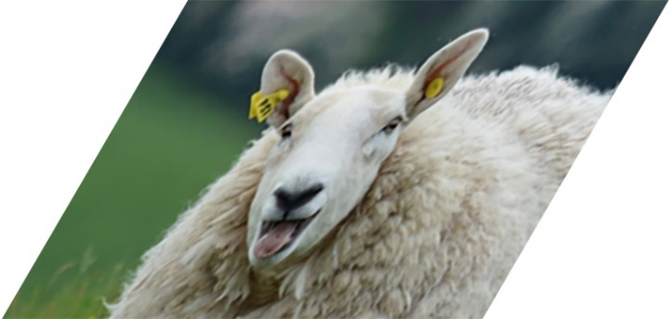




Inverse transformations
If $A$ represents a transformation, then $A^{−1}$ represents the reverse of that transformation
If $Av=v^{′}$ then $A^{−1}v^{′}=v$
Scale: ${\left(\begin{matrix}s_{x} & 0 \\ 0 & s_{y}\end{matrix}\right)}^{−1}=$ $\left(\begin{matrix}1/{s_{x}} & 0 \\ 0 & 1/{s_{y}}\end{matrix}\right)$
Rotation: $R_{θ}^{−1}=R_{−θ}$
Translation: ${\left(\begin{matrix}1 & 0 & t_{x} \\ 0 & 1 & t_{y} \\ 0 & 0 & 1\end{matrix}\right)}^{−1}=\left(\begin{matrix}1 & 0 & {−t}_{x} \\ 0 & 1 & −t_{y} \\ 0 & 0 & 1\end{matrix}\right)$
$$A^{−1}$$
$$A$$
Rotation through $−θ$
Notes:
For transformation matrices, the inverse is simply
Doing the opposite thing, to take the points back to where they started, which is usually pretty easy to figure out. For example;
The opposite of doubling something’s size is halving it;
If you turn something around, you can turn it back in the opposite direction by rotating through
the negative of the angle you initially rotated through,
And if you move something, you just send it back the way it came. As usual, feel free to check all these results for yourself!

Slide 13

Rotating about the origin
Question: How can we rotate an object about its own centre if it’s not located at the origin?
Answer: move it to the origin! (Then back again afterwards).
If the current transformation matrix is $M$,
$M^{−1}$ realigns the local axes with the scene,
$R$ performs the desired rotation,
$M$ returns the object to its starting position
Combined transform: $MRM^{−1}$
Notes:
Speaking of moving things back again, we can now answer the question posed earlier about how to rotate an object about its own origin when it doesn’t coincide with the scene origin…
And the answer is, to move it back so that it does! In fact, if we have the object’s current transformation matrix,
which we’ll call M, which is the accumulation of all the transforms that have been applied to the object so far,
we can apply the inverse of M to realign its local coordinates with the scene,
Perform our rotation about the origin,
And apply the original transform on top of our new rotation.
We can do all this in one go by multiplying the matrices – note, as always, the right-to-left order.

Slide 14


Basis vectors
Linearly independent means that no vector in the set can be written as a linear combination of the others
Definition: a vector basis of a space is a subset of linearly independent vectors $v_{1}…v_{n}$ such that every vector $v$ in the space can be uniquely written as $v={a_{1}v}_{1}+{a_{2}v}_{2}+…+{a_{n}v}_{n}$ for scalar values $a_{1}…a_{n}$
e.g. the vectors $\left(\begin{matrix}1 \\ 0\end{matrix}\right)$ and $\left(\begin{matrix}0 \\ 1\end{matrix}\right)$ form a basis for $ℝ^{2}$; $\left(\begin{matrix}x \\ y\end{matrix}\right)=x\left(\begin{matrix}1 \\ 0\end{matrix}\right)+y\left(\begin{matrix}0 \\ 1\end{matrix}\right)$
Known as the standard basis, these are also orthonormal
AKA $i$ and $j$
i.e. mutually perpendicular
Notes:
Before we finish with matrices for now, I want to introduce one more concept that will be touched on in the workshop exercises and useful later on, and that’s the idea of a vector basis,
Which is essentially a set of vectors that can be combined using addition and scalar multiplication to give any other vector in the space – so for example,
The vectors (1, 0) and (0, 1) define a basis for two-dimensional real space; by writing points as a combination of these, we’re essentially splitting out the x and y components.
These are known as the standard basis, which as well as being linearly independent (meaning that
none of them is a linear combination of the others), they are also orthonormal,
Which is essentially another way of saying mutually perpendicular.
You might also sometimes see these written as vectors i and j, for short.

Slide 15

Basis vectors and matrices
The identity matrix is made of the basis vectors: $I=\left(\begin{matrix}\left[\begin{matrix}1 \\ 0\end{matrix}\right] & \left[\begin{matrix}0 \\ 1\end{matrix}\right]\end{matrix}\right)$
Matrix multiplication is distributive, so $\left(\begin{matrix}x \\ y\end{matrix}\right)=x\left(\begin{matrix}1 \\ 0\end{matrix}\right)+y\left(\begin{matrix}0 \\ 1\end{matrix}\right)$ $⇒A\left(\begin{matrix}x \\ y\end{matrix}\right)=A\left[x\left(\begin{matrix}1 \\ 0\end{matrix}\right)+y\left(\begin{matrix}0 \\ 1\end{matrix}\right)\right]$ $=x\left[A\left(\begin{matrix}1 \\ 0\end{matrix}\right)\right]+y\left[A\left(\begin{matrix}0 \\ 1\end{matrix}\right)\right]$
Notes:
So what has this got to do with matrices?
Well, for one thing, the basis vectors actually make up the identity matrix; when we look more at coordinate spaces later, we’ll see how matrices can be viewed as a mapping from one space to another, defined by the basis vectors, so it makes sense that the identity matrix maps back to the same space.
For now, we can use the property that every other vector is some combination of these to figure out what a matrix will do to any point; although matrix multiplication is not commutative, it is distributive, so that the result of applying a matrix to a vector that’s a linear combination of the basis vectors is another linear combination, with the same coefficients (x and y) applied to vectors that are the results of applying the matrix to the basis vectors. These new vectors actually form a basis for the space that the matrix transforms to – but that’s a topic for another day.
This concludes the lecture material for this week, and also our consideration of 2D geometry and linear algebra; we’ll be looking at how it all works in 3D in weeks 7 and 8, but before then we’ll take a break to play with some projectiles for the next two weeks as we study the mechanics of physical simulation.

