Slide 1
11: Numerical Representations
COMP110 Principles of Computing

Slide 2
Worksheets
Worksheet 7 (Recursion): due this Wednesday
Worksheet 8 (Floating point numbers and vectors): due next Wednesday
Worksheet 9 (TIS-100): released this Friday, due after xmas break
This worksheet will ask you to play through a few levels of TIS-100 (Zachtronics, 2015)
TIS-100 is currently in the Steam sale for £2.49 until 1st December (normal price £4.99)

Slide 3
Today’s session
We have seen before how to represent non-negative integers in the digital computer, using binary notation
Today we extend to two other useful types of numbers
Negative integers
Real numbers

Slide 4
Modular arithmetic

Slide 5
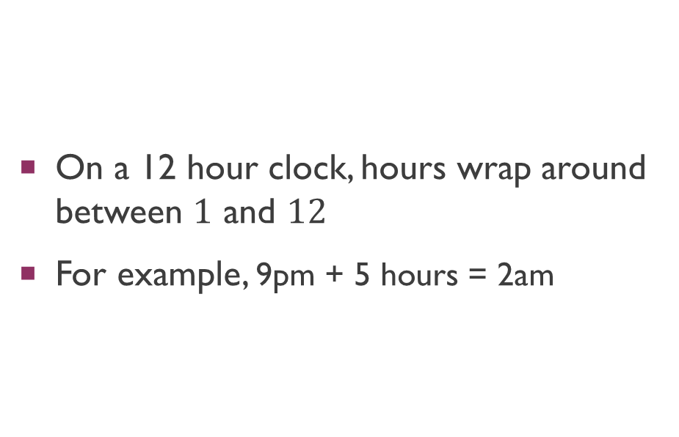
Telling the time
12
1
2
3
4
5
6
7
8
9
10
11
On a 12 hour clock, hours wrap around between $1$ and $12$
For example, 9pm + 5 hours = 2am

Slide 6
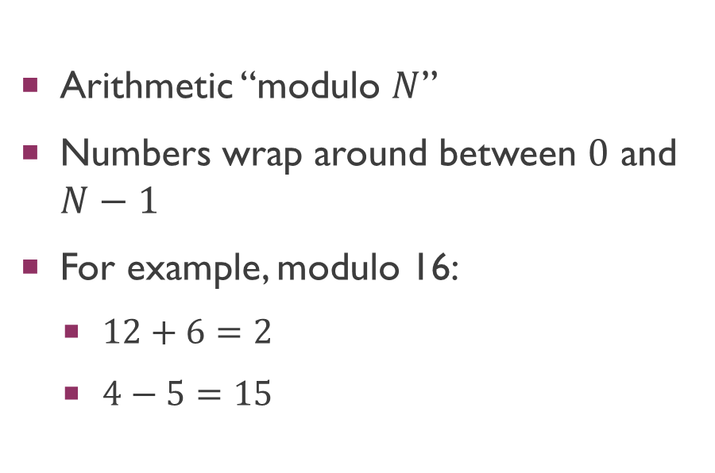
Modular Arithmetic
0
1
2
3
4
5
6
7
8
9
10
11
12
13
14
15
Arithmetic “modulo $N$”
Numbers wrap around between $0$ and $N−1$
For example, modulo 16:
$12+6=2$
$4−5=15$

Slide 7
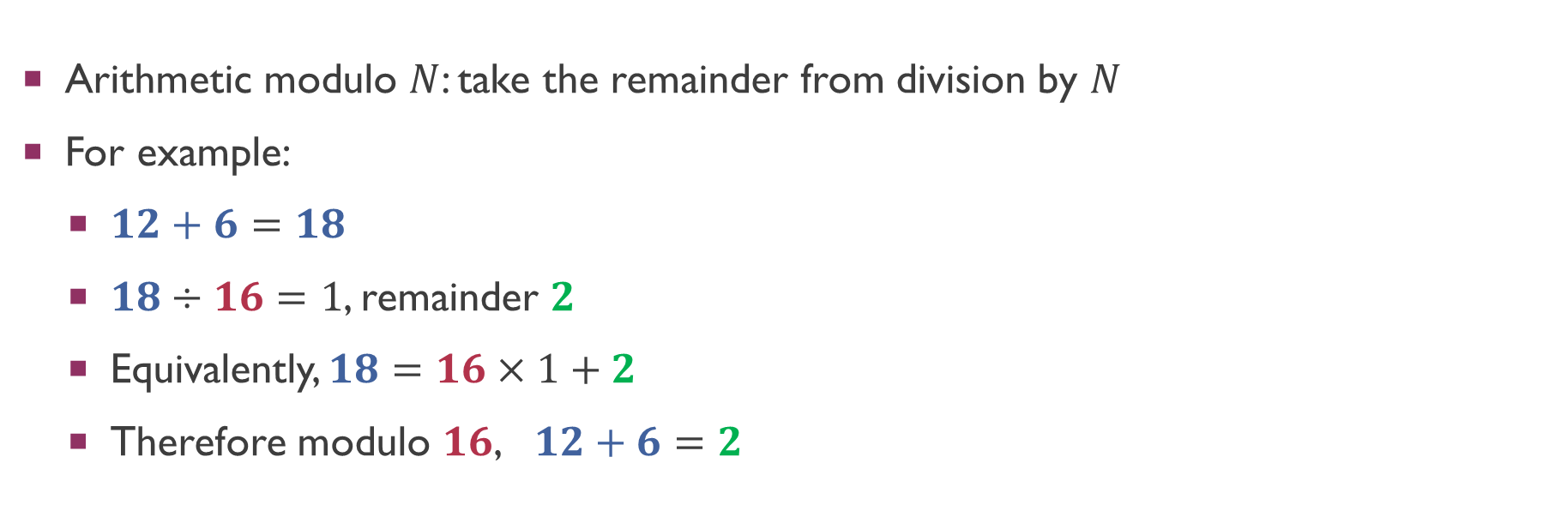
Modular arithmetic and division
Arithmetic modulo $N$: take the remainder from division by $N$
For example:
$12+6=18$
$18÷16=1$, remainder $2$
Equivalently, $18=16×1+2$
Therefore modulo $16$, $12+6=2$

Slide 8
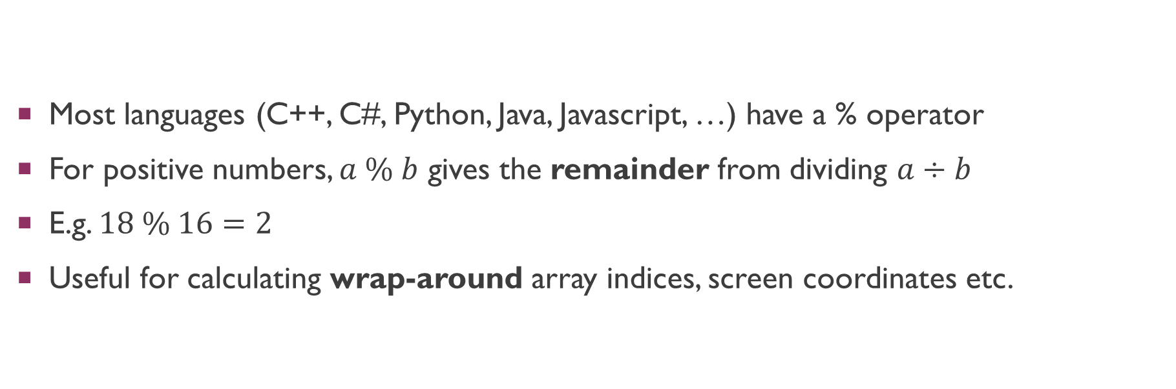
The modulo operator
Most languages (C++, C#, Python, Java, Javascript, …) have a % operator
For positive numbers, $a \% b$ gives the remainder from dividing $a÷b$
E.g. $18 \% 16=2$
Useful for calculating wrap-around array indices, screen coordinates etc.

Slide 9
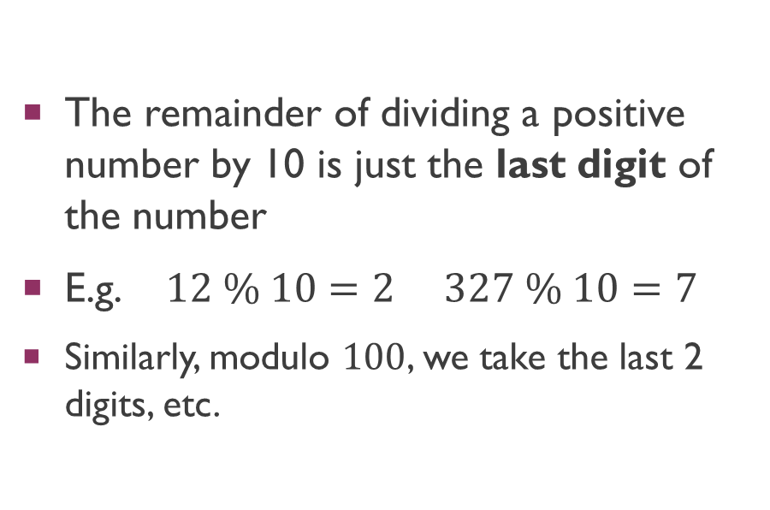
Modulo 10, 100, …
0
1
2
3
4
5
6
7
8
9
The remainder of dividing a positive number by 10 is just the last digit of the number
E.g. $12 \% 10=2$ $327 \% 10=7$
Similarly, modulo $100$, we take the last 2 digits, etc.

Slide 10
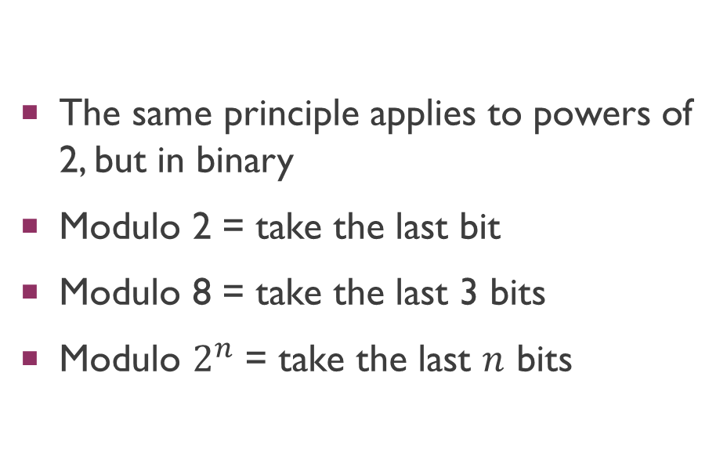
Modulo 2, 4, 8, 16, …
000
001
010
011
100
101
110
111
The same principle applies to powers of 2, but in binary
Modulo 2 = take the last bit
Modulo 8 = take the last 3 bits
Modulo $2^{n}$ = take the last $n$ bits

Slide 11
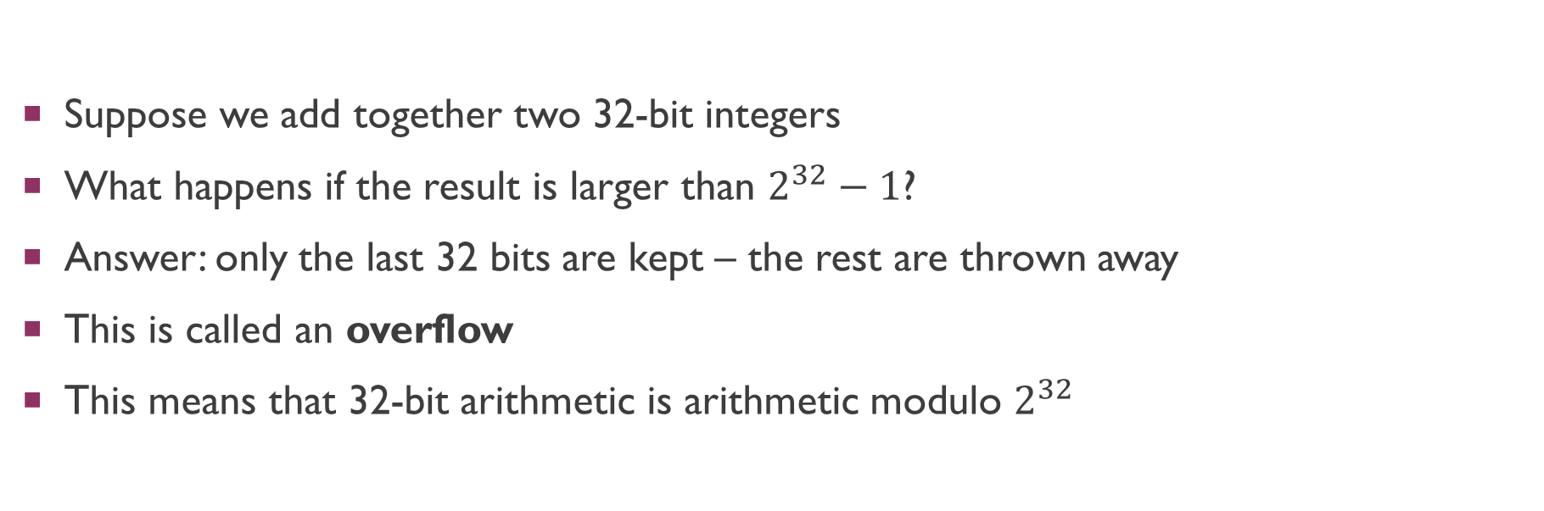
Overflow
Suppose we add together two 32-bit integers
What happens if the result is larger than $2^{32}−1$?
Answer: only the last 32 bits are kept – the rest are thrown away
This is called an overflow
This means that 32-bit arithmetic is arithmetic modulo $2^{32}$

Slide 12
2’s Complement

Slide 13
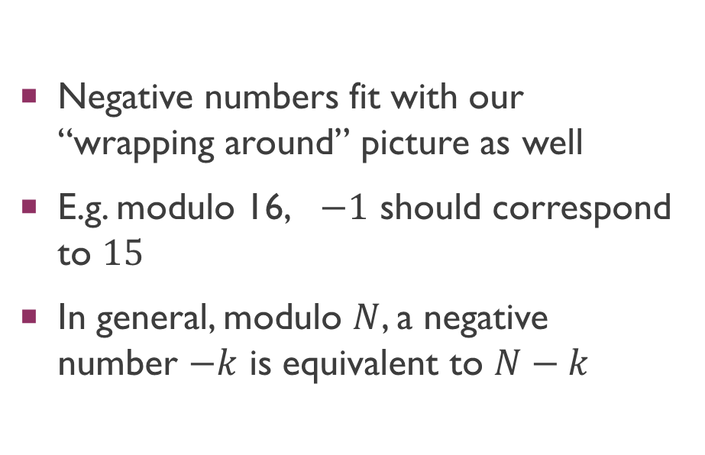
What about negative numbers?
0
1
2
3
4
5
6
7
8
9
10
11
12
13
14
15
Negative numbers fit with our “wrapping around” picture as well
E.g. modulo 16, $−1$ should correspond to $15$
In general, modulo $N$, a negative number $−k$ is equivalent to $N−k$

Slide 14
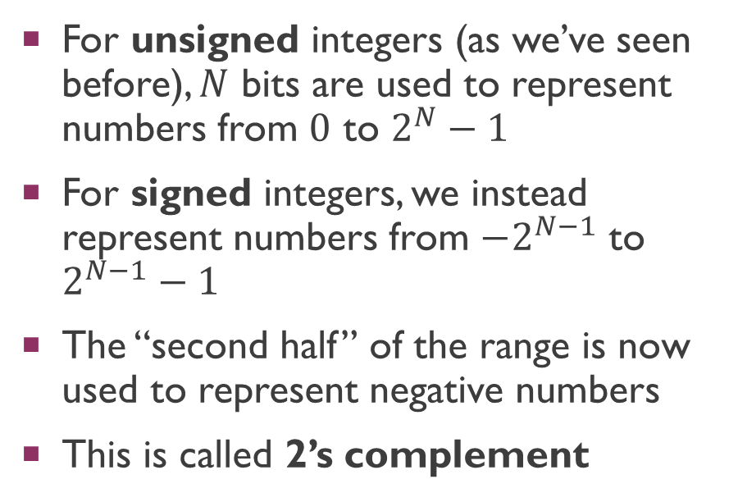
Representing signed integers
0
1
2
3
4
5
6
7
8
9
10
11
12
13
14
15
For unsigned integers (as we’ve seen before), $N$ bits are used to represent numbers from $0$ to $2^{N}−1$
For signed integers, we instead represent numbers from $−2^{N−1}$ to $2^{N−1}−1$
The “second half” of the range is now used to represent negative numbers
This is called 2’s complement
-1
-2
-3
-4
-5
-6
-7
-8

Slide 15
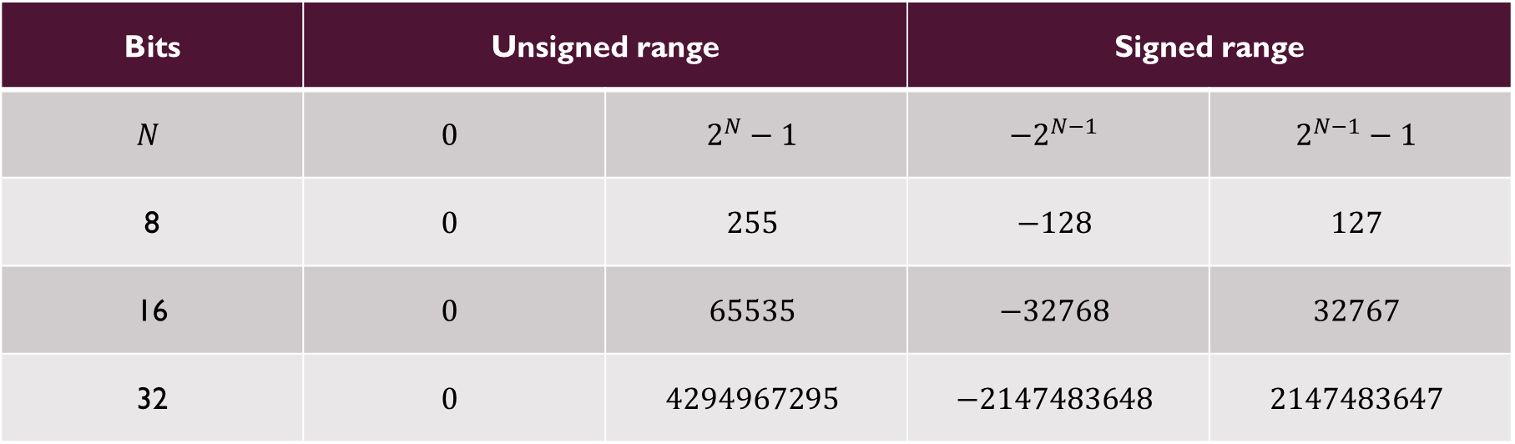
Ranges of integers
Bits | Unsigned range |  | Signed range
$$N$$ | $$0$$ | $$2^{N}−1$$ | $$−2^{N−1}$$ | $$2^{N−1}−1$$
8 | $$0$$ | $$255$$ | $$−128$$ | $$127$$
16 | $$0$$ | $$65535$$ | $$−32768$$ | $$32767$$
32 | $$0$$ | $$4294967295$$ | $$−2147483648$$ | $$2147483647$$

Slide 16
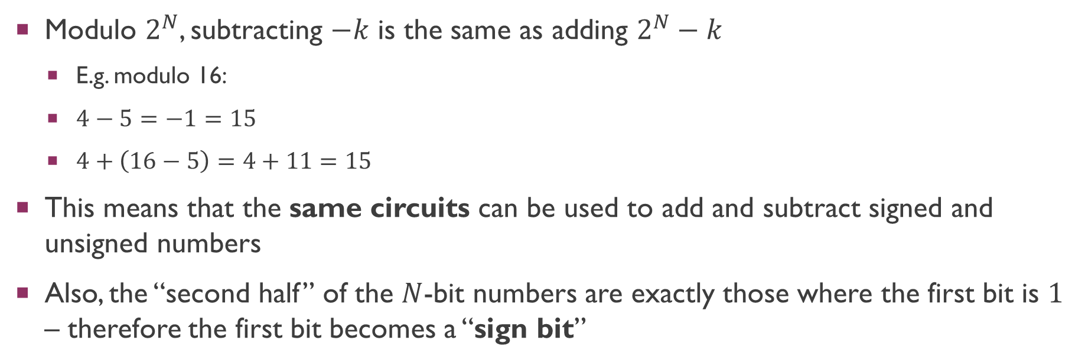
Why 2’s complement?
Modulo $2^{N}$, subtracting $−k$ is the same as adding $2^{N}−k$
E.g. modulo 16:
$4−5=−1=15$
$4+\left(16−5\right)=4+11=15$
This means that the same circuits can be used to add and subtract signed and unsigned numbers
Also, the “second half” of the $N$-bit numbers are exactly those where the first bit is $1$ – therefore the first bit becomes a “sign bit”

Slide 17
Scientific notation

Slide 18
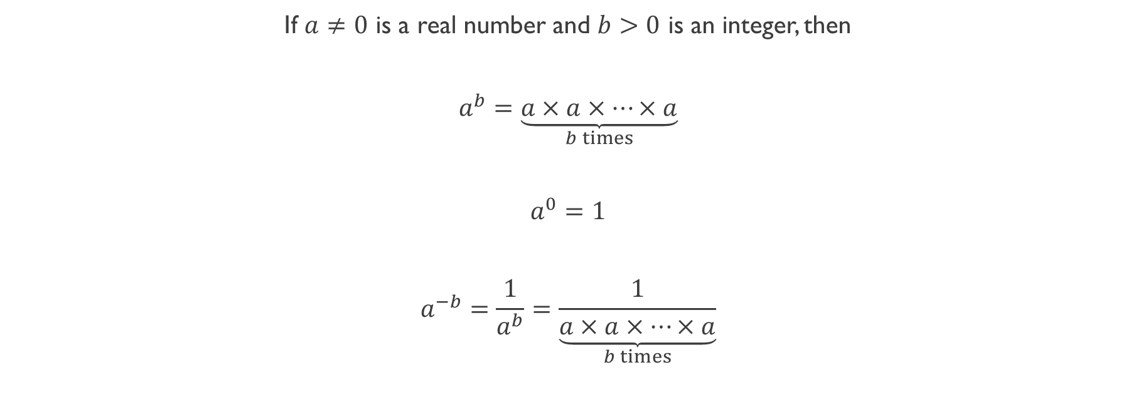
Integer Powers
If $a≠0$ is a real number and $b>0$ is an integer, then
$$a^{b}=\underset{b times}{\underbrace{a×a×…×a}}$$
$$a^{0}=1$$
$$a^{−b}=\frac{1}{a^{b}}=\frac{1}{\underset{b times}{\underbrace{a×a×…×a}}}$$

Slide 19
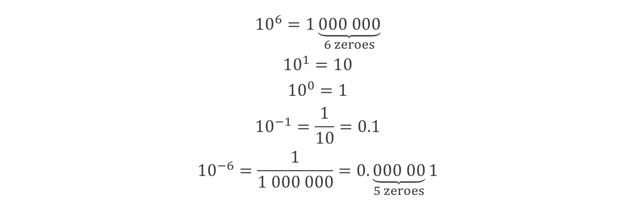
Powers of 10
$${10}^{6}=1\underset{6 zeroes}{\underbrace{000 000}}$$
$${10}^{1}=10$$
$${10}^{0}=1$$
$${10}^{−1}=\frac{1}{10}=0.1$$
$${10}^{−6}=\frac{1}{1 000 000}=0.\underset{5 zeroes}{\underbrace{000 00}}1$$

Slide 20
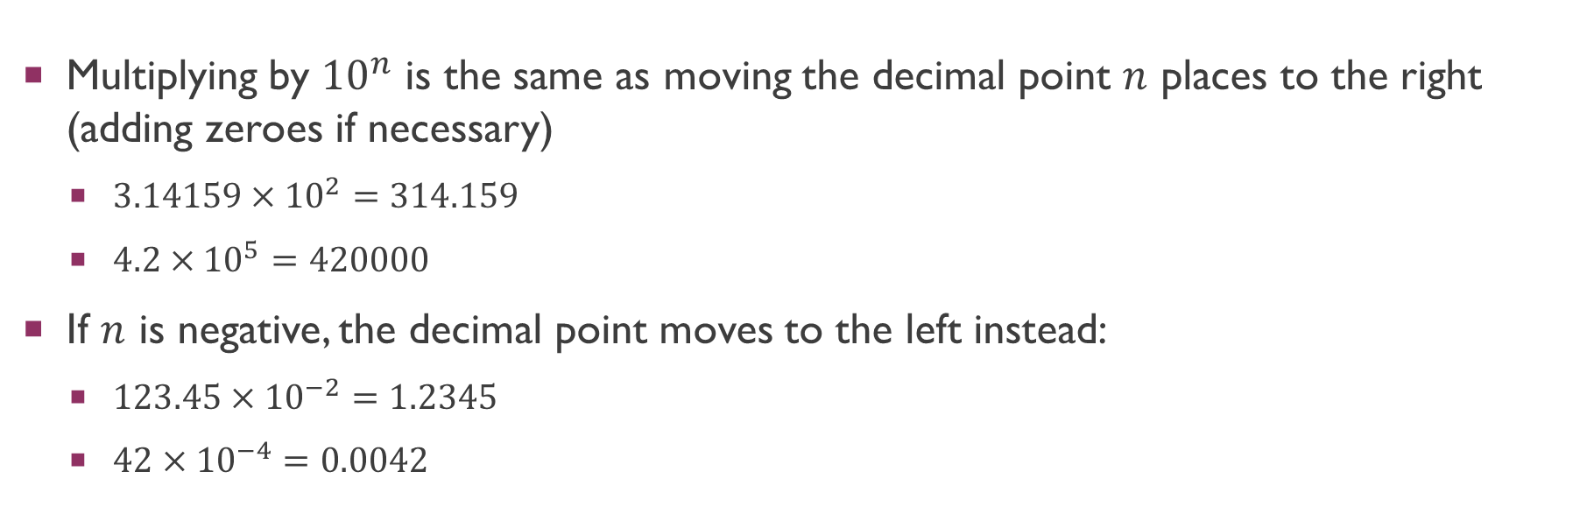
Multiplying by powers of 10
Multiplying by ${10}^{n}$ is the same as moving the decimal point $n$ places to the right (adding zeroes if necessary)
$3.14159×{10}^{2}=314.159$
$4.2×{10}^{5}=420000$
If $n$ is negative, the decimal point moves to the left instead:
$123.45×{10}^{−2}=1.2345$
$42×{10}^{−4}=0.0042$

Slide 21
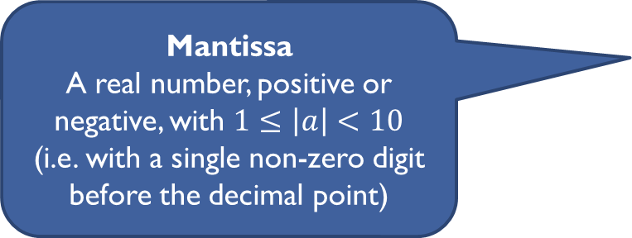
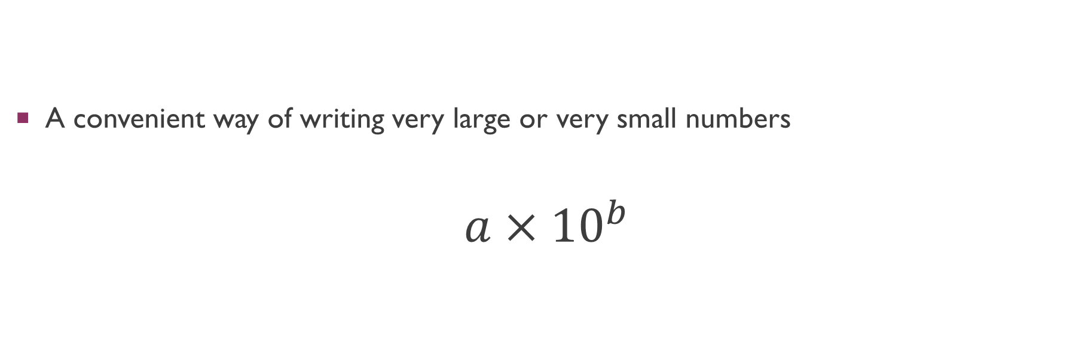
Scientific notation
A convenient way of writing very large or very small numbers
$$a×{10}^{b}$$
Mantissa
A real number, positive or negative, with $1≤\left|a\right|<10$
(i.e. with a single non-zero digit before the decimal point)
Exponent
An integer, can be positive, negative or zero

Slide 22
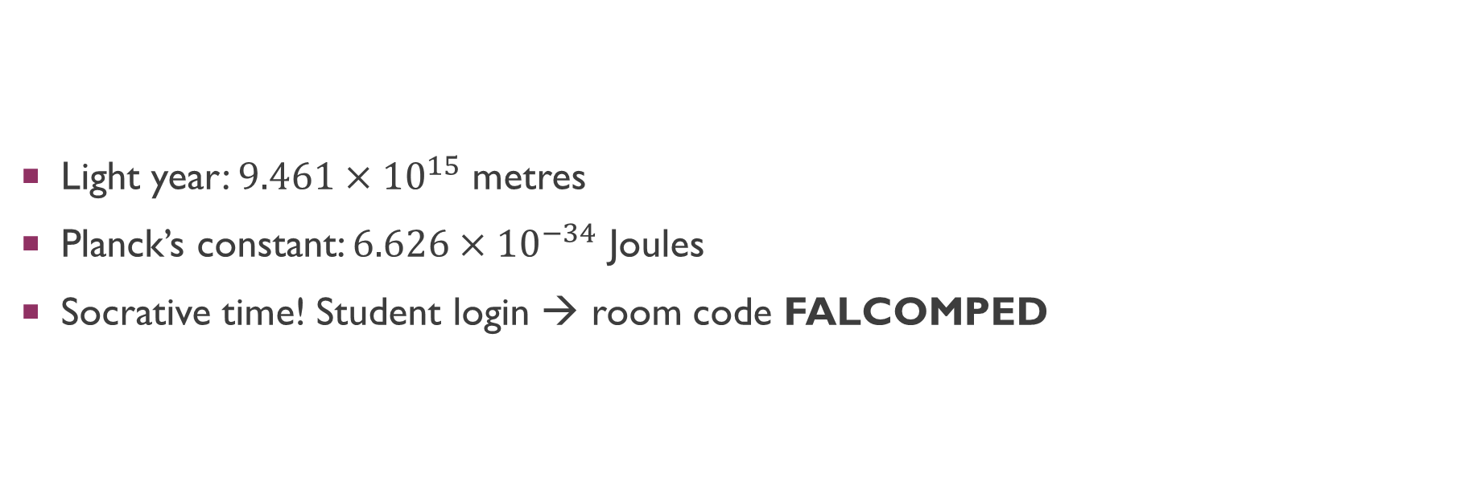
Examples
Light year: $9.461×{10}^{15}$ metres
Planck’s constant: $6.626×{10}^{−34}$ Joules
Socrative time! Student login → room code FALCOMPED

Slide 23
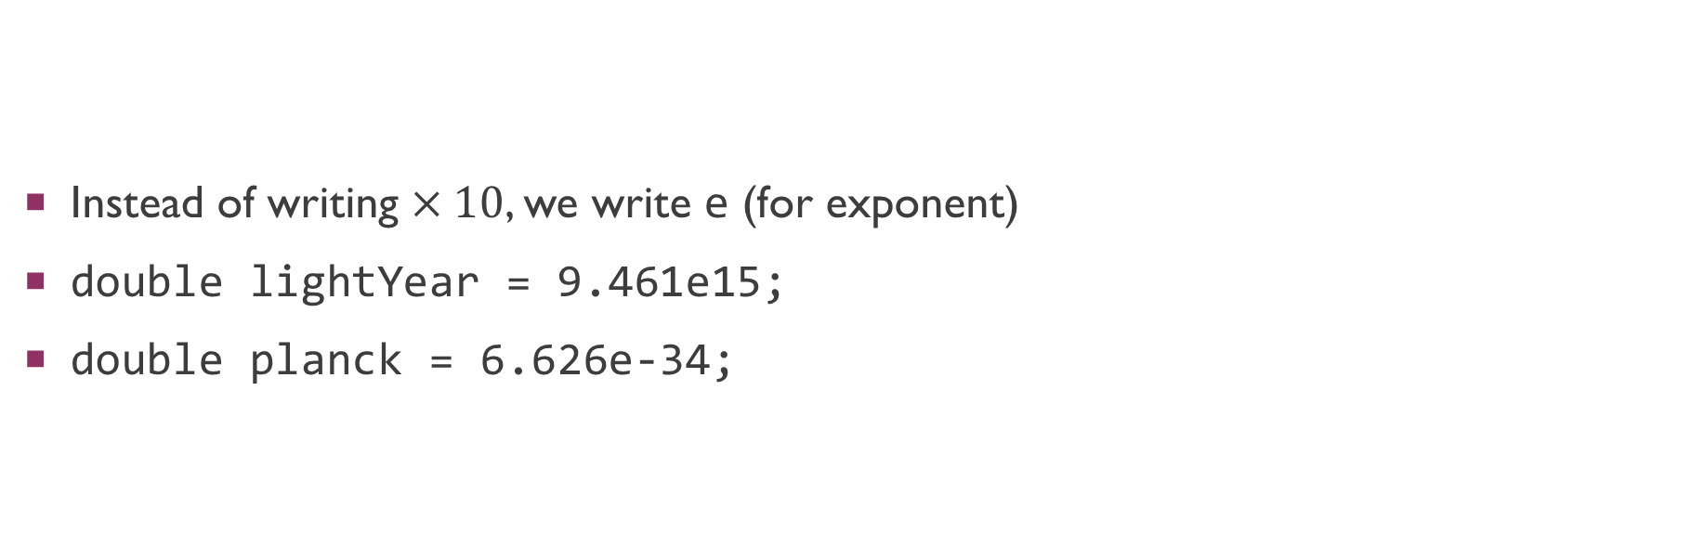
Scientific notation in code
Instead of writing $×10$, we write e (for exponent)
double lightYear = 9.461e15;
double planck = 6.626e-34;

Slide 24
Floating point notation

Slide 25
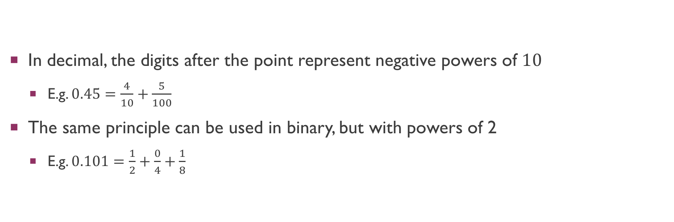
“Decimal” points in binary
In decimal, the digits after the point represent negative powers of $10$
E.g. $0.45=\frac{4}{10}+\frac{5}{100}$
The same principle can be used in binary, but with powers of 2
E.g. $0.101=\frac{1}{2}+\frac{0}{4}+\frac{1}{8}$

Slide 26
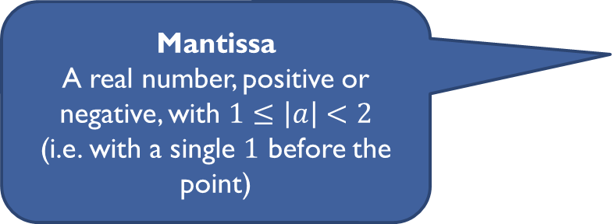
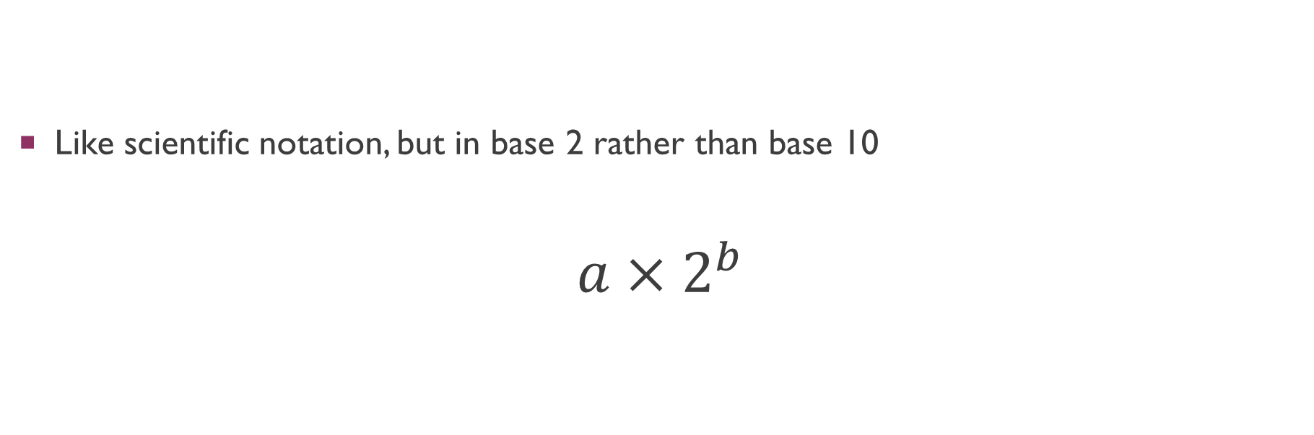
Floating point notation
Like scientific notation, but in base 2 rather than base 10
$$a×2^{b}$$
Mantissa
A real number, positive or negative, with $1≤\left|a\right|<2$
(i.e. with a single $1$ before the point)
Exponent
An integer, can be positive, negative or zero

Slide 27
Storing the mantissa
IEEE754 is the most common standard for storing floating point numbers
Mantissa is a positive or negative number, with a 1 before the point
Sign is stored as a single bit (0 = positive, 1 = negative)
We know the bit before the point is a 1, so it is not actually stored
Instead we just store the bits after the point

Slide 28
Storing the exponent
Exponent | Stored as
-126 | 00000001 (1)
… | …
-1 | 01111110 (126)
0 | 01111111 (127)
1 | 10000000 (128)
… | …
127 | 11111110 (254)
Exponent is a signed integer
Not stored in 2’s complement!
Instead, stored as an integer with a bias added
E.g. bias = 127, we store exponent + 127
Exponents of 000…0 and 111…1 are reserved, more on this later

Slide 29
IEEE754 floating point formats
Type | Sign | Exponent | Mantissa | Total
Single precision | 1 bit | 8 bits Bias 127 | 23 bits | 32 bits
Double precision | 1 bit | 11 bits Bias 1023 | 52 bits | 64 bits
Extended precision | 1 bit | 15 bits Bias 16383 | 64 bits | 80 bits

Slide 30
IEEE754 floating point formats
C# (and many other languages) have float and double types for single and double precision, respectively
Literals are interpreted as float if they end in f, otherwise double
3.14f is a float
3.14 is a double
Python’s float type is actually double precision
Extended precision is not generally used in programs, but is used internally on the CPU for intermediate calculation results

Slide 31
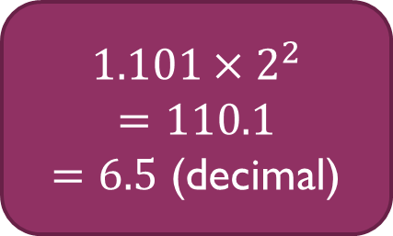
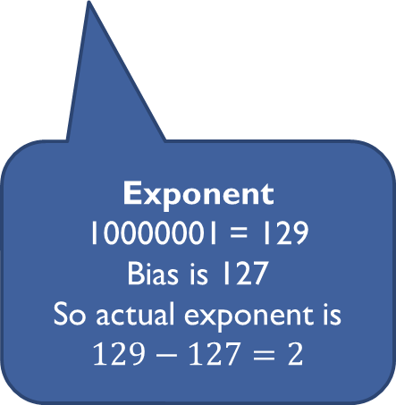
Example (single precision)
01000000110100000000000000000000
Sign
0, so the number is positive
Mantissa
1.101000…
Don’t forget the 1 in front of the point!
Exponent
10000001 = 129
Bias is 127
So actual exponent is $129−127=2$
$$1.101×2^{2}$$
$$=110.1$$
$=6.5$ (decimal)

Slide 32
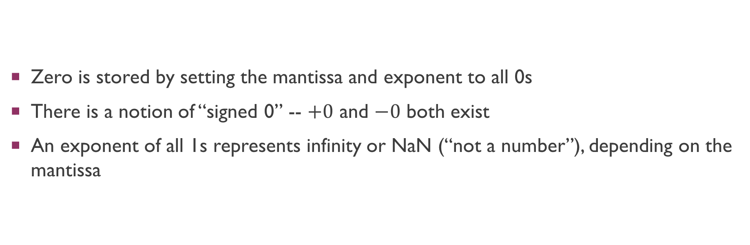
Special floating point numbers
Zero is stored by setting the mantissa and exponent to all 0s
There is a notion of “signed 0” -- $+0$ and $−0$ both exist
An exponent of all 1s represents infinity or NaN (“not a number”), depending on the mantissa

Slide 33
Infinity and NaN
float.PositiveInfinity > x is true for all finite x
float.NegativeInfinity < x is true for all finite x
float.NaN > x, float.NaN < x, float.NaN == x are false for all x
Similarly for double.PositiveInfinity etc
Can check for these with float.IsNaN, float.IsInfinity etc
Infinity is useful wherever you want a “very large” value
Infinity and NaN can also arise from calculations (especially division by 0)

Slide 34
Numerical precision

Slide 35
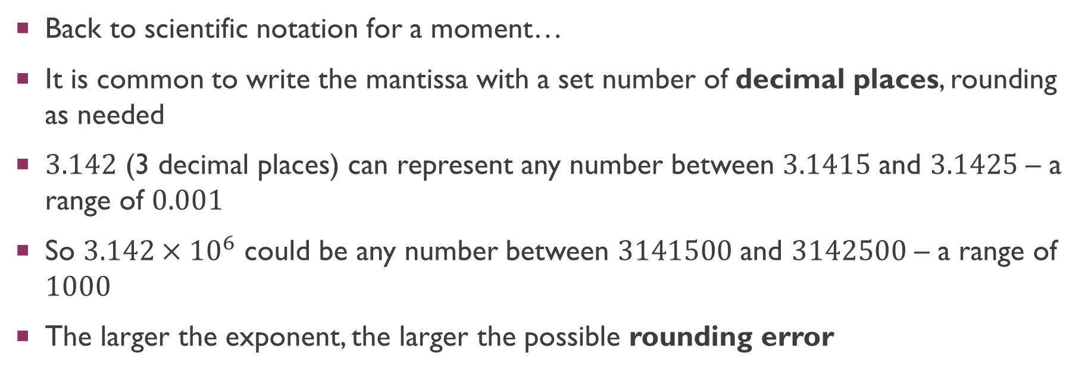
Numerical precision
Back to scientific notation for a moment…
It is common to write the mantissa with a set number of decimal places, rounding as needed
$3.142$ (3 decimal places) can represent any number between $3.1415$ and $3.1425$ – a range of $0.001$
So $3.142×{10}^{6}$ could be any number between $3141500$ and $3142500$ – a range of $1000$
The larger the exponent, the larger the possible rounding error

Slide 36
Floating point precision
Floating point numbers have a limited number of bits for the mantissa
Therefore they are also subject to rounding error
And the margin of error gets larger as the exponent gets larger
This can have real impacts, e.g. physics calculations getting less precise as we move further from the origin

Slide 37
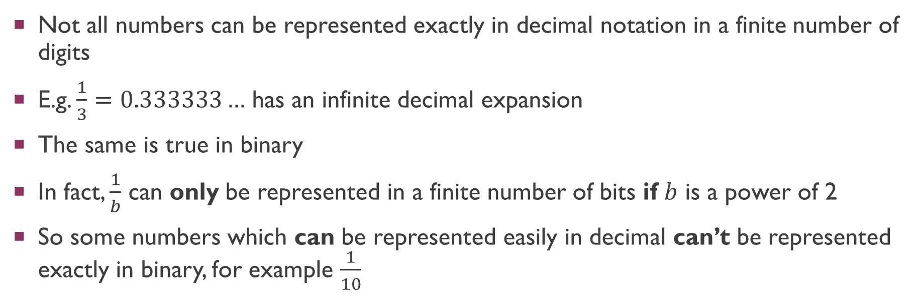
Limitations of decimals
Not all numbers can be represented exactly in decimal notation in a finite number of digits
E.g. $\frac{1}{3}=0.333333…$ has an infinite decimal expansion
The same is true in binary
In fact, $\frac{1}{b}$ can only be represented in a finite number of bits if $b$ is a power of 2
So some numbers which can be represented easily in decimal can’t be represented exactly in binary, for example $\frac{1}{10}$

Slide 38
Testing for equality
Due to rounding errors, using == or != with floating point numbers is almost always a bad idea
E.g. in most languages, 0.1 + 0.2 == 0.3 is actually false!
Better to check for approximate equality: calculate the difference between the two numbers, and check it is smaller than some small threshold values
Unity has this built in: Mathf.Approximately(0.1 + 0.2, 0.3) will return true as you would expect

Slide 39
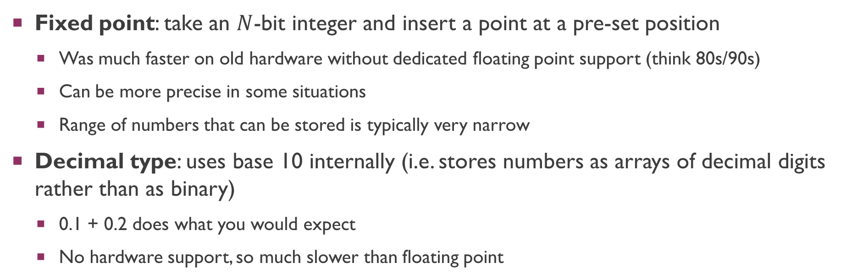
Other representations
Fixed point: take an $N$-bit integer and insert a point at a pre-set position
Was much faster on old hardware without dedicated floating point support (think 80s/90s)
Can be more precise in some situations
Range of numbers that can be stored is typically very narrow
Decimal type: uses base 10 internally (i.e. stores numbers as arrays of decimal digits rather than as binary)
0.1 + 0.2 does what you would expect
No hardware support, so much slower than floating point

Slide 40
Summary
Modern computers have efficient ways of storing signed integers and real numbers
IEEE754 gives a good tradeoff between storage space, range and precision
… however it is important to understand the limitations of its precision

Slide 41
Workshop

