Slide 1



4: UML – Unified Modeling Language
GAM140: Individual Creative Computing Project

Slide 2
Assignment Roadmap
Assignment 1
Week 6 – First prototype of game and controller
Week 9 – Peer review of game and controller
Assignment 2
Week 3 – Project Proposal
Week 8 – Draft Poster presentation
Week 10 – Report Peer Review
Next up: WEEK 6 – First Prototype of game and controller

Slide 3
Learning outcomes
Understand rationale behind UML
Understand a subset of UML Diagrams useful for game development
Develop some UML Diagrams

Slide 4
Introduction
In COMP110 you were introduced to flow charts and pseudocode
These were useful for designing the high level flow of an application, and detail how an algorithm could be implemented
UML is an attempt to create a formal design language for designing software

Slide 5
What is UML?
UML is a visual notation system which can be used to design software
It was first devised in 1996 by Booch, Jacobson and Rumbaugh
The goal was to unify/standardise all the various modelling languages and diagrams used in Software Development
In 2005, ISO published UML as an international standard
UML 2.0 is the most current version, there are currently 14 different diagram types

Slide 6
Why UML?
UML offers us a standardised way of designing software
It allows us to think through our systems before committing them to code
It offers a shared language between programmer and other disciplines including clients

Slide 7
Diagram Types
UML2.0 is split into two diagram families
Behaviour Diagrams
Describes what happens in a system, this includes interactions between users and the system
Or the current system and other external systems
Structure Diagrams
Describes what is contained in the system
Typically used to model the system

Slide 8
Diagramming Tools
Gliffy - https://go.gliffy.com/go/auth/login
draw.io - https://www.draw.io/
Microsoft Visio - https://products.office.com/en-gb/visio/flowchart-software

Slide 9
Behavioural Diagrams

Slide 10
Use Case Diagram
Use Case diagrams typically details the user’s interaction with the system
In essence it details the Use Case of the system and the Actors which interact with the system
NB. These Actors could be other systems!
Created using terms that a layman could understand
Can be used to capture and communicate User Requirements
This is often the first diagram created for a system

Slide 11
Use Case Diagram
Actor
Use Case
System Boundary

Slide 12
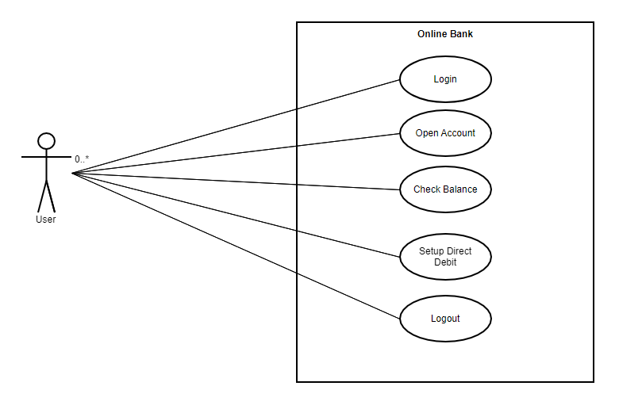
Use Case Diagram

Slide 13
Use Case Diagram – Class Exercise
What are the key Use Cases for Discord?
Lets diagram it together

Slide 14
Activity Diagram
Activity Diagrams describe behaviour composed of a collection of tasks
This is used to model the flow of work and/or data in a system
This type of diagram supports choice, iteration and concurrency
You can think of this diagram as a structured Flow Chart

Slide 15
Activity Diagram
Start Node
Decision
Actions
End Node
Split or join of concurrent activities

Slide 16
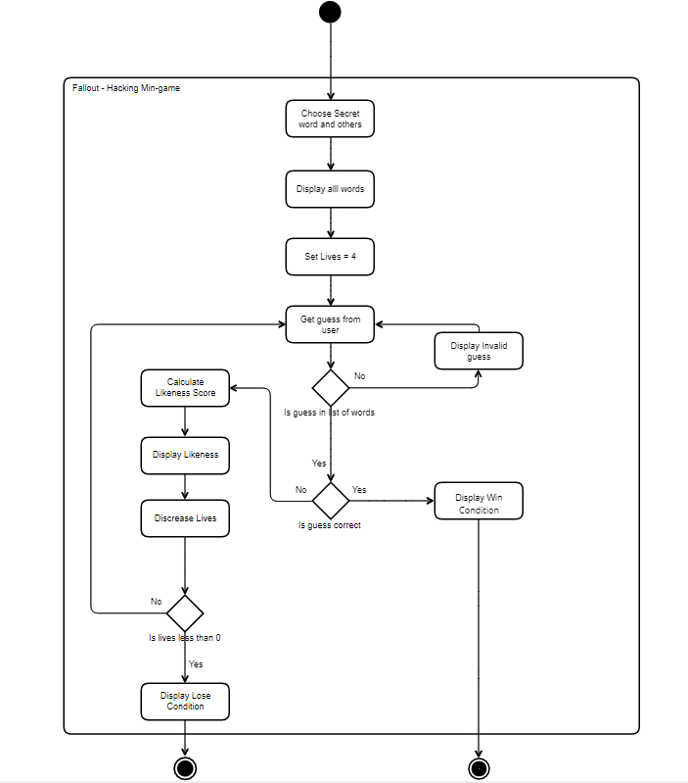
Activity Diagram

Slide 17
State Diagram
State Diagrams are used to model the possible states of your applications
This allows you to not only to model the states but the flow of events and transitions between states
Is useful for modelling the following in games:
AI Finite State Machines
Game States
Animation Systems

Slide 18
State Diagram
Initial State
Simple
State with
compartments
Simple
State
Final State
Choice
Fork or Join
Composite State

Slide 19
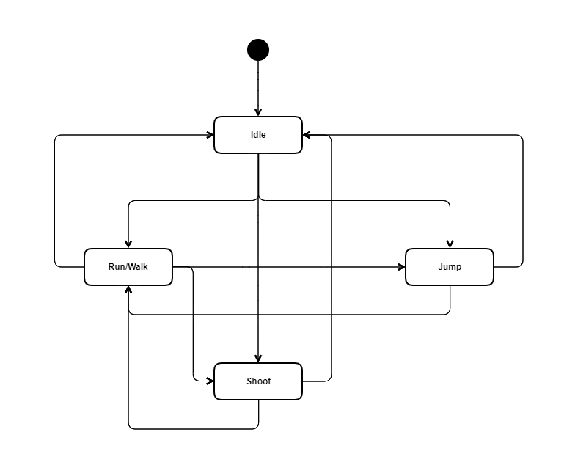
State Diagram

Slide 20

State Diagram – Class Exercise
Watch the following video
https://www.youtube.com/watch?v=gMk7WIGi-W0

Slide 21
State Diagram – Class Exercise
Identify the States of the Cathedral Grave Warden

Slide 22
Sequence Diagram
This can be used to model the flow of logic in a system
This is useful to see how the user interacts with the system
How the data flows between different parts of the system
These diagrams are often time focused with the vertical axis used to represent time

Slide 23
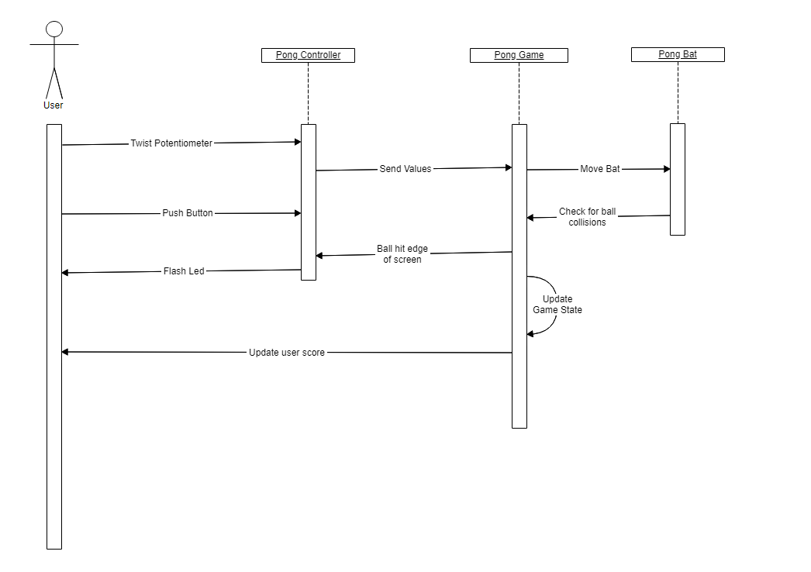
Sequence Diagram

Slide 24
Structural Diagrams

Slide 25
Class Diagram
This attempts to model object-orientated systems
Is the one diagram which can be directly translated into code
It has entities which represent:
Classes with functions and variables
Interfaces
Enumerations
It can also be used to model relationships between classes
Dependency
Association
Aggregation
Composition
Inheritance
Realization/Implementation

Slide 26
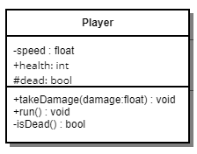
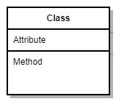
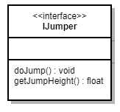
Class Diagram
Class (example)
- Private
+ public
# protected
Class
Interface

Slide 27
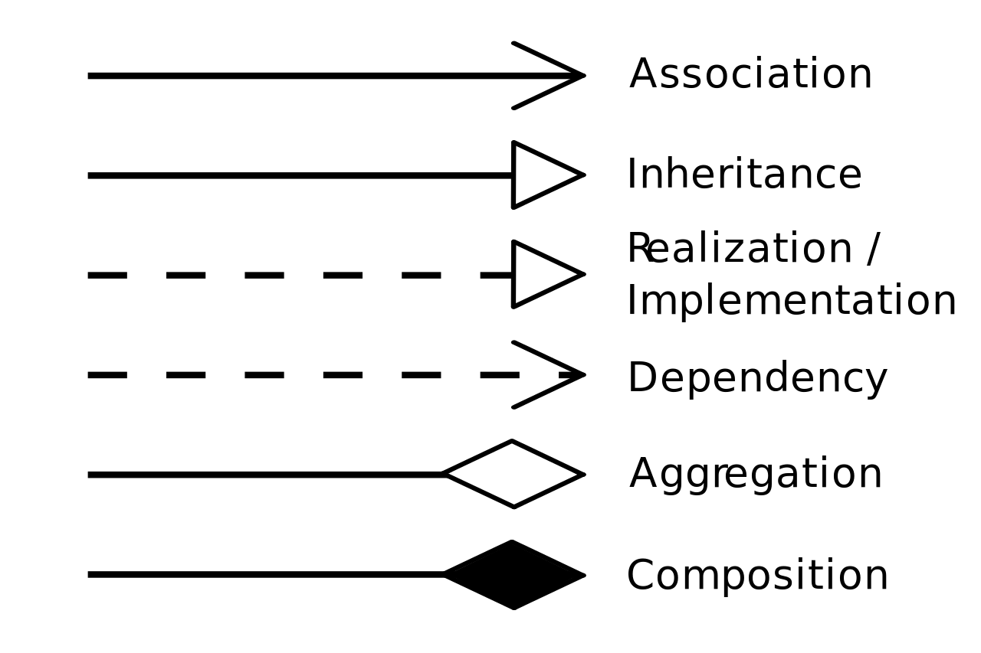
Class Diagram
https://en.wikipedia.org/wiki/Class_diagram

Slide 28
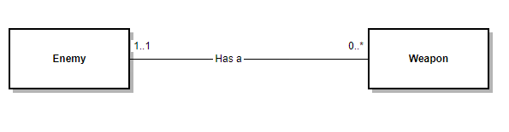
Class Diagram
Association:
Enemy has 0 or many weapons
A Weapon has only 1 Enemy

Slide 29
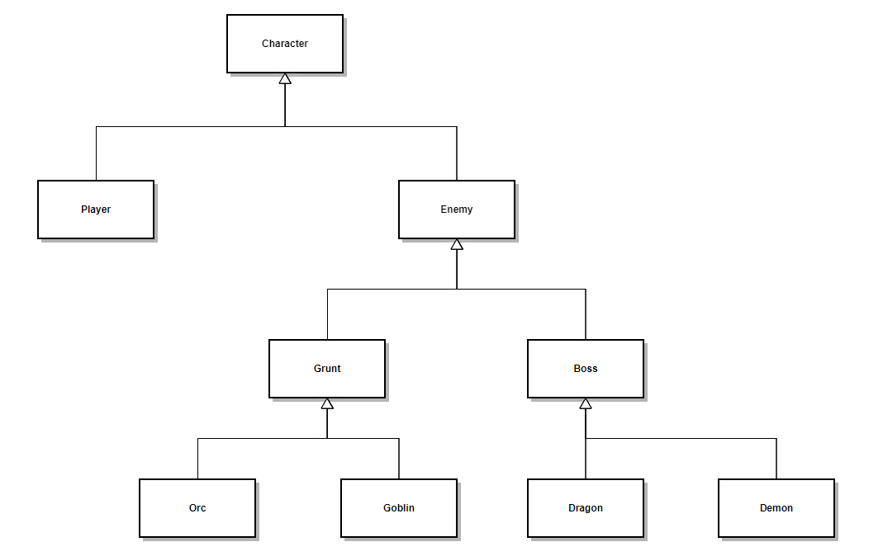
Class Diagram
Inheritance

Slide 30
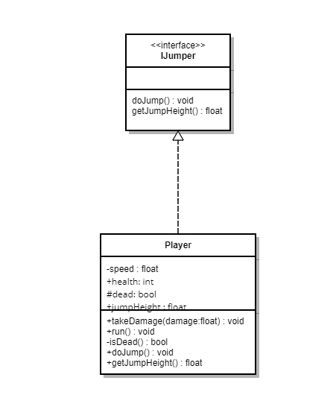
Class Diagram
Implements

Slide 31
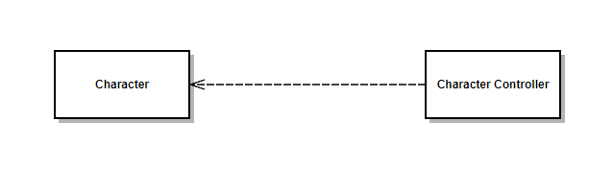
Class Diagram
Dependency

Slide 32
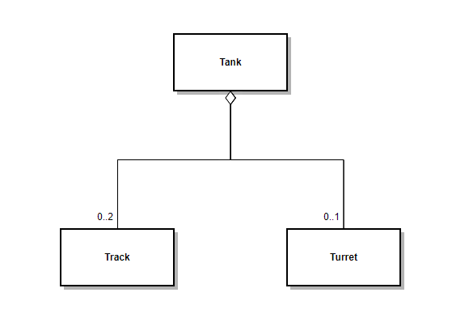
Class Diagram
Aggregation

Slide 33
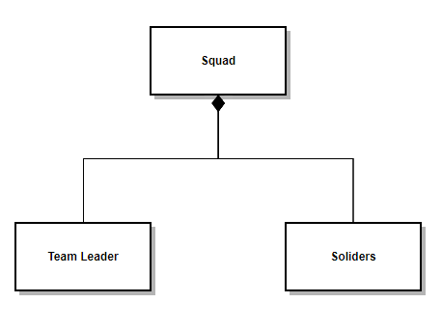
Class Diagram
Composition

Slide 34
UML Tips
While UML is a standard, like Agile it is sometimes helpful to modify for your use case
You can make multiple diagrams at different levels
A high level class diagram to show relationships
Lower level which shows implementation
You don’t need to use each diagram type in your projects, you will find some more useful than others

