Slide 1
Workshop Week 3 Planning
COMP250: Artificial Intelligence

Slide 2
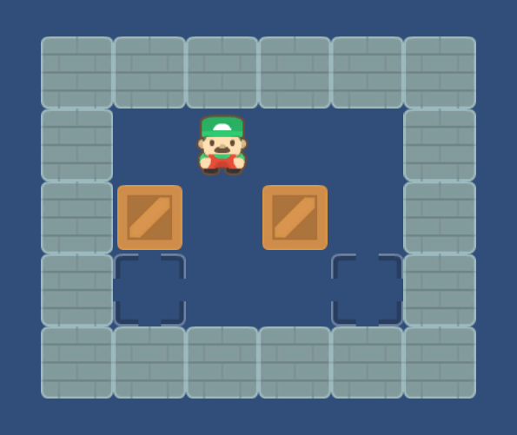
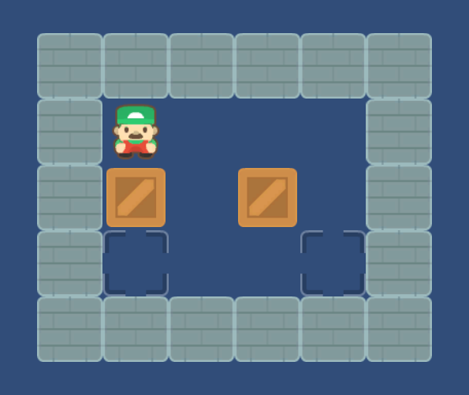
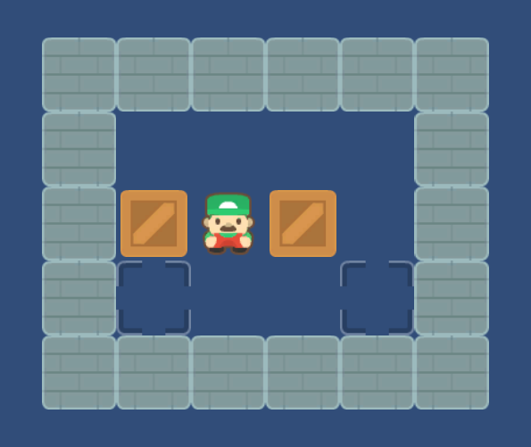
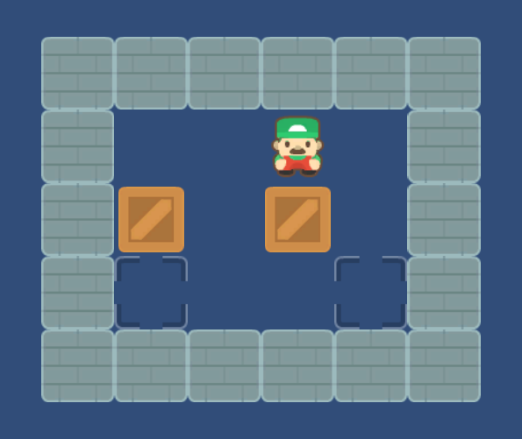
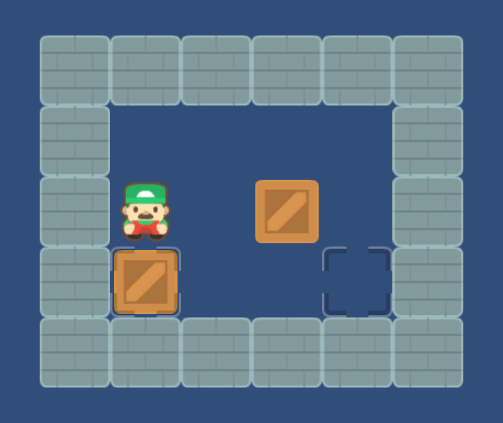
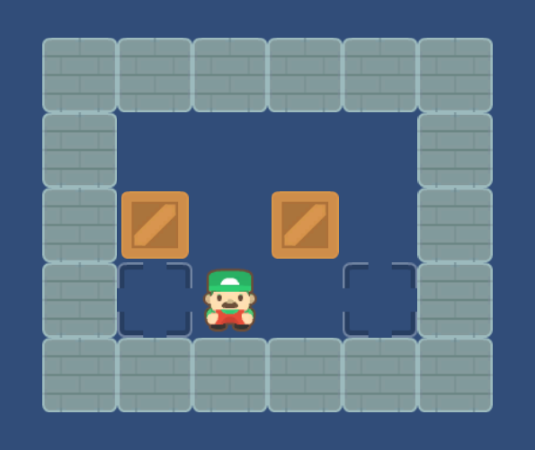
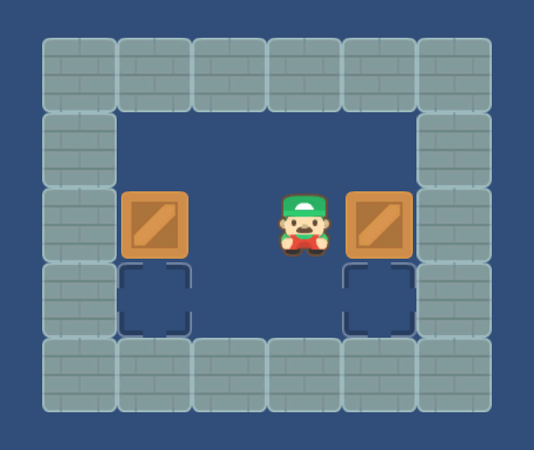
State-Action Tree
←
←
←
←
←
←
←
←

Slide 3
Breadth-First Search with a queue

Slide 4
BFS
←
←
←
←
←
←
←
←

Slide 5
Path to solution

Slide 6
Duplicated states
←
←
←
←
←
←
←
←

Slide 7
Pruning duplicated states

Slide 8
Workshop Activity
Implement a solver for the classic puzzle game Sokoban!
Mob program in your breakout rooms
Fork and clone the repo linked on LearningSpace
Look at the pseudocode on LearningSpace
At 5:15pm we’ll reconvene and review – I’ll be dropping in on you in the meantime

