Slide 1
Monte Carlo Tree Search (MCTS)

Slide 2
The perfect 1-ply search
Current state
Move A
Move B
Move C
State
after move A
State
after move B
State
after move C
Reward signal for move B
“Oracle” policy
Value of move B
Win=1, Loss=-1
Playout policy
Terminal state
Win=1, Loss=-1

Slide 3
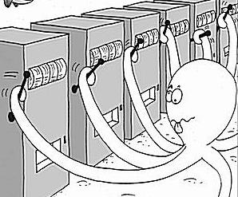
The multi-armed bandit problem
At each step pull one arm
Noisy/random reward signal
In order to:
Minimise regret
Maximise expected return
(Find the best arm)

Slide 4

Upper Confidence Bound (UCB1)
Balance exploitation with exploration
Select the arm that maximises
Total number of trials so far
Total reward from this arm so far
$$\frac{V_{a}}{n_{a}}+k\sqrt{\frac{\log{n}}{n_{a}}}$$
Number of times this arm has been selected so far
Exploitation
Exploration
Tuning constant
P Auer, N Cesa-Bianchi, P Fischer. Finite-time analysis of the multiarmed bandit problem. Machine Learning. 47(2):235-256, 2002.
Notes:
Important to make the simple point that there are two reasons for pulling an arm – that it looks good based on the evidence so far (=exploitation) and that you don’t know enough to know whether it might be good (exploration).

Slide 5
UCB1 demo
http://orangehelicopter.com/academic/bandits.html?ucb

Slide 6
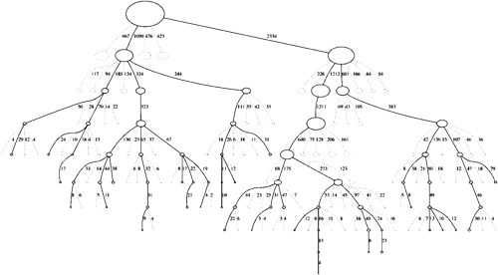
Monte Carlo Tree Search (MCTS)
Iteratively build a partial search tree, one node per iteration
Monte Carlo evaluation (random playouts) for nonterminal states
Asymmetric
balance exploitation with exploration
Anytime
can do as many (or as few) iterations as we want
Aheuristic
Monte Carlo evaluation requires only a forward model

Slide 7
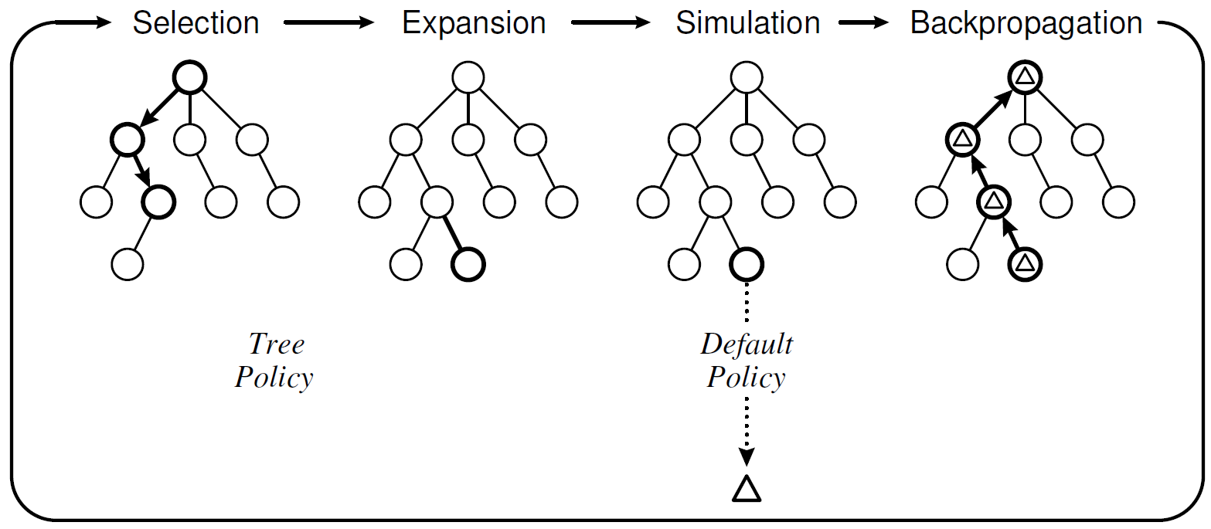
Monte Carlo Tree Search (MCTS)
Choose a node with unexpanded children
Add a child to the selected node
Do a Monte Carlo simulation
Update statistics for the visited nodes
Repeat

Slide 8
Game Decisions
Current state
Move A
Move B
Move C
State
after move A
State
after move B
State
after move C
Reward signal for move B
Win=1, Loss=-1
Playout policy
Terminal state
Win=1, Loss=-1

Slide 9
Monte Carlo Tree Search (MCTS)
Current state
Move A
Move B
Move C
State
after move A
State
after move B
State
after move C
Tree policy
Move D
State
after moves B,D
Playout policy
Reward signal
Win=1, Loss=-1
Default policy
Terminal state
Win=1, Loss=-1
Notes:
Tree policy is learned
Default policy is unlearned e.g. random
As search progresses, tree policy improves, and makes up more of the playout policy => closer approximation to oracle policy

Slide 10

Upper Confidence bound for Trees (UCT)
$$\frac{V_{a}}{n_{a}}+k\sqrt{\frac{\log{n}}{n_{a}}}$$
Tree policy: UCB1
Default policy: uniform random
L Kocsis, C Szepesvári. Bandit based Monte-Carlo planning. In Machine Learning: ECML 2006, vol 4212 of Lecture Notes in Artificial Intelligence, 282-293, 2006.

Slide 11
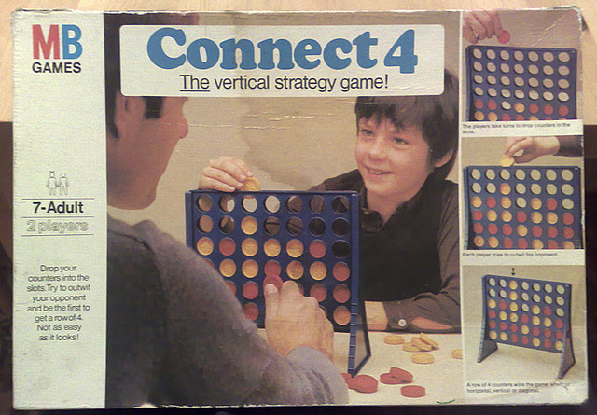
Demo

Slide 12
MCTS for a real-time game
Edward J. Powley, Daniel Whitehouse and Peter I. Cowling. Monte Carlo Tree Search with macro-actions and heuristic route planning for the Physical Travelling Salesman Problem. Proceedings of IEEE Conference on Computational Intelligence in Games (CIG), 234–241, 2012.
Diego Perez, Edward J. Powley, Daniel Whitehouse, Philipp Rohlfshagen, Spyridon Samothrakis, Peter I. Cowling and Simon M. Lucas. Solving the Physical Travelling Salesman Problem: tree search and macro-actions. IEEE Transactions on Computational Intelligence and AI in Games, 6(1):31–45, 2014.

Slide 13
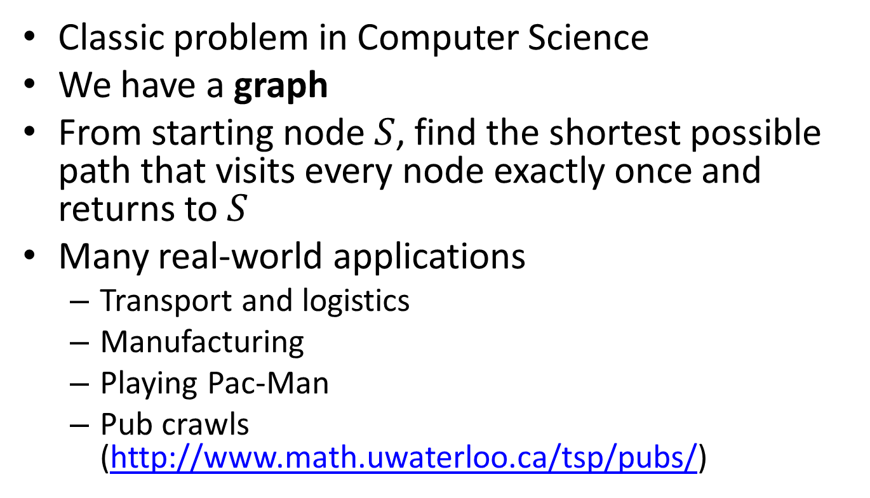
Travelling Salesman Problem (TSP)
Classic problem in Computer Science
We have a graph
From starting node $S$, find the shortest possible path that visits every node exactly once and returns to $S$
Many real-world applications
Transport and logistics
Manufacturing
Playing Pac-Man
Pub crawls (http://www.math.uwaterloo.ca/tsp/pubs/)

Slide 14
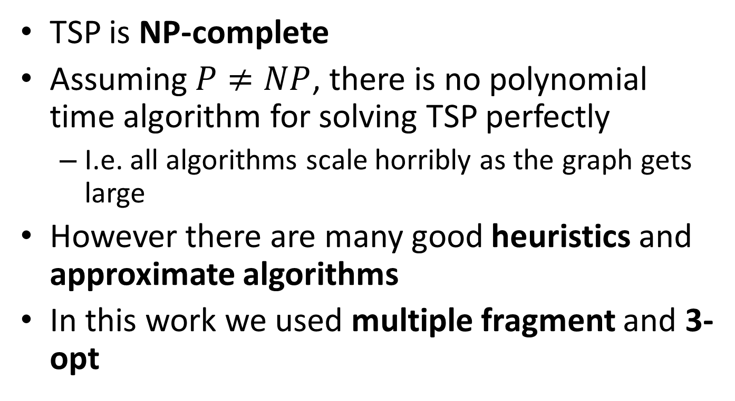
Solving TSP
TSP is NP-complete
Assuming $P≠NP$, there is no polynomial time algorithm for solving TSP perfectly
I.e. all algorithms scale horribly as the graph gets large
However there are many good heuristics and approximate algorithms
In this work we used multiple fragment and 3-opt

Slide 15
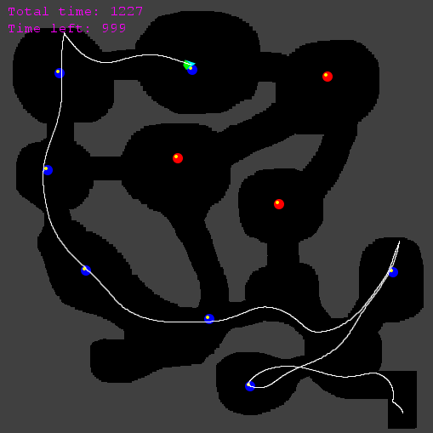
Physical Travelling Salesman Problem (PTSP)
Steer a spaceship to collect all waypoints
Asteroids-like controls
Newtonian physics
Map is unknown in advance
Controller has a few seconds of initialisation time, and then must make an input to the ship every 40ms

Slide 16
Demo
Our PTSP controller in action

Slide 17
Challenges for tree search in real-time domains
Many more decisions per game than most turn-based games
Hence state space is enormous even if branching factor is small
PTSP has of the order 10¹⁵⁵⁶ states
19×19 Go has of the order 10¹⁷¹ states
Time budget is restricted (milliseconds per decision)

Slide 18
Key features of our PTSP controller
Hierarchical structure
Higher-level route planner chooses the waypoint order
TSP solver with heuristics for avoiding sharp turns
Lower-level steering controller executes the route
MCTS with macro-actions and heuristic evaluation
Depth limiting and heuristic evaluation
Guides the steering controller along the route
Macro-actions
Vastly reduce the state-action space for steering

Slide 19
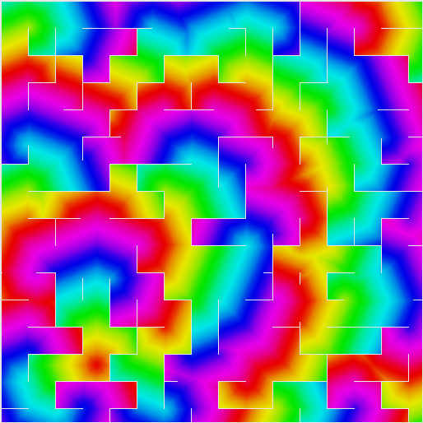
Heuristic evaluation
Based on “A* path” distance to next waypoint
Precomputed using a flood-fill algorithm

Slide 20
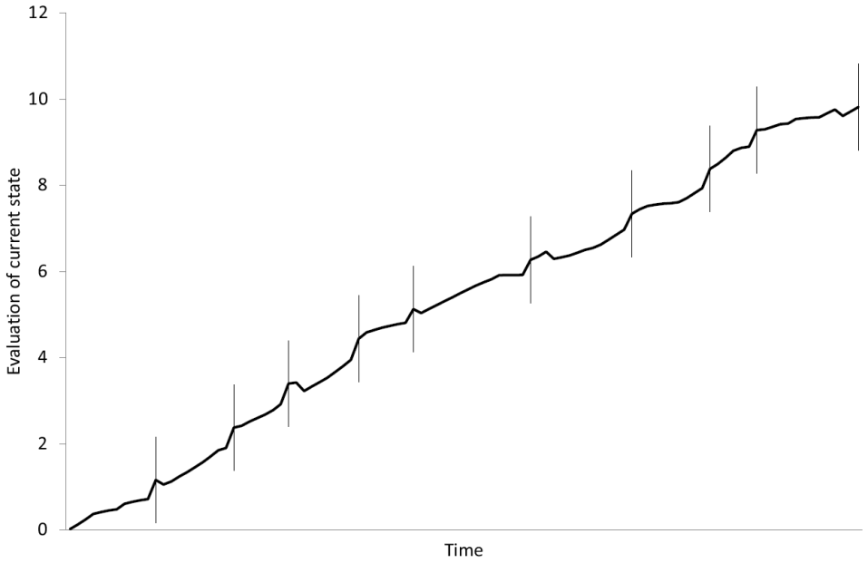
Heuristic evaluation
Guides the ship towards the current waypoint
Sharp increase in score for collecting the waypoint…
… At which point the distance to the next waypoint takes over

Slide 21
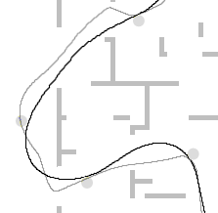
Macro-actions
Choosing a different action every time step is an unnecessary level of granularity
Instead, choose an action to be executed for the next T time steps
T=90
T=30

Slide 22
Benefits of macro-actions
Vastly reduce size of state space
Original state space size: ≈10¹⁵⁵⁶
Macro-action state space size (T=15): ≈10¹⁰³
A reduction of ≈1453 orders of magnitude
Size of macro-action space is comparable to 9×9 Go
See T times further into the future for the same tree depth
Have T times longer to make each decision
MCTS is not only anytime but also interruptible

Slide 23
Conclusion
MCTS is a powerful general-purpose AI technique
Asymmetric, Anytime, Aheuristic
MCTS has proven successful in several challenging classes of games
Games of imperfect information
Commercial mobile games
Real-time games
It shows promise in many other games and non-game applications

Slide 24
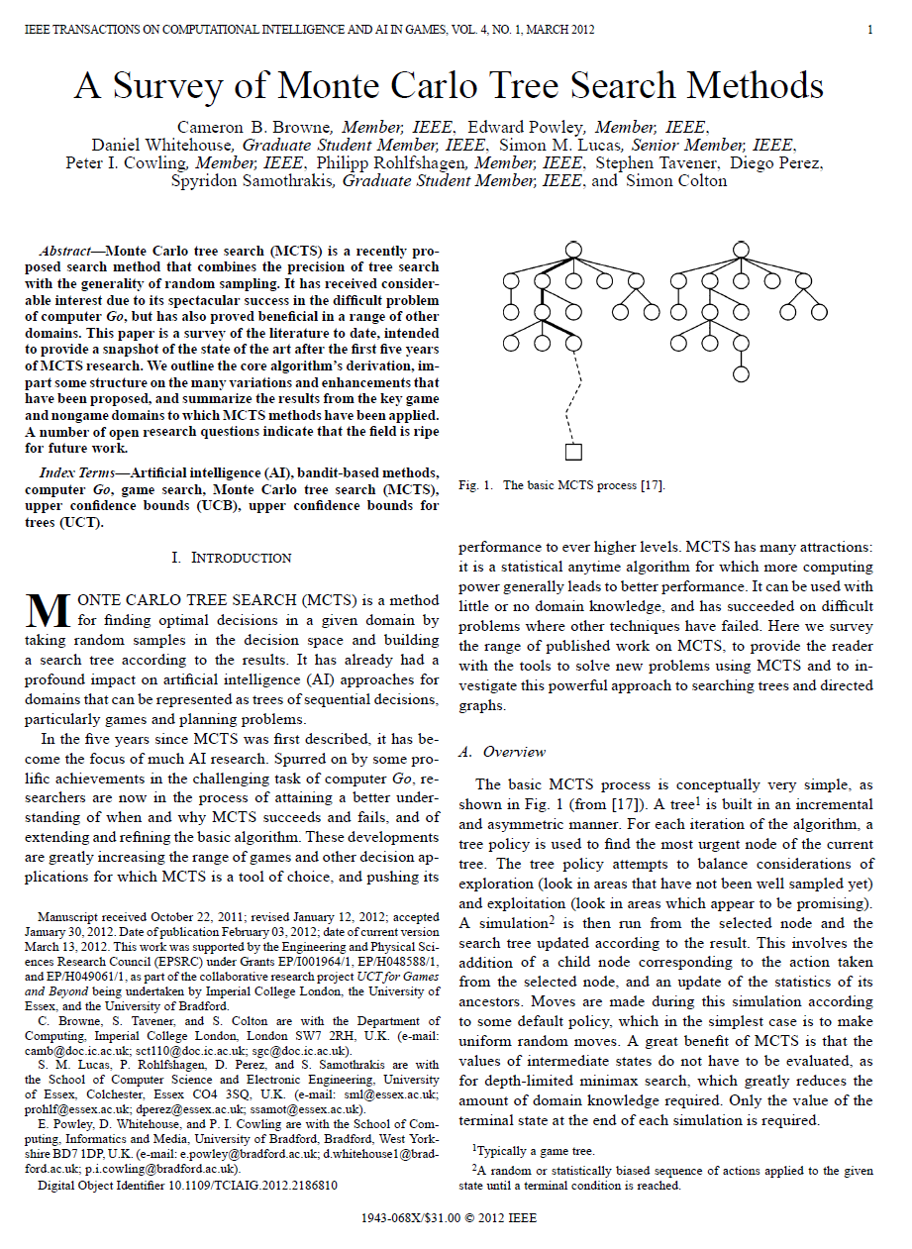
Further reading
C Browne et al.
A Survey of Monte Carlo Tree Search Methods.
IEEE Transactions on Computational Intelligence and AI in Games, 4(1):1-43, 2012.

