Slide 1

Week 1: Revision Numbers and Spaces
COMP270: Mathematics for 3D Worlds and Simulations

Slide 2
Objectives
Recall the most common number systems
Understand the relationships between the different number systems
Describe collections of numbers using set notation
Introduce coordinate systems as a mathematical concept

Slide 3

Counting
Humans first developed numbers as a way of counting things
How many sheep do I have? 1, 2, 3, 4, …
This gives us the natural numbers i.e. the counting numbers $ℕ=\left\{1, 2, 3, 4,…\right\}$
We use blackboard bold font for the standard number systems
Curly braces denote a set
“…” means “continue this sequence to infinity”

Slide 4

Counting
Humans first developed numbers as a way of counting things
How many sheep do I have? 1, 2, 3, 4, …
This gives us the natural numbers i.e. the counting numbers $ℕ=\left\{1, 2, 3, 4,…\right\}$
What if I have no sheep? This gives us the concept of zero
Some people include 0 in the natural numbers, some don’t
You may also see $ℕ_{0}=\left\{0, 1, 2, 3, 4, …\right\} ℕ_{+}=\{1, 2, 3, 4, …\}$

Slide 5

Integers
We can calculate with natural numbers: $5+3$, $5×3$, $5 −3$…
What is the answer to $3−5$? We need negative numbers
Adding negative numbers to the natural numbers gives us the integers (or whole numbers) $ℤ=\left\{…, −3, −2, −1, 0, 1, 2, 3, …\right\}$
Why Z? From the German Zahlen, meaning numbers
Infinite sequence to the left as well as to the right

Slide 6
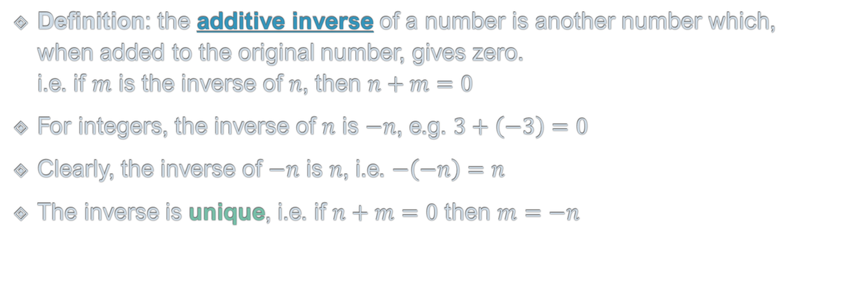
Negative Numbers and Inverses
Definition: the additive inverse of a number is another number which, when added to the original number, gives zero. i.e. if $m$ is the inverse of $n$, then $n+m=0$
For integers, the inverse of $n$ is $−n$, e.g. $3+\left(−3\right)=0$
Clearly, the inverse of $−n$ is $n$, i.e. $−\left(−n\right)=n$
The inverse is unique, i.e. if $n+m=0$ then $m=−n$
Zero is called the additive identity

Slide 7
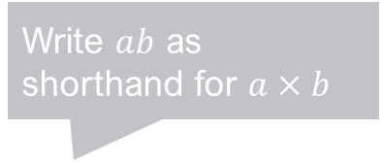
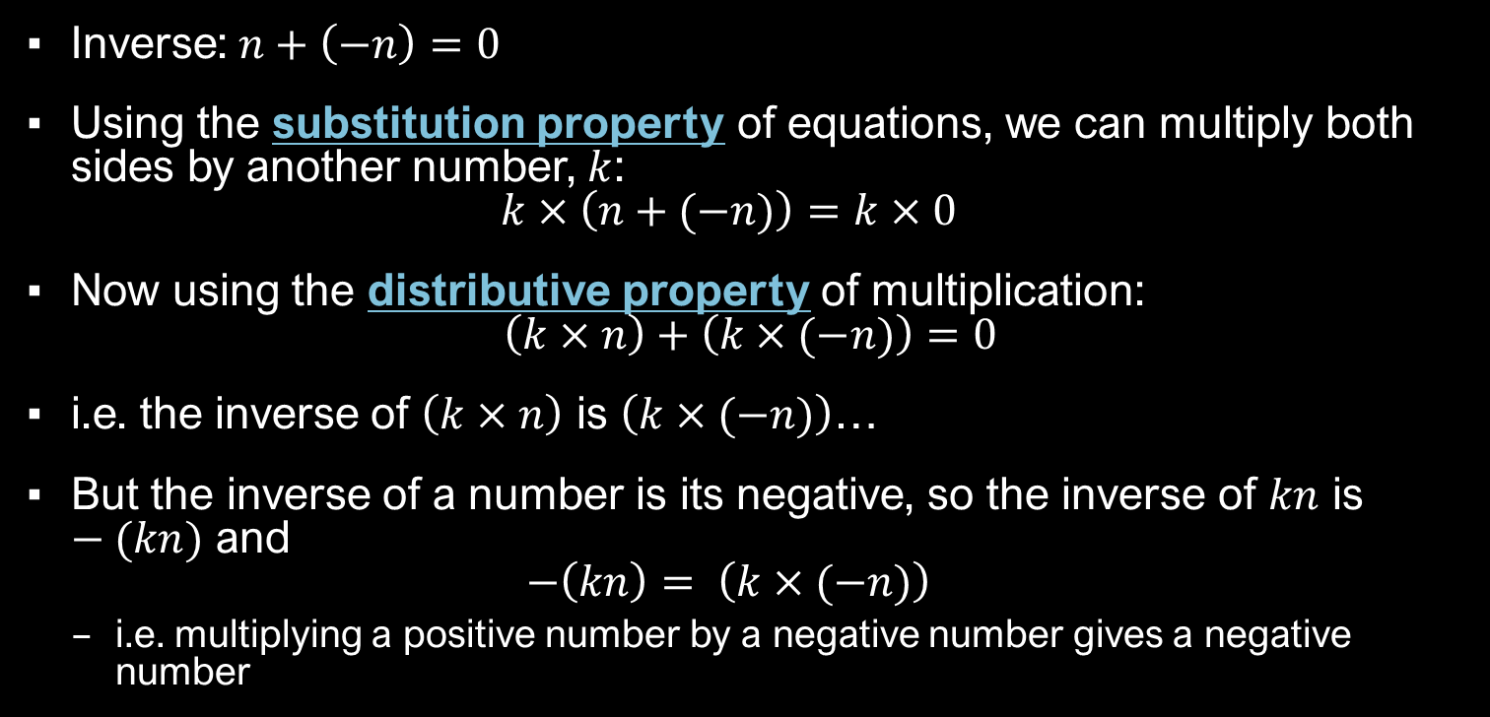

Multiplying Negative Integers
“Doing the same thing to both sides of the equation”
Inverse: $n+\left(−n\right)=0$
Using the substitution property of equations, we can multiply both sides by another number, $k$: $k×\left(n+(−n)\right)=k×0$
Now using the distributive property of multiplication: $\left(k×n\right)+\left(k×(−n)\right)=0$
i.e. the inverse of $\left(k×n\right)$ is $\left(k×(−n)\right)$…
But the inverse of a number is its negative, so the inverse of $kn$ is $−(kn)$ and $−\left(kn\right)= \left(k×(−n)\right)$
i.e. multiplying a positive number by a negative number gives a negative number
$$a×\left(b+c\right)=\left(a×b\right)+(a×c)$$
Write $ab$ as shorthand for $a×b$

Slide 8

Multiplying Negative Integers
What if we multiply by a negative number, $−k$? $(−k)×\left(n+(−n)\right)=0$
Again, using distributivity: $\left((−k)×n\right)+\left((−k)×(−n)\right)=0$
From the previous slide, we know that $\left((−k)×n\right)=−\left(kn\right)$, so: $−(kn)+\left((−k)×(−n)\right)=0$
i.e. $\left((−k)×(−n)\right)$ is the inverse of $−kn$
We know that the inverse of $−\left(kn\right)$ is $kn$, so that $kn=k×n=\left((−k)×(−n)\right)$
i.e. multiplying two negative numbers gives a positive number

Slide 9
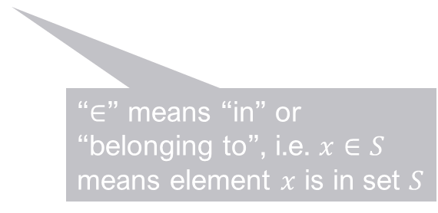
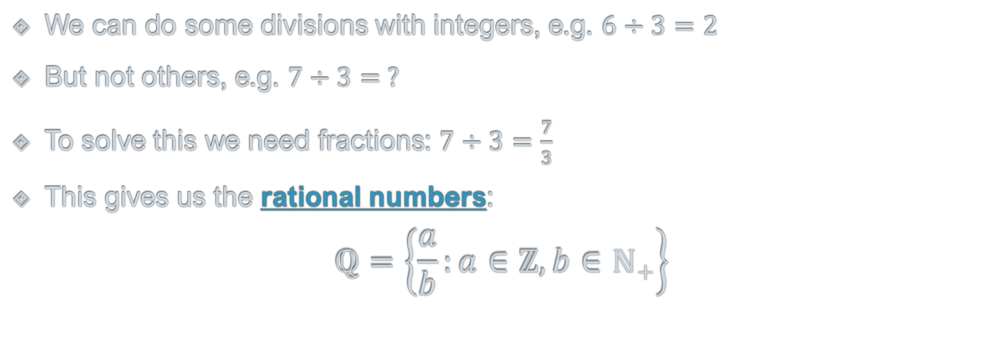

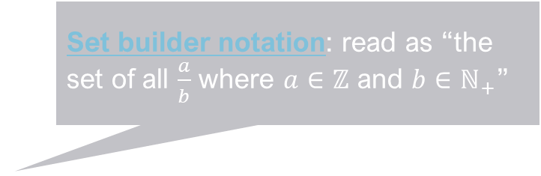
Division and Fractions
We can do some divisions with integers, e.g. $6÷3=2$
But not others, e.g. $7÷3= ?$
To solve this we need fractions: $7÷3=\frac{7}{3}$
This gives us the rational numbers: $ℚ=\left\{\frac{a}{b}:a∈ℤ, b∈ℕ_{+}\right\}$
Set builder notation: read as “the set of all $\frac{a}{b}$ where $a∈ℤ$ and $b∈ℕ_{+}$”
Note the restriction on $b$…
Why Q? From Quotient, meaning ratio or division
“$∈$” means “in” or “belonging to”, i.e. $x∈S$ means element $x$ is in set $S$
“:” means “where”

Slide 10

Division and Fractions
We can do some divisions with integers, e.g. $6÷3=2$
But not others, e.g. $7÷3= ?$
To solve this we need fractions: $7÷3=\frac{7}{3}$
This gives us the rational numbers: $ℚ=\left\{\frac{a}{b}:a∈ℤ, b∈ℕ_{+}\right\}$
There are multiple ways to write the same fraction, e.g.
$\frac{7}{3}=\frac{14}{6}=\frac{700}{300}$ Mathematically, they are all considered to be identical.

Slide 11

Decimals
In a fraction $\frac{a}{b}$ , $a$ is called the numerator and $b$ the denominator
Note that decimals are just fractions where the denominator is a power of 10
e.g. $0.7=\frac{7}{10}$ $12.345=\frac{12345}{1000}$
So the decimal numbers are a subset of $ℚ$ (or equal to $ℚ$ if we allow recurring decimals)

Slide 12

Reals
Some numbers cannot be written exactly as fractions, e.g. $π$, $\sqrt{2}$, $e$
Such numbers are called irrational
Putting together the rational and irrational numbers gives the real numbers $ℝ$
The real numbers can be thought of as the points on an infinite line (from $−∞$ to $+∞$)
Note however that all real numbers are finite

Slide 13

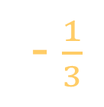
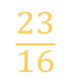





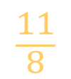



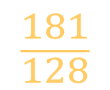



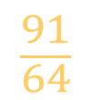



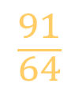


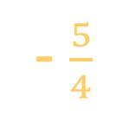
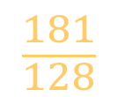



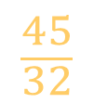
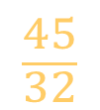


$$\sqrt{2}≈\frac{99}{70}$$
The Number Line
$$\frac{23}{16}$$
$$\frac{5}{4}$$
$$\frac{11}{8}$$
$$\frac{3}{2}$$
$$\frac{45}{32}$$
$$ℚ$$
$$1$$
$$\frac{91}{64}$$
- $\frac{5}{4}$
- $\frac{1}{3}$
$$\frac{1}{2}$$
$$\frac{3}{2}$$
$$\frac{45}{32}$$
$$\frac{181}{128}$$
$$\frac{91}{64}$$
$$\frac{181}{128}$$
$$ℝ$$
$$−4$$
$$−3$$
$$−2$$
$$2$$
$$e$$
$$3$$
$$−1$$
$$0$$
$$1$$
$$\sqrt{2}$$
$$π$$
$$4$$
$$ℕ$$
$$ℤ$$

Slide 14

The Cartesian Product
Named after René Descartes, 1596-1650, French mathematician
For two sets $S$ and $T$, the Cartesian product $S×T$ is defined as the set of all pairs of elements, the first from $S$ and the second from $T$: $S×T=\left\{\left(a,b\right):a∈S, b∈T\right\}$
Generalises to products of 3, 4, … sets
Cartesian products of a set with itself give Cartesian powers: $S^{2}=S×S=\left\{\left(a,b\right):a∈S, b∈S\right\}$ $S^{3}=S×S×S=\left\{\left(a,b,c\right):a∈S, b∈S, c∈S\right\}$
B
 | 1 | 2 | 3
x | (x,1) | (x,2) | (x,3)
y | (y,1) | (y,2) | (y,3)
z | (z,1) | (z,2) | (z,3)
A

Slide 15



















$$3$$
$$(4, 3)$$
$$ℤ×ℤ$$
$$(−3, 2)$$
$$2$$
$$1$$
$$(1, 1)$$
$$(0, 0)$$
$$−4$$
$$−3$$
$$−2$$
$$−1$$
$$1$$
$$2$$
$$3$$
$$4$$
$$(−4, −1)$$
$$−1$$
$$−2$$

Slide 16

Cartesian Coordinate Systems
Idea: use the elements from a Cartesian product as coordinates to specify positions in a space.
$ℝ^{1}=ℝ$ is 1-dimensional space, aka the space of scalars
$ℝ^{2}=ℝ×ℝ$ is 2-dimensional space, aka the 2D plane
$ℝ^{3}$ is 3-dimensional space
$ℝ^{n}$ is n-dimensional space…

