Slide 1
Week 2: Geometry I Part 2: Vector Basics
COMP270: Mathematics for 3D Worlds and Simulations
Notes:
This is the second part of COMP270 week 2 content, where we’ll be introducing vectors,

Slide 2
Objectives
Recall the definition of a vector and how it differs from a point or a line
Apply basic arithmetic operations to vectors in 2D
Notes:
Seeing what exactly they are and looking at some operations we can do with them.

Slide 3




Recap
$$y$$
A point in 2D is a pair of values, or coordinates, specifying a position relative to a pair of perpendicular axes.
A line extends infinitely and can be uniquely defined by two points through which it passes.
$$B=(x_{b}, y_{b})$$
$$x$$
$$A=(x_{a}, y_{a})$$
Notes:
Last time, we looked at points, which specify a position in a given coordinate space,
And lines, which can be defined by a pair of points. Strictly speaking, a mathematical line has infinite length and it doesn’t matter which order we consider the points in, but often, we’re only interested in the section between the two points, which can be described by a vector:

Slide 4
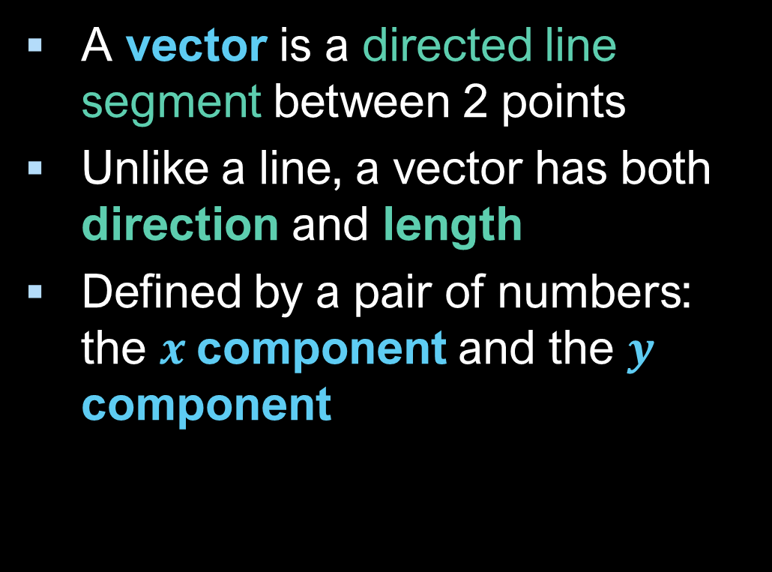




2D Vectors
A vector is a directed line segment between 2 points
Unlike a line, a vector has both direction and length
Defined by a pair of numbers: the $x$component and the $y$ component
$$B=(x_{b}, y_{b})$$
$$y=y_{b}−y_{a}$$
$$A=(x_{a}, y_{a})$$
$x=$ $x_{b}−x_{a}$
Notes:
Which is defined as a directed line segment between two points.
Clearly, it has a length, and the direction is also important: whether it points from A to B, or B to A, which is why we draw vectors as arrows.
It’s represented by two numbers, the x and y components, which are the differences in the coordinate values between the two points. Given that they’re both defined by a pair of values, vectors look a lot like points, and in fact

Slide 5






Vectors and points
A vector can represent a point relative to the origin:
… but a point is not the same as a vector!
$$y$$
$$B=(x_{b}, y_{b})$$
$$y=y_{b}−0$$
$$A=(0,0)$$
$x=$ $x_{b}−0$
$$x$$
(Except in some code…)
Notes:
A vector can be used to express the displacement of a point from the origin, in which case the components of the vector are equal to the coordinates of the point –
Although they are not the same thing,
Since they do share some similarities, some maths libraries use the same object to represent both, but there are situations where it’s important to remember the distinction between them (which we’ll look at later in the course).

Slide 6







Writing vectors
For COMP270: this is a point
As a pair of numbers: $(x,y)$
As a row or column vector: $\left[\begin{matrix}x & y\end{matrix}\right]$, $\left(\begin{matrix}x \\ y\end{matrix}\right)$
Variable representing a vector: written in bold i.e. $v=\left(\begin{matrix}x \\ y\end{matrix}\right)$
Other notations: $\vec{v},\underline{v}$
Vector from $A$ to $B$: $\vec{AB}$ Vector from $B$ to $A:$ $\vec{BA}$
Note: these are not the same, as the components will have opposite signs
$$B$$
$$B$$
$$\vec{AB}$$
$$\vec{BA}$$
$$A$$
$$A$$
Notes:
When it comes to notation, there are different ways of indicating that something is a vector. The coordinates can be written as a pair of numbers,
Though this looks a lot like a point, so I tend to avoid using it.
You can also write the values as a row vector (with either round or square brackets – I think the 3d math primer uses square ones), or as a column vector, which I find the clearest and so will be using for this module.
If we want to give a vector a variable name, this is generally indicated by using a lower case letter in bold font. Since it’s hard to use bold in handwriting, an alternative is to use an underline, or sometimes you’ll see an arrow above the letter.
You might also see a vector written as two capital letters with an arrow above, in which case the letters refer to the start and end points of the vector, written in the order that indicates the direction of the vector. Note that if we reverse the direction, we’ll be negating the components.

Slide 7






Vector magnitude and direction
Recall: a vector is the hypotenuse of the triangle formed with lines through its end points, parallel to the axes
The other side lengths are the vector components, $x$ and $y$
The magnitude (or length) of a vector is given by: $\left\|v\right\|=\sqrt{x^{2}+y^{2}}$
The angle between $v$ and the positive $x$-axis is given by $\tan{θ}=\frac{y}{x}$ (with $\sin{θ}=\frac{y}{\left\|v\right\|}$ and $\cos{θ}=\frac{x}{\left\|v\right\|}$)
$$B$$
$$v$$
$$y$$
$$A$$
θ
$$x$$
Notes:
If the defining characteristics of a vector are its length and direction, how do we compute these?
If you remember, in the last video, we looked at the section of a line between two points as being the hypotenuse, with the other sides given by the horizontal and vertical distances between the points – which are the components of our vector, meaning that the length, or magnitude, of a vector is given by the square root of the sum of the components.
Similarly, the angle with the x-axis is given by the inverse tangent of y over x

Slide 8
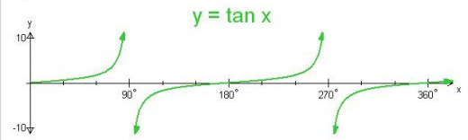





Inverse tangent
An asymptote is a line or curve that approaches a given curve arbitrarily closely
Care is needed when using $\tan^{−1}$:
$\tan^{−1}{\frac{y}{x}}=\tan^{−1}{\frac{−y}{−x}}$ so we need to be aware of which quadrant the vector is in (otherwise the result may be out by 180°)
If $x=0$ (the vector points vertically along the $y$-axis) then we’re dividing by zero
Most programming languages have an atan2(y, x) function which handles all of these cases for you
$$Q2$$
$$y$$
$$Q1$$
$$x$$
$$Q3$$
$$Q4$$
Notes:
There are some things to be aware of when using the inverse tangent that don’t really matter if we’re just looking at angles in triangles or lines without direction, but can give a wrong result when we’re considering vectors.
First of all, as we saw before, dividing two negative numbers cancels the minus signs, so we need to keep track of which way the vector is pointing to make sure we get the correct angle with the positive x axis.
Secondly, if the x component is zero, then we’re in trouble, which we can see reflected in the graph, which has asymptotes for any angles that would be perpendicular to the x-axis. Helpfully,
Most programming languages provide an atan2 function that checks these things for us, so you should always use that one if it’s available, taking care to get the arguments in the right order (y first).

Slide 9
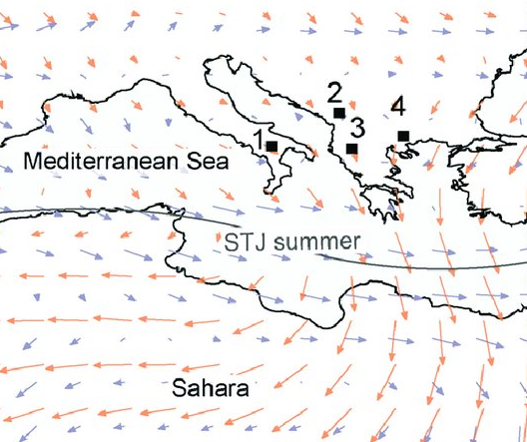



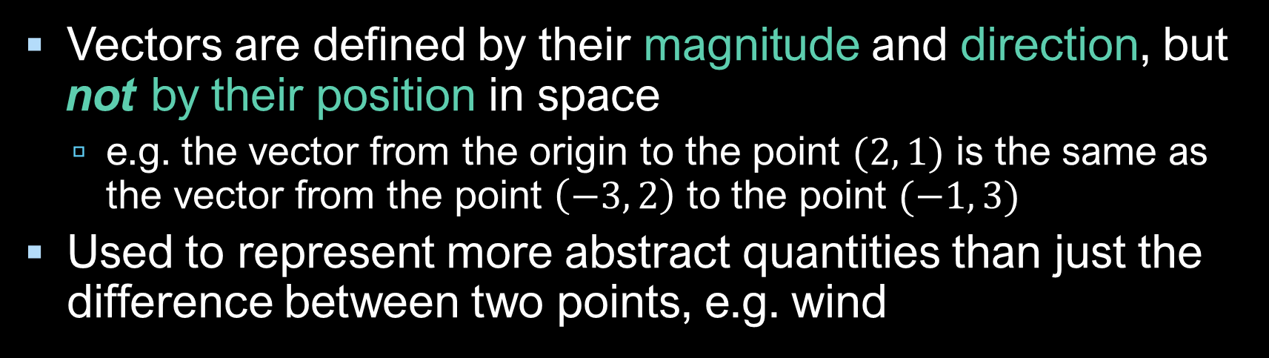















Vector equivalence
Vectors are defined by their magnitude and direction, but not by their position in space
e.g. the vector from the origin to the point $(2, 1)$ is the same as the vector from the point $\left(−3, 2\right)$ to the point $(−1, 3)$
Used to represent more abstract quantities than just the difference between two points, e.g. wind
$$y$$
$$3$$
$$1$$
$$2$$
$$2$$
$$1$$
$$2$$
$$1$$
$$−4$$
$$−3$$
$$−2$$
$$−1$$
$$0$$
$$1$$
$$2$$
$$3$$
$$4$$
$$x$$
Notes:
So vectors can have the same length but different directions, even along the same line, in which case they are not equivalent. If two vectors have the same magnitude and direction, though,
Then they are considered to be the same, regardless of where they are in space: they are position-invariant, for example the vector 2, 1 might start at the origin and go to the point 2, 1, or it could start somewhere else: it’s still the same vector. Although we introduced a vector as being defined between two points,
They’re often used to represent more abstract quantities, such as the wind,
Or forces, in physics. We can combine vectors in different ways,

Slide 10






Vector addition
If $p$ and $q$ are vectors,
$p+q$ is obtained by putting $p$ and $q$ end to end
Performed component-wise, $\left(\begin{matrix}x_{1} \\ y_{1}\end{matrix}\right)+\left(\begin{matrix}x_{2} \\ y_{2}\end{matrix}\right)=\left(\begin{matrix}x_{1}+x_{2} \\ y_{1}+y_{2}\end{matrix}\right)$
Note: addition is commutative: $p+q=q+p$
$$p$$
$$p+q$$
$$q$$
$$p$$
$$q$$
Notes:
Including adding them together. If we think of a vector as a displacement from its start to its end, the sum of two vectors is the displacement from the start of the first to the end of the second, which we can visualise by putting them end to end.
The components of the resulting vector are just the summed components of the original vectors, and so
it doesn’t matter which order we place them in, as addition is commutative.

Slide 11





Vector subtraction
If $p$ and $q$ are vectors representing points on the plane,
$q−p$ represents the vector from $p$ to $q$
Note the order of the subtraction!
$\left(\begin{matrix}x_{1} \\ y_{1}\end{matrix}\right)−\left(\begin{matrix}x_{2} \\ y_{2}\end{matrix}\right)=\left(\begin{matrix}x_{1}−x_{2} \\ y_{1}−y_{2}\end{matrix}\right)$
Note: subtraction is anticommutative: $q−p=−\left(p−q\right)$
i.e. $\vec{BA}=−\vec{AB}$
$$p$$
$$q−p$$
$$0$$
$$q$$
Notes:
We can also subtract vectors, which is conceptually like travelling along one vector and then ‘backwards’ along the other. We’ve met this operation before, when we took the differences between the coordinates of two points to get the vector between them;
Obviously, the order this time does matter, as reversing it will negate the result.

Slide 12




Scalar multiplication
If $v$ is a vector and $c$ is a positive number
$cv$ is a vector with the same direction as $v$, but $c$ times the magnitude
$c\left(\begin{matrix}x \\ y\end{matrix}\right)=\left(\begin{matrix}cx \\ cy\end{matrix}\right)$
If c is negative then $cv$ has the opposite direction to $v$
$$2v$$
$$v$$
$$−2v$$
Notes:
Finally, we can multiply a vector by a scalar value, which for a positive number preserves the direction but scales the magnitude – you can verify this using the formulae on slide 7. If the number is negative, then the direction is flipped and the vectors are parallel but opposite.
That’s all we need to know right now about vectors; we’re going to make use of these operations in the next video, where we’ll be looking at ways of describing lines and other objects.

