Slide 1
Week 3: Geometry II Part 3: Types of Transform
COMP270: Mathematics for 3D Worlds and Simulations
Notes:
Welcome to part 3 of this week’s lecture, where we’ll look at one of the key applications of matrices in computer graphics, which is to use them to transform objects in space – by transform, I basically mean ‘move around’.

Slide 2
Objectives
Identify the main types of affine transformation
Understand the purpose of homogeneous coordinates and how to apply a transform using them
Notes:
The kinds of movement we tend to make are described by something known as affine transformations, so we’ll see what exactly those are, and we’ll also look at a workaround for the limitation of matrices that was touched on in the last video and came up in the quiz, namely not being able to include constant terms in the linear combinations they represent. This workaround is called homogeneous coordinates, which are used pretty much ubiquitously in computer graphics.

Slide 3

Recap: transformation functions as matrices
A matrix can represent a transformation applied to a vector: $\left(\begin{matrix}a_{11} & a_{12} \\ a_{21} & a_{22}\end{matrix}\right)\left(\begin{matrix}x \\ y\end{matrix}\right)=\left(\begin{matrix}a_{11}x+a_{12}y \\ a_{21}x+a_{22}y\end{matrix}\right)$
e.g. $\left(\begin{matrix}0 & 2 \\ 1 & −1\end{matrix}\right)\left(\begin{matrix}x \\ y\end{matrix}\right)=\left(\begin{matrix}2y \\ x−y\end{matrix}\right)$
… Provided that the transformation function is a linear combination of the vector components
Notes:
We saw in the last video that
we can use matrices as a shorthand for applying functions to transform vectors using a kind of multiplication,
For example the function that maps the vector x, y to 2y, x-y can be written as the matrix 0, 2, 1, -1.
As we’ve noted, this only applies for functions that are linear combinations of the components. This is actually fine, because when we’re moving objects around in our virtual worlds we don’t generally want to do anything too weird and wonderful with them, in fact we’re mostly interested in a special class of transformations that are known as

Slide 4
Affine transformations
Definition: an affine transformation is any transformation that preserves collinearity and ratios of distances
i.e. Straight lines remain straight, and
Proportions are preserved
Does not necessarily preserve angles or lengths
Includes expansion, dilation, reflection…
Most are compositions of rotation, translation, scale and shear
Notes:
Affine transformations.
These are mappings that preserve collinearity – meaning that points that were on a line before the transform is applied are still on a line afterwards, or in other words,
Straight lines stay straight – and they also preserve the ratios of distances between points on a line, so the
midpoint of the line stays in the middle and each line’s length stays the same relative to the other lines. However,
It doesn’t necessarily preserve absolute lengths or angles: it can stretch things, just not bend them. For instance, it’s possible to map any triangle to any other using an affine transformation; you just can’t map it to any other shape.
There are various different kinds of affine transformation, which you can look up online if you’re interested, but
Most are actually some combination of the four main types: rotation, translation, scale, and shear, which we’re going to look at now.

Slide 5
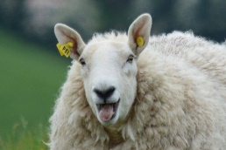

Scale matrix
Multiplying a vector by a scalar $s$ has the effect of scaling about the origin
Represented by a matrix, this is: $\left(\begin{matrix}s & 0 \\ 0 & s\end{matrix}\right)$
More generally, can represent a scaling by a factor of $s_{x}$ horizontally and $s_{y}$ vertically by the matrix $\left(\begin{matrix}s_{x} & 0 \\ 0 & s_{y}\end{matrix}\right)$
Notes:
We’ll start with scale, as it’s the simplest:
a uniform scale is effectively just a scalar multiplication, like we saw in the last video,
Which we can represent with a diagonal matrix with s for each non-zero entry.
If we apply this to every point in an object – or rather, to each vector representing the displacement of a point from the origin - it will expand all the points away from the origin
We can also apply a non-uniform scale by setting different values for the x and y components, like so;
this has the effect of stretching the object further along one axis than the other.

Slide 6
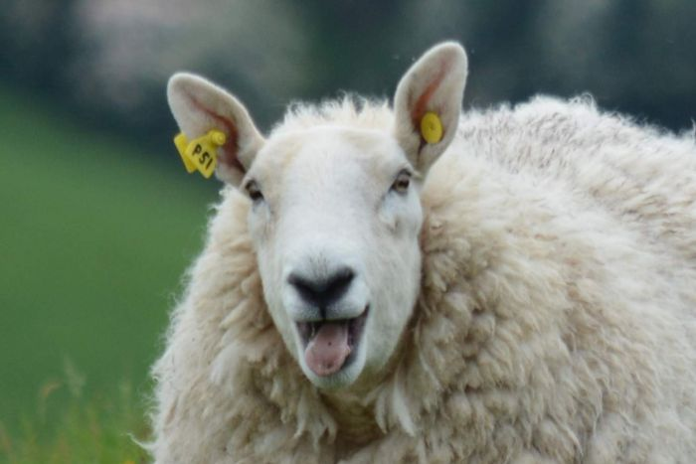

Reflection matrix
The following matrices represent horizontal and vertical reflections respectively: $\left(\begin{matrix}−1 & 0 \\ 0 & 1\end{matrix}\right) \left(\begin{matrix}1 & 0 \\ 0 & −1\end{matrix}\right)$
Notes:
We can use a non-uniform scale to perform a reflection in one of the axes, by flipping the component along that axis to the negative, effectively scaling by minus 1.

Slide 7
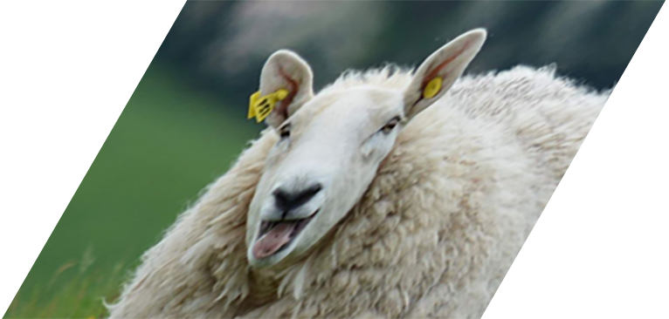


Shear matrix
A shear transformation by a factor of $λ$ parallel to the $x$-axis is given by the matrix $\left(\begin{matrix}1 & λ \\ 0 & 1\end{matrix}\right)$
$$\left(\begin{matrix}x \\ y\end{matrix}\right)=\left(\begin{matrix}x+λy \\ y\end{matrix}\right)$$
Notes:
Another fairly straightforward transformation is
shearing (if you’d not guessed, that’s why we brought the sheep).
Unfortunately PowerPoint doesn’t seem to have a shearing animation, so you’ll have to make do with static images for this one… As you can see, this is a transform that doesn’t preserve angles; it effectively pushes the x values out to some degree proportional to the corresponding y value,
by including a multiple of y in the new x component. It’s possible to shear in the y-direction, too; I’ll leave it to you to figure out how to achieve that… We tend not to come across this transform so often in computer graphics (not intentionally, anyway – if this happens to an object you’re transforming it generally means something has gone awry), but it does come up in image processing, and it’s useful to know what it is.

Slide 8




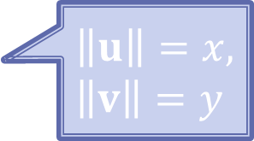




Rotation around the origin
Consider a point represented by the vector $p=\left(\begin{matrix}x \\ y\end{matrix}\right)$
Rotate $p$ by an angle of $θ$ anticlockwise around the origin
by taking this triangle…
…and rotating it by $θ$
Define vectors along the rotated triangle’s sides: $u=\left(\begin{matrix}x\cos{θ} \\ x\sin{θ}\end{matrix}\right)$ and $v=\left(\begin{matrix}−y\sin{θ} \\ y\cos{θ}\end{matrix}\right)$
So $p^{′}=u+v=\left(\begin{matrix}x\cos{θ}−y\sin{θ} \\ x\sin{θ}+y\cos{θ}\end{matrix}\right)$
$$p′$$
$$v$$
$$p$$
$$u$$
$$y$$
$$\left\|u\right\|=x, \\ \left\|v\right\|=y$$
$$θ$$
$$x$$
Notes:
Things get a little more complicated when we start rotating objects; let’s break down the steps and the calculations involved.
We’ll start with a point represented by a vector p, with components x and y.
Now suppose we want to rotate p around the origin by an angle theta; by convention, we’ll go anticlockwise.
We can find p’s new position by considering the triangle formed by the components
And rotating it so that the side that was lying on the x-axis is now at an angle theta from it.
We can find the vectors that represent the rotated triangle’s shorter sides using trigonometry – you can check the results yourself, remembering that
the lengths of the vectors, which form the hypontenuses of the triangles with their components, are the original x and y component values.
Finally, the new position of the point, p’, is given by u plus v, as shown.

Slide 9


Rotation matrix
$r_{θ}\left[\left(\begin{matrix}x \\ y\end{matrix}\right)\right] =\left(\begin{matrix}x\cos{θ}−y\sin{θ} \\ x\sin{θ}+y\cos{θ}\end{matrix}\right)$
$R_{θ}=\left(\begin{matrix}\cos{θ} & −\sin{θ} \\ \sin{θ} & \cos{θ}\end{matrix}\right)$
Some useful rotations:
$R_{0}=\left(\begin{matrix}\cos{0} & −\sin{0} \\ \sin{0} & \cos{0}\end{matrix}\right)=\left(\begin{matrix}1 & 0 \\ 0 & 1\end{matrix}\right)$
$R_{\frac{π}{2}}=\left(\begin{matrix}\cos{\frac{π}{2}} & −\sin{\frac{π}{2}} \\ \sin{\frac{π}{2}} & \cos{\frac{π}{2}}\end{matrix}\right)=\left(\begin{matrix}0 & −1 \\ 1 & 0\end{matrix}\right)$
The identity matrix: doesn’t change the vector.
A uniform scale by -1, or a reflection in both axes.
$R_{π}=\left(\begin{matrix}\cos{π} & −\sin{π} \\ \sin{π} & \cos{π}\end{matrix}\right)=\left(\begin{matrix}−1 & 0 \\ 0 & −1\end{matrix}\right)$
Notes:
We can write this as a function, r-theta, which transforms a vector to its rotation about theta,
Or putting it into matrix form, we get the rotation matrix capital-R theta as shown. By the way, this is standard notation, to use a bold face capital letter to denote a matrix.
There are some rotations we might be particularly interested in, for example,
A rotation through zero degrees gives the special matrix with ones along the diagonal and zeroes elsewhere, which is
Known as the identity matrix, and doesn’t alter the vector it’s applied to; we’ll be looking at this in more detail in the next video.
Another common angle to be interested in is 90 degrees, or pi over two radians, which gives the matrix we introduced in the last video for the function we called r.
Finally, rotating through 180 degrees flips both components to the negative,
Which is effectively a scale by minus one, or a reflection in both axes.

Slide 10

Translation matrix?
$\left(\begin{matrix}a_{11} & a_{12} \\ a_{21} & a_{22}\end{matrix}\right)\left(\begin{matrix}x \\ y\end{matrix}\right)=\left(\begin{matrix}a_{11}x+a_{12}y \\ a_{21}x+a_{22}y\end{matrix}\right)$
For any matrix $A$, we have $A\left(\begin{matrix}0 \\ 0\end{matrix}\right)=\left(\begin{matrix}0 \\ 0\end{matrix}\right)$
i.e. any transformation that can be represented by a matrix must keep the origin fixed
Therefore translation (i.e. shifting all points by a constant vector) cannot be represented as a matrix
Neither can rotating / scaling / shearing / reflecting around a point other than the origin…
Notes:
We’ve now seen three of the main types of affine transforms I mentioned at the start: scale, shear and rotation, so that just leaves one more: translation, or moving a point by a fixed amount.
However, we have a slight problem with this, in that we can only represent functions as matrices if they transform the components to some combination of x and y – there isn’t any way to include any other values, including constants.
This means that if we apply the matrix to the origin, we can only get the origin back,
In other words, a matrix transform will always keep the origin fixed – because it can’t do anything else.
This means that we can’t actually represent adding a constant vector, which is what translation is, by a matrix in this way,
And also that all the operations we’ve looked at so far have been centred on the origin, for instance scaling takes the points a multiple of their original distance from the origin, and rotations are always through an angle that’s measured from the origin.

Slide 11

Homogeneous coordinates
Definition: homogeneous coordinates $(x_{1}$, $x_{2}$, $x_{3})$ of a finite point $(x, y)$ in the plane are three numbers for which $\frac{x_{1}}{x_{3}}=x$ and $\frac{x_{2}}{x_{3}}=y$
i.e. represent points in $ℝ^{2}$ by vectors in $ℝ^{3}$
The third component is usually $1$ if the vector represents a point – so $\left(\begin{matrix}x \\ y\end{matrix}\right)$ becomes $\left(\begin{matrix}x \\ y \\ 1\end{matrix}\right)$
Often written $(x, y, w)$
Notes:
This rather spoils our neat notation, so we use a workaround, called homogenous coordinates,
Which turn our two-dimensional coordinates into three components, the third of which acts as a scaling factor on the other two. You don’t generally need to worry about what that means, though, as 99% of the time,
For a point, that third component will just be 1.
Often, this third component is termed w, rather than using subscripts – we can’t use z because that will be our third axis in 3D space. Note that even though it is usually just 1, it’s generally implemented as a variable in code, as there are situations when its value might change; we might have a look at those later on.

Slide 12

Homogeneous matrices
Translation by $\left(\begin{matrix}t_{x} \\ t_{y}\end{matrix}\right)$ is represented by the matrix $\left(\begin{matrix}1 & 0 & t_{x} \\ 0 & 1 & t_{y} \\ 0 & 0 & 1\end{matrix}\right)$
Multiplying by this matrix is the same as adding $\left(\begin{matrix}t_{x} \\ t_{y} \\ 0\end{matrix}\right)$ : $\left(\begin{matrix}1 & 0 & t_{x} \\ 0 & 1 & t_{y} \\ 0 & 0 & 1\end{matrix}\right)\left(\begin{matrix}x \\ y \\ 1\end{matrix}\right)=\left(\begin{matrix}x+t_{x} \\ y+t_{y} \\ 1\end{matrix}\right)$
Existing transformation matrices stay similar: $\left(\begin{matrix}a_{11} & a_{12} \\ a_{21} & a_{22}\end{matrix}\right)$ becomes $\left(\begin{matrix}a_{11} & a_{12} & 0 \\ a_{21} & a_{22} & 0 \\ 0 & 0 & 1\end{matrix}\right)$
Notes:
Now that we have an extra value to work with, we can write a 3x3 matrix to represent translation, like so:
You can see when we apply this to one of our homogeneous vectors, it has the effect of adding our constant values in x and y to the coordinates.
We can also transfer our existing transformation matrices for rotation, scale and shear to this new format, by putting their values into the top-left corner and setting the translation components to zero; you can check for yourselves to make sure that the results for the x and y components are the same as with the 2x2 matrices.
We now have the four basic affine transformations – translation, rotation, scale and shear – expressed in matrix form, which we will want to combine to move our points and vectors (and any objects made up of these) around in a variety of ways. Of course, we could just keep applying matrices to our vector until we get the result we want, but that doesn’t make use of the matrix’s full potential. They also have some quirks that you need to look out for, which will be the subject of the next video.

