Slide 1
Week 4: Mechanics I Part 1: Calculus
COMP270: Mathematics for 3D Worlds and Simulations
Notes:
The topic for this week is the mechanics of physical simulation, which involves computing an object’s position in 2D or 3D space as it changes over time due to external forces. We’ll take a look at the quantities and variables we’ll be dealing with in the next video, but first we need to establish some general notation and concepts for how we represent the ideas associated with values that change over time, which is the field known as calculus.

Slide 2
Objectives
Define the derivative and the integral of a quantity
Understand the relationship between changes in a quantity, time and their graphical representation
Estimate values using numerical methods
Notes:
We’ll start by defining the key entities of calculus, which are the derivative and the integral, and introducing the processes by which these are obtained from an expression for a particular quantity as well as how they can be represented visually on a graph and how they describe relationships between changing values, for instance over time. Finally, we’ll consider how to use the derivative to estimate how values change in a discrete setting using numerical methods.

Slide 3






Recap: functions and graphs
Define a function $f :S→T$ as $f\left(s\right)∈T$ for $s∈S$
Represent the function $f : ℝ→ℝ$ as a graph by plotting the points $\left(x,f\left(x\right)\right)$against 2D axes
AKA $y=f\left(x\right)$
$$f(x′)$$
$$f(x)$$
$x$’
$$x$$
$$y={\frac{1}{4}x}^{2}−4$$
Notes:
Let’s start with a quick recap: if you remember earlier in the module,
we looked at functions as relationships between values in sets, mapping an element of one set – the domain - onto an element of another, the codomain, which might be the same set as the domain or a different one. For functions operating on real numbers,
We drew the graph by plotting the output of the function
on the vertical axis against the input values
on the horizontal at various intervals
and drawing lines between them.
Since we’re representing the input and output values as distances along the x and y axes respectively, we call this the graph of y = f of x.
Let’s pretend for a moment that we can plot points for every value in the domain, or along the x-axis, so we have a smooth, continuous curve.

Slide 4
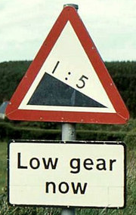






Graph properties: tangent and rate of change
Definition: the slope (or gradient) is a quantity which gives the inclination of a curve or line with respect to another curve or line.
$m= \frac{Change in y}{Change in x}=\frac{∆y}{∆x}$
For a quantity that changes over time: $\text{Rate} \text{of} \text{change}=\frac{\text{Change} \text{in} \text{quantity}}{\text{Change} \text{in} \text{time}}$
This Photo by Unknown Author is licensed under CC BY-SA
$$=\tan{θ}$$
Tangent line
$$∆y$$
$$θ$$
How much the quantity changes in a single unit of time
$$y={\frac{1}{4}x}^{2}−4$$
$∆$ (delta) = “change in”
$$∆x$$
Notes:
Besides considering individual pairs of domain and codomain elements, or in other words input and output values, which are all the points lying on the curve, it’s often useful to know how these pairs of values relate to each other as we travel along the curve; in particular, looking at how much the y output changes as the x input does. We can represent this using
the tangent to the graph at the point we’re considering, which is drawn as a line that “just touches” the curve at that point. If we’ve drawn it accurately, we can measure the
slope (or gradient) of the curve at that point by
Taking the change in the y value, and dividing it by the change in x – if you drive, you might be familiar with
road signs that give the gradient, or steepness, of a hill as a ratio of how far you have to travel horizontally to drop one unit in height, so ‘1 in 5’ means that for every 5 miles you travel horizonally, you end up a mile lower than you started, or higher if you’re driving the other way. I think most signs actually use a percentage now, which is the same information but presented in a different way. So we use the same idea to analyse our graphs;
These little triangle-looking symbols are the Greek capital letter delta, which is used as shorthand to represent a change in some quantity.
Notice that this fraction is the same as the tangent function of the angle between the tangent line and the x-axis, hence the naming. As a more general term, and especially for quantities that change over time, so that the x value represents points in time,
We say that the rate of change of the quantity is the amount of change in that quantity divided by the time over which that change takes place. =Note that we could just take the difference in the actual values of the quantity at the start and end of the interval, we would get the an averaged rate of change over the interval; we use the values from the tangent to give the rate of change at a particular point. You can see that on this graph, the gradient down here is fairly low, but it increases as you move along the curve.=
Dividing by the time gives us the amount by which the quantity changes for a single unit of time.

Slide 5
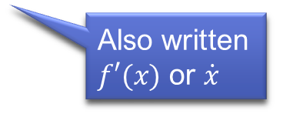
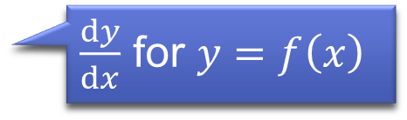


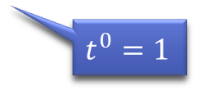


Derivatives
Definition: the derivative of a quantity $x$ with respect to time $t$ is the rate of change of $x$ with respect to $t$
Denoted $\frac{dx}{dt}$ for $x=f(t)$
The mathematical process of finding $\frac{dx}{dt}$ given $x$ is called differentiation
For polynomials:
Multiply coefficients by corresponding exponents
Lower each exponent by one degree
Remove constant (exponent = 0)
$$x=f(t)$$
$\frac{dy}{dx}$ for $y=f\left(x\right)$
$$t$$
Also written $f′(x)$ or $\dot{x}$
e.g. $x=2t^{3}+t^{2}+3t+4$ $⇒$ $\frac{dx}{dt}={6t}^{2}+2t+3$
$t^{0}=1$
Notes:
Measuring lines graphs is fun but somewhat inaccurate. The more precise way to find a gradient is to use what’s known as the derivative,
Which is an algebraic way of calculating the rate of change of one quantity with respect to another; =the phrase “with respect to” is standard maths-speak to indicate that the change in the first quantity is being measured as the result of changing the second.=
If we’re measuring a quantity x that changes over time, the derivative is written as dx by dt. Note that we’ve kinda switched the variables around here from the previous slide, so that in our graph,
the value of t for time would be along the horizontal axis, with x being a function of t measured along the vertical. If we were using the usual axis labels x and y, we’d write the derivative
as dy by dx. This notation matches the formula we had on the previous slide, with the ds instead of deltas essentially representing an infinitesimal change in the values, as if you made your measurements using the smallest possible distances along each axis .
We find the derivative by a process known as differentiation, for which there are various rules depending on what form the function takes; I’m not going to go through them all as actually computing them is beyond the scope of this module, but one technique I’ll be using in another of this week’s videos is
differentiating polynomials, where you follow three simple steps: first, multiply the coefficients of t by the exponents, or powers; then reduce the exponent values, then remove constant values (which are essentially coefficients multiplied by t to the power of zero).
So, for example, the polynomial […] has derivative =2x3 t ^ (3-1) + 1x2 t ^ (2-1) + (3x1)t ^ 1-1… remember that
anything to the power zero is one, so this t term becomes a constant, and the constant 4 disappears, as it’s essentially the coefficient of t with exponent zero, so multiplying that exponent vanishes the term. There are, of course, reasons for why this works as it does, which you can see in one of the videos on LearningSpace if you’re interested, though don’t worry about remembering the process; as long as you remember that the derivative is just the rate of change, or gradient, that’s enough for this module; also bear in mind that the derivative is another function, mapping between the same sets as the original, so it can be differentiated again and again until all it just becomes a constant term. Those of you who’ve completed the third task on the first assignment worksheet have seen an example of differentiation, where you were given the formula for the tangent to the Bezier curve that you could use to point the car in the right direction, so hopefully now you can see where that came from.
Just as a final note, you might also see the derivative written as f-dash x, or x-dot; these all mean exactly the same thing, though the x-dot notation is reserved for derivatives with respect to time only.

Slide 6





Derivatives: example
$$t$$
A car drives along a straight road at a constant speed
In half an hour, it covers a distance of 20 miles
Its speed (which we know is constant) is $\frac{\text{20 }\text{miles}}{\text{0.5 }\text{hours}}\text{ = 40}\text{mph}$
In other words…
“Distance travelled” is a quantity varying with time
We call the rate of change (the derivative) of this quantity “speed”
If $x$ is distance travelled and $t$ is time, then $\frac{dx}{dt}=\frac{20}{0.5}=40$
$$x$$
$$t=0$$
Notes:
We’ve just covered a lot of theory, so let’s look at an example of where we might find derivatives in everyday real life.
If we have a car driving in a straight line at a constant speed – that is, with no acceleration or deceleration,
And in half an hour, it covers 20 miles,
We can find the speed as distance over time, which is 40 mile per hour.
If we break down the quantities here, then
The distance travelled is the quantity, x, that varies with time;
And its rate of change, or derivative, is the speed - since in this case it’s constant, we don’t have to worry about it changing at different points.
So for this particular case, the value of dx by dt, the derivative of the distance travelled with respect to time, is the constant 40. We’ll have a look at what to do if the speed does change in later videos, but for now there’s another entity we should meet, which is

Slide 7


Integrals
Definition: the integral is the reverse of the derivative…
Given $\frac{dx}{dt}$, $x$ is the integral of $\frac{dx}{dt}$
The process of finding this is called integration – the opposite of differentiation
For polynomials:
Increase each exponent by one degree
Divide coefficients by new exponents
Add a constant…
e.g. $\frac{dx}{dt}={6t}^{2}+2t+3$
$$⇒ x=2t^{3}+t^{2}+3t+c$$
Some constant value…
Notes:
The integral.
Which is basically just the opposite of the derivative; so
It describes what the quantity x is in relationship to its derivative dx by dt.
We find the integral of a value by a process known as integration, which is just the steps to differentiate applied backwards – so,
For a polynomial, first add the one degree back to the exponents that differentiation took off, and then divide the coefficients by these new exponents, and reintroduce the constants that were removed in the derivative.
So if we apply those rules to the function we differentiated earlier, we get back the same function… well, almost.
We actually lost information about the constants when we differentiated, and there’s no way to know just from the derivative what they are; we’d need some extra information to find their values, though it’s often enough just to be aware that they might exist.
We’ll see this in action later on when we use integration to produce some formulae that extend the concepts from the previous slide, but for now, let’s go back to the discrete world that we left when we assumed that we had a function that we could evaluate at any point in time to find the value of the quantity, and consider how we can find information about the rate of change of a quantity that isn’t defined as a nice neat function, but by a more complex formula or perhaps a simulation. In this case, we have to estimate what will happen next based on the current values, for which we can use a process of

Slide 8
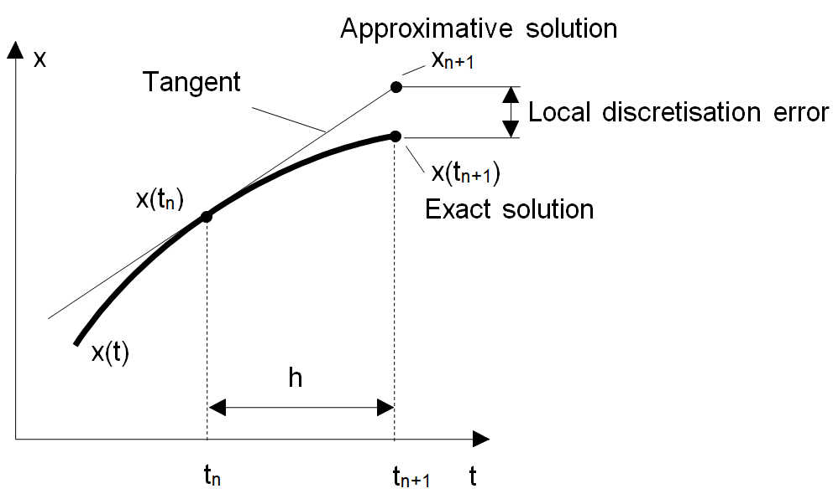
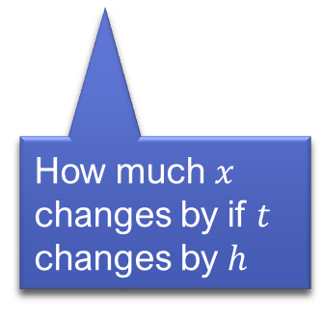

Numerical integration – Euler’s method
Leonhard Euler (1707-1783), Swiss mathematician
Given the values of $x$ and $\frac{dx}{dt}$ at time $t$, we can estimate the value of $x$ at time $t+h$ for small $h$: $x\left(t+h\right)≈x\left(t\right)+h\frac{dx}{dt}$
Demonstration here
How much $x$ changes by if $t$ changes by $h$
Notes:
Numerical integration, or Euler integration,
Which is name after the 18th century Swiss mathematician Leonhard Euler, who made several important contributions to calculus, graph theory and topology, as well as in mechanics and fluid dynamics. He figured out that,
If you know the value of the quantity x at time t, and its derivative at that time, you can estimate the value of x at a time close to t – say, t + h – as being the value at t plus h times the derivative. Since dx/dt, the rate of change, tells us how much x changes if t changes by 1, then if we multiply it by h, that gives
“how much x changes if t changes by h”.
If we look at this represented on a graph, we can intuitively see how it works, as we =start at the original point, and then move a along the tangent line until we’ve reached the point where t = t + h, which gives a rough estimate of where the graph will be. Obviously, the larger our value of h, the less accurate the result is likely to be (assuming that the derivative changes), so we have to be careful to not take too big a step and introduce a significant error.= There are also more sophisticated formulae for numerical integration that give smaller errors, which tend to be used in most applications nowadays, but this simple approximation gives the essential idea.
You can see a demonstration of how to use Euler’s method on the Khan Academy site here; there’s also a link on LearningSpace.

Slide 9

Calculus with vectors
The rate of change of a vector is also a vector
If $v∈ℝ^{n}$ then $\frac{dv}{dt}∈ℝ^{n}$
Differentiate component-wise: if $v=\left(\begin{matrix}x \\ y\end{matrix}\right)$ then $\frac{dv}{dt}=\left(\begin{matrix}{dx}/{dt} \\ {dy}/{dt}\end{matrix}\right)$
Notes:
As you may have gathered from previous module content, not all of the quantities we deal with in computer graphics are simple scalar values; for instance, if things are moving, they tend to have a position in 2 or 3 dimensions, with changes in position – an offset between two points - represented by a vector that has direction as well as size. The good news is that we can use the same calculus techniques with vectors as we do with scalars;
The rate of change of a vector is also a vector quantity,
And the dimension stays the same. We’re effectively measuring the rates of change of each component direction of the vector, and so
We can just differentiate component-wise to the get the derivative of the vector. We’re going to look later at how we actually apply these calculations in a simulation, but before then, the next video will introduce the quantities and units that we’ll be dealing with.

