Slide 1
Week 5: Mechanics II Part 2: Calculating Distances
COMP270: Mathematics for 3D Worlds and Simulations
Notes:
In the first part of this week’s lecture, we looked at how to tell if one object intersects another, which means that they’re both trying to occupy the same point in space. In this section, we’ll continue the idea of comparing the positions in space,

Slide 2
Objectives
Apply geometric principles and vector arithmetic to calculate the distance between a point and a line
Recall a simple method to clamp values in code
Notes:
Using the geometric principles and vector arithmetic we looked at in previous weeks to calculate the distance between a point and a line. As part of this, we’ll see a neat way to clamp values in code.

Slide 3





Recap: Circle and line segment collision
The two collide if and only if the shortest distance between $c$ and the line is $≤r$
The shortest distance may not be the perpendicular distance…
Need to find the closest point on the line segment to $c$.
$$a$$
$$r$$
$$c$$
$$b$$
Notes:
In the last video, we considered how we could tell if a line segment passes through a circle,
Concluding that it happens when the shortest distance between the line segment and the centre of the circle is less than or equal to the radius of the circle. We can find the perpendicular distance by projecting a vector from the centre of the circle to any point on the line onto the line normal, but that doesn’t work when the circle
Goes past the end of the line segment, in which case the shortest distance will be the distance from the centre to the closest end point.
So we need to find what the closest point to the circle centre along the line segment actually is.

Slide 4




Distance between a point and a line
Given a point $p$ and an infinite line through $a$ and $b$
What is the (shortest) distance between the point and the line?
$$a$$
$$p$$
?
$$b$$
Notes:
I’m going to lose the circle for the rest of the slides so we can focus on just a point,
which we’ll call p, and start by considering and infinite line through two points, a and b. We’ve already mentioned one way to compute the
Shortest distance between the point and the line, using the normal to the line; now we’ll see a slightly different method that also allows us to calculate the point on the line that is closest to p.

Slide 5


Distance between a point and a line
Let $q$ be the point on the line that is closest to $p$
Then the line from $q$ to $p$ must be perpendicular to the line through $a$ and $b$
Thus we have a right-angled triangle as shown
$$a$$
$$p$$
$$q$$
$$b$$
Notes:
We’ll call this point
Q, and since
the line from q to p is perpendicular to the line through a and b,
We can construct a right-angled triangle between q, p and a.

Slide 6





Distance between a point and a line
$$p−a$$
Let $θ$ be the angle shown, then by SOH CAH TOA: $\cos{θ}=\frac{\left\|q−a\right\|}{\left\|p−a\right\|}$
But also by dot product: $\left(p−a\right)⋅\left(b−a\right)=\left\|p−a\right\|\left\|b−a\right\|\cos{θ}$
Substituting $\cos{θ}$: $\left(p−a\right)⋅\left(b−a\right)=\left\|p−a\right\|\left\|b−a\right\|$ $\frac{\left\|q−a\right\|}{\left\|p−a\right\|}$
Rearranging:$\left\|q−a\right\|=\frac{\left(p−a\right)⋅\left(b−a\right)}{\left\|b−a\right\|}$
$$a$$
$$θ$$
$$p$$
$$q−a$$
$$q$$
$$b−a$$
$$b$$
Notes:
Applying our knowledge of trigonometry in right-angled triangles,
We can call the angle at point a theta, and see that its cosine is equal to the
length of the vector between a and q – the adjacent side - divided by the
length of the vector from a to p, the hypotenuse.
We can also find an expression including cosine theta using the geometric definition of the dot product of the
vector from a to p with the
vector from a to b.
If we substitute our trigonometric ratio for cosine theta into the dot product expression,
Noticing that the magnitude of p – a terms cancel out,
we can rearrange what’s left to give the distance from q to a as the dot product of p – a with b – a, divided by the distance from a to b.

Slide 7


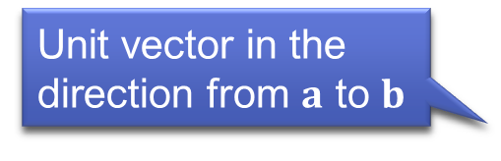
Distance between a point and a line
$$p−a$$
Since $q$ is on the line, we know that the vector $q−a$ is parallel to $b−a$
In fact, $q−a=\left\|q−a\right\|\frac{b−a}{\left\|b−a\right\|}$
Therefore $q=a+\frac{\left(p−a\right)⋅\left(b−a\right)}{{\left\|b−a\right\|}^{2}}(b−a)$
Knowing $q$, the distance between the point and the line is simply $\left\|q−p\right\|$
$$a$$
$$θ$$
$$p$$
Unit vector in the direction from $a$ to $b$
$$q−a$$
$$q$$
“$t$”
$$b−a$$
$$b$$
Notes:
This is all we need to know to find the position of q:
Since it lies on the same line as a and b,
We can find the vector from a to q by multiplying its length, which we found on the previous slide, by the
unit vector in the direction from a to b; remember that to find a unit vector, you just divide a vector by its length.
If we substitute in the expression for the magnitude of q – a from the previous slide, we get an expression for q as a plus a scalar value given by the dot product of p – a with b – a divided by the squared magnitude of b – a. multiplied by the vector from b to a.
Now we have the position of q, we can find the distance between it and p as the magnitude of the vector q – p. If we go back now to the expression for q, and call this scalar value from the dot product, say,
T, you might see that it that the expression resembles how we wrote the vector equation of a line…

Slide 8






Recap: Parametric form of a line
$$t<0$$
Any point on the line between $a$ and $b$ can be written as $a+t\left(b−a\right)$ for some scalar $t$
$0≤t≤1$ for points between $a$ and $b$
Restricting $0≤t≤1$ gives a line segment
$$t=0$$
$$a$$
$$t\left(b−a\right)$$
$$t=1$$
$$b$$
$$t>1$$
Notes:
As a reminder, we defined a line parametrically by realising that
you can get to any point on it by first going to a, and then going some distance along the vector from a to b, with that distance represented by the parameter t.
When t is 0, the point is at a,
And when t is 1, the point is at b.
For t between zero and 1, the point is somewhere between a and b, and
Outside of this range, the point is somewhere beyond
The line segment that is defined between the points.

Slide 9


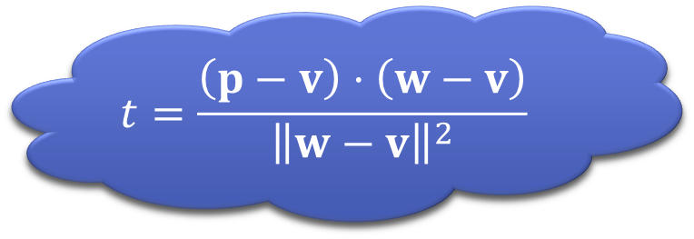

Distance between a point and a line segment
Consider the point $q$ we just found
If $q$ is between $a$ and $b$ ($0<t<1$), then the shortest distance between $p$ and the line segment is $\left\|q−p\right\|$
If $q$ is beyond $b$ ($t>1$), then the shortest distance is $\left\|b−p\right\|$
If $q$ is beyond $a$ ($t<0$) then the shortest distance is $\left\|a−p\right\|$
$$a$$
$$p$$
$$q$$
$$p′$$
$$t=\frac{\left(p−v\right)⋅\left(w−v\right)}{{\left\|w−v\right\|}^{2}}$$
$$b$$
$$q′$$
Notes:
This helpfully gives us a way to determine whether our point
q is on the finite segment of the line between a and b – we just need to see whether the
scalar expression we identified earlier as the value of the parameter t is between 0 and 1. If it is, then
The shortest distance between the point and the line is the distance between p and q.
If q is out beyond b, so that the t scalar is greater than 1, then the shortest distance to the actual line segment will be
Between b and p. Likewise, if
Q is the other side of a, with t less than 0, then the shortest distance is between a and p.

Slide 10

Computing the distance for all cases
To clamp a value x between m and m: max(m, min(x, n))
if (t < 0)
d = (a – p).magnitude();
else if (t > 1)
d = (b – p).magnitude();
else
d = (q – p).magnitude();
t = max(0, min(1, t));
q = a + t(b – a);
d = (q – p).magnitude();
If we clamp $0≤t≤1$ then we can just use $\left\|q−p\right\|$ in all cases (since $t=0$ gives $q=a$ and $t=1$ gives $q=b$)
Notes:
If we want to write this in code, we might be tempted to write something like
This, treating each case separately. This is OK, but we can actually do something neater if we
Clamp the value of t, which means that if it’s less than zero we set it equal to zero, and if it’s greater than 1 we set it to 1 – which will give us that q = a or b as appropriate. Some libraries contain a clamp function we could use, but if there isn’t one it’s still possible to do it on a single line, using the
Min and max functions like so. The general form to clamp a value x between a minimum value of m and a maximum of n is
to take the minimum of the actual value of x and the highest value we want to let it be, n, which clamps it to the top end of the range, then take the maximum of that result and the lowest value we’ll allow x be, m, to clamp to the bottom end. / So now we’ve seen how to find out how close a point is to a line, which we can use as part of our intersection tests, and also factors into the computations of collision response, which is how we simulate the effects of collisions on the behaviour of objects (and get them to stop intersecting); this is the subject of the next part of the lecture.

