Slide 1
Week 7: 3D Geometry I Part 1: Vectors in 3D
COMP270: Mathematics for 3D Worlds and Simulations
Notes:
We’re going to step back into the world of geometry this week, but this time with an extra dimension…

Slide 2
Objectives
Extend 2D vector arithmetic into three dimensions
Define a new vector operation, the cross product
Notes:
There’ll be a bit of revision as we recap some basic vector arithmetic and extend it into the third dimension, and we’ll also introduce a new vector operation, the cross product.

Slide 3









































Recap: coordinate systems
2D Cartesian coordinates:
$$ℝ^{2}=ℝ×ℝ$$
3D Cartesian coordinates:
$$ℝ^{3}=ℝ×ℝ×ℝ$$
$$y$$
$$y$$
$$3$$
$$(4, 2.5)$$
$$3$$
$$(0,2,2)$$
$$(4, 2.5,0)$$
$$(−3, 2)$$
$$2$$
$$(−3, 2,0)$$
$$z$$
$$2$$
$$(1, 1)$$
$$(1, 1,0)$$
$$4$$
$$1$$
$$1$$
$$3$$
$$2$$
$$1$$
$$−4$$
$$−3$$
$$−2$$
$$−1$$
$$0$$
$$1$$
$$2$$
$$3$$
$$4$$
$$x$$
$$−4$$
$$−3$$
$$−2$$
$$−1$$
$$0$$
$$1$$
$$2$$
$$3$$
$$4$$
$$x$$
$$−1$$
$$−1$$
$$(−4, −1)$$
$$(−4, −1,0)$$
$$−2$$
$$−1$$
$$−3$$
$$−2$$
$$−4$$
$$−2$$
$$(3,−1,−3)$$
Notes:
Let’s start by reminding ourselves of the
2D coordinate system setup, where we represented the Cartesian product of the set of real numbers with itself as a
pair of axes at right angles to each other, crossing at the origin, which represents the value of zero on both axes.
We can represent other values in the space as points with pairs of coordinates that represent distances along each axis.
Taking this idea into three dimensions, we now need to use
An additional axis, which is perpendicular to both the x and y axes. Unfortunately, computer screens are still only 2D for the moment, so you’ll need to imagine the z axis as pointing either into or out of your screen; it doesn’t really matter which way for now, though the way I’ve drawn it here is generally interpreted as pointing away from you. We also need to include the extra coordinate when writing our points;
the 2D points from before can all be given a z coordinate of zero, as they stay on the xy plane,
And we can also specify points with a non-zero z coordinate which might lie on one of the other axis planes,
Or in between all of them.

Slide 4












Recap: what is a vector?
A vector is a directed line segment between 2 points
$$B=(x_{b}, y_{b})$$
$$B=(x_{b}, y_{b},z_{b})$$
In 2D:
In 3D:
$$z=z_{b}−z_{a}$$
$$y=y_{b}−y_{a}$$
$$y=y_{b}−y_{a}$$
$$y$$
$$A=(x_{a}, y_{a})$$
$x=$ $x_{b}−x_{a}$
$$z$$
$$A=(x_{a}, y_{a},z_{a})$$
$x=$ $x_{b}−x_{a}$
$$x$$

Slide 5




Addition and subtraction in 3D
Addition:
$$\left(\begin{matrix}x_{1} \\ y_{1} \\ z_{1}\end{matrix}\right)+\left(\begin{matrix}x_{2} \\ y_{2} \\ z_{2}\end{matrix}\right)=\left(\begin{matrix}x_{1}+x_{2} \\ y_{1}+y_{2} \\ z_{1}+z_{2}\end{matrix}\right)$$
Subtraction:
$$\left(\begin{matrix}x_{1} \\ y_{1} \\ z_{1}\end{matrix}\right)−\left(\begin{matrix}x_{2} \\ y_{2} \\ z_{2}\end{matrix}\right)=\left(\begin{matrix}x_{1}−x_{2} \\ y_{1}−y_{2} \\ z_{1}−z_{2}\end{matrix}\right)$$
$$y$$
$$z$$
$$x$$

Slide 6

3D dot product and magnitude
Dot product:
$$\left(\begin{matrix}x_{1} \\ y_{1} \\ z_{1}\end{matrix}\right)∙\left(\begin{matrix}x_{2} \\ y_{2} \\ z_{2}\end{matrix}\right)= x_{1}x_{2}+y_{1}y_{2}+z_{1}z_{2}$$
Magnitude:
$$\left\|\left(\begin{matrix}x \\ y \\ z\end{matrix}\right)\right\|=\sqrt{x^{2}+y^{2}+z^{2}}=\sqrt{\left(\begin{matrix}x \\ y \\ z\end{matrix}\right)∙\left(\begin{matrix}x \\ y \\ z\end{matrix}\right)}$$

Slide 7






3D vector magnitude: proof
$$y$$
$$z$$
_{(x, y, z)}
Consider that $\left(\begin{matrix}x \\ y \\ z\end{matrix}\right)=\left(\begin{matrix}x \\ y \\ 0\end{matrix}\right)+\left(\begin{matrix}0 \\ 0 \\ z\end{matrix}\right)$
We know that the magnitude of the 2D vector $\left({x \atop y}\right)$ is $\sqrt{x^{2}+y^{2}}$
Consider the triangle orthogonal to the $xy$ plane, formed by this vector and the $z$ component…
_{(x, y, 0)}
$$x$$
_{(x, y, z)}
$$z$$
_{(0, 0, 0)}
_{(x, y, 0)}
$$\sqrt{x^{2}+y^{2}}$$

Slide 8



3D dot product: geometric interpretation
2D theorem: $v_{1}∙v_{2}=\left\|v_{1}\right\|\left\|v_{2}\right\|cosθ$
Still applies in 3D because proof is based only on the two vectors, which will always lie on a plane…
For proof/derivation of the formula, see proofwiki.org/wiki/Cosine_Formula_for_Dot_Product
$$v_{1}$$
θ
Infinite flat surface
$$v_{2}$$

Slide 9





Vector cross product
The cross product of two vectors is given as: $$\left(\begin{matrix}x_{1} \\ y_{1} \\ z_{1}\end{matrix}\right)×\left(\begin{matrix}x_{2} \\ y_{2} \\ z_{2}\end{matrix}\right)=\left(\begin{matrix}y_{1}z_{2}−y_{2}z_{1} \\ x_{2}z_{1}−x_{1}z_{2} \\ x_{1}y_{2}−x_{2}y_{1}\end{matrix}\right)$$
Properties
$v_{1}×v_{2}$ is orthogonal to both $v_{1}$and $v_{2}$ $\left(v_{1}×v_{2}\right)∙v_{1}=\left(v_{1}×v_{2}\right)∙v_{2}=0$
Anticommutative: $v_{2}×v_{1}=−\left(v_{1}×v_{2}\right)$
$$v_{1}×v_{2}$$
Direction is determined by the ‘handedness’ of the coordinate system – see part 4!
$$v_{2}$$
$$v_{1}$$
$$v_{2}×v_{1}$$

Slide 10



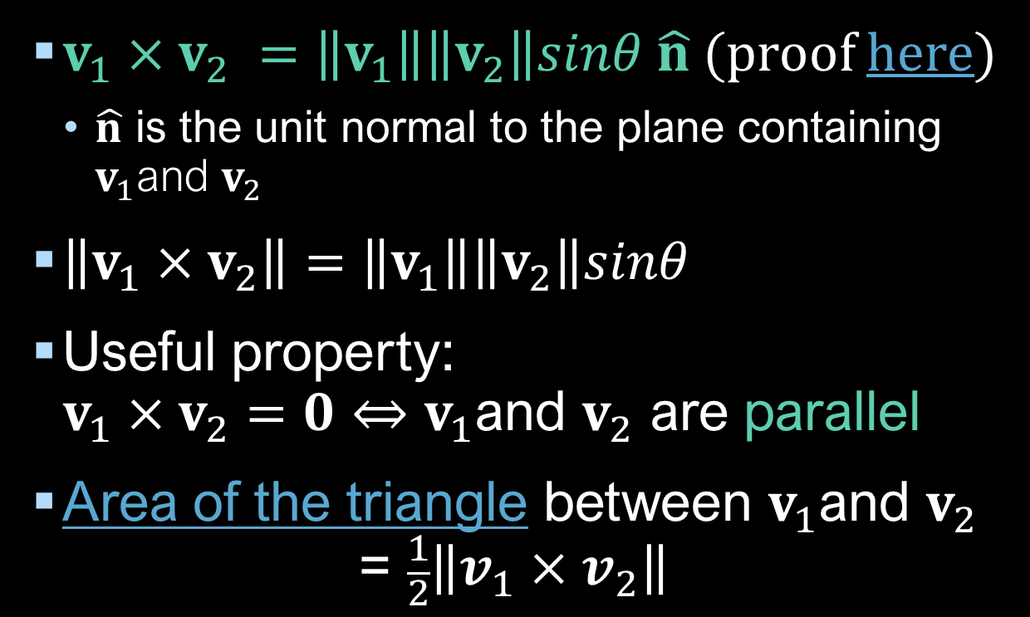

Cross product: geometric interpretation
$v_{1}×v_{2} =\left\|v_{1}\right\|\left\|v_{2}\right\|sinθ \hat{n}$ (proof here)
$\hat{n}$ is the unit normal to the plane containing $v_{1}$and $v_{2}$
$\left\|v_{1}×v_{2}\right\|=\left\|v_{1}\right\|\left\|v_{2}\right\|sinθ$
Useful property: $v_{1}×v_{2}=0⇔$ $v_{1}$and $v_{2}$ are parallel
Area of the triangle between $v_{1}$and $v_{2}$ $\text{= }\frac{1}{2}\left\|v_{1}{×v}_{2}\right\|$
$$v_{1}×v_{2}$$
$\hat{n}$
$$v_{2}$$
θ
$$v_{1}$$
Notes:
We’ve mentioned this idea of a plane and its normal a couple of times in this video, and this is one of the most fundamental concepts in geometry, which we’ll take a closer look at in the next video.

