Slide 1
Week 8: 3D Geometry II Part 2: Coordinate transforms
COMP270: Mathematics for 3D Worlds and Simulations
Notes:
Now we’ve seen how to use matrices for 3D transforms, we can continue our consideration of coordinate spaces from last week,

Slide 2
Objectives
Apply matrix transformations to express points known in one coordinate space relative to another coordinate space
Notes:
And see how to apply the transformations to express points whose coordinates are known in one space relative to the axes of another coordinate space. This is a fundamental operation in computer graphics;

Slide 3






Recap: coordinate spaces
Screen space
$$y$$
World space
Camera space
$$x$$
$$y$$
$$y$$
$$z$$
$$z$$
Object spaces
Centre of Projection (COP)
$$x$$
View plane (screen)
$$x$$
Notes:
As we saw last week, a scene is made up of many different objects, all of which have their own coordinate spaces, defined relative to the world coordinate space, but we need to be able to relate those different spaces to each other -

Slide 4
Transforming between coordinate spaces
Apply world transform to get vertices in world space
Individual vertices of an object are probably stored in object space, with the object’s overall transform specified in world space
To find collisions between two objects, we need both sets of vertices in the same space
Either transform both to world space, or one object to the other object’s space (via the world) – or define a new ‘collision space’
To render the objects, we need to know their vertex positions in camera space (via world space).
Notes:
For example,

Slide 5
Transforming objects vs. spaces
Duality between describing a point in a different coordinate space, and applying a transformation to the point:
Transforming a point to a new coordinate space = transforming the new space to the old
i.e. applying the inverse of the new space’s transform in the old space
Transform in local coordinates…
… or in world coordinates, after applying local to world transform
Notes:
So we can apply matrices to two seemingly different scenarios: the first is transforming objects, moving them to a different point within the same space, and the second is transforming spaces, or leaving the objects where they are but describing them relative to a different set of coordinate axes. As it turns out, these are actually two sides of the same coin –
…
Transforming a point to a new coordinate space is the same as transforming the new space to match the old, or in other words, applying the inverse of the new space’s transform in the old space. So in this example, if we start with the object’s coordinate in the white, world space axes, and want to find the coordinates in the local space, then we take the transform that maps the original axes onto the new ones – so here, shrinking, moving it up and to the right, and rotating it – and apply the opposite of that transform to the object, which is the transform that would match the new, local coordinates, to the old world ones. Let’s look at that idea in a little more detail, as it can be quick tricky to get your head around:

Slide 6







World to local space
Translate (to world space origin), rotate, scale:
The opposite transformation to the one that describes the local space in world coordinates
$$x$$
$$y$$
$$sx$$
θ
$$sy$$
Translate by $\left({−x \atop −y}\right)$
Rotate through $θ$
Scale by $\left({\frac{1}{s_{x}} \atop \frac{1}{s_{y}}}\right)$
Notes:
We’re looking at taking the world-space coordinates of an object and finding them relative to the local axes,
and the order that we do this in is to first translate, then rotate, and finally scale:

Slide 7






Local to world space
Scale, rotate, translate:
the same transformation as the one that describes the local space in world coordinates… this is just how we move objects around the world!
$$x$$
$$y$$
$$sx$$
θ
$$sy$$
Translate by $\left({x \atop y}\right)$
Rotate through $−θ$
Scale by $\left({s_{x} \atop s_{y}}\right)$

Slide 8

Matrices and coordinate space transforms
Remember that a matrix describes a linear mapping:
$$\left(\begin{matrix}m_{11} & m_{12} & m_{13} \\ m_{21} & m_{22} & m_{23} \\ m_{31} & m_{32} & m_{33}\end{matrix}\right)\left(\begin{matrix}x \\ y \\ z\end{matrix}\right)=\left(\begin{matrix}m_{11}x+m_{12}y+m_{13}z \\ m_{21}x+m_{22}y+m_{23}z \\ m_{31}x+m_{32}y+m_{33}z\end{matrix}\right)$$
Applied to the standard basis vectors:
$$\left(\begin{matrix}m_{11} & m_{12} & m_{13} \\ m_{21} & m_{22} & m_{23} \\ m_{31} & m_{32} & m_{33}\end{matrix}\right)\left(\begin{matrix}1 \\ 0 \\ 0\end{matrix}\right)=\left(\begin{matrix}m_{11} \\ m_{21} \\ m_{31}\end{matrix}\right)$$
$$\left(\begin{matrix}m_{11} & m_{12} & m_{13} \\ m_{21} & m_{22} & m_{23} \\ m_{31} & m_{32} & m_{33}\end{matrix}\right)\left(\begin{matrix}0 \\ 1 \\ 0\end{matrix}\right)=\left(\begin{matrix}m_{12} \\ m_{22} \\ m_{32}\end{matrix}\right)$$
$$\left(\begin{matrix}m_{11} & m_{12} & m_{13} \\ m_{21} & m_{22} & m_{23} \\ m_{31} & m_{32} & m_{33}\end{matrix}\right)\left(\begin{matrix}0 \\ 0 \\ 1\end{matrix}\right)=\left(\begin{matrix}m_{13} \\ m_{23} \\ m_{33}\end{matrix}\right)$$
Notes:
Let’s look now at the relationship between matrices and coordinate space transforms.
We use matrices to describe linear mappings between an input point, and its output, which is either the transformed point in the same space, or the point left where it is, but described relative to a different set of axes, which are defined by basis vectors of the space.
So what happens if

Slide 9




Matrices and basis vectors
Theorem: the columns of a transformation matrix $M$ can be interpreted as basis vectors of the space that $M$ transforms to.
Proof: since any vector $x$ can be written as a linear combination of $i$, $j$ and $k$:
$$x=ai+bj+ck$$
$$Mx=M(ai+bj+ck)$$
$$=M\left(ai\right)+M\left(bj\right)+M\left(ck\right)$$
$$=a\left(Mi\right)+b\left(Mj\right)+c(Mk)$$
$$=a\left(\begin{matrix}m_{11} \\ m_{21} \\ m_{31}\end{matrix}\right)+b\left(\begin{matrix}m_{12} \\ m_{22} \\ m_{32}\end{matrix}\right)+c\left(\begin{matrix}m_{13} \\ m_{23} \\ m_{33}\end{matrix}\right)$$
Tip: visualise a transformation by extracting the basis vectors and comparing them to the original axes.
We used this idea to create the 2D rotation matrix:
$$p′$$
$$v$$
$$p$$
$$u$$
$$θ$$
$$y$$
$$x$$
Notes:
This gives us a useful fact:

Slide 10



Example: generalised camera coordinates
VUV
$$y$$
Viewing coordinate system (VC):
View reference point (VRP): the origin (point) of the VC system in world space
The point with respect to which the COP and view plane are defined
View plane normal (VPN): direction vector specifying the positive z-axis of the VC system in world space
Direction the camera is pointing
View up vector (VUV): direction vector used to define the positive y-axis of the VC system in world space
The VC y-axis is formed by projecting the VUV onto a plane perpendicular to the VPN, passing through the VRP
World space
Camera space
VPN
$$y$$
$$z$$
$$z$$
Centre of Projection (COP)
VRP
$$x$$
$$x$$
Notes:
Let’s look at an example of transforming between coordinate spaces, by extending the
simple camera model that we met last week so that the camera can be moved around anywhere in world space, Rather than being constrained to the z axis as before. To do this, we need to set up the viewing coordinate system,
‘’’
VUV doesn’t have to actually be the y axis, as random – so first step is to

Slide 11








Generalised camera: viewing coordinates
Let the $x$-, $y$- and $z$-axes of the viewing coordinates be referred to as $u$, $v$ and $n$ respectively:
$n$ is a unit vector in the direction of the VPN: $n=\frac{VPN}{\left\|VPN\right\|}$
$u$ is unit vector in the direction of the $u$-axis of the viewing coordinates. To form a left-handed system, $u=\frac{n×VUV}{\left\|n×VUV\right\|}$
To obtain the unit vector $v$ along the $v$-axis: $v=u×n$
$$y$$
$$u$$
$$v$$
VUV
VRP
$$n$$
$$x$$
$$z$$

Slide 12
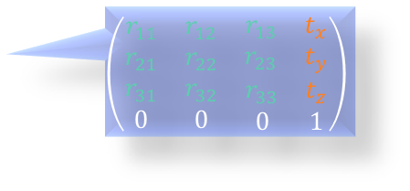
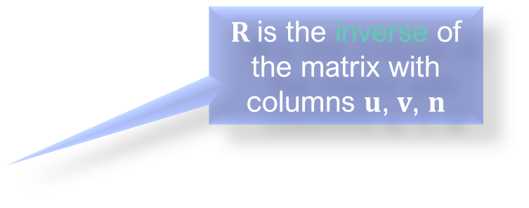

Generalised camera: rotation
Gives a world space point in camera space (= the inverse transform of the camera in world space)
Let $M$ be the 4×4 matrix that maps world coordinate space into viewing coordinate space, partitioned into a rotational part, R, and translation vector $t$: $M=\left(\begin{matrix}R & t \\ 0 & 1\end{matrix}\right)$
The vectors $u$, $v$, $n$ (in world space) must be rotated by $R$ into the unit basis vectors of VC space: $Ru=\left(\begin{matrix}1 \\ 0 \\ 0\end{matrix}\right),Rv=\left(\begin{matrix}0 \\ 1 \\ 0\end{matrix}\right),Rn=\left(\begin{matrix}0 \\ 0 \\ 1\end{matrix}\right)$
That is, $R\left(\begin{matrix}u & v & n\end{matrix}\right)=I$
Since $u$, $v$ and $n$ are orthonormal, $R={\left(\begin{matrix}u & v & n\end{matrix}\right)}^{T}=\left(\begin{matrix}u_{1} & u_{2} & u_{3} \\ v_{1} & v_{2} & v_{3} \\ n_{1} & n_{2} & n_{3}\end{matrix}\right)$ (explanation here).
$$\left(\begin{matrix}\begin{matrix}r_{11} & r_{12} \\ r_{21} & r_{22}\end{matrix} & \begin{matrix}r_{13} & t_{x} \\ r_{23} & t_{y}\end{matrix} \\ \begin{matrix}r_{31} & r_{32} \\ 0 & 0\end{matrix} & \begin{matrix}r_{33} & t_{z} \\ 0 & 1\end{matrix}\end{matrix}\right)$$
$R$ is the inverse of the matrix with columns $u$, $v$, $n$

Slide 13

Generalised camera: translation
Similarly, the VRP must be transformed into the origin of the VC space. If the position of the VRP in world space is given by $q$, then $M\left(\begin{matrix}q \\ 1\end{matrix}\right)=\left(\begin{matrix}\begin{matrix}0 \\ 0\end{matrix} \\ \begin{matrix}0 \\ 1\end{matrix}\end{matrix}\right)$
Substituting $M$ for its partitioned form, $\left(\begin{matrix}R & t \\ 0 & 1\end{matrix}\right)\left(\begin{matrix}q \\ 1\end{matrix}\right)=\left(\begin{matrix}\begin{matrix}0 \\ 0\end{matrix} \\ \begin{matrix}0 \\ 1\end{matrix}\end{matrix}\right)⇒Rq+t=0⇒t=−Rq$

Slide 14
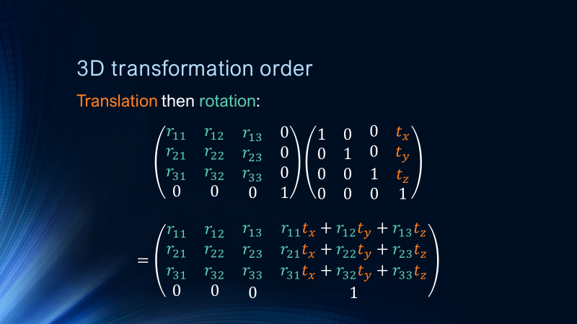
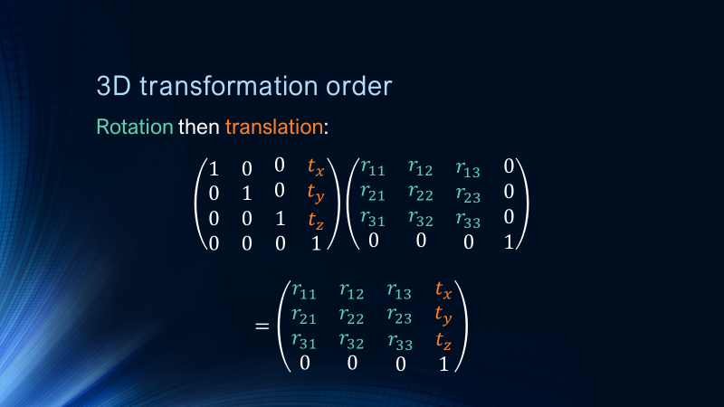

Generalised camera: full transform
Putting everything together, we get $M=\left(\begin{matrix}R & t \\ 0 & 1\end{matrix}\right)=\left(\begin{matrix}\begin{matrix}u \\ v \\ n\end{matrix} & −Rq \\ 0 & 1\end{matrix}\right)=\left(\begin{matrix}\begin{matrix}u_{1} & u_{2} \\ v_{1} & v_{2}\end{matrix} & \begin{matrix}u_{3} & −u∙q \\ v_{3} & −v∙q\end{matrix} \\ \begin{matrix}n_{1} & n_{2} \\ 0 & 0\end{matrix} & \begin{matrix}n_{3} & −n∙q \\ 0 & 1\end{matrix}\end{matrix}\right)$
In addition, the inverse (which transforms from viewing coordinates back to world coordinates) can be written as: $M^{−1}=\left(\begin{matrix}R^{T} & q \\ 0 & 1\end{matrix}\right)$
Notes:
In your raycaster worksheets, you’re asked to implement the transformation for camera to world coordinates, which is the final inverse matrix on this slide. As we’ve seen, this is equivalent to the camera’s transformation in world coordinates, which you can also obtain by combining the elements to move the camera around as you would any other object, bearing in mind some quirks of 3D rotations, which we’ll consider in the next video.

