Slide 1



Lecture 3: Controls and Legal frameworks for
Cybersecurity
COMP280: Creative Computing
BSc(Hons) Computing for Games
BA(Hons) Game Development: Programming

Slide 2


Slide 3
Last time …
Understand how developments in social, technical, legal and economic spheres created an environment for cybersecurity
Define the term ‘cybersecurity’
Identify common hacking and phishing approaches

Slide 4
Learning outcomes
Define the 3 types of control and 6 control strategies
Understand the application of GDPR and DMCA from the perspectives of individuals and organisations
Identify common software development issues using the OWASP as a framework

Slide 5
Define the 3 types of control and 6 control strategies

Slide 6
Types of control
As someone in charge of cybersecurity, what approaches can you use to:
protect the confidentiality, integrity & availability of an organisation’s information assets from malicious actors and/or accidents.

Slide 7
Types of control
As someone in charge of cybersecurity, what approaches can you use to:
Normally, consider this as ‘stopping bad things from happening’
Let’s make an impenetrable system
However, we know from our experiences with virus detection – you are always one step behind the hackers
This is the plot of every bad heist / hacking movie
protect the confidentiality, integrity & availability of an organisation’s information assets from malicious actors and/or accidents.

Slide 8
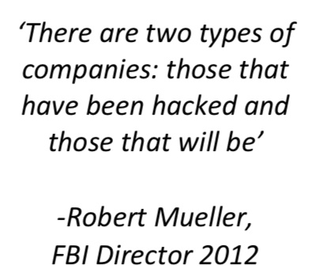
Types of control

Slide 9
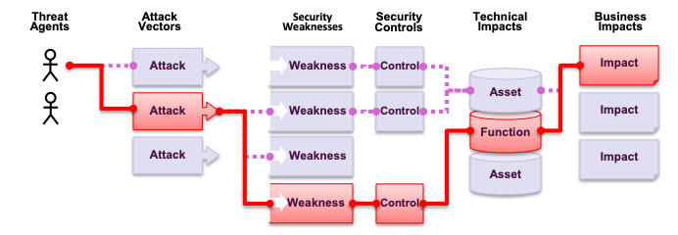
Types of control

Slide 10
Types of control
Preventative
Detective
Corrective

Slide 11
Types of control
Preventative
We want to stop malicious activities where we can:
Passwords & usernames
Locking accounts (close accounts when people quit organisation, limit accounts to certain locations and levels of access)
Updating software to up to date versions
Training Users
Anti-virus / anti-malware applications
Firewalls
We can see this at play in the Academy as part of the IT policy
Detective
Corrective

Slide 12
Types of control
Preventative
Detective
If we can’t stop an attack with preventative measures, we want to monitor what’s going on
Anti-virus / anti-malware reporting applications
Network logging systems
Log files
Again, these are all part of the Academy and University’s IT Policies
Corrective

Slide 13
Types of control
Preventative
Detective
Corrective
When bad things happen, we need to be able to recover lost assets & services quickly and efficiently
Incident report process
Forensic analysis
Back-ups
Redundant systems

Slide 14
Control strategies
There are a lot of control strategies & frameworks:
These will often relate to industries, given that different kinds of industries will have different legal and ethical considerations to operate in
Remember cyber risk assessments from last week
ISO 27001
FFIEC Cyber Security assessment
Payment Card Industry Data Security Standard
Health Insurance Portability and Accountability Act (HIPAA)
CIS 20 Critical Controls
UK NCSC Cyber Essentials
Australian CSC Essential Eight
etc

Slide 15
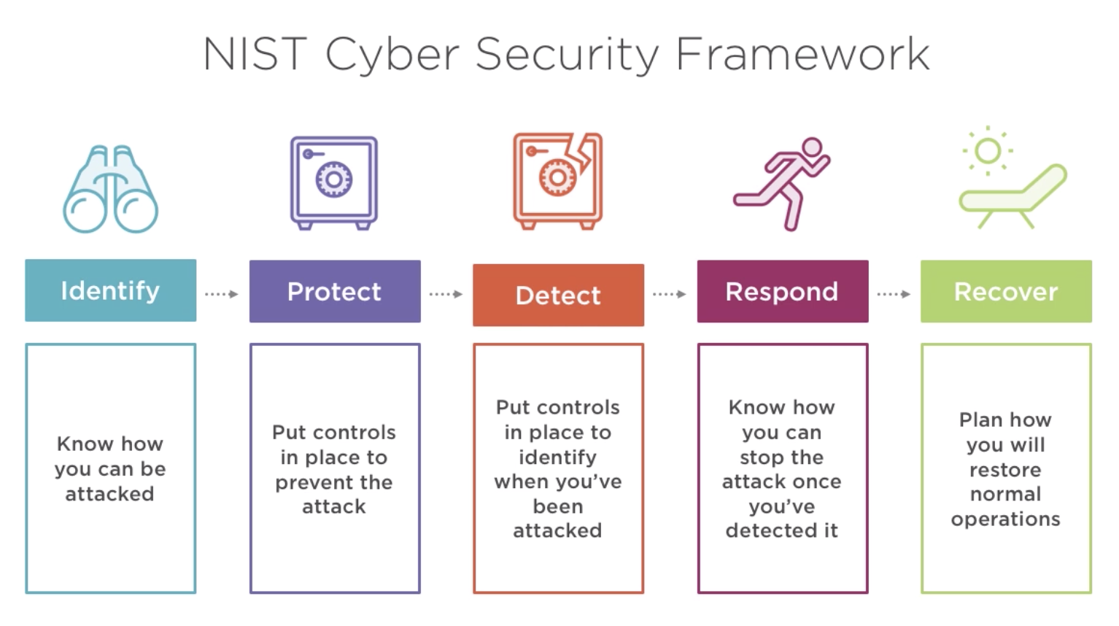
Control strategies
NIST Cybersecurity Framework
(US National Institute of Standards & Technology)

Slide 16
Control strategies
6 essential control strategies
Patch vulnerabilities
Application Whitelisting
System Hardening
Limit accounts
Two-factor authentication
Backup systems and data

Slide 17
Control strategies
6 essential control strategies
Patch vulnerabilities
Update O/S and S/W to address known vulnerabilities
This has become very common with internet-enabled devices
However, does open attack vectors for bogus updates ;)
Application Whitelisting
System Hardening
Limit accounts
Two-factor authentication
Backup systems and data

Slide 18
Control strategies
6 essential control strategies
Patch vulnerabilities
Application Whitelisting
Provide approved applications for users & update/patch to address vulnerabilities
System Hardening
Limit accounts
Two-factor authentication
Backup systems and data

Slide 19
Control strategies
6 essential control strategies
Patch vulnerabilities
Application Whitelisting
System Hardening
Hardening refers to removing things that aren’t needed (or could cause issues)
Harden system security for machines & network infrastructure (e.g. closing ports to firewall)
Stop users from running their ‘own’ applications
This becomes an IT policy with things like ‘no C drive’ and no install privileges on user-level accounts.
Limit accounts
Two-factor authentication
Backup systems and data

Slide 20
Control strategies
6 essential control strategies
Patch vulnerabilities
Application Whitelisting
System Hardening
Limit accounts
Typically, O/S will provide ‘admin’ and ‘user’ level accounts
Look to limit number of admin accounts
Look to limit privilege and functionality of all accounts:
Applications that can be run
Access on network
Two-factor authentication
Backup systems and data

Slide 21
Control strategies
6 essential control strategies
Patch vulnerabilities
Application Whitelisting
System Hardening
Limit accounts
Two-factor authentication
Provide more than just name & password accounts
2nd factor (mobile, email, app, device) can be very useful
Very frustrating in poor mobile environments
2nd factor can be pointless if not properly considered
Backup systems and data

Slide 22
Control strategies
6 essential control strategies
Patch vulnerabilities
Application Whitelisting
System Hardening
Limit accounts
Two-factor authentication
Backup systems and data
Provide fast recovery for system failure & non-availability of systems and/or data (ransomware)
Back-up power …

Slide 23
Control strategies
6 essential control strategies
Patch vulnerabilities
Application Whitelisting
System Hardening
Limit accounts
Two-factor authentication
Backup systems and data
Control assurance
Put systems in place to make sure these strategies work
White hat hacking, disaster recovery
Keep strategies up to date

Slide 24
Understand the application of GDPR and DMCA from the perspectives of individuals and organisations

Slide 25
Legal frameworks
So far, cybersecurity sounds like the Wild West.
Part of STEP / PESTLE is L, Legal considerations
Law making tends to lag law breaking, particularly in ‘new’ areas
technology is a good example of this
Laws will often act as deterrent rather than detective measure
i.e. look to stop crime by making the downsides of crime larger than the upsides
Laws are often blunt

Slide 26
Legal frameworks
UK
Computer Misuse Act (1990)
Serious Crime Act (2015)
Regulation of Investigatory Powers Act (2000)
US
Computer Fraud & Abuse Act (1986)
Digital Millennium Copyright Act (DMCA) (1998)
EU
General Data Protection Regulation (GDPR) (2018)

Slide 27
Legal frameworks
Generally, these laws work to make unauthorised use of computers a criminal act
Blanket and vague enough to cover most cyber criminal attacks (hacking)
Can be problematic for social phishing crimes
Traditional fraud laws will generally cover them, but perpetrators are often in other countries
Nigerian 419 scams
Indian ‘help desk’ scams
For local crimes, US wire & mail fraud laws & UK fraud laws will apply

Slide 28
GDPR (2018)
GDPR applies to all organisations operating within the European Union that process personal data and any companies in the world that process data about EU residents.
This makes it very wide ranging
Anyone or organisation that commits an offence under the GDPR can face fines of up to E20M or 4% of worldwide turnover for organisations
This makes it (potentially) very costly

Slide 29
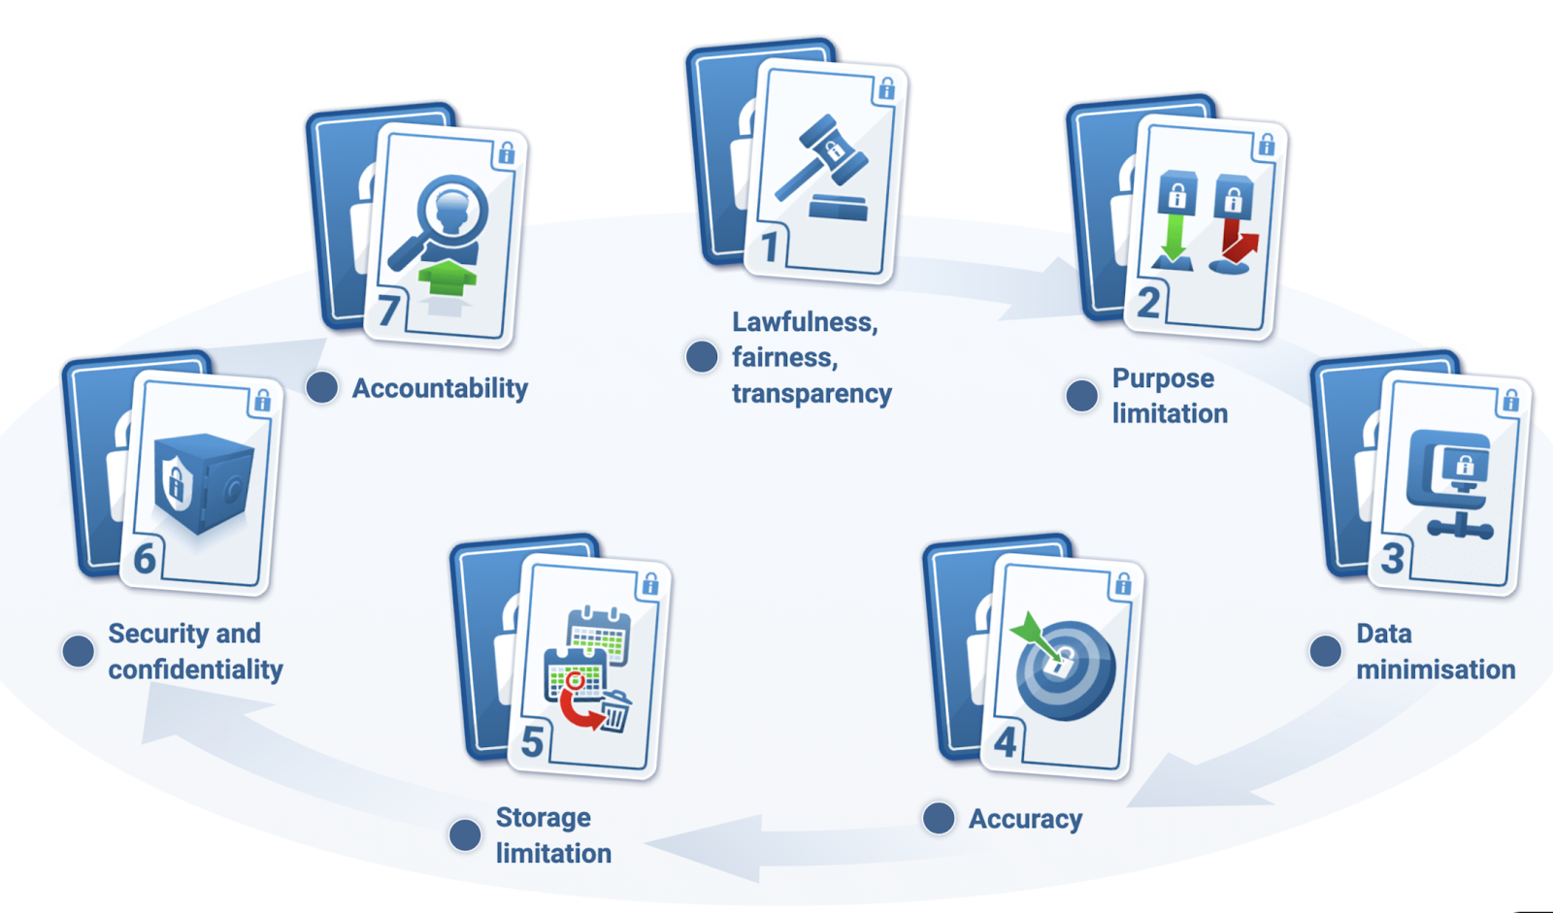
GDPR (2018)
GDPR covers all personal data relating to identifiable living individuals, that is help or indented to be be held in a computer or structured filing system.

Slide 30
GDPR (2018)
As a collector / store of data you have clear responsibilities
As a data subject you have rights:
Right to be informed about your data
Right of access
Right of rectification
Right to erasure
Right to restrict processing
Right to data portability
Right to object
Right to challenge automated decisions
Exceptions to this are:
Data is necessary for protecting life or providing medical treatment
Clear legal requirement or strong public interest

Slide 31
DCMA (1998)
US copyright law concerning circumvention of DRM
Often referred to in games as ‘DCMA takedowns’
To remove unflattering game commentary on Steam, Youtube et al
See jimquisition
Remember, information assets covers digital content
Content creators rightly have significant issues with content sharing, particularly if they aren’t being paid for it

Slide 32
Identify common software development issues using the OWASP as a framework

Slide 33
Creating secure applications
OWASP (Open Web Application Security Project)
Open community to share good practice
Produces a yearly top-10 of issues
https://www.owasp.org/images/7/72/OWASP_Top_10-2017_%28en%29.pdf.pdf
Can be used by developers to build better systems
Input for ‘types of control’
‘Identify’ as part of NIST framework
‘Overarching’ control strategy

Slide 34
Creating secure applications
OWASP (Open Web Application Security Project)
A10: Insufficient Logging and Monitoring
A9: Using components with known vulnerabilities
A8: Insecure Deserialisation
A7: Cross-site scripting (XSS)
A6: Security misconfiguration
A5: Broken Access Control
A4: XML External Entities
A3: Sensitive Data Exposure
A2: Broken Authentication
A1: Injections (SQL, LDAP)

Slide 35
Wrap-up
Significant resources exist for cybersecurity
Though you are always vulnerable to novelty
Expect to be hacked at some point and work out
1. how to detect anomalous situations
2. how to recover from them with back-ups and redundant systems
3. how to stop them from happening in the future
Legal protection exists world-wide
Not all of it is for organisations (GDPR)
Will be scant reward seeing hackers sent to prison if your company has lost IP, reputation, finance etc

Slide 36
Wrap-up
Define the 3 types of control and 6 control strategies
Control types:
Stop things from happening
Detect when bad things happen
Recover from whatever has happened
Control strategies
Patch vulnerabilities
Application Whitelisting
System Hardening
Limit accounts
Two-factor authentication
Backup systems and data

Slide 37
Wrap-up
Understand the application of GDPR and DMCA from the perspectives of individuals and organisations
GDPR exists to protect living individuals
DMCA exists to protect copyright holders

Slide 38
Wrap-up
Identify common software development issues using the OWASP as a framework
We have the OWASP top ten
https://www.owasp.org/images/7/72/OWASP_Top_10-2017_%28en%29.pdf.pdf
These are all defined in OWASP report
A10: Insufficient Logging and Monitoring
A9: Using components with known vulnerabilities
A8: Insecure Deserialisation
A7: Cross-site scripting (XSS)
A6: Security misconfiguration
A5: Broken Access Control
A4: XML External Entities
A3: Sensitive Data Exposure
A2: Broken Authentication
A1: Injections (SQL, LDAP)

Slide 39
Questions

