Slide 1
Week 7: 3D Geometry I Part 3: A simple camera
COMP270: Mathematics for 3D Worlds and Simulations
Notes:
This part of the lecture is just a short section to introduce the idea of a camera model, which is

Slide 2
Objectives
Apply vectors and intersection tests in transferring a 3D scene to a 2D screen
Notes:
the basis of how we can project 3D scenes onto a 2D viewing surface, using the vector operations and intersection tests that we’ve covered so far in a process known as ray-casting, which isn’t the most sophisticated or the most efficient kind of projection, but it’s quite intuitive as it mimics the real-world interactions of light to some extent.

Slide 3
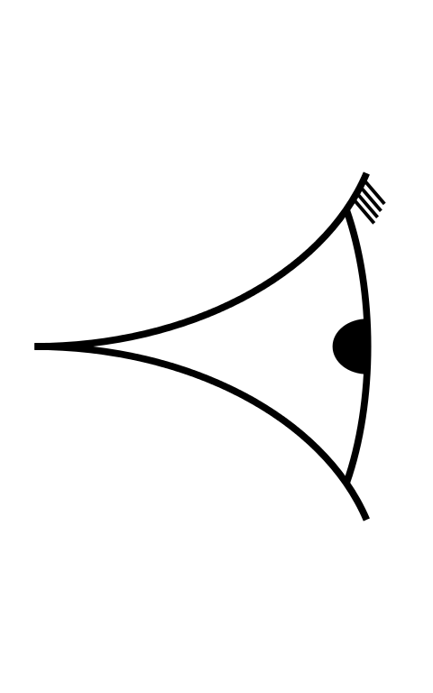



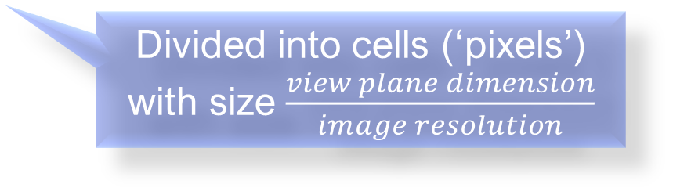

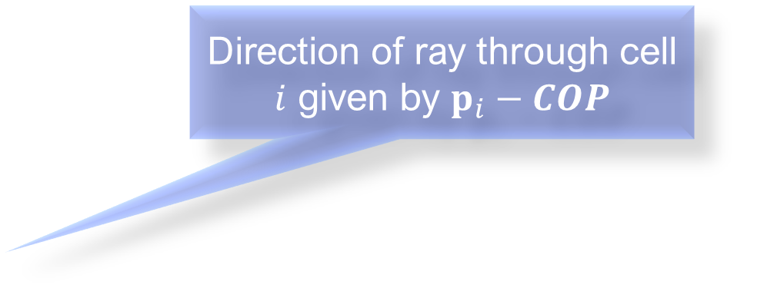
Vectors as rays
Direction of ray through cell $i$ given by $p_{i}−COP$
$$y$$
$$p_{i}$$
$$z$$
Centre of Projection (COP)
View plane (screen)
Divided into cells (‘pixels’) with size $\frac{view plane dimension}{image resolution}$
$$x$$
Notes:
We start with our three axes, as usual; you might notice they’re in a slightly different configuration from how I’ve been drawing them before, which is something we’ll be looking at in the next video. These axes define a space, or a scene, into which we
Add our objects. Right now we’re not really interested in how we put them there or how they’re oriented – that’s the topic of next week’s content; what we’re interested in for the moment is how we can see them on our screen. The first thing we need to define is where we’re looking from, which is represented by a
Point in space known as the centre of projection, or viewpoint, which is often associated with some kind of camera object; putting this on the z axis like this is fairly common practice as it presents the x and y axes the way we’re used to drawing them for graphs. Now we need to know what kind of 2D image to create that would appear to an observer as if they were viewing the scene through their 2D computer screen, so we also create a virtual counterpart of the screen,
Called the view plane, which is just a plane oriented at right angles to the viewing direction. The view plane is
divided into elements, or cells – you could call them pixels as they will be the elements of your picture, though they’re not necessarily the same as the pixels on your screen. Their size is controlled by the resolution of the image you want to create: if you divide the dimension of the viewing plane by the resolution, or number of cells in each direction, you can find the dimension of the cells. The bigger the cells, the faster the scene will render, but the less detail it will have, as each cell is given a single colour based on the objects that are visible through it from the centre of projection. The way we determine which objects these are is by emulating the paths of rays of light as they travel from the objects to the observer – though since we don’t really know where on the objects’ surfaces these rays would start from, we trace the paths backwards,
Casting rays from the viewpoint through the view plane, vaguely towards the objects in the scene. If we create one ray per cell, then it makes sense to send it
Through the centre of the cell, which we can find based on the size of the cells and the position of the view plane in space, and then subtract the position of the centre of projection to get the direction. There are more accurate techniques such as path-tracing that send multiple rays through each pixel, but they’re much more computationally intensive. These rays here aren’t doing much,

Slide 4
Colour by numbers
$$y$$
$$z$$
Centre of Projection (COP)
View plane (screen)
$$x$$
Notes:
But eventually,
we’ll get to one that intersects with an object (which we can tell using the intersection tests we looked at earlier),
So we now colour that cell to match the object.
And we keep doing that until we’ve sent rays through all of the cells and coloured them appropriately. We can vary the image that appears slightly,

Slide 5
Zoom
$$y$$
$$z$$
Centre of Projection (COP)
View plane (screen)
$$x$$
Notes:
By moving the view plane along the z axis so that we get a basic zoom effect, with the rays from the centre of projection to the object passing through different parts of the view plane, so the objects take up more or less space on the screen.
But this is a pretty limited way of observing the scene – we’re tied to a particular viewpoint when really we’d like to be able to move around and see the scene from different angles. To do this, we need to use matrices, which we’ll look at next week; before we get to that, the last part of this lecture examines the concept of coordinate spaces, which is something we’ve touched on previously but not really explained, and is crucial to being able to deal with multiple objects moving relative to one another.

