Slide 1
Week 4: Mechanics I Part 2: Quantities and variables
COMP270: Mathematics for 3D Worlds and Simulations
Notes:
Welcome to part 2 of this week’s lecture. Hopefully you’ve recovered from the previous video on calculus - before we get into how to actually apply the concepts in it, we’re going to take a break from abstract theory and lay the groundwork of what exactly we’ll be dealing with,

Slide 2
Objectives
Define the basic quantities of mechanics and their units
Recall Newton’s Laws of Motion and the key steps to apply them in a physical simulation
Notes:
In terms of the basic quantities of mechanics and the units they’re measured in, as well as the fundamental rules that govern physical behaviour, as defined by Newton’s laws of motion, and how we can apply these in a simulation.

Slide 3

Basic quantities of mechanics
Position describes an object’s location in space: $x$
Velocity is rate of change of position: $v=\frac{dx}{dt}$
Acceleration is rate of change of velocity: $a=\frac{dv}{dt}=\frac{d^{2}x}{dt^{2}}$
Jerk is the rate of change of acceleration: $j=\frac{da}{dt}=\frac{d^{2}v}{dt^{2}}=\frac{d^{3}x}{dt^{3}}$
Notes:
We’ve actually already met some of the quantities:
The position is just the location in space, which we’ll represent by a vector x;
The velocity v is the rate of change of the position, given by the derivative of x with respect to time.
Taking it a step further, the acceleration is the rate of change of velocity, given by the derivative of v with respect to time, which is also the second derivative of x with respect to time – in other words, what you get when you differentiate the position twice, which is denoted by the notation d2x/dt2
Going even further, the jerk is the rate of change of acceleration, or the third derivative of the position, which we won’t really be looking at here but it makes for some good nerdy jokes.

Slide 4




Velocity and speed
Velocity is a vector quantity – has a magnitude and a direction
We call the magnitude of velocity the speed
$$x_{2}$$
$$v$$
$$\left\|v\right\|=s$$
$$x_{1}$$
Notes:
You might have noticed that we’ve changed terminology a little since the last video, where we presented speed as being the derivative of the position. The two words are often used interchangeably in common parlance, but in mathematics and physics we draw a distinction, which is that
Velocity is a vector quantity, representing movement in a particular direction and with a magnitude
Which is the speed. If we’re dealing with one-dimensional, scalar quantities, the speed is essentially the same as the velocity, but otherwise it’s important to be aware of the difference.

Slide 5
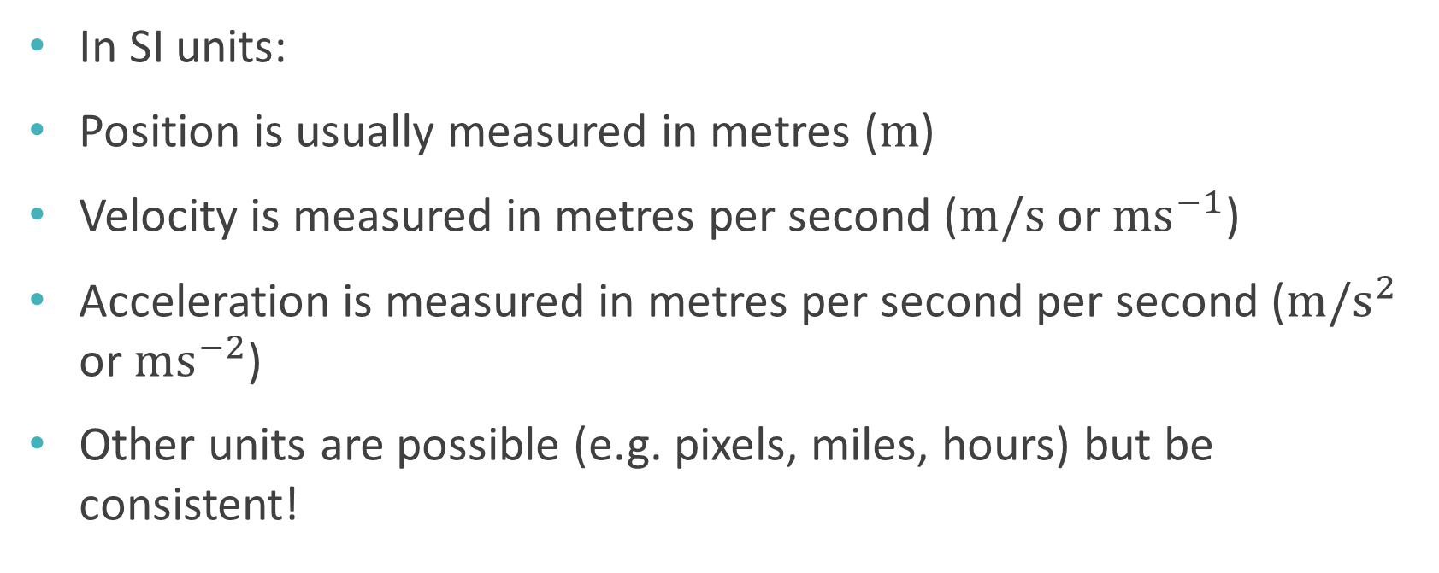
Units
Système international, or the International System of Units
In SI units:
Position is usually measured in metres ($m$)
Velocity is measured in metres per second ($m/s$ or $ms^{−1}$)
Acceleration is measured in metres per second per second ($m/s^{2}$ or $ms^{−2}$)
Other units are possible (e.g. pixels, miles, hours) but be consistent!
Notes:
Now we’ve defined the quantities, we should talk about how we measure them, and the units they’re expressed in, which is important as we want to make sure we’re being consistent about how we express values relative to one another.
The units we use are called ‘SI’ units, which stands for
‘systeme internationale’, the modern form of the metric system that’s used as standard pretty much worldwide. Under this system,
Position is measured in metres, or m for short;
Velocity is measured in metres per second, with the shorthand taken from the position unit, m, written as a fraction over s for seconds, or using the negative power notation is also common.
Similarly, acceleration – the second derivative of the position - is metres per second per second, or metres per second squared.
It’s possible to use other units, for instance imperial measurements, or in graphics applications you might measure the screen in pixels; as long as you’re consistent and use the same units throughout, you should still get the correct answers.

Slide 6

Force
Definition: a force is a push or pull on an object resulting from its interaction with another object
Direct: e.g. friction, tension, air resistance
Distant: e.g. gravity, magnetism
SI unit: Newtons (N)
Linked to mass (kg)
Named after Isaac Newton (1642-1726/27), English mathematician
This Photo by Unknown Author is licensed under CC BY-SA
Notes:
There’s also another quantity that we’ve not looked at yet, which is force.
This is essentially some kind of push or pull acting on an object because of its interaction with another object
which could be direct, as a result of some kind of collision or contact, including with air molecules,
or over a distance, including the effect of large masses such as planets on nearby objects, which is known as gravity.
Force is measured in Newtons, named after
Sir Isaac Newton, whom you’ve hopefully heard of,
And it’s linked to an object’s mass, which is measured in kilograms, by a set of rules known as

Slide 7
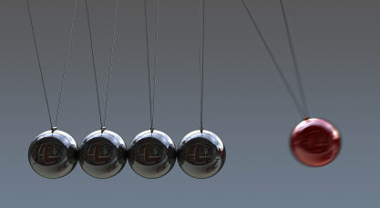
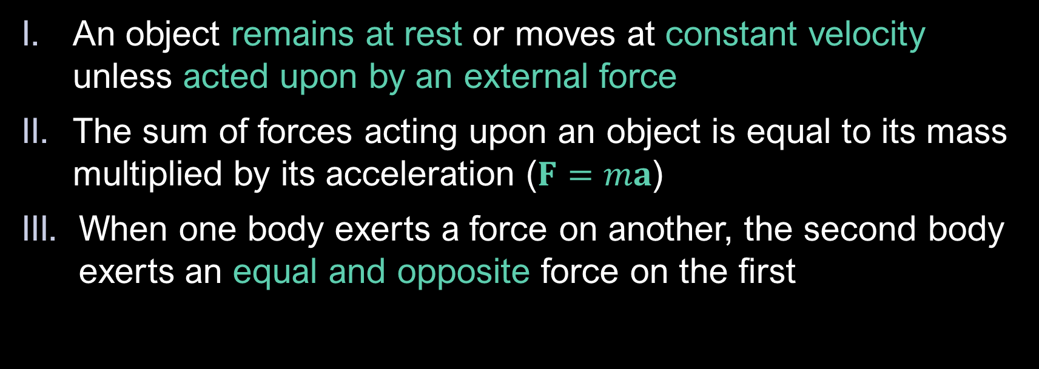
Newton’s Laws of Motion
An object remains at rest or moves at constant velocity unless acted upon by an external force
The sum of forces acting upon an object is equal to its mass multiplied by its acceleration ($F=ma$)
When one body exerts a force on another, the second body exerts an equal and opposite force on the first
This Photo by Unknown Author is licensed under CC BY
Notes:
Newton’s laws of motion, which are:
Firstly, that an object will remain at rest, or continue with its current constant velocity, unless acted upon by an external force. In other words, some external input is required to change the behaviour of an object; this change of behaviour is determined by the second law, which states that
The sum of forces acting on the object is equal to the mass multiplied by its acceleration, giving the famous equation F = ma; the acceleration is what describes the change of behaviour from the constant velocity. Newton’s third law is also pretty famous: when one body exerts a force on another, the second body exerts an equal and opposite force on the first. This is often worded as ‘every action having an equal and opposite reaction’, which means the same thing in physics terms but is a little vaguer in everyday speech.

Slide 8

Force and acceleration
Definition: 1 Newton of force is the force required to accelerate an object with a mass of 1 kilogram at 1 meter per second per second
$$F=ma$$
$⇒1$N$=1$kg$×1$ms⁻²
Alternative unit: N = kgms⁻²
Notes:
Going back to relationship between force and mass, which is encapsulated by Newton’s second law, we have the definition of
One Newton of force being the amount required to give an object with a mass of one kilogram an acceleration of one meter per second per second. If we write that out using the equation
force = mass times acceleration
including the units, we get the alternative, combined unit “kilogram meters per second squared”,
Which tells us a little more about what kind of thing a force actually is, but is a pain to write and say, hence the much more concise Newton. We’re not going to look in much detail at forces in this module, but there is one that we can’t get away from dealing with, at least not without travelling some distance into space, and that is

Slide 9

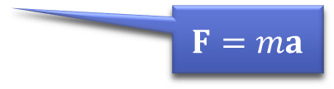

Gravity
$$F=G\frac{m_{1}m_{2}}{d^{2}}$$ $G=6.674×{10}^{−11}$N
A force which pulls all objects with mass towards each other
Tiny unless one or both objects has huge mass (e.g. a planet)
Near the surface of a planet, gravity pulls objects downwards (towards the centre of the planet) with a force called weight
$w=mg$, where $w$ is weight, $m$ is mass and $g$ is the acceleration due to gravity
Near Earth’s surface, $g≈9.81$ms⁻²
$$F=ma$$
Notes:
Gravity. This is
A force that pulls all objects with mass towards each other; every object exerts the force, which is equal to
the product of the two objects’ masses divided by the square of the distance between them, multiplied by the gravitational constant, G, which is 6.674 x 10 to the minus 11. Because this constant is so small,
The gravitational pull is tiny unless at least one of the objects has a huge mass, for instance a planet, and the squared distance in the denominator means the objects need to be reasonably close together.
The force acts towards the centre of the objects, so near the surface of a planet, gravity pulls everything in a direction we call “downwards”, and we call the force weight. It’s given by the formula
w = mg, with w being the weight, m the mass and g the acceleration due to gravity,
Which comes from Newton’s second law.
Near the Earth’s surface, this acceleration is roughly 9.81 meters per second squared.

Slide 10
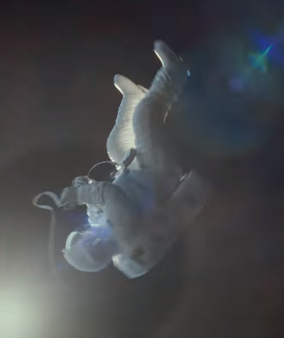

Gravity and mass
Gravity applies the same acceleration ($9.81ms^{−2}$) to all objects on Earth, regardless of weight (or mass)
$m_{o}g= G\frac{m_{o}m_{E}}{d^{2}}$
The only reason that some objects fall faster than others is air resistance – in a vacuum all objects fall at the same rate
Image © Framestore www.framestore.com/work/gravity
Even a feather and a bowling ball!
Notes:
Note that
This acceleration is constant and the same for all objects on Earth (obviously it’s different for other planets, as their mass is different). We can see why this is if we
equate the two formulae for the force, or weight, using m-o as the mass of the object and m-e as the mass of the earth: You can see that the object’s mass appears on both sides of the equation,
so cancels out, leaving the acceleration as being roughly the mass of the earth divided by the distance of the object form the earth’s centre – which is more or less the radius of the earth - times the gravitational constant. Obviously, we can see around us that some objects do fall faster; but
This is purely due to air resistance, rather than gravity. You can observe objects falling at the same rate in a vacuum, or if you find ones that have similar shapes but different masses – there have been various experiments done to demonstrate this,
Including one a few years ago with professor brian cox dropping feathers and a bowling ball in some NASA chamber, which there’s a link to the video of on LearningSpace.

Slide 11

Simulating Newtonian physics
For each object, store its position $x$ and velocity $v$
On each time step:
Apply numerical integration to the velocity to determine the new position, $x^{′}=x+v∆t$
Calculate the forces acting upon the object, and thus the acceleration $a$ from Newton’s 2nd law
Apply numerical integration to the acceleration to determine the new velocity, $v^{′}=v+a∆t$
Notes:
So now we have the quantities and the rules that define the relationships between then, how can we use this in our simulation? The basic procedure is as follows:
We start by storing the position x and the velocity v of the object we’re simulating, and then
For each time step, which might be a frame or even a subframe,
We use the numerical integration technique we met earlier to give the new position as x plus its derivative, the velocity, times delta t, the timestep.
Next, we need to factor in any forces acting on the object, from which we can use Newton’s second law to find the acceleration,
Which we can then apply using the same numerical integration technique to find the new velocity. Now we’re all set to start the process again,
using the new position and velocity to find the next ones, and the next, and so on. So it’s a pretty straightforward overall process, but depending on how many forces are acting on an object, the calculations can be pretty complex. We’re actually going to ignore most of the forces for now, and in the next video, take a look at how to compute motion under constant acceleration.

