Slide 1
Week 2: Geometry I Part 1: Points, Lines and Triangles
COMP270: Mathematics for 3D Worlds and Simulations

Slide 2
Objectives
Define the basic geometric primitives
Recall the formulae that express relationships between the sides and angles of a right-angled triangle

Slide 3





What is a point?
Definition: a point is a 0-dimensional mathematical object that can be specified in $n$-dimensional space using an $n$-tuple $\left(x_{1},x_{2},…,x_{n}\right)$ consisting of $n$ coordinates.
0-dimensional because it has no measurements in any direction…
In 1D space, its coordinate is just the distance from an origin:
$$P$$
$$=(x)$$
$$O$$
$$x$$

Slide 4



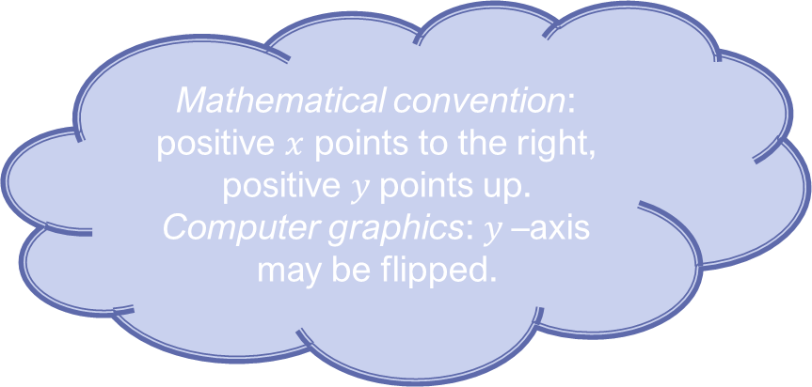

















Points in 2D
$$y$$
$$3$$
$$(4, 2.5)$$
$$(−3, 2)$$
$$2$$
$$(1, 1)$$
$$1$$
$$0$$
$$x$$
$$−4$$
$$−3$$
$$−2$$
$$−1$$
$$1$$
$$2$$
$$3$$
$$4$$
Mathematical convention: positive $x$ points to the right, positive $y$points up.
Computer graphics: $y$–axis may be flipped.
$$−1$$
$$(−4, −1)$$
$$−2$$

Slide 5



Lining up
Definition: a line is a straight one-dimensional figure having no thickness and extending infinitely in both directions.
Defines a 1D space
In a space of 2 or more dimensions, a line is uniquely determined by 2 points:
$$B=(x_{b}, y_{b})$$
$$A=(x_{a}, y_{a})$$
$$d=?$$

Slide 6



Let’s try angles…
From Latin/Greek, “many-angled”; a shape with 3 or more straight sides.
Definition: a triangle is a polygon with three sides and three angles, some of which may be the same.
Uniquely determined by 3 points:
$$A=(x_{a}, y_{a})$$
$$B=(x_{b}, y_{b})$$
Acute
Obtuse
Angles add to 180°
Equilateral
Isosceles
$$C=(x_{c}, y_{c})$$

Slide 7







Right-angled triangles
Named after Pythagoras of Samos (c570-c495BC), Greek philosopher
$$A$$
The hypotenuse is the side opposite the right angle
Pythagorean Theorem: $a^{2}+b^{2}{=c}^{2}$
i.e. $$c=\sqrt{a^{2}+b^{2}}$$
Visual depiction: www.youtube.com/watch?v=ANR4g0lPrEQ
$$c$$
$$b$$
$$B$$
$$C$$
$$a$$

Slide 8





The Trigonometric Functions
SOHCAHTOA
$$\sin{θ}=\frac{\text{Opposite}}{\text{Hypotenuse}}$$
$$\cos{θ}=\frac{\text{Adjacent}}{\text{Hypotenuse}}$$
$$\tan{θ}=\frac{\text{Opposite}}{\text{Adjacent}}$$
$$Hypotenuse$$
$$Opposite$$
θ
$$Adjacent$$
$$=\frac{\sin{θ}}{\cos{θ}}$$
Silly Old Harry Caught A Herring Trawling Off America

Slide 9
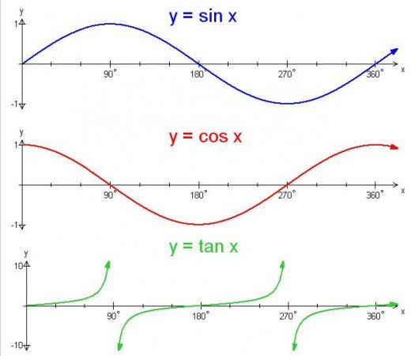
The Trigonometric Functions

Slide 10

Inverse trig. functions
$$\sin{θ}=\frac{\text{Opposite}}{\text{Hypotenuse}}$$
$$θ=\sin^{−1}\left(\frac{\text{Opposite}}{\text{Hypotenuse}}\right)$$
Also known as arcsin / arccos / arctan
In code: asin() / acos() / atan()

Slide 11












Lines and triangles
$$y$$
$$B=(x_{b}, y_{b})$$
$$y_{b}$$
$$−$$
$$A=(x_{a}, y_{a})$$
$$+$$
$$y=y_{a}$$
$$−x_{a}$$
$$x_{b}$$
$$y_{a}$$
$$x$$
$$x=x_{b}$$

Slide 12


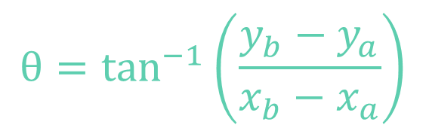
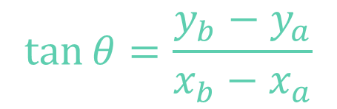
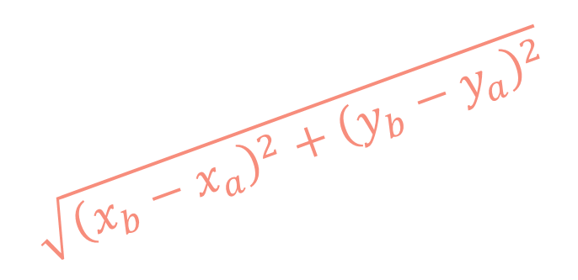
Lines and triangles
$$y$$
$$\tan{θ}=\frac{y_{b}−y_{a}}{x_{b}−x_{a}}$$
$$B=(x_{b}, y_{b})$$
$$θ=\tan^{−1}\left(\frac{y_{b}−y_{a}}{x_{b}−x_{a}}\right)$$
$$\sqrt{{\left(x_{b}−x_{a}\right)}^{2}+{\left(y_{b}−y_{a}\right)}^{2}}$$
$$y_{b}−y_{a}$$
$$A=(x_{a}, y_{a})$$
θ
$$y=y_{a}$$
$$x_{b}−x_{a}$$
$$x$$
$$x=x_{b}$$

Slide 13





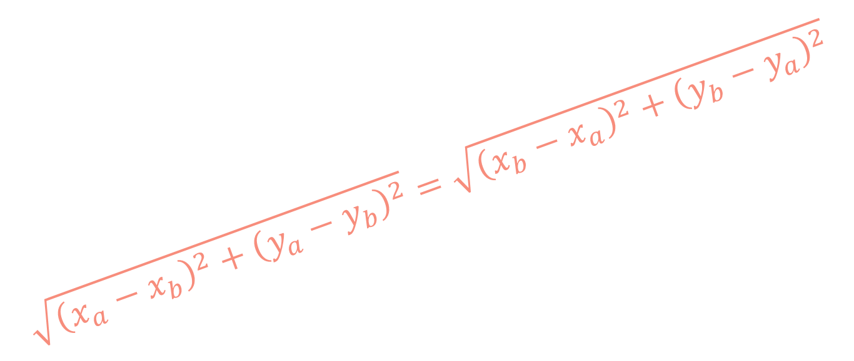
Line direction
$$y$$
$$\tan{θ}=\frac{y_{a}−y_{b}}{x_{a}−x_{b}}=\frac{−(y_{b}−y_{a})}{−(x_{b}−x_{a})} \\ =\frac{y_{b}−y_{a}}{x_{b}−x_{a}}$$
$$\sqrt{{\left(x_{a}−x_{b}\right)}^{2}+{\left(y_{a}−y_{b}\right)}^{2}}=\sqrt{{\left(x_{b}−x_{a}\right)}^{2}+{\left(y_{b}−y_{a}\right)}^{2}}$$
$$A=(x_{a}, y_{a})$$
$$y_{a}−y_{b}$$
$$B=(x_{b}, y_{b})$$
θ
$$y=y_{a}$$
$$x_{a}−x_{b}$$
$$x$$
$$x=x_{b}$$

