Slide 1
Week 4: Mechanics I Part 4: Projectile motion
COMP270: Mathematics for 3D Worlds and Simulations
Notes:
In the past three videos we’ve essentially been setting the scene, introducing calculus as a method for analysing quantities that change over time and looking at how it can be applied to physical behaviours, deriving a set of equations relating the quantities of displacement, velocity and acceleration over time.

Slide 2
Objectives
Derive some general results from the equations of motion to discover how projectiles move
Apply the results/equations to solve target-finding problems
Notes:
We’re now going to play around with these equations, to see what information they can give us about the way that objects move through geometric space and discover some general results about that motion. This will also reveal how we can apply the equations to solve problems where we need to find certain of the values given others, for example to determine the initial settings to achieve a desired outcome.

Slide 3

Recap: Equations of motion (‘suvat’ equations)
$v=u+at$ (no $s$)
$s=ut+\frac{1}{2}at^{2}$ (no $v$)
$s=\frac{1}{2}\left(u+v\right)t$ (no $a$)
${\left\|v\right\|}^{2}={\left\|u\right\|}^{2}+2a⋅s$ (no $t$)
$s=vt−\frac{1}{2}at^{2}$ (no $u$)
Notes:
Just as a reminder,
here are the equations of motion that we derived in the last video; five equations, each of which excludes one of the five variables. These equations apply to the motion of projectiles,

Slide 4


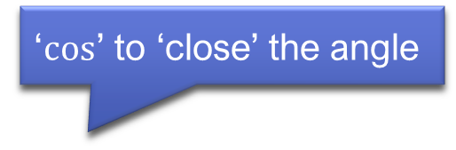




Projectiles
‘$cos$’ to ‘close’ the angle
Definition: a projectile is a body projected by external force and continuing in motion by its own inertia.
e.g. dropped, thrown, shot…
$u=\left(\begin{matrix}u\cos{θ} \\ u\sin{θ}\end{matrix}\right)$ ($u=\left\|u\right\|$)
$a=\left(\begin{matrix}0 \\ −g\end{matrix}\right)$
At time t, the displacement is: $s=ut+\frac{1}{2}at^{2}$
$$=\left(\begin{matrix}u\cos{θ} \\ u\sin{θ}\end{matrix}\right)t+\frac{1}{2}\left(\begin{matrix}0 \\ −g\end{matrix}\right)t^{2}$$
$$a$$
$$\left\|u\right\|$$
$$u$$
$$s$$
$$θ$$
Notes:
Which are any objects that have been projected by some mechanism that causes them to continue in motion with no further forces being applied, which means that the acceleration remains constant. Normally, it’s only gravity that is considered, but you might model certain other forces, such as wind, as a constant acceleration for simplicity, although that’s not strictly accurate in a physical sense. Projectiles can include
Anything dropped from rest or thrown vertically upwards, but the general situation would look something like
This, with the object =represented by a particle, or a point mass, that’s been propelled from its starting point, or origin=, with some initial velocity u
– which might be specified as a vector, or
by its magnitude, the speed, and an angle from the horizontal, theta. If this is the case, we can easily find the horizontal and vertical components of the vector
using the usual trigonometry… By the way, an easy way to remember which way round to put the sine and cosine is that you use the cosine to =close the angle=, so
‘cos’ is for ‘close’. =Here I’ve written the speed as just a non-vector u, rather than using the magnitude notation=, which is a common notation convention that keeps things a little less cluttered, and avoids writing lines everywhere.
We also normally have the acceleration due to gravity, which is more or less constant anywhere on earth, so that
As the particle travels along its path, its position relative to its starting point at time t is given by our second suvat equation. Note that s is the displacement, which is the vector from the origin or starting position to the current position, rather than the total distance travelled. If we
substitute our values of u and g in, and then simplify to a single vector expression,

Slide 5
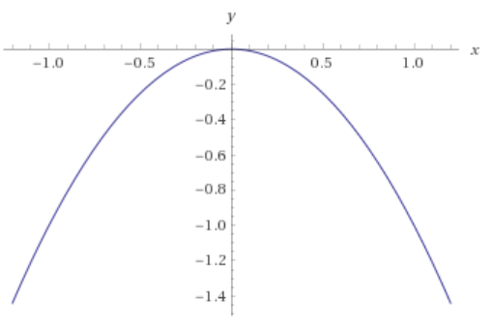
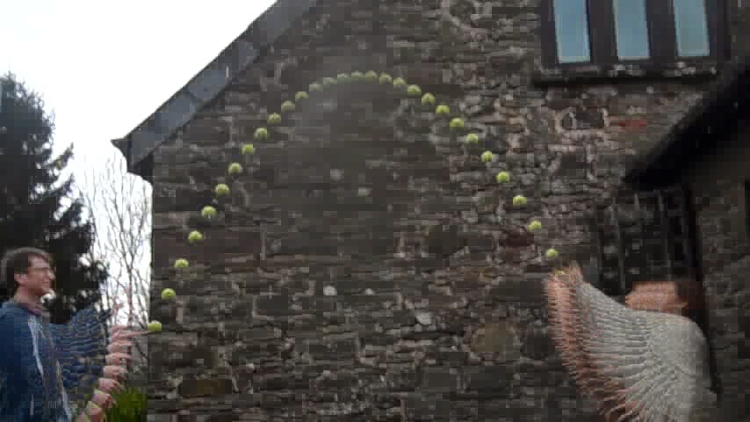
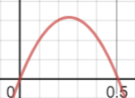




Projectile path
$$s=\left(\begin{matrix}u\cos{θ}t \\ u\sin{θ}t−\frac{gt^{2}}{2}\end{matrix}\right)$$
Horizontally: position changes linearly with $t$
Vertically: position is a quadratic
The shape of motion is a parabola
$$y$$
$$y=u\sin{θ}t−\frac{gt^{2}}{2}$$
for $u=5$, $θ=30°$
$$t$$
http://www.tom-e-white.com/2015/03/tennis-ball-parabola.html
Notes:
We have a parametric equation in t for the position,
The horizontal component of which is just a linear expression of t – since the acceleration only acts downwards, the horizontal component of the velocity doesn’t change and the projectile moves at a constant speed in that direction.
Vertically, we have a quadratic expression; if we
Plot this out as the vertical y position against t, we can see that =as long as the upwards effect of the initial velocity is greater than the effect of gravity pulling downwards, the projectile’s height remains above the starting point, increasing to start with as the linear initial velocity term is dominant until this t-squared gravity term pulls it down, eventually becoming large enough that the y-value becomes negative and object falls below its origin (if it doesn’t hit the ground or something else first). So if we combine the horizontal and vertical components and plot them against each other,
The shape we get is also a parabola, which can be observed if we use burst mode to photograph an object in flight, as in this photo of a tennis ball being thrown.

Slide 6
Separating components
It’s often useful to consider horizontal and vertical motion separately –
We can do this because our basis vectors are orthogonal, i.e. the components are at right-angles and do not affect one another
Further explanation here: https://www.physicsclassroom.com/class/vectors/Lesson-1/Independence-of-Perpendicular-Components-of-Motion
Notes:
When we’re solving problems in projectile motion,
it’s often useful to separate the components out and deal with them individually, as we might have information that makes one direction simpler to deal with – for example, as we just saw, having no horizontal acceleration means the displacement in that direction is linear rather than quadratic, which is easier to solve.
We can do this because our basis vectors that we’re using to represent our coordinates are orthogonal, as we saw in a previous video – or in other words, because the components are at right-angles to one another, they are independent and don’t influence each other.
You can read more about separating vectors into components online; for now, let’s take a look at how we can use the technique in practice,

Slide 7





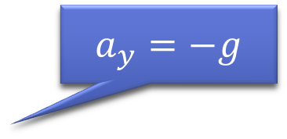


General results
Or the height difference between the start and end points
Time of flight:
At $t=T$, $s_{y}=0$, so
use $s_{y}=u_{y}t+\frac{1}{2}a_{y}t^{2}$
$$0=u\sin{θ}t−\frac{1}{2}gt^{2}$$
$$0=t\left(u\sin{θ}−\frac{1}{2}gt\right)$$
$t=0$ at the origin, so
$$T=\frac{2u\sin{θ}}{g}$$
$$a_{y}=−g$$
$$a$$
$$s_{y}$$
$$u$$
$$θ$$
$$t=0$$
$$t=T$$
Notes:
To express some general results about the path of the projectile, given the starting speed and direction. The first thing we might be interested in finding out is the
Time of flight – or how long it takes the projectile to reach its starting elevation, at which point it would hit the ground if the ground is level. For this, we’ll just consider the vertical motion,
as we know that at the time we’re interested in, the vertical displacement is zero. The information we have – displacement, starting velocity and acceleration – and that we want to find – the time – means we want to choose the equation that uses these values, which is the second one: considering just the vertical components, we have
S = ut + 1/2at^2, which with our values substituted in, gives
[…], with the vertical acceleration
being –g as always. We can factorise this expression
Like this. Here we have two values that when multiplied give zero, meaning that one of them must be zero…
We know that t is zero at the origin, so that leaves us with the expression u sin theta – 0.5gt being equal to zero, which we can rearrange to give the time of flight as
[…]. I should point out that you probably won’t find this result as a standard formula; I’m just generating these expressions to illustrate how you can manipulate the equations to find different values. Note that we can adapt this particular expression for situations where the projectile will land at a different height from where it started by
Using the final vertical displacement, or the difference between the start and end heights. In this case we’ll need to solve a quadratic equation that includes a constant value instead of zero for the displacement and choose the most appropriate result for the time.

Slide 8





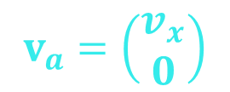
General results
Apex
$$v_{1}$$
$$v_{a}=\left(\begin{matrix}v_{x} \\ 0\end{matrix}\right)$$
Greatest height:
At $s_{y}=H$, $v_{y}=0$, so
use ${v_{y}}^{2}={u_{y}}^{2}+2a_{y}s_{y}$
$$0={\left(u\sin{θ}\right)}^{2}−2gH$$
$$H=\frac{u^{2}\sin^{2}{θ}}{2g}$$
$$v_{2}$$
$$a$$
$$s_{y}=H$$
$$u$$
$$θ$$
Notes:
Another value we might like to find is the
highest point that the projectile reaches before it starts to fall. This point is known as the
apex, and an interesting thing happens to the velocity here.
If we consider points just before and after the apex, we can see that the velocity changes from generally upwards to generally downwards; at some point, the vertical component flips from positive to negative. Since the velocity changes continuously, this means that at some point, the vertical component must be zero – and this point
Is the apex. Note that there is still some horizontal velocity; the projectile is only instantaneously at rest in the vertical direction.
To use this, we need an equation that involves v and s, plus we have u and a, so we’ll choose
[…].
Substituting our values gives […],
Which we can rearrange straightforwardly as

Slide 9
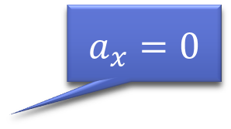

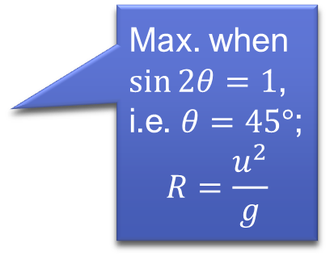

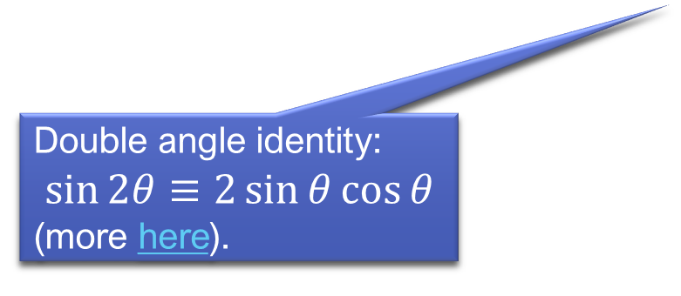
General results
Horizontal range:
At $s_{x}=R$, $t=T$, so
use $s_{x}=u_{x}t+\frac{1}{2}a_{x}t^{2}$
$$R=u\cos{θ}×\frac{2u\sin{θ}}{g}$$
$$R=\frac{u^{2}\sin{2θ}}{g}$$
$$a_{x}=0$$
$$a$$
$$u$$
$$θ$$
Max. when $\sin{2θ}=1$, i.e. $θ=45°$;
$$R=\frac{u^{2}}{g}$$
$$t=0$$
$$s_{x}=R$$
$$t=T$$
Double angle identity:
$$\sin{2θ}≡2\sin{θ}\cos{θ}$$
(more here).
Notes:
We might also be interested in another distance, which is the
horizontal range, or how far the projectile will travel before it hits the ground, again assuming the ground is level here. For this,
We’ll bring in the result we calculated previously for the time, and use the equation
[…] horizontally. Since we’re assuming that gravity is the only force, which means that there is no horizonal acceleration,
if we substitute our values in here, we get
[…]. This isn’t the prettiest expression, but we can use a particular trigonometric identity known as the double angle identity for sin to simplify this
To the much neater […]. We can also work out the maximum range for a given speed by setting the numerator of the fraction to be its highest value,
which occurs when sin 2theta is 1, meaning 2theta would be 90 and theta would be 45.

Slide 10

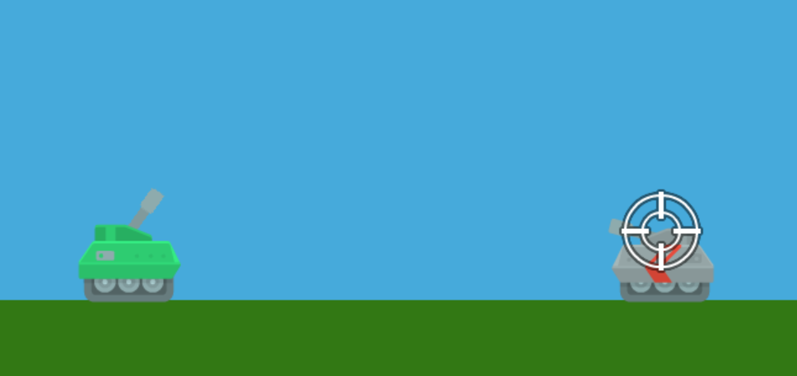





Target practice
$$u= ?$$
$$θ$$
The enemy tank is a distance of $x$ units away, at the same elevation
Given angle $θ$, what shot speed $u$ is needed to hit the enemy tank?
$$s_{x}=x$$
$$x=\frac{u^{2}\sin{2θ}}{g}⇒u= \sqrt{\frac{xg}{\sin{2θ}}}$$
Equivalent to solving $s=\left(\begin{matrix}x \\ 0\end{matrix}\right)=\left(\begin{matrix}u\cos{θ}t \\ u\sin{θ}t−\frac{1}{2}gt^{2}\end{matrix}\right)$
Notes:
Sometimes, we want to kind of work backwards, and find out the initial values to use to achieve a given range – for example,
If we want to fire a shot to hit an object a known distance away,
And we have a fixed angle to shoot from, what speed should we fire with?
To find out, we can just take the expression for the range from the previous slide and rearrange it to give u in terms of the values we know. Remember that finding this expression involved first calculating the time of flight; splitting the components down and dealing with them separately is
equivalent to solving the simultaneous equations that come from the vector expression of the projectile’s path.
Rearranging and combining the equations this way is useful for obtaining a variety of results in different situations, but there are some limitations on when we can apply them…

Slide 11
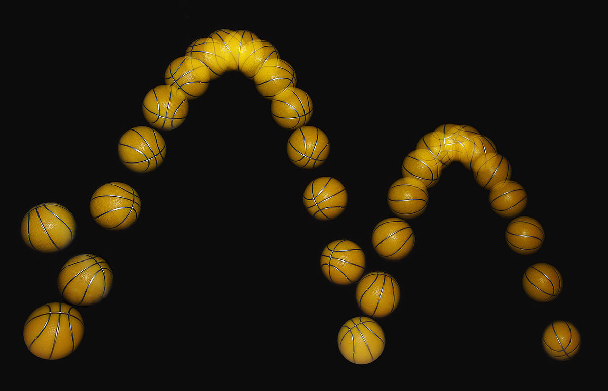
When don’t these equations work?
For very small objects (quantum mechanics)
For objects travelling close to the speed of light (theory of relativity)
For objects that interact with other objects or forces that change their acceleration…
This Photo by Unknown Author is licensed under CC BY-SA
Notes:
For instance,
we can’t use them for objects with a size that isn’t above the quantum scale; they have their own set of rules;
Likewise for objects that are travelling extremely fast, approaching the speed of light – for those we have to refer to Einstein’s theory of relativity. Fortunately, unless you’re making a very niche game, you generally won’t have to worry about those things, but there is another situation in which you’ll need to employ additional techniques, and that’s when
There are other objects, or forces, that can change the behaviour of the one you’re simulating; this is what we’ll be looking at next week.

