Slide 1
Week 5: Mechanics II Part 1: When Objects Collide
COMP270: Mathematics for 3D Worlds and Simulations
Notes:
Welcome to week 5 of COMP270, and the second week on the topic of of simulating physical objects. Last week, we introduced the basic quantities of position, velocity and acceleration and saw how they’re related to each other and to the forces on the objects as defined by Newton’s Laws, and we looked at how to use some of those ideas to model projectile motion in simplified circumstances, in particular when there are no external forces acting besides gravity. Of course, in reality there could be all sorts of forces at work, in particular those that come from interactions with other objects, so this week we’ll be considering how we can factor in the effects of collisions.

Slide 2
Objectives
Consider what it means for two objects to collide
Implement methods for detecting whether two objects are in collision
Notes:
We’ll start in this video by considering what it actually means for two objects to collide, and from there we’ll look at ways to detect whether two objects are colliding, before we move on to what to do with them if they are in a later video.

Slide 3
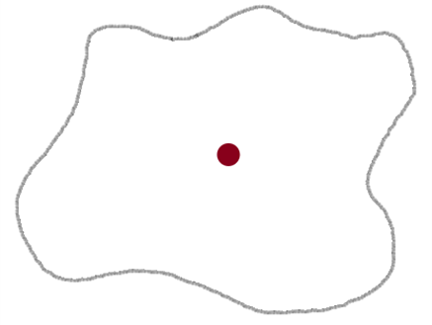
What is a collision?
A collision occurs when two objects occupy the same point in space at the same time (or try to)
!
Notes:
So, what is a collision? Basically,
It’s when you have two objects – or possibly more, but we’ll stick with the simple case for now – and these objects are trying occupy the same point in space at the same time; for the point masses we looked at before, this would mean having the same position, but
usually we deal with objects that have a size and shape, in which case we need to consider where their edges are. This can get fairly complex, depending how detailed the shapes are, but for simple shapes, the calculations can be very straightforward – for example,

Slide 4





Point and circle collision
Consider a circle with centre $c$ and radius $r$
A point $p$ is inside the circle if and only if the distance between $p$ and $c$ is at most $r$: $\left\|p−c\right\|≤r$
$$r$$
$$p$$
$$c$$
$$p−c$$
Notes:
If we have a circular object
with its centre at the position given by the vector c, and a radius r, and we simply want to know whether a
point, represented by the vector p, is inside the circle, then all we need to do is
Compare the distance between the circle’s centre and the point to the radius. The distance between the centre and the point is, of course, just the magnitude of the vector between them; if this is equal to the radius, then the point is on the circle’s perimeter, and if it’s less then the point is inside the circle.

Slide 5





Circle and circle collision
Consider two circles with centres $c_{1},c_{2}$ and radii $r_{1},r_{2}$
The circles overlap (collide) if and only if $\left\|c_{1}−c_{2}\right\|≤r_{1}+r_{2}$
$$c_{1}$$
$$r_{1}$$
$$r_{2}$$
$$c_{2}$$
Notes:
The same principle applies if we have two circles; this time, we want to know if at any point the edge of one circle is in between the edge of the other circle and its centre.
If we say they have centres c1 and c2 and radii r1 and r2, then the condition for a collision is that
The distance between the centres of the circle, given by the magnitude of the vector between c1 and c2, is less than (or equal to) the sum of the radii.
The two values are equal when the circles are just touching.

Slide 6







Circle and ground collision
$$x_{g}$$
$${x′}_{g}$$
Consider a circle with centre $c=\left(\begin{matrix}c_{x} \\ c_{y}\end{matrix}\right)$ and radius $r$
Let $y_{g}$ be the $y$ coordinate of the ground, and let the ground be horizontal
The circle collides with the ground if and only if $c_{y}−y_{g}≤r$
(and $x_{g}≤$ $c_{x}$ $≤$ ${x′}_{g}$)
$$c$$
$$c_{y}−y_{g}$$
$$r$$
$$y_{g}$$
Notes:
Another simple case is when the circle collides with the ground. If the ground is horizontal, and
The components of the circle centre’s position c are cx and cy,
With the ground height above the origin given by yg,
Then we can just compare the y component of the circle’s centre to the ground level to see if there’s enough room to fit the radius in between them.
Unlike when we’re computing the vector lengths, we obviously want to make sure we’re subtracting the ground height from the circle’s height so that we have the correct sign; if we did yg – cy we’d get a negative result when the circle was above the ground. We could use that flipped version to test against a ceiling, and we can also compare the x components in a similar way to test for collisions with vertical walls. Since we’re only checking against one value of y (or x), then we’re effectively assuming that the ground is infinitely thick, and
unless we introduce some horizontal limits, we’re also treating it as extending infinitely to the sides

Slide 7



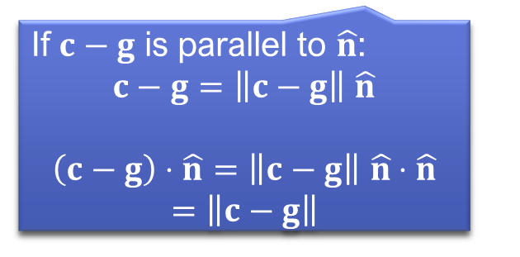



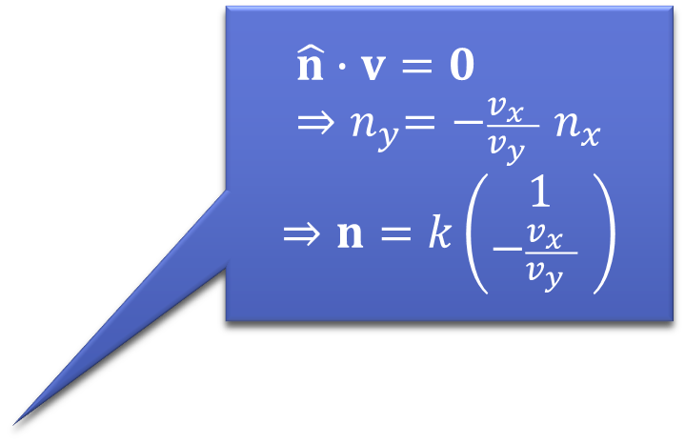
Generalised circle and ground collision
$$\hat{n}∙v=0 \\ {⇒n}_{y}=−\frac{v_{x} }{v_{y} } n_{x}$$
$$⇒n=k\left(\begin{matrix}1 \\ −\frac{v_{x} }{v_{y} } \end{matrix}\right)$$
Let $\hat{n}$ be a normal vector (a unit vector perpendicular to the ground)
Let $g$ be any point on the ground
The distance from $c$ to the ground is the projection of its offset from $g$ onto the normal: $\left(c−g\right)⋅\hat{n}$
Therefore the circle collides with the ground if and only if $\left(c−g\right)⋅\hat{n}≤r$
$$V$$
$$\hat{n}$$
$$c$$
$$g$$
$$r$$
If $c−g$ is parallel to $\hat{n}$:
$c−g=\left\|c−g\right\|$ $\hat{n}$
$$\left(c−g\right)⋅\hat{n}=\left\|c−g\right\| \hat{n}⋅\hat{n}$$
$$=\left\|c−g\right\|$$
Notes:
While it’s reasonable to make the assumption that any point below ground level is a collision, it’s not always practical to have a ground that’s perfectly horizontal, so we need to adapt the test to take a slope into account. The same principle applies – testing to see how far the centre is from the ground – but this time we’re working at an angle, which is defined by the
normal vector, n-hat, which is a unit vector that is perpendicular to the ground; we know from week 2 that this means
the dot product of n-hat with a vector along the ground will be zero, which we can use to find the ratio between the components of the normal vector by just rearranging the algrebraic formula for the dot product. Of course we’d need at least one of the components to start with, but since we’re only interested in the direction and will be normalising the normal vector in any case, it doesn’t matter what length we choose, so we can just set the x component to 1 and figure out the y component using the value of v, which we can get from any two points on the surface of the ground.
If we take one of these ground points, g, we can use it to find the perpendicular distance of the circle’s centre from the ground by noting that
This distance is just the result of taking the vector between g and c and projecting it onto the normal, which found by simply taking the dot product.
Note that if g happens to be the point where the perpendicular from c to the ground meets the ground, then c – g will be a scalar multiple of n-hat, with that scalar being the length, so the dot product will just be the length of c – g. Now we have the distance,
We just compare it to the radius of the circle as before.

Slide 8





Circle and line segment collision
Collisions with lines or line segments is the basis of raycasting
Consider a circle with centre $c$ and radius $r$, and a line segment from point $a$ to point $b$
The two collide if and only if the shortest distance between $c$ and the line is $≤r$
$$a$$
$$r$$
$$c$$
$$b$$
Notes:
It would be reasonable to ask whether we can apply the same approach to collisions between a circle and any line, which could represent the side of a shape or a ray of light,
such as in raycasting, which will be the topic of your third assignment worksheet. If we have a line
through 2 points, a and b, then as before,
The line passes through the circle if and only if the shortest distance between it and the circle’s centre is less than the radius of the circle. It might be tempting to use the same approach that we just looked at for the ground, and project the vector from c to one of the line points, a or b, onto the normal to get the perpendicular distance. This approach works for an infinite line, and it’s also true for a finite line segment as long as where the perpendicular from c meets the line is between the two points. However, it would return a collision
any time the sphere goes past an end of the line segment, which we don’t want. We’ll look specifically at how to deal with this case, and find what the closest point on the line is, in the next part of the lecture, but first it’s probably worth mentioning some other shapes, as unfortunately not everything we’ll need to simulate is a circle.

Slide 9





Box and box collision
$max$ $1$
Consider two axially aligned boxes (i.e. rectangles) defined by maximum and minimum vertices
The boxes overlap (collide) if and only if at least one of them has a minimum coordinate not greater than the corresponding maximum coordinate
$¬(x_{\min_{1}}>x_{\max_{2}}∨x_{\min_{2}}>x_{\max_{1}}∨y_{\min_{1}}>y_{\max_{2}}∨y_{\min_{2}}>y_{\max_{1}}$)
$max$ $2$
$$min1$$
$min$ $2$
Notes:
Another fairly simple shape is the rectangle, which is also sometimes referred to as a box. In the general case, we’d have to look at the edges as lines, but in the special case where the boxes are
Axially aligned – which means that their sides are parallel with the coordinate axes – then we can easily compare the edges if we find, or even better, store, their maximum and minimum coordinates in x and y.
In order for the boxes to collide, then at least one of the minimum coordinates needs to not be greater than the corresponding maximum coordinate of the other; with the boxes intersecting as shown, then the edge coordinates of one box fall between the minimum and maximum of the other, but if we were to
Move one box so that its minimum x coordinate is greater than the other box’s maximum x coordinate, then as long as this remains true, there’s
No position in which the boxes can intersect – and of course the same applies in the other directions. Writing this out using mathematical and logic symbols
Is not especially attractive, but it’s much simpler

Slide 10
Box and box collision - code
bool boxesCollide(Vector2 box1_min, Vector2 box1_max, Vector2 box2_min, Vector2 box2_max) {
if (box1_min.x > box2.max.x) return false;
if (box1_max.x < box2.min.x) return false;
if (box1_min.y > box2.max.y) return false;
if (box1_max.y < box2.min.y) return false;
return true;
}
Notes:
When implemented in code, where we determine if there’s an intersection by a process of elimination, ruling out cases where the
minimum coordinate of one box is greater than the maximum of another,
and vice versa, until we run out of cases and therefore one of the edges must pass through the other box.

Slide 11
More complex shapes
General collision detection is beyond the scope of this module
Algorithms and libraries do exist
Basic idea: two shapes collide if at least one point (or edge) of one is inside the other
Notes:
Of course, not every object that isn’t a circle is an axially aligned box, so we’d need to extend our methods even further to deal with arbitrary shapes…
Which is beyond the scope of this module, though there are
Some standard algorithms, and some libraries that implement them; if you’re feeling adventurous, one of the workshop exercises will allow you to try and implement one or two!
All of the techniques are developed from the same basic idea, which is that two shapes collide, or intersect, if some part of one – a vertex point, or an edge – is inside the other. This is good to know, but sometimes we want more information about the collision, such as where the closest point actually is, and how far away, which we’ll consider in the next video.

