Slide 1
Week 5: Mechanics II Part 4: Simplifying Collisions
COMP270: Mathematics for 3D Worlds and Simulations
Notes:
Welcome to the final section in our consideration of simulating physical behaviour. So far, we’ve looked at objects moving on their own, with no other forces, and extended that to consider pairs of objects that may be colliding, but most scenes tend to have more than two objects in them; in fact, there could be many hundreds, or even thousands if you’re simulating a massive destruction scene. Although the techniques we’ve covered can be repeated as many times as needed, that’s not always the most efficient option;

Slide 2
Objectives
Introduce some techniques for optimising collision detection with large numbers of objects
Notes:
There are various ways that we can improve our implementations to optimise the detection of collisions between large numbers of objects.

Slide 3
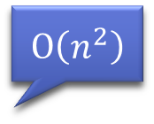
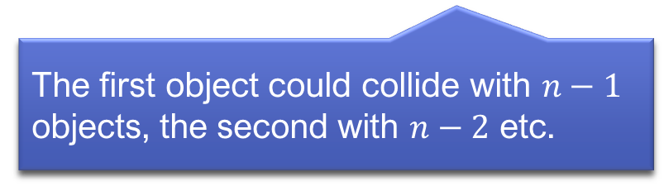

The problem(s)
Not every shape is a point, line, square or a circle
Intersection tests with arbitrary polygons can be complex
There may be many (many) objects in a scene
Collision testing is done in pairs
$⇒$ If there are $n$ objects in a scene, you could have $\frac{n\left(n−1\right)}{2}$ complex tests…
$$O\left(n^{2}\right)$$
The first object could collide with $n−1$ objects, the second with $n−2$ etc.
Notes:
To do this, we need to address a number of factors that contribute to the problem, starting with the fact that
Not all shapes are the simple ones we considered in the first part of the lecture, and
Performing intersection tests with other polygonal shapes can be quite complex; you can find details of them online if you’re interested. If you’re only testing a handful of shapes, this might not matter too much, but
In scenes where there are large numbers of objects,
The intersection test still needs to be done for each pair of objects, meaning that
For a scene with n objects, you could have up to n times n – 1 over 2 tests being performed; this formula is just the number of unique pairs in a set, which you can work out from the fact that
the first object could collide with any of the other n – 1 objects, the second has already been tested against the first, but could collide with any of the remaining n – 2 objects, and so on. So the overall complexity of the collision test loop is O n squared… And the inside of the loop will itself be a complex algorithm.

Slide 4

Strategy 1: bounding shapes
Radius = max. distance of any vertex from the centre
Centre = average vertex position
Min. $x$ = smallest $x$ of any vertex
Max. $x$ = largest $x$ of any vertex
Min. $y$ = smallest $y$ of any vertex
Max. $y$ = largest $y$ of any vertex
Notes:
So, what can we do to improve things? The first point we can note is that, although the shapes we’re dealing with aren’t necessarily simple, we can approximate them as such by fitting them inside something more manageable,
like a circle or a rectangle. This is known as a bounding shape, as it should completely contain the boundary, formed of all the vertices, of the shape. For the circle, this means that
Its radius needs to be the maximum distance of any of the shape’s vertices from the circle’s centre,
Which can be computed as the average position of the vertices. For the rectangle, the simplest way to define its dimensions is to find its
maximum and minimum corners, noting that its
Minimum x coordinate must be the smallest x component of any of the shape’s vertices, while it’s
Maximum x coordinate will be the largest x component –
And similarly for the y values. \So, we have two simple bounding shapes we could use, both of which are straightforward to define for any polygon; how do we decide which is the most suitable? One thing to consider is how complex the intersection tests are – remember that the reason we’re doing this is to reduce processing, so let’s recap.

Slide 5
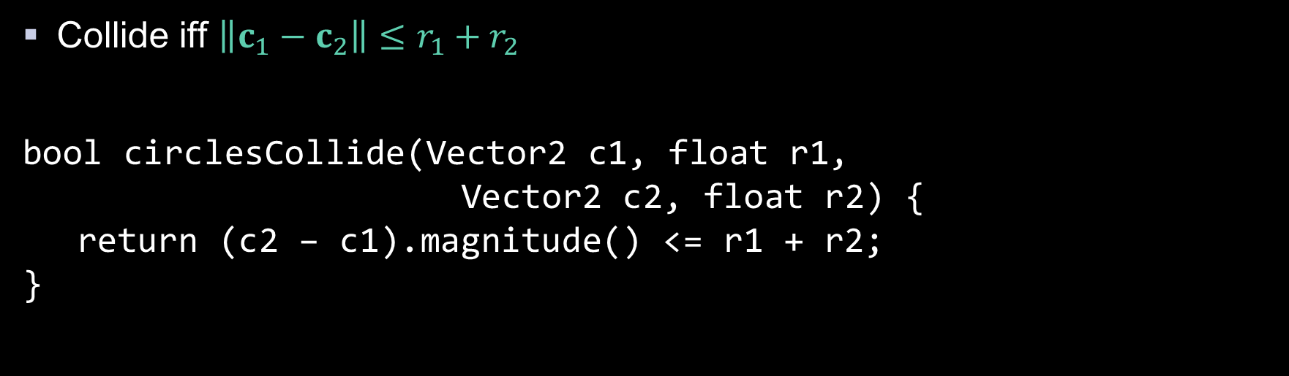




Recap: circle-circle intersection
$$c_{1}$$
$$r_{1}$$
Collide iff $\left\|c_{1}−c_{2}\right\|≤r_{1}+r_{2}$
bool circlesCollide(Vector2 c1, float r1, Vector2 c2, float r2) { return (c2 – c1).magnitude() <= r1 + r2; }
$$r_{2}$$
$$c_{2}$$
Or avoiding sqrt():
Vector2 centreDiff = c2 – c1;
float radSum = r1 + r2;
return centreDiff.dot(centreDiff) <= radSum * radSum;
Notes:
Detecting an intersection between two circles is possibly the simplest test to express mathematically;
We simply say that the distance between the centres has to be less than or equal to the sum of the radii.
In code, this is equally straightforward; we can use a built-in vector magnitude function to get the length, or
If we wanted to avoid the square root that that involves, we can compare the squared values, using the dot product to get the squared distance.

Slide 6
Recap: box-box intersection
$max$ $1$
$max$ $2$
$$min1$$
Collide iff the min component of one box is not greater than the max of the other
bool boxesCollide(Vector2 box1_min, Vector2 box1_max, Vector2 box2_min, Vector2 box2_max) { if (box1_min.x >= box2.max.x) return false; if (box1_max.x <= box2.min.x) return false; if (box1_min.y >= box2.max.y) return false; if (box1_max.y <= box2.min.y) return false; return true; }
$min$ $2$
Notes:
The intersection between two boxes is not such a neat mathematical expression,
as we have to compare each component of the boxes against each other,
But it’s still pretty simple to write in code, and perhaps even more efficient as it’s simply comparing values rather than performing any arithmetic. So, that could be a good reason to choose boxes over circles.

Slide 7
Circle vs. box
Notes:
Another thing to consider is the fact that the radius of a circle is the same all the way round, so it doesn’t always fit shapes that are long and thin; we’re likely to get more
false positives with the circle than the box.
Most of the time, we’ll want a more accurate result than either bounding shape can give in any case, so would go on to perform the full collision test for the polygon shapes if their bounding shapes intersect, but the more full tests we can avoid the better, so we tend to prefer a bounding shape that matches the dimensions of the actual shapes reasonably closely.

Slide 8






Axis aligned bounding boxes (AABBs)
Object orientation
(World) axis aligned
$$v′$$
$$v$$
$$y$$
$$u′$$
$$x$$
$$u$$
Notes:
You might be wondering why we don’t orient the box so that it fits the shape even more closely,
Like so. The first answer is that it’s more difficult to compute the box corners – they don’t match the min and max x and y values that we used before. We could take the approach of aligning the box with the
Object’s local coordinate system, but since any object it collides with will likely have
a different coordinate system, we’d have to transform at least one of the boxes to a different coordinate system, and we still wouldn’t be able to use the simple intersection test, which relies on the edges being parallel with the same set of axes. For this reason, it’s most common to use what are called
axis aligned bounding boxes, meaning that their edges are parallel to the world coordinate axes.

Slide 9
Dealing with many objects
Notes:
So now we’ve reduced the number of full-complexity intersection tests, but we still have an order of n squared simple tests to carry out, which for large numbers of objects can add up. If we were to look at the scene, as a human, we’d probably be able to spot straight away that some objects don’t really need to be tested; they’re obviously not going to intersect because
they’re a long way apart. We’d want to rule these out immediately, and focus on
groups of objects in the same region of space, which are more likely to intersect. We can achieve this by
partitioning the space, storing the objects in a specially-designed data structure rather than a simple array.

Slide 10
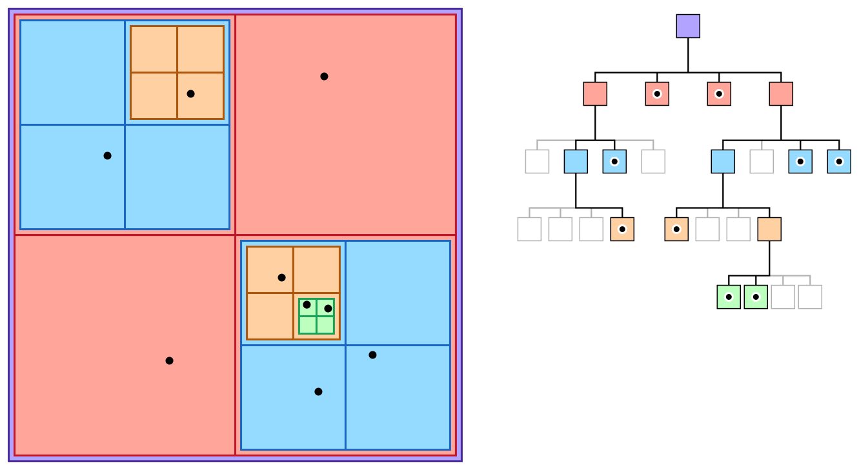
Spatial data structures: quadtree
A quadtree is a tree data structure in which space is recursively divided into four sections (quadrants)
Non-leaf nodes are parent/child quadrants
Leaf nodes are the objects (points), so that each “cell” contains only one object
Cells under the same parent node are close to each other
More details here
https://developer.apple.com/documentation/gameplaykit/gkquadtree
Notes:
One such data structure is the quadtree,
which recursively subdivides space into four equal sections, known as quadrants,
which are stored as child nodes of the parent quadrant
until it reaches a section that is either empty or that contains a single object, which becomes a leaf node. This means that
The cells under each parent node are close together, so depending how wide you want the search area to be, you can choose a level of the tree to restrict your tests to.
I’m not going to go any deeper into the implementation details, but there’s plenty of information online if you’re interested.

Slide 11
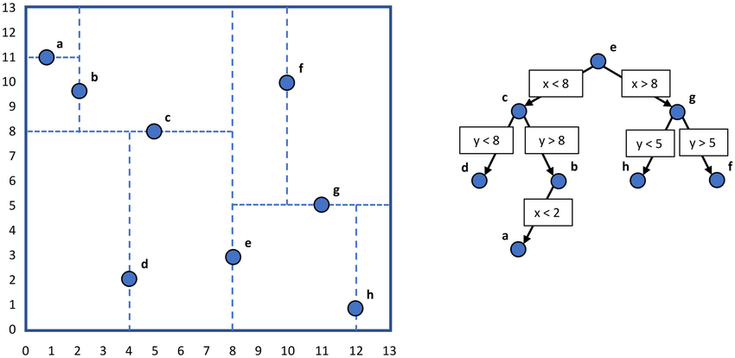
Spatial data structures: K-d tree
A K-d tree is a binary data structure for organising points in a k-dimensional space
All nodes are objects/points
Non-leaf nodes represent a division of space into half-spaces by a hyperplane defined by one of the points
More details here
A line in 2D
https://www.researchgate.net/figure/An-example-two-dimensional-k-d-tree-k-2-built-from-nodes-a-through-h-Dividing-planes_fig2_314298746
Notes:
Similar to the quatree is the kd-tree, which also
successively partitions space into sections, but this time is a binary tree, as it splits the space into two each time.
In this case, all the nodes represent objects, or points in space; and the tree is created by considering each point in turn and adding it as a child on the left if it falls on one side
Of the hyperplane
(which in 2 dimensions is just a line) passing through the parent point’s centre, and on the right if it lies on the other side. The dividing lines are alternated to be parallel to the x and y axes, to help keep the tree a little more balanced, though obviously the order you add the points is going to change the structure of the tree.
Again, there’s plenty of information online that explains this in more detail.

Slide 12
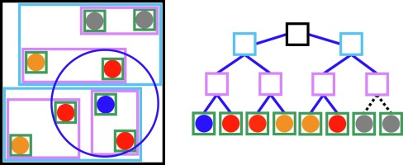
Spatial data structures: BVH
A bounding volume hierarchy (BVH) is a tree structure containing a set of geometric objects enclosed in bounding volumes
Leaf nodes are the object bounding volumes (AABBs)
Groups of nearby BVs are enclosed in larger BVs
A single object may have multiple BVs for separate components
More details here
https://www.sciencedirect.com/science/article/abs/pii/S092702561930206X
Notes:
A final type of data structure that’s specifically designed for collision detection is
bounding volume hierarchy, or BVH, which makes use of the bounding volumes, which are usually AABBs.
The AABBs of the individual objects are the leaf nodes, and these are
Grouped together with nearby objects, and higher-level AABBs are computed that enclose all of the AABBs in the group, all the way up to as many levels as make sense for the scene.
You can also work downwards, in the same way, decomposing a single complex object into several components which each have their own AABB, which gets around issues with irregularly shaped or concave objects where a single bounding box may not be a very close fit.
There’s also plenty more information about this online, but the key idea is that we can simply test the bounding boxes against each other at different scales, potentially discounting large numbers of objects at a time, and only perform the more complex shape intersection tests when we really need to.

Slide 13
Summary: simulation tips
Simplify where necessary:
Use constant accelerations
Ignore factors that don’t contribute to the overall effect
Approximate shapes
Avoid unnecessary computations:
Store objects in a way that makes sense, e.g. spatial subdivision
Notes:
That concludes the content for this week, and our consideration of physical simulation for this module. As you may have gathered, it can be quite a complex subject, but there are a few tricks to make it more manageable.
The most important thing is to keep things as simple as possible, for example by
assuming constant accelerations and
Ignoring factors that don’t add much to the end result, such as air resistance or lost energy from sound and heat.
Approximating shapes using bounding boxes is another very effective simplification, which helps us to
Avoid unnecessary computations. This can also be achieved by
Storing objects in a way that makes sense for processing, such as using the spatial subdivision data structures. Of course these same principles apply whatever it is you’re implementing, so practicing them in any context is good; you’ll have the opportunity to explore some of these techniques in the workshop and seminar.

