Slide 1
Week 7: 3D Geometry I Part 4: Coordinate spaces
COMP270: Mathematics for 3D Worlds and Simulations
Notes:
For the final part of this week’s lecture, we’re going to clarify what is meant by a coordinate space, which is something we’ve referred to a few times, such as when we were considering collision response, but not fully defined.

Slide 2
Objectives
Define the characteristics of a coordinate space
Introduce some common coordinate spaces
Notes:
We’re not going to do anything with them this week, just familiarise ourselves with their characteristics, and meet some of the most common ones that you’ve probably already been dealing with. There will be a few definitions and perhaps some terms that are unfamiliar, but the concepts behind them are things that we’ve already met and used, so we’re really just giving them their technical names so that you can recognise them if you come across them in any of your investigations.

Slide 3





What is a coordinate space?
Definition: a coordinate space is a space with a coordinate system defined by an origin and a number of axes equal to the dimension of the space, allowing any point in the space to be uniquely identified as a linear combination of distances along the axes.
In 3D coordinate space, define the unit vectors along the $x$, $y$ and $z$ axes to be $i$, $j$ and $k$ respectively, i.e. $i=\left(\begin{matrix}1 \\ 0 \\ 0\end{matrix}\right),j=\left(\begin{matrix}0 \\ 1 \\ 0\end{matrix}\right),k=\left(\begin{matrix}0 \\ 0 \\ 1\end{matrix}\right)$
Any vector $\left(\begin{matrix}a \\ b \\ c\end{matrix}\right)$ in the space can be written as $ai+bj+ck$
$$c$$
$$b$$
$$y$$
$$z$$
$$a$$
A linear combination
$$x$$
Notes:
A
Coordinate space is basically just something that has a coordinate system, which is defined by an origin and some axes. The number of axes is determined by the dimensionality of the space – so a 2-dimensional space will have 2 axes, 3D space has 3 axes, and so on. We also need to be able to uniquely identify any point in the space using a linear combination of distances along the axes –
Which is just what we’ve doing all along, when we describe a point, or a vector, using the coordinates or components along the axes. If a vector has the same components as another, then they are in fact the same vector.
In 3D space, we often use a shorthand for describing points as distances along the axes by denoting the unit vectors along each axis as i. j and k as shown, so instead of writing vectors
In column format, we can also write them out as the sum of the products of their components with the corresponding unit vector; this is
A linear combination of the unit vectors, as they’re just being multiplied by scalar coefficients and added together. We can do this because of something known as

Slide 4

Basis vectors
a₁v₁ + a₂v₂ + … + a_{n}v_{n} = 0 if and only if a₁ = a₂ = … = a_{n} = 0
Definition: a set of linearly independent vectors v₁…v_{n} in n-dimensional space form a basis for that space if any vector in that space can be expressed uniquely as a linear combination of the vectors v_{i}: $x = a1v1 + a2v2 + … + anvn$ where the coefficients a_{i} are the coordinates of x
Any set of $n$ linearly independent vectors form a basis…
Therefore, the vectors $i$, $j$ and $k$ on the previous slide form a basis for 3D space.
So do the vectors $\left(\begin{matrix}1 \\ 0 \\ −1\end{matrix}\right)$, $\left(\begin{matrix}2 \\ 1 \\ −1\end{matrix}\right)$ and $\left(\begin{matrix}−2 \\ 1 \\ 4\end{matrix}\right)$ (proof here).
Notes:
Basis vectors, which
Is defined as a set of vectors with some special properties relating to the space they’re in. Firstly, they have to be linearly independent,
Meaning that if any linear combination of the vectors evaluates to zero, that must mean all the coefficients are zero – the vectors don’t ‘cancel each other out’ in any way. This means that there needs to be as many vectors in a basis as there are dimensions in the space: a 2D space will have 2 vectors in any basis, and so on. They’re a little like the axes in that way, as well as in that any vector in the space can be expressed uniquely as a linear combination of the vectors, and we call the coefficients of the linear combination the coordinates relative to that basis. This sounds a lot like the definition for a coordinate space, and the two are closely linked, although a basis is a slightly broader concept that’s used across different areas of mathematics. It’s also slightly looser,
As any set with the right number of linearly independent vectors in it will form a basis;
Clearly, the unit vectors i, j and k along the axes do, but there are less obvious ones, too, for instance,
The vectors […] also form a basis, for which you can see a proof at the link on the slide if you’re interested. If we look at an example of how this works,

Slide 5

Basis example
$$\left(\begin{matrix}1 \\ 2 \\ 3\end{matrix}\right)=1\left(\begin{matrix}1 \\ 0 \\ 0\end{matrix}\right)+2\left(\begin{matrix}0 \\ 1 \\ 0\end{matrix}\right)+3\left(\begin{matrix}0 \\ 0 \\ 1\end{matrix}\right)$$
$$\left(\begin{matrix}1 \\ 2 \\ 3\end{matrix}\right)=5\left(\begin{matrix}1 \\ 0 \\ −1\end{matrix}\right)+0\left(\begin{matrix}2 \\ 1 \\ −1\end{matrix}\right)+2\left(\begin{matrix}−2 \\ 1 \\ 4\end{matrix}\right)$$
What do coefficients (5, 0, 2) mean?!
Notes:
We can very easily express the
vector 1, 2, 3 in terms of our usual basis, ijk, simply by multiplying the components by the corresponding basis vector.
We can also express the same vector as a linear combination of the other basis vectors, with the coefficients 5, 0, and 2… but what do these values mean? They’re the distances along each of the vectors, as before, but they’re harder to visualise, and if we just
Take the coefficients as coordinates, we don’t have any real idea of what’s being represented, so they’re quite tricky to work with. Part of the reason for this is that they’re not

Slide 6
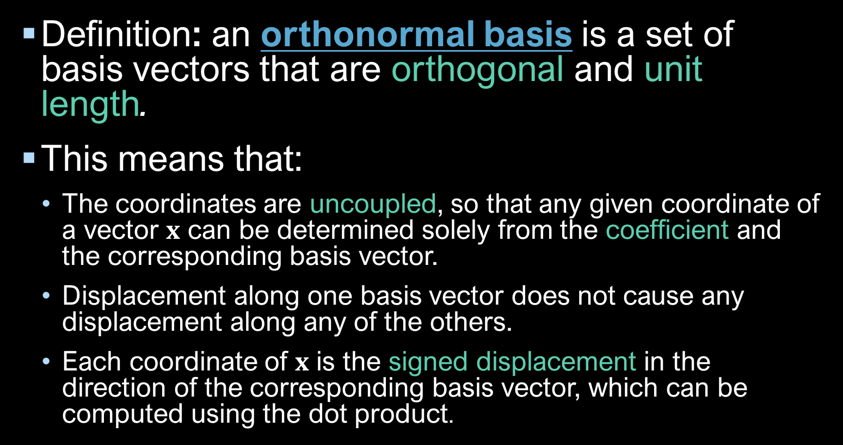
Orthonormal basis vectors
Definition: an orthonormal basis is a set of basis vectors that are orthogonal and unit length.
This means that:
The coordinates are uncoupled, so that any given coordinate of a vector $x$ can be determined solely from the coefficient and the corresponding basis vector.
Displacement along one basis vector does not cause any displacement along any of the others.
Each coordinate of $x$ is the signed displacement in the direction of the corresponding basis vector, which can be computed using the dot product.
Notes:
Orthonormal,
Which means being both orthogonal, or mutually perpendicular to each other, and unit length, or normalised.
When a basis is orthonormal, if means that some useful things are true:
The coordinates (or coefficients in the linear combination) are uncoupled, so there’s no overlap between them, and each component of the resulting vector comes from only one term of the linear combination.
Additionally, the fact that there’s no ‘cross-talk’ means that you can
change the displacement along one of the basis vectors without it affecting the displacement along the others; we’ve used this when we were separating projectile motion into horizontal and vertical parts, but if the basis vectors weren’t orthogonal, then
Moving the point along one axis also changes its displacement along another.
Keeping the basis vectors orthogonal essentially means that the individual coordinates are what we’d expect: the only place we have to look to find the displacement along each of the basis vectors. As we’ve seen before, the amount of one vector that’s in the direction of another is given by projection, using the dot product, which is essentially what we’re doing intuitively to find the coefficients when we expand the vectors out into the linear combination as on the previous slide.

Slide 7
Properties of a coordinate space
Has a coordinate system:
A set of axes (orthonormal basis)
An origin
→ directions
→ position
… relative to what?!
Notes:
So now we’ve got through the definitions, let’s recap what it means in practice for coordinate spaces – which is essentially that they have a
Sensible coordinate system,
With a set of axes defined by an orthonormal basis, so that we can represent the objects in the space in the intuitive way we expect, and
define the directions that they move in.
We also have an origin, which is where the axes meet and defines where we start measuring the distances along them from,
So that we can specify positions. If all our positions within the space are relative to the origin, though,
what is the position of the origin relative to? The answer to which depends on what kind of coordinate space we’re in;

Slide 8
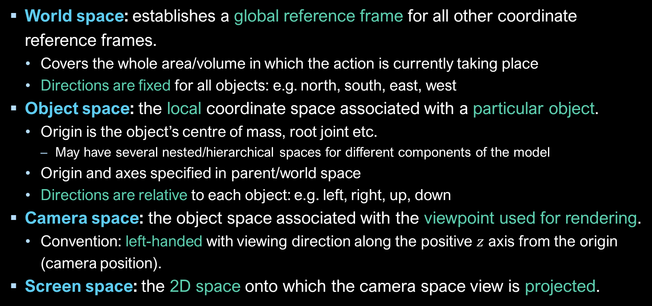
Some common coordinate spaces
World space: establishes a global reference frame for all other coordinate reference frames.
Covers the whole area/volume in which the action is currently taking place
Directions are fixed for all objects: e.g. north, south, east, west
Object space: the local coordinate space associated with a particular object.
Origin is the object’s centre of mass, root joint etc.
May have several nested/hierarchical spaces for different components of the model
Origin and axes specified in parent/world space
Directions are relative to each object: e.g. left, right, up, down
Camera space: the object space associated with the viewpoint used for rendering.
Convention: left-handed with viewing direction along the positive $z$ axis from the origin (camera position).
Screen space: the 2D space onto which the camera space view is projected.
Notes:
There are some standard ones we use in computer graphics to help us navigate the scenes.
The first is the world space, which is a global reference frame for everything else in the scene and allows us to describe where every object is in relation to the other objects by use of fixed directions, similar to compass bearings: north is always north, whichever way you’re facing. This space obviously has to be big enough to contain all the action, and the origin is usually close to the centre of where most of the interesting stuff happens.
Within the world space, each object also has its own local coordinate space, where its vertices or dimensions are specified relative to its own origin, which will generally be at the centre of mass, or the root joint of an articulated model. Complex models might even have several nested spaces for their component parts, and each object space has a transform specified relative to its parent space, which at the top level is the world space; by transforming the object spaces within their parent spaces, we can move the objects around without having to apply the transformation to every vertex of the shape. Within the local frame, the directions are relative to the object, the same way that ‘right’ might be any compass direction depending which way you’re facing.
Some objects have specially named spaces, in particular the camera that defines the viewpoint for the scene has its own camera space, which by convention has the z-axis pointing in the viewing direction from the camera position and the y-axis ‘up’ towards the top of the screen…
Which also has its own coordinate space, this time always in 2 dimensions regardless of how many the others have, meaning that the view must be projected using a technique such as the one we looked at in the last video. Let’s see how all these spaces fit together

Slide 9






Relative spaces
Screen space
$$y$$
World space
Camera space
$$x$$
$$y$$
$$y$$
$$z$$
$$z$$
Object spaces
Centre of Projection (COP)
$$x$$
View plane (screen)
$$x$$
Notes:
On our scene diagram from before; starting with the world space, giving the global frame of reference.
Each of the objects in the scene has its own space, which could be any position or orientation within the world coordinates and will change as the object moves.
The camera space is effectively another object space, though for now we’ve constrained it to lie on the world z-axis, and the
screen space defines a 2D plane within the 3D world space – or it may also be defined in the camera space, since it must always be aligned so that the viewing direction passes through it. It’s quite likely that the screen-space y-axis will point downwards, while the world and camera y-axes might be the ‘up’ direction, although that’s not guaranteed… The fact is that none of these spaces necessarily match any of the others; in particular, since the positive camera z-axis is pointing towards the origin, where the action is, it will most likely be pointing in the negative direction of at least one world axis; placing it on the world z-axis like this is fairly standard as it allows the directions of the other axes to match, with just the z coordinates flipped. This gives the two spaces a different chirality, or mirrored symmetry, which for coordinate spaces is described as being either

Slide 10







Left or right handed?
Cross product direction follows the same ‘handedness’ as the coordinate system
Left handed:
Unity ($y$ up)
Unreal ($z$ up)
(DirectX)
Right handed:
Maths/physics
(Maya)
(OpenGL)
$$y$$
$$y$$
$$z$$
$$x$$
$$x$$
$$z$$
Notes:
Left or right handed.
In a left-handed system, with the x and y axes pointing horizontally and vertically as we’ve been doing so far, the z axis would point into the page, while in a
right-handed system, it would point outwards; the names come from the ‘left hand’ and ‘right hand’ rules, which match the axes to fingers and thumbs to define the relative directions, as explained in the video linked on LearningSpace. The same rule as applies to the coordinate systems determines the
Direction of the cross product of two vectors, so that the result is numerically the same either way; you’d have to draw the axes to see the difference. Of course, this being virtual 3D space, you can draw them with any orientation you wish, and somewhat frustratingly, you’ll find different configurations in different contexts. For instance,
Unity and Unreal both use left-handed coordinate systems, though unity has the y axis pointing upwards while Unreal keeps the xy plane on the floor and uses z for height. DirectX also uses a left-handed system by default, though I believe this can be configured.
Meanwhile, maths and physics traditionally use a right-handed system. By default, Maya and OpenGL do also, though like DirectX, these are configurable. Plus even if there isn’t a built-in switch to change between coordinate systems, there are ways to transform points from one to another, however different they are, which is what we’ll be looking at next week.

