Slide 1

3: Computational Geometry II
COMP270: Mathematics for 3D Worlds & Simulations

Slide 2

Dot product

Slide 3

Dot product
$$\left(\begin{matrix}x_{1} \\ y_{1}\end{matrix}\right)⋅\left(\begin{matrix}x_{2} \\ y_{2}\end{matrix}\right)=x_{1}x_{2}+y_{1}y_{2}$$

Slide 4

Dot product and magnitude
Theorem: For a vector $v$, ${\left\|v\right\|}^{2}=v⋅v$
Proof:
Let $v=\left(\begin{matrix}x \\ y\end{matrix}\right)$
Then ${\left\|v\right\|}^{2}={\sqrt{x^{2}+y^{2}}}^{2}=x^{2}+y^{2}$
And $v⋅v=xx+yy=x^{2}+y^{2}$
QED

Slide 5
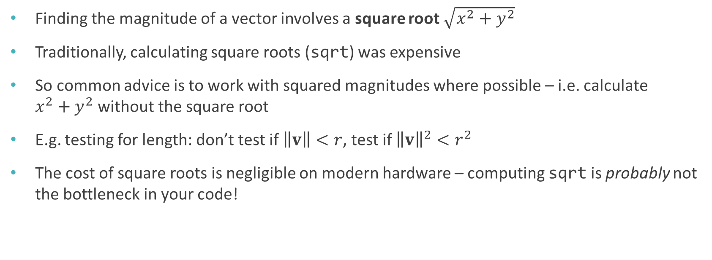
Magnitude and squared magnitude
Finding the magnitude of a vector involves a square root $\sqrt{x^{2}+y^{2}}$
Traditionally, calculating square roots (sqrt) was expensive
So common advice is to work with squared magnitudes where possible – i.e. calculate $x^{2}+y^{2}$ without the square root
E.g. testing for length: don’t test if $\left\|v\right\|<r$, test if ${\left\|v\right\|}^{2}<r^{2}$
The cost of square roots is negligible on modern hardware – computing sqrt is probably not the bottleneck in your code!

Slide 6




Geometric interpretation of dot product
$$v_{1}$$
Theorem: For vectors $v_{1}$ and $v_{2}$,
$$v_{1}⋅v_{2}=\left\|v_{1}\right\|\left\|v_{2}\right\|\cos{θ}$$
where $θ$ is the angle between the two vectors
$$θ$$
$$v_{2}$$

Slide 7
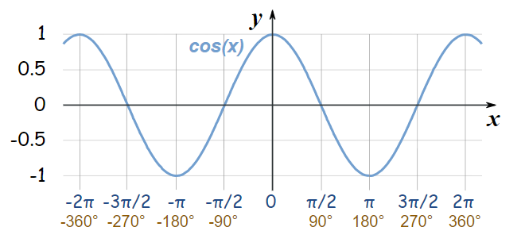
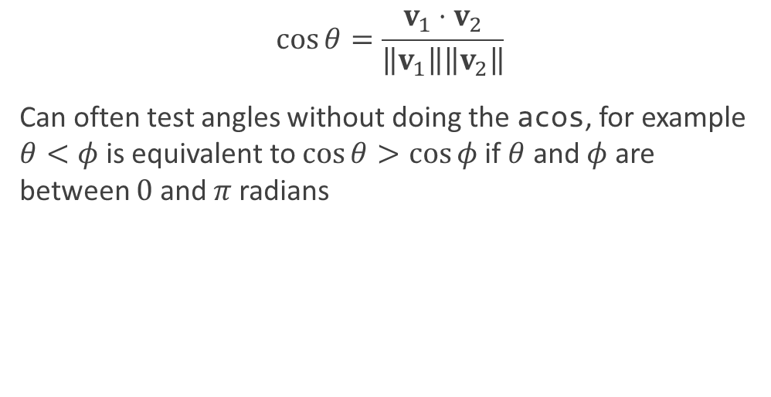
Dot products and angles
$$\cos{θ}=\frac{{v_{1}⋅v}_{2}}{\left\|v_{1}\right\|\left\|v_{2}\right\|}$$
Can often test angles without doing the acos, for example $θ<φ$ is equivalent to $\cos{θ}>\cos{φ}$ if $θ$ and $φ$ are between $0$ and $π$ radians

Slide 8

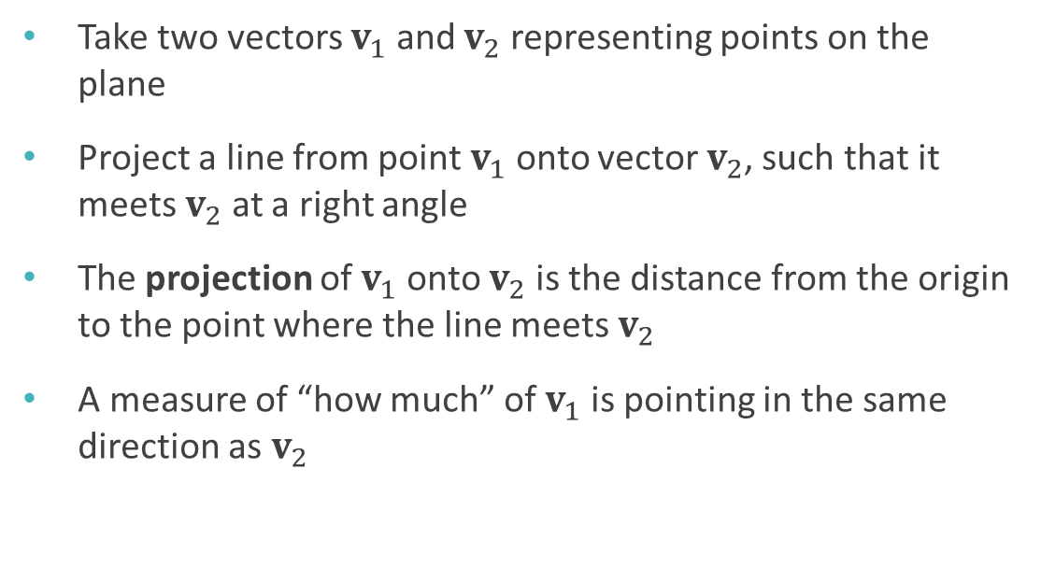
Vector projection
Take two vectors $v_{1}$ and $v_{2}$ representing points on the plane
Project a line from point $v_{1}$ onto vector $v_{2}$, such that it meets $v_{2}$ at a right angle
The projection of $v_{1}$ onto $v_{2}$ is the distance from the origin to the point where the line meets $v_{2}$
A measure of “how much” of $v_{1}$ is pointing in the same direction as $v_{2}$
$$v_{1}$$
$$v_{2}$$

Slide 9
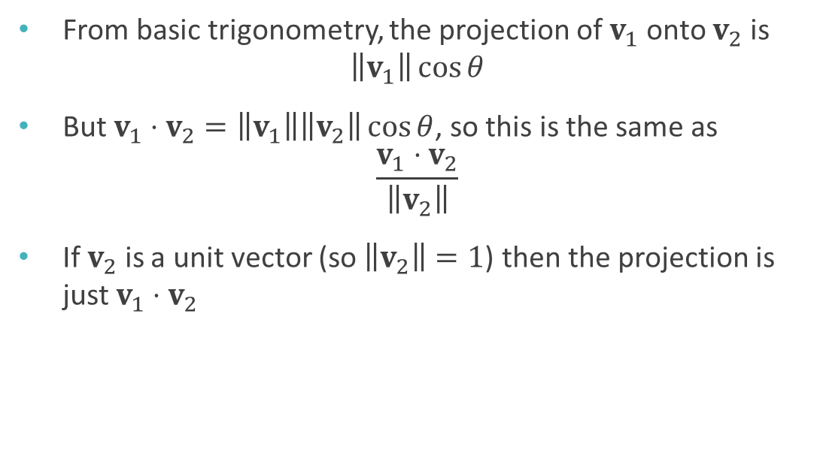
Projection and dot product
From basic trigonometry, the projection of $v_{1}$ onto $v_{2}$ is $\left\|v_{1}\right\|\cos{θ}$
But $v_{1}⋅v_{2}=\left\|v_{1}\right\|\left\|v_{2}\right\|\cos{θ}$, so this is the same as $\frac{v_{1}⋅v_{2}}{\left\|v_{2}\right\|}$
If $v_{2}$ is a unit vector (so $\left\|v_{2}\right\|=1$) then the projection is just $v_{1}⋅v_{2}$
$$v_{1}$$
$$θ$$
$$v_{2}$$

Slide 10
Matrices

Slide 11

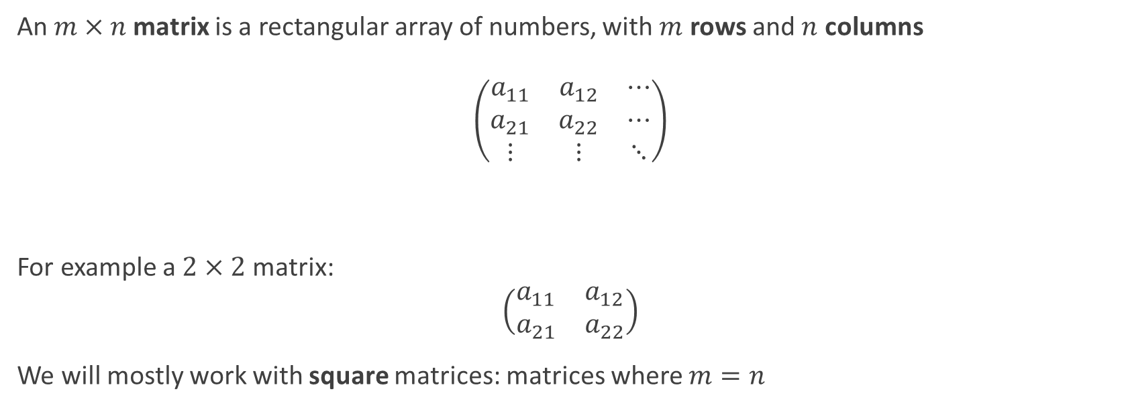

Matrices
The plural of matrix is matrices, not “matrixes”!
An $m×n$ matrix is a rectangular array of numbers, with $m$ rows and $n$ columns $$\left(\begin{matrix}a_{11} & a_{12} & ⋯ \\ a_{21} & a_{22} & ⋯ \\ ⋮ & ⋮ & ⋱\end{matrix}\right)$$
For example a $2×2$ matrix: $$\left(\begin{matrix}a_{11} & a_{12} \\ a_{21} & a_{22}\end{matrix}\right)$$
We will mostly work with square matrices: matrices where $m=n$
$m$ rows
$n$ columns

Slide 12
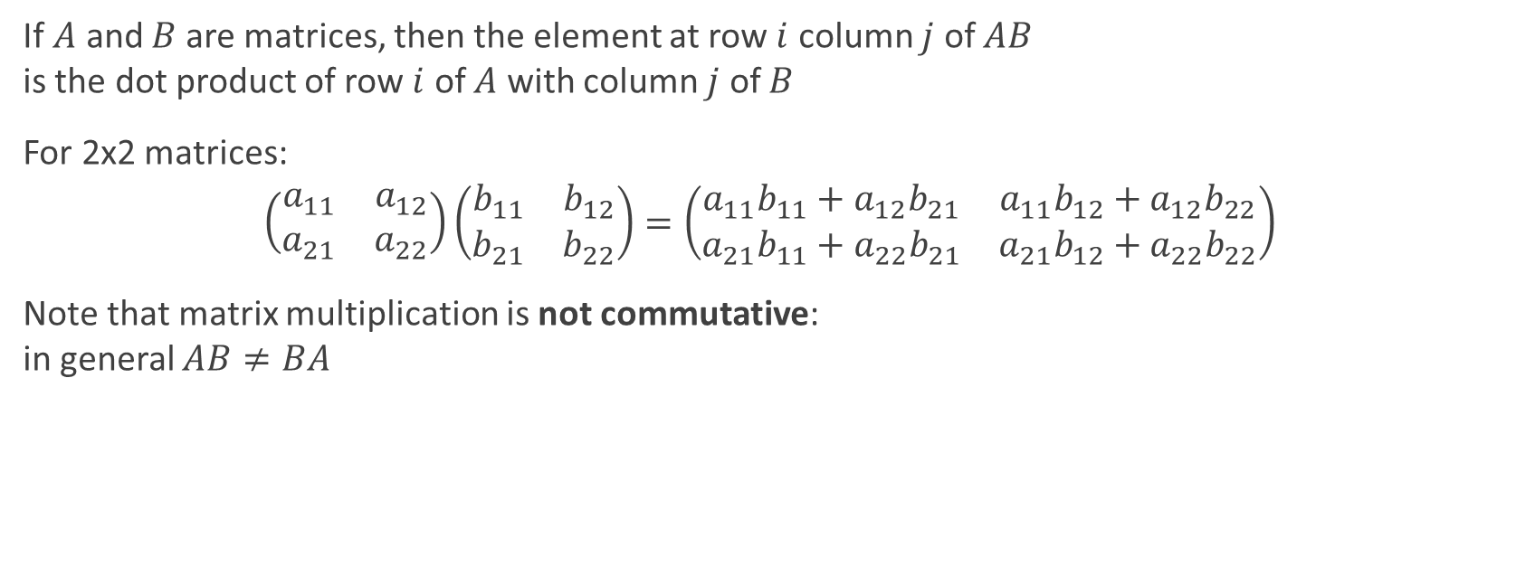
Multiplying matrices
If $A$ and $B$ are matrices, then the element at row $i$ column $j$ of $AB$ is the dot product of row $i$ of $A$ with column $j$ of $B$
For 2x2 matrices:
$$\left(\begin{matrix}a_{11} & a_{12} \\ a_{21} & a_{22}\end{matrix}\right)\left(\begin{matrix}b_{11} & b_{12} \\ b_{21} & b_{22}\end{matrix}\right)=\left(\begin{matrix}a_{11}b_{11}+a_{12}b_{21} & a_{11}b_{12}+a_{12}b_{22} \\ a_{21}b_{11}+a_{22}b_{21} & a_{21}b_{12}+a_{22}b_{22}\end{matrix}\right)$$
Note that matrix multiplication is not commutative: in general $AB≠BA$

Slide 13
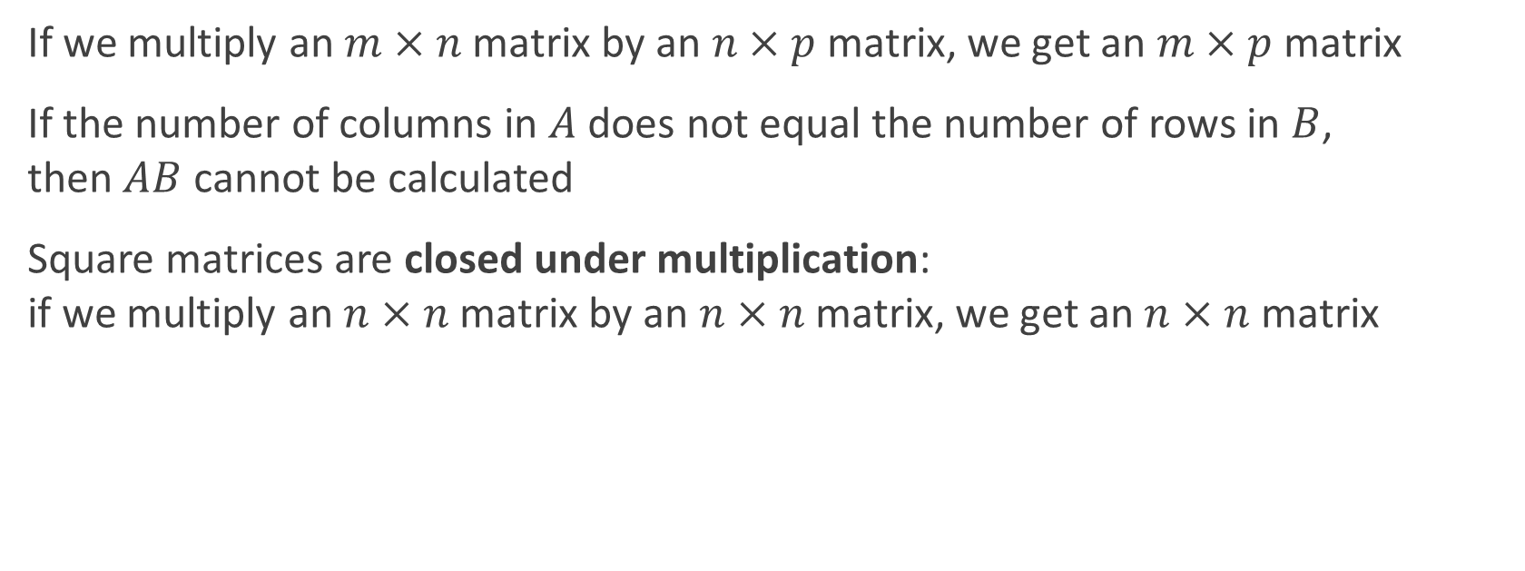
Multiplying matrices
If we multiply an $m×n$ matrix by an $n×p$ matrix, we get an $m×p$ matrix
If the number of columns in $A$ does not equal the number of rows in $B$, then $AB$ cannot be calculated
Square matrices are closed under multiplication: if we multiply an $n×n$ matrix by an $n×n$ matrix, we get an $n×n$ matrix

Slide 14
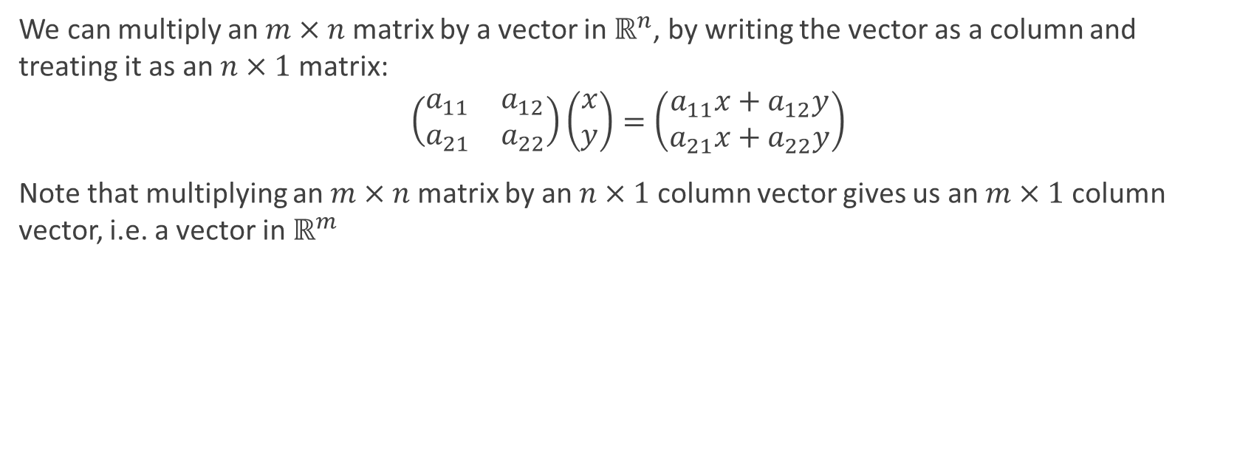
Multiplying matrices and vectors
We can multiply an $m×n$ matrix by a vector in $ℝ^{n}$, by writing the vector as a column and treating it as an $n×1$ matrix:
$$\left(\begin{matrix}a_{11} & a_{12} \\ a_{21} & a_{22}\end{matrix}\right)\left(\begin{matrix}x \\ y\end{matrix}\right)=\left(\begin{matrix}a_{11}x+a_{12}y \\ a_{21}x+a_{22}y\end{matrix}\right)$$
Note that multiplying an $m×n$ matrix by an $n×1$ column vector gives us an $m×1$ column vector, i.e. a vector in $ℝ^{m}$

Slide 15

Identity matrix
An identity matrix is a square matrix with 1 on the main diagonal and 0 everywhere else:
$$I=\left(\begin{matrix}1 & 0 \\ 0 & 1\end{matrix}\right)$$
For any square matrix $A$, $AI=A=IA$
So $I$ works like $1$ does for multiplication in $ℝ$

Slide 16
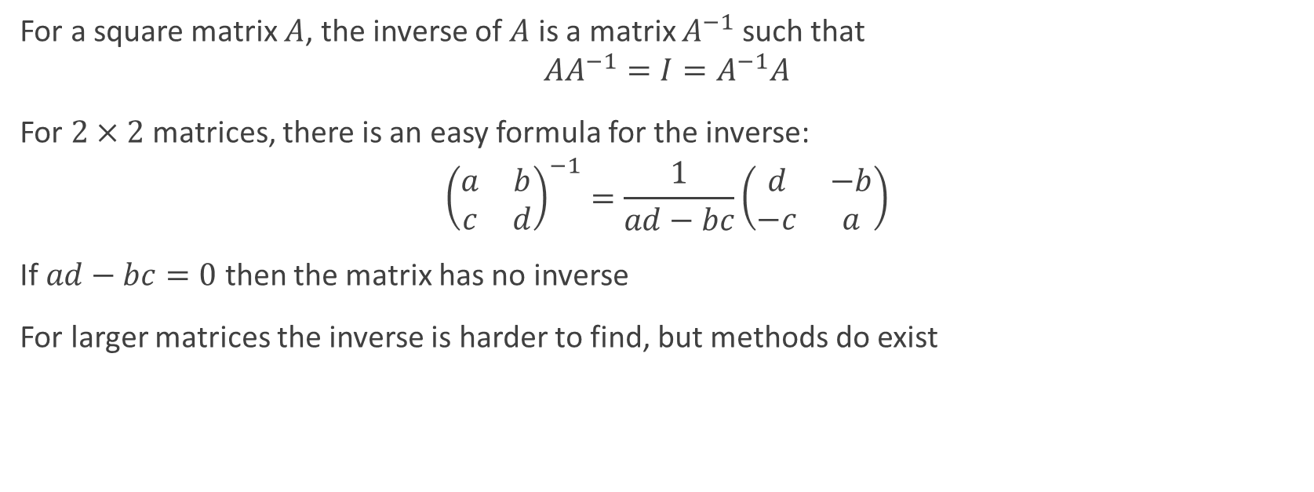
Inverse matrix
For a square matrix $A$, the inverse of $A$ is a matrix $A^{−1}$ such that $$AA^{−1}=I=A^{−1}A$$
For $2×2$ matrices, there is an easy formula for the inverse:
$${\left(\begin{matrix}a & b \\ c & d\end{matrix}\right)}^{−1}=\frac{1}{ad−bc}\left(\begin{matrix}d & −b \\ −c & a\end{matrix}\right)$$
If $ad−bc=0$ then the matrix has no inverse
For larger matrices the inverse is harder to find, but methods do exist

Slide 17
Rotation

Slide 18

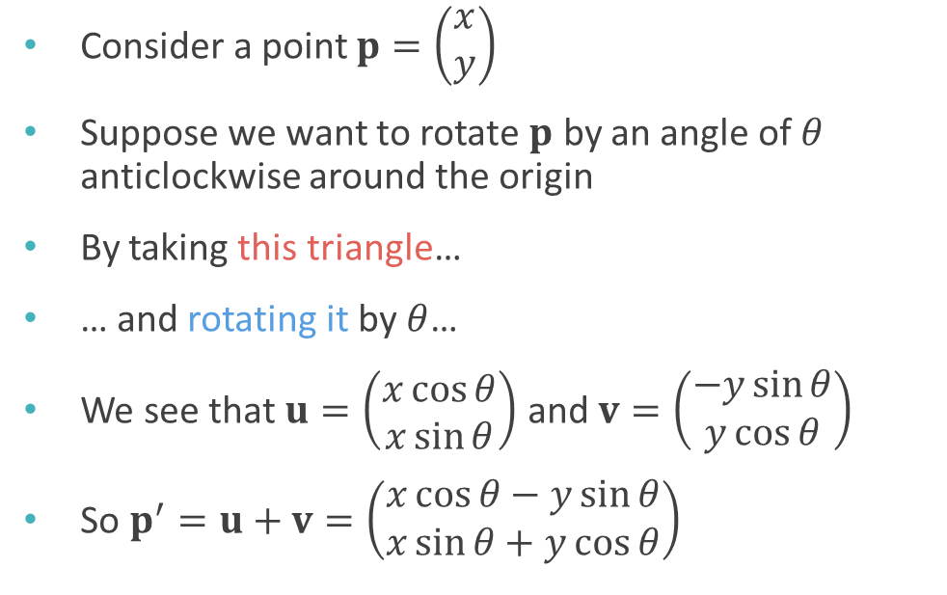



Rotation around the origin
Consider a point $p=\left(\begin{matrix}x \\ y\end{matrix}\right)$
Suppose we want to rotate $p$ by an angle of $θ$ anticlockwise around the origin
By taking this triangle…
… and rotating it by $θ$…
We see that $u=\left(\begin{matrix}x\cos{θ} \\ x\sin{θ}\end{matrix}\right)$ and $v=\left(\begin{matrix}−y\sin{θ} \\ y\cos{θ}\end{matrix}\right)$
So $p^{′}=u+v=\left(\begin{matrix}x\cos{θ}−y\sin{θ} \\ x\sin{θ}+y\cos{θ}\end{matrix}\right)$
$$p′$$
$$v$$
$$u$$
$$p$$

Slide 19

Rotation matrix
$p^{′}=u+v=\left(\begin{matrix}x\cos{θ}−y\sin{θ} \\ x\sin{θ}+y\cos{θ}\end{matrix}\right)$
We can write this as a matrix multiplication: $p^{′}=\left(\begin{matrix}\cos{θ} & −\sin{θ} \\ \sin{θ} & \cos{θ}\end{matrix}\right)\left(\begin{matrix}x \\ y\end{matrix}\right)$
We call $R_{θ}=\left(\begin{matrix}\cos{θ} & −\sin{θ} \\ \sin{θ} & \cos{θ}\end{matrix}\right)$ a rotation matrix

Slide 20

Inverting the rotation matrix
Theorem: $$R_{θ}^{−1}=R_{−θ}$$
The inverse of the rotation matrix for angle $θ$ is the rotation matrix for angle $−θ$

Slide 21
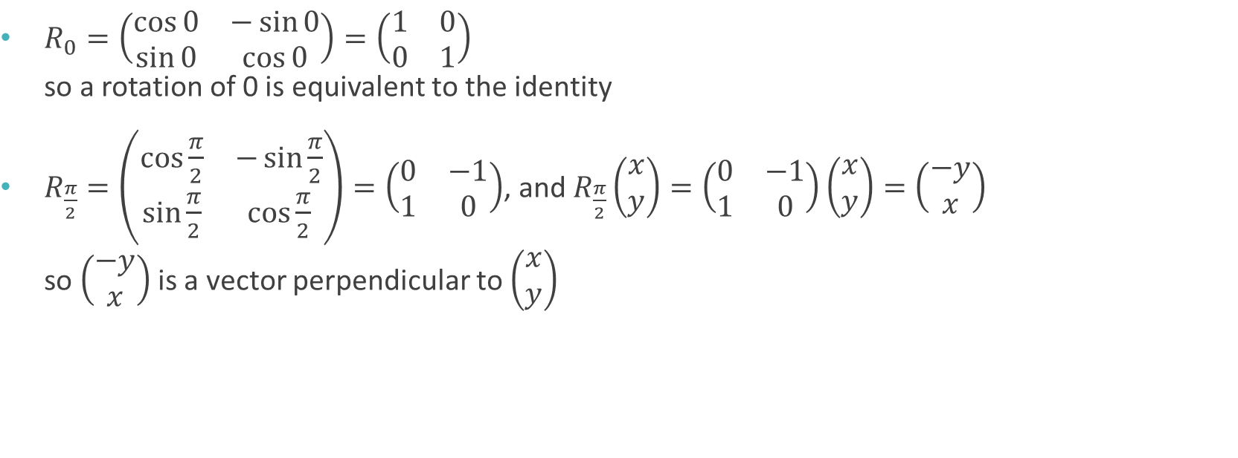
Useful rotation matrices
$R_{0}=\left(\begin{matrix}\cos{0} & −\sin{0} \\ \sin{0} & \cos{0}\end{matrix}\right)=\left(\begin{matrix}1 & 0 \\ 0 & 1\end{matrix}\right)$ so a rotation of 0 is equivalent to the identity
$R_{\frac{π}{2}}=\left(\begin{matrix}\cos{\frac{π}{2}} & −\sin{\frac{π}{2}} \\ \sin{\frac{π}{2}} & \cos{\frac{π}{2}}\end{matrix}\right)=\left(\begin{matrix}0 & −1 \\ 1 & 0\end{matrix}\right)$, and $R_{\frac{π}{2}}\left(\begin{matrix}x \\ y\end{matrix}\right)=\left(\begin{matrix}0 & −1 \\ 1 & 0\end{matrix}\right)\left(\begin{matrix}x \\ y\end{matrix}\right)=\left(\begin{matrix}−y \\ x\end{matrix}\right)$ so $\left(\begin{matrix}−y \\ x\end{matrix}\right)$ is a vector perpendicular to $\left(\begin{matrix}x \\ y\end{matrix}\right)$

Slide 22
Other transformation matrices

Slide 23
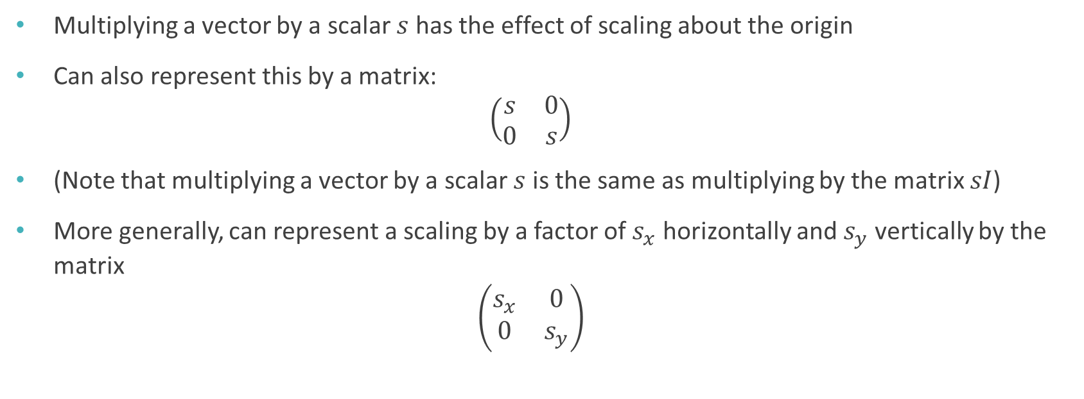
Scaling
Multiplying a vector by a scalar $s$ has the effect of scaling about the origin
Can also represent this by a matrix: $\left(\begin{matrix}s & 0 \\ 0 & s\end{matrix}\right)$
(Note that multiplying a vector by a scalar $s$ is the same as multiplying by the matrix $sI$)
More generally, can represent a scaling by a factor of $s_{x}$ horizontally and $s_{y}$ vertically by the matrix $\left(\begin{matrix}s_{x} & 0 \\ 0 & s_{y}\end{matrix}\right)$

Slide 24
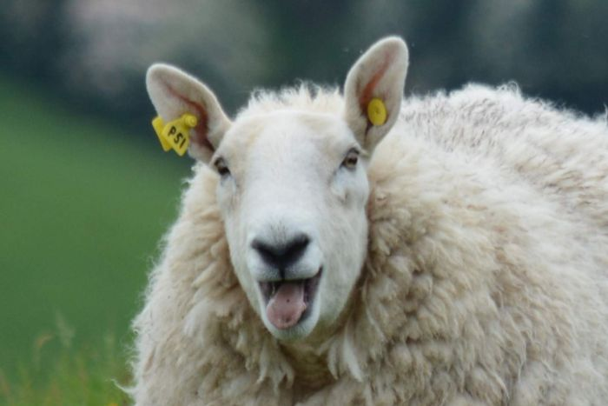
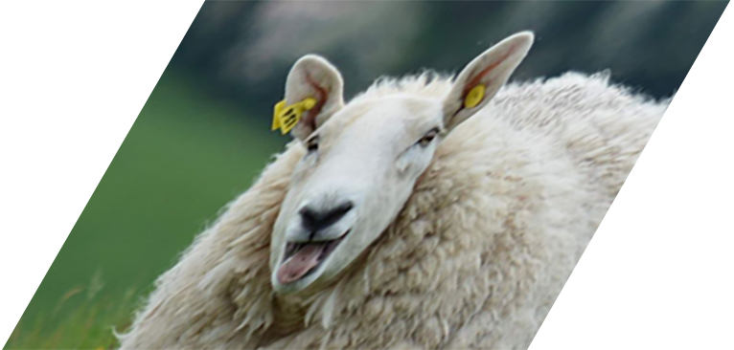

Shearing
A shear transformation by a factor of $λ$ parallel to the $x$-axis is given by the matrix $\left(\begin{matrix}1 & λ \\ 0 & 1\end{matrix}\right)$

Slide 25

Reflection
The following matrices represent horizontal and vertical reflections respectively: $\left(\begin{matrix}−1 & 0 \\ 0 & 1\end{matrix}\right) \left(\begin{matrix}1 & 0 \\ 0 & −1\end{matrix}\right)$

Slide 26



Inverses
If $A$ represents a transformation, then $A^{−1}$ represents the reverse of that transformation
If $Av=v^{′}$ then $A^{−1}v^{′}=v$
$$A^{−1}$$
$$A$$

Slide 27
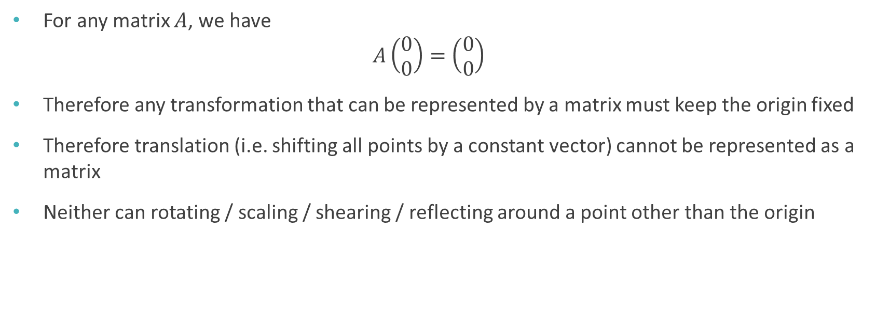
Translation?
For any matrix $A$, we have $A\left(\begin{matrix}0 \\ 0\end{matrix}\right)=\left(\begin{matrix}0 \\ 0\end{matrix}\right)$
Therefore any transformation that can be represented by a matrix must keep the origin fixed
Therefore translation (i.e. shifting all points by a constant vector) cannot be represented as a matrix
Neither can rotating / scaling / shearing / reflecting around a point other than the origin

Slide 28
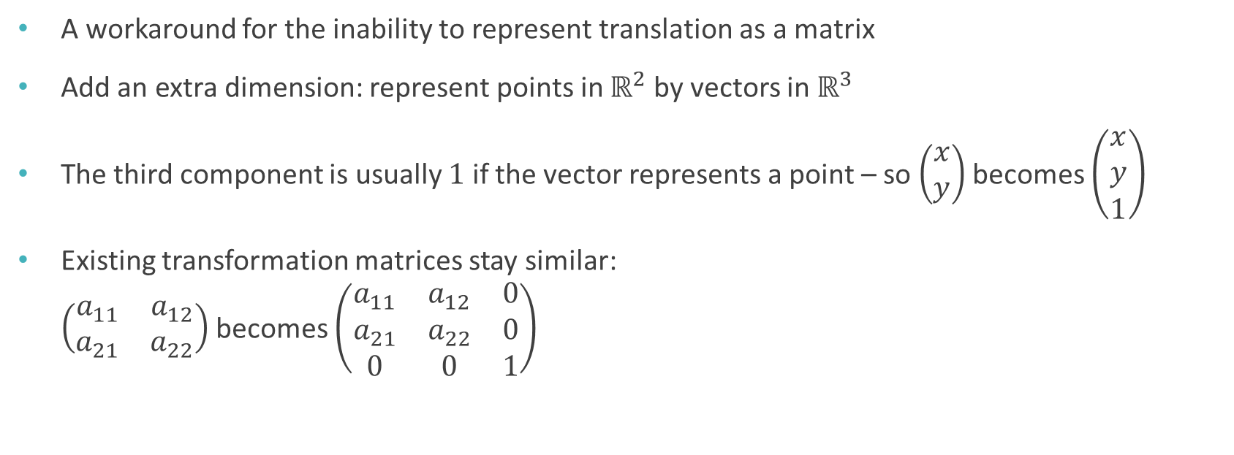
Homogeneous coordinates
A workaround for the inability to represent translation as a matrix
Add an extra dimension: represent points in $ℝ^{2}$ by vectors in $ℝ^{3}$
The third component is usually $1$ if the vector represents a point – so $\left(\begin{matrix}x \\ y\end{matrix}\right)$ becomes $\left(\begin{matrix}x \\ y \\ 1\end{matrix}\right)$
Existing transformation matrices stay similar: $\left(\begin{matrix}a_{11} & a_{12} \\ a_{21} & a_{22}\end{matrix}\right)$ becomes $\left(\begin{matrix}a_{11} & a_{12} & 0 \\ a_{21} & a_{22} & 0 \\ 0 & 0 & 1\end{matrix}\right)$

Slide 29

Translation in homogeneous coordinates
Translation by $\left(\begin{matrix}t_{x} \\ t_{y}\end{matrix}\right)$ is represented by the matrix $\left(\begin{matrix}1 & 0 & t_{x} \\ 0 & 1 & t_{y} \\ 0 & 0 & 1\end{matrix}\right)$
Multiplying by this matrix is the same as adding $\left(\begin{matrix}t_{x} \\ t_{y} \\ 0\end{matrix}\right)$ $\left(\begin{matrix}1 & 0 & t_{x} \\ 0 & 1 & t_{y} \\ 0 & 0 & 1\end{matrix}\right)\left(\begin{matrix}x \\ y \\ 1\end{matrix}\right)=\left(\begin{matrix}x+t_{x} \\ y+t_{y} \\ 1\end{matrix}\right)$

Slide 30

Sequences of transformations
If $A$ and $B$ are matrices representing transformations, then $AB$ represents doing $B$ followed by $A$
Note the right to left order!
This is because the vector being transformed appears on the far right of the product

Slide 31

Order of transformation matters! $$AB≠BA$$
Rotate
Translate
Translate
Rotate

Slide 32

Reminder: Worksheet A due next Monday!

