Slide 1
Week 2: Geometry I Part 4: Curves and Parameters
COMP270: Mathematics for 3D Worlds and Simulations
Notes:
This is the last video for this week, in which we’ll draw together some of the things we’ve looked at in the first three sections by considering general curves and the parameters used to represent them,

Slide 2
Objectives
Express a variety of shapes using parametric equations
Compute the vector equation of a straight line
Notes:
In a form known as parametric equations. As part of this, we’ll also see how to formulate the vector equation of a straight line.

Slide 3


Recap: drawing functions
Define a function $f :S→T$ as $f\left(s\right)∈T$ for $s∈S$
Represent the function as a graph by plotting the points $\left(x,f\left(x\right)\right)$against 2D axes
$$y={\frac{1}{4}x}^{2}−4$$
Notes:
In the last video, we started to look at functions and
how to draw some simple graphs of the form y = f(x) by plotting a suitable number of points to draw lines between,
which gives some approximation of a curved line.
Euclid had a rather more poetic description of this, where he said that

Slide 4
What is a curve?
“The [curved] line is […] the first species of quantity, which has only one dimension, namely length, without any width nor depth, and is nothing else than the flow or run of the point which […] will leave from its imaginary moving some vestige in length, exempt of any width.”
Euclid, Elements (English translation from Wikipedia)
one dimension, namely length
flow or run of the point
leave from its imaginary moving some vestige
Notes:
[…]
So, you can imagine a curve as the trail left by a point as it moves through space, a little like when you write your name with a sparkler on bonfire night. We can represent the point’s motion using a function, which we can evaluate at various points to build up a picture of the overall path in as much detail as we require. The functions we looked at last time relate a distance along one axis of space to the distance along another, which works well for fairly simple curves, where each value of x gives only one y value, and can be extended to other shapes, too, for example

Slide 5







Defining a circle
How do we define a circle of radius 1 (aka a unit circle)?
The set of points $(x, y)$ such that $x^{2}+y^{2}=1$
The pair of curves $y=±\sqrt{1−x^{2}}$
Or we can define it parametrically
$$y$$
1
$$(x, y)$$
$$1$$
$$y$$
-1
$$x$$
1
$$x$$
-1
Notes:
A circle.
This is a little different from the curves we looked at before, as there appear to be two values of y for each value of x. We can describe the relationship between the two coordinates as being constrained
By the equation x^2 + y^2 = 1 (for a unit circle), which comes from the right-angled triangle formed from the radius of the circle and the coordinates of the point at its end. We can rearrange this to give the more usual form y = f(x) as
For which we effectively have to draw two separate semicircles for the positive and negative roots. There is a way we can describe curves like this as a single unit, which is to define them parametrically,

Slide 6

Parametric equations
Definition: parametric equations express a set of quantities as explicit functions of a number of independent variables, known as “parameters”
e.g. a curve defined by two functions $f :ℝ→ℝ$ and $g :ℝ→ℝ$, with points $(x, y)$ with $x=f\left(t\right)$ and $y=g\left(t\right)$ for $t$ in some range
$t$ is the parameter
Equivalently, defined by a single function $h : ℝ→ℝ^{2}$ which takes a scalar parameter and returns a vector
$$h\left(t\right)=\left(\begin{matrix}f\left(t\right) \\ g\left(t\right)\end{matrix}\right)$$
Notes:
Where instead of relating the y value directly to the x, relate both coordinates to some other value (or values) which are independent variables that change over, say, time or distance.
For the 2 dimensional space we’re working in, we’d have a pair of equations mapping between the same domains and codomains for the same input element, one giving the x coordinate and one the y. The input they operate on is known as the parameter, and it’s often represented by the letter t.
We can also combine these two functions into a single function that takes the parameter as input, and returns the x and y values as a vector, rather than considering them separately and then combining.

Slide 7








Vector equation of a line
For a line defined by two points, we can represent any point on the line as a scalar multiple of the vector between the points, plus the vector to first point from the origin
$$p_{2}$$
$$v$$
$$1.25v$$
$$p_{1}$$
$$p_{1}+0.5v$$
$$0.5v$$
$$−0.5v$$
$$O$$
Notes:
The simplest example of this is the vector equation of a line. Remember from the second of this week’s videos that a vector can be defined by two points, and
we can represent vectors of any length, and either direction, along the same line by taking a scalar multiple of the original vector.
This means that we can find the coordinates, or vector displacement from the origin, of any point along the line by multiplying the vector v by some scalar, which gives a displacement from the starting point, and then adding the vector from the origin to the starting point.
For instance, the point halfway between p1 and p2 is given by p1
Plus 0.5v

Slide 8






Vector equation of a line
For a line defined by two points, we can represent any point on the line as a scalar multiple of the vector between the points, plus the vector to first point from the origin
$p= p_{1}+tv$
$f(t)= p_{1}+t\left(p_{2}−p_{1}\right)=\left(1−t\right)p_{1}+tp_{2}$
$$p_{2}$$
A function of t, $f(t)$
$$v=p_{2}−p_{1}$$
$$tv$$
$$p$$
$$p_{1}$$
$$O$$
Notes:
We can write this parametrically, as p, our general point, equals p1 (the starting point) plus tv, with t representing the scalar we multiply the vector v by; since p1 and v are known quantities, this is a function of t.
If we expand it out to replace v with p2 – p1, we get that the function of t that gives a point p is (1-t)p1 + tp2 -

Slide 9


Vector equation of a line
For a line defined by two points, we can represent any point on the line as a scalar multiple of the vector between the points, plus the vector to first point from the origin
$p= p_{1}+tv$
$f(t)= p_{1}+t\left(p_{2}−p_{1}\right)=\left(1−t\right)p_{1}+tp_{2}$
$$p_{2}$$
$$v=p_{2}−p_{1}$$
$${tp}_{2}$$
$$p$$
$${(1−t)p}_{1}$$
$$p_{1}$$
$$O$$
Notes:
That is, we’re adding a multiple of p1 to a multiple of p2, or in other words travelling some way along the vector from the origin to the starting point and then some way along the vector from the origin to the end point.

Slide 10






Vector equation of a line
For a line defined by two points, we can represent any point on the line as a scalar multiple of the vector between the points, plus the vector to first point from the origin
$p= p_{1}+tv$
$f(t)= p_{1}+t\left(p_{2}−p_{1}\right)=\left(1−t\right)p_{1}+tp_{2}$
$t=0⇒f(0)=1p_{1}+0p_{2}=p_{1}$ $t=1⇒f(1)=0p_{1}+1p_{2}=p_{2}$
For $0≤t≤1$, this is a linear interpolation (lerp)
$$p_{2}$$
$$v=p_{2}−p_{1}$$
$$t=1$$
$$1−t$$
$$t=0$$
$$p$$
$$t$$
$$p_{1}$$
$$O$$
Notes:
We can see that, when t is 0, the result is just the starting point p1. As t increases, the point moves along the vector v and at t = 1, it’s at the end point p2;
the values t and t – 1 are proportional to the distances between the point and the start and end of the vector.
Varying t in this way is known as performing a linear interpolation – linear because it’s along a line.

Slide 11












Parameterising a line
$f(t)= \left(1−t\right)p_{1}+tp_{2}$
$x=f\left(t\right)=\left(1−t\right)x_{1}+tx_{2}$ $y=g\left(t\right)=\left(1−t\right)y_{1}+ty_{2}$
i.e. performing a(n identical) linear interpolation along both axes
$$y$$
$$t>1$$
$$t=1$$
$$(x_{2},y_{2})$$
$$(x,y)$$
$$t=0$$
$$p=f(t)$$
$$p_{2}$$
$$(x_{1},y_{1})$$
$$t<0$$
$$p_{1}$$
$$x$$
$$O$$
Notes:
We can separate this vector function out and consider the x and y coordinates separately, and see that as t varies, we’re performing a linear interpolation along each axis;
We can also extend t above 1 and below 0 to find points outside the original ones.

Slide 12

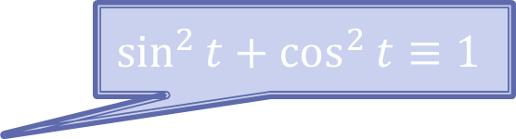


Parametric definition of a unit circle
$$\sin^{2}{t}+\cos^{2}{t}≡1$$
$$y$$
$$x=\cos{t}$$
$$y=\sin{t}$$
For $0≤t<2π$
1
-1
1
$$x$$
-1
Notes:
Going back to our unit circle, we can define its parametric equation as x = cost, y = sint;
You can verify that this is equivalent to the original equation, x^2 + y^2 = 1, using the trigonometric identity shown. Here, rather than the linear displacement from the starting point, the parameter t is the angle with the positive x-axis, and it’s defined over a range of 0 to 2pi.

Slide 13
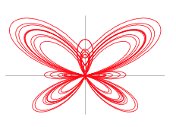

Parametric definition of a butterfly
$$x=\sin{t}\left[e^{\cos{t}}−2\cos\left(4t\right)+{\left(\sin{(\frac{1}{12}t)}\right)}^{5}\right]$$
$$y=\cos{t}\left[e^{\cos{t}}−2\cos\left(4t\right)+{\left(\sin{(\frac{1}{12}t)}\right)}^{5}\right]$$
https://mathworld.wolfram.com/ButterflyCurve.html
Notes:
We can use parametric equations to express a wide range of different curves, including this butterfly, and some others that are part of this week’s workshop exercises. Being able to express the x and y components of a function independently will also be useful when we look at mechanics in weeks 4 and 5.
There is an another special kind of curve that is defined using a parameter, and that’s

Slide 14
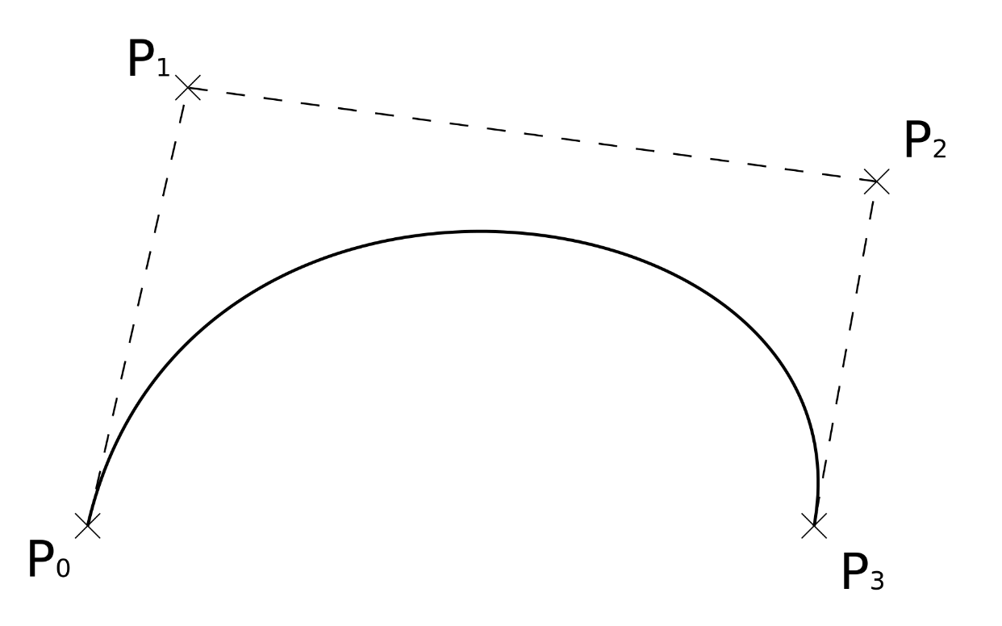
Bézier curves
Named after Pierre Bézier, 1910-1999, French engineer
Defined by a weighted blend of a number of control points
Commonly used in computer graphics and game development, as allows artists/designers good control over the precise shape of the curve
See worksheet A…
Notes:
The Bezier curve, named after a French engineer. Instead of being defined by a fixed equation,
Bezier curves are given as a weighted blend of control points, which is a little like an interpolation as it allows the creation of something that’s in between the values.
These control points can be specified as coordinates by artists or designers in graphics packages, and allows them to create smooth shapes whilst only having to store a few values in memory.
That’s all I’m going to say about Bezier curves for now; there is more information on worksheet A, where your first task is to draw a curve from a given set of control points.
This concludes the lecture content for this week; if you haven’t already done so, have a go at the learning space quizzes to see how much you can remember, then take a look at the exercises for the workshop and the first assignment worksheet. If you have any questions or comments, please post them on the forum or send me an email.

