Slide 1
Week 3: Geometry II Part 1: More on Vectors
COMP270: Mathematics for 3D Worlds and Simulations

Slide 2
Objectives
Define the dot product vector operator
Understand its potential uses in graphics coding applications

Slide 3






Recap: vector definition
A vector is a directed line segment between 2 points
Written in column form as $\left(\begin{matrix}x \\ y\end{matrix}\right)$
Magnitude $\left\|\left(\begin{matrix}x \\ y\end{matrix}\right)\right\|=\sqrt{x^{2}+y^{2}}$
Scalar multiplication $c\left(\begin{matrix}x \\ y\end{matrix}\right)=\left(\begin{matrix}cx \\ cy\end{matrix}\right)$
$$\left\|\left(\begin{matrix}x \\ y\end{matrix}\right)\right\|$$
$$y$$
$$cy$$
$$cx$$
$$x$$

Slide 4

Recap: vector arithmetic
For two vectors $\left(\begin{matrix}x_{1} \\ y_{1}\end{matrix}\right)$ and $\left(\begin{matrix}x_{2} \\ y_{2}\end{matrix}\right)$:
$\left(\begin{matrix}x_{1} \\ y_{1}\end{matrix}\right)+\left(\begin{matrix}x_{2} \\ y_{2}\end{matrix}\right)=\left(\begin{matrix}x_{1}{+x}_{2} \\ y_{1}+y_{2}\end{matrix}\right)$
$\left(\begin{matrix}x_{1} \\ y_{1}\end{matrix}\right)−\left(\begin{matrix}x_{2} \\ y_{2}\end{matrix}\right)=\left(\begin{matrix}x_{1}−x_{2} \\ y_{1}{−y}_{2}\end{matrix}\right)$
+
-

Slide 5

Dot product: algebraic definition
For two vectors $v_{1}=\left(\begin{matrix}x_{1} \\ y_{1}\end{matrix}\right)$ and $v_{2}=\left(\begin{matrix}x_{2} \\ y_{2}\end{matrix}\right)$, the dot product is given by: $v_{1}∙v_{2}=\left(\begin{matrix}x_{1} \\ y_{2}\end{matrix}\right)∙\left(\begin{matrix}x_{2} \\ y_{2}\end{matrix}\right)=x_{1}x_{2}{ + y}_{1}y_{2}$
The result is a scalar value…

Slide 6

Dot product and magnitude
Theorem: for a vector $v$, ${\left\|v\right\|}^{2}=v⋅v$
Proof:
Let $v=\left(\begin{matrix}x \\ y\end{matrix}\right)$
Then ${\left\|v\right\|}^{2}={\sqrt{x^{2}+y^{2}}}^{2}=x^{2}+y^{2}$
Also, $v⋅v=xx+yy=x^{2}+y^{2}$
QED
Quod erat demonstradum: “what was to be demonstrated”

Slide 7

Magnitude and squared magnitude
Finding the magnitude of a vector involves a square root: $\sqrt{x^{2}+y^{2}}$
Traditionally, calculating square roots (sqrt) was expensive
Common advice: work with squared magnitudes where possible – i.e. calculate $x^{2}+y^{2}$ without the square root
e.g. testing for length: don’t test if $\left\|v\right\|<r$, test if ${\left\|v\right\|}^{2}<r^{2}$
The cost of square roots is negligible on modern hardware – computing sqrt is probably not the bottleneck in your code!

Slide 8




Dot product: geometric interpretation
Theorem: for vectors $a$ and $b$, $v_{1}∙v_{2}=\left\|v_{1}\right\|\left\|v_{2}\right\|\cos{θ}$ where $θ$ is the angle between the two vectors.
Proof: available at proofwiki.org/wiki/Cosine_Formula_for_Dot_Product
$$v_{1}$$
$$θ$$
$$v_{2}$$

Slide 9
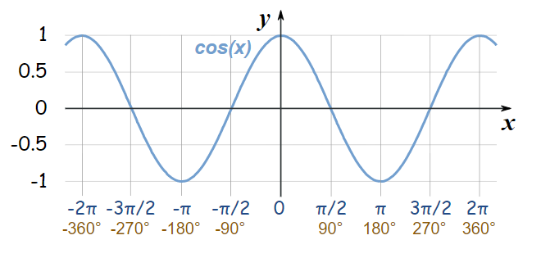

Dot product and angles
$\cos{θ}=\frac{v_{1}∙v_{2}}{\left\|v_{1}\right\|\left\|v_{2}\right\|}$
Can often test angles without doing the acos
e.g. $θ<φ$ is equivalent to $\cos{θ}>\cos{φ}$ if $θ$ and $φ$ are between $0$ and $π$ radians
Useful result: $a$ and $b$ are perpendicular if and only if $v_{1}⋅v_{2}=0 (=\cos{90°})$

Slide 10

Vector projection
Take two vectors $v_{1}$ and $v_{2}$ representing points on the plane
Project a line from point $v_{1}$ onto vector $v_{2}$, such that it meets $v_{2}$ at a right angle
The projection of $v_{1}$ onto $v_{2}$ is the distance from the origin to the point where the line meets $v_{2}$
A measure of “how much” of $v_{1}$ is pointing in the same direction as $v_{2}$
$$v_{1}$$
$$v_{2}$$
Notes:
Can also think of it as a ‘shadow’ cast on v2 by v1. Has applications in physics, when dealing with forces; may also come across it in graphics calculations. So, how do we find the value?

Slide 11

Vector projection and the dot product
From basic trigonometry, the projection of $v_{1}$ onto $v_{2}$ is $\left\|v_{1}\right\|\cos{θ}$
But $v_{1}⋅v_{2}=\left\|v_{1}\right\|\left\|v_{2}\right\|\cos{θ}$, so this is the same as $\frac{v_{1}⋅v_{2}}{\left\|v_{2}\right\|}$
If $v_{2}$ is a unit vector (so $\left\|v_{2}\right\|=1$) then the projection is just $v_{1}⋅v_{2}$
$$v_{1}$$
$$θ$$
$$v_{2}$$
Notes:
So, that’s essentially the dot product; it’s a really simple operation, with some very useful applications, so you’ll probably see rather a lot of it as you pursue a programming career in any graphics or physics-related field.

