Slide 1
Object Oriented Programming
COMP110: Principles of Computing

Slide 2
Learning objectives
By the end of this section, you should understand
The concepts of objects, classes, instances, fields and methods
The principles of good OOP design, particularly encapsulation
How to define simple classes in Python
The difference between values and references, and when Python uses each

Slide 3
Object Oriented Programing (OOP)
An object is a collection of data along with functions which operate on that data
The data members are called fields
A.k.a. attributes a.k.a. member variables
The functions are called methods
What fields and methods an object has are defined by its class a.k.a. type

Slide 4
Classes and instances
A class is the blueprint for an object
It defines the fields and methods possessed by a particular type of object
An instance is the actual object
A set of field values stored in memory

Slide 5
What should I make into an object?
Things with a real-world analogy
Things which need multiple instances
Bundles of closely related data and code
“Black boxes” which do one task (or several closely related tasks)

Slide 6
Encapsulation
Good OOP design allows for
Related code and data definitions to be collected in a single place
Development of modular reusable components
Decoupling of object behaviour from implementation details

Slide 7
Examples
We have already seen many examples of objects
Some application-specific
Turtle
Picture
Polygon
And some general purpose
List
Random number generator

Slide 8

Discussion
What might be some examples of objects in a Super Mario style platform game?
What fields and methods might they have?

Slide 9
Classes and instances in Python
class Circle: def __init__(self, centre_x, centre_y, radius): self.centre_x = centre_x self.centre_y = centre_y self.radius = radius def get_area(self): return math.pi * self.radius * self.radius c = Circle(10, 10, 5) print c.get_area()

Slide 10
Classes and instances in Python
class Circle: def __init__(self, centre_x, centre_y, radius): self.centre_x = centre_x self.centre_y = centre_y self.radius = radius def get_area(self): return math.pi * self.radius * self.radius c = Circle(10, 10, 5) print c.get_area()
Methods are defined like normal Python functions

Slide 11
Classes and instances in Python
class Circle: def __init__(self, centre_x, centre_y, radius): self.centre_x = centre_x self.centre_y = centre_y self.radius = radius def get_area(self): return math.pi * self.radius * self.radius c = Circle(10, 10, 5) print c.get_area()
Methods always take self as their first argument
self can be used to refer to the instance’s own methods and fields

Slide 12
Classes and instances in Python
class Circle: def __init__(self, centre_x, centre_y, radius): self.centre_x = centre_x self.centre_y = centre_y self.radius = radius def get_area(self): return math.pi * self.radius * self.radius c = Circle(10, 10, 5) print c.get_area()
_ _init_ _ is a special constructor method, called when an instance is created
Note the double underscores!

Slide 13
Classes and instances in Python
class Circle: def __init__(self, centre_x, centre_y, radius): self.centre_x = centre_x self.centre_y = centre_y self.radius = radius def get_area(self): return math.pi * self.radius * self.radius c = Circle(10, 10, 5) print c.get_area()
Fields are defined by assigning values to them, usually in __init__

Slide 14
Classes and instances in Python
class Circle: def __init__(self, centre_x, centre_y, radius): self.centre_x = centre_x self.centre_y = centre_y self.radius = radius def get_area(self): return math.pi * self.radius * self.radius c = Circle(10, 10, 5) print c.get_area()
Instances are created by calling the class name as if it were a function
This actually calls the __init__ method

Slide 15
Classes and instances in Python
class Circle: def __init__(self, centre_x, centre_y, radius): self.centre_x = centre_x self.centre_y = centre_y self.radius = radius def get_area(self): return math.pi * self.radius * self.radius c = Circle(10, 10, 5) print c.get_area()
Methods and fields are accessed using dot notation
Note that self is omitted from the argument list when calling a method

Slide 16
Classes and instances in Python
class Circle: def __init__(self, centre_x, centre_y, radius): self.centre_x = centre_x self.centre_y = centre_y self.radius = radius def get_area(self): return math.pi * self.radius * self.radius c = Circle(10, 10, 5) print c.get_area()
Socrative room code: 6E8NSW3IN

Slide 17
References
Variables in Python do not hold instances, they hold references (or pointers) to instances
Assignment sets references, it does not create new instances
Same goes for fields, list entries, function parameters, ...
It is common to have multiple references to the same underlying instance
Changing the instance through one reference means the change will be visible through all other references

Slide 18
Values and references
a
10
class Thing: def __init__(self, foo, bar): self.foo = foo self.bar = bar a = 10 b = 20 c = b x = Thing(30, 40) y = Thing(50, 60) z = y
b
20
c
20
x
foo
30
bar
40
Wrong!
y
foo
50
bar
60
z
foo
50
bar
60

Slide 19
Values and references
a
10
class Thing: def __init__(self, foo, bar): self.foo = foo self.bar = bar a = 10 b = 20 c = b x = Thing(30, 40) y = Thing(50, 60) z = y
b
20
c
20
x
foo
30
bar
40
y
foo
50
bar
60
z

Slide 20
Values and references
Socrative room code: 6E8NSW3IN
1.
a = 10 b = a a = 20 print "a:", a print "b:", b
2.
3.
class X: def __init__(self, value): self.value = value a = X(10) b = X(10) a.value = 20 print "a:", a.value print "b:", b.value
class X: def __init__(self, value): self.value = value a = X(10) b = a a.value = 20 print "a:", a.value print "b:", b.value

Slide 21
Summary
An object consists of data (fields) and functions acting on that data (methods)
A class is a blueprint for an object; an instance is the object itself
In Python, objects are always held and passed around by reference, not by value

Slide 22
Databases and SQL
COMP110: Principles of Computing

Slide 23
Learning objectives
By the end of this section, you should understand
The concepts of databases, tables, columns, rows, primary keys and relations
The analogy and differences between OOP and relational databases
How to use web resources to start exploring SQL query syntax

Slide 24
Database basics
A database consists of several tables
E.g. Students, courses, modules
A table has several columns
E.g. Name, student number, email address
A table also has several rows
E.g. A row in the Students table holds the information about one student
The tables and columns are the schema of the database

Slide 25
Relational databases
Database columns can refer to other tables
Every table has a primary key column, which is unique for every row
E.g. Student ID number, course code
Tables can have columns which reference a foreign key – the primary key of another table
E.g. Which course a student is enrolled on

Slide 26
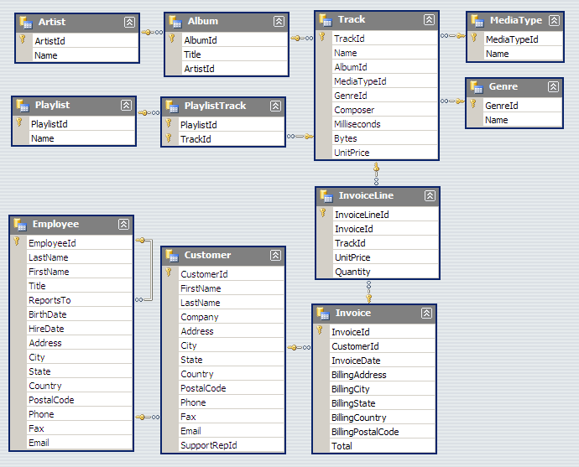
Relational database example
http://chinookdatabase.codeplex.com/
“One to many” relationship
← Primary key
Foreign key →
Socrative room code: 6E8NSW3IN

Slide 27
OOP and databases
Not the same, but there are analogies
Object Oriented Programming | Relational databases
Module or program | Database
Class | Table
Field | Column
Method | No direct analogy
Instance | Row
Reference | Primary key
Field holding a reference to an instance of another class | Foreign key

Slide 28
Structured Query Language (SQL)
Language for writing database queries
Examples:
SELECT FirstName, LastName FROM Students WHERE Course = ‘BSCCOMP’
INSERT INTO Students (StudentId, FirstName, LastName, Course) VALUES (123456, ‘John’, ‘Smith’, ‘BSCCOMP’)

Slide 29
SQL exercises
http://sqlzoo.net

Slide 30
Computer Architecture Essay
COMP110: Principles of Computing

Slide 31
The essay
You will write a 1000 word essay which
Reviews three papers (no more, no less) on a topic in game engine architecture
Makes a recommendation based on empirical evidence
You have two topics to choose from:
Convexity-based collision detection for a 2D game engine
Procedural level generation for a 2D platform game

Slide 32
Your task now
Identify five papers relevant to your chosen topic
Fork the repository at
https://github.com/Falmouth-Games-Academy/comp110-architecture-essay
Using the LaTeX template in the proposal folder, fill in the details of your five papers
Submit a pull request by next Wednesday (11th November)

Slide 33
Allowed sources
Your five papers must be peer-reviewed academic publications reporting primary research
Journal articles
Conference articles
Workshop articles
Some books and book chapters
Only those which report primary research – most do not

Slide 34
Allowed sources
Your five papers should be:
Published by an internationally renowned publisher (e.g. IEEE, ACM, Springer, Elsevier, ...)
And/or published in an internationally renowned journal or conference
And/or considered as influential works by the scientific community

Slide 35
Forbidden sources
Websites, blogs, wikis, forums
Newspaper articles, magazine articles
Textbooks, general interest books
Technical manuals
Secondary sources (e.g. papers titled “A survey of...”, most academic books)
Masters/PhD theses
Preprints (from ArXiv or authors’ webpages)
However, some of these may be useful in identifying sources you can use

Slide 36
What now?
Find abstracts and bibliographic details for your five papers
If you can, find full-text PDFs
Google Scholar, CiteSeer, authors’ websites
Don’t worry if you can’t find them
Submit a pull request, and schedule a meeting with your personal tutor
Don’t upload the paper PDFs to GitHub
We will guide you in narrowing your five articles down to the final three

