Slide 1
Introduction to Game Platforms
COMP130: Game Platform History

Slide 2
First Computers?

Slide 3
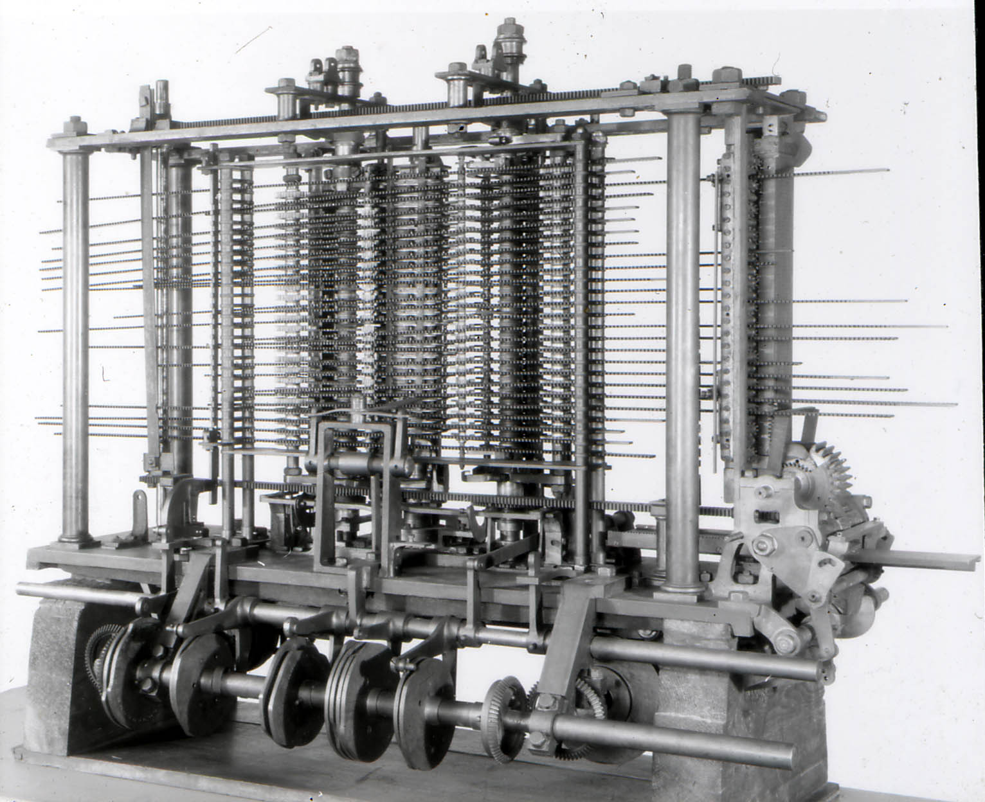
Babbage’s Difference and Analytical Engines (1837)

Slide 4
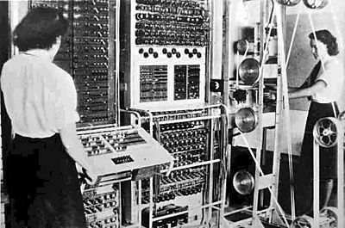
Colossus (1943)

Slide 5
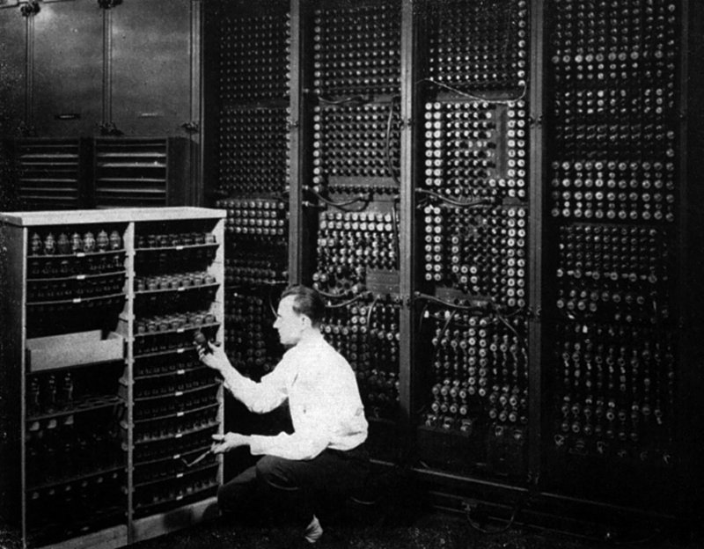
ENIAC (1946)

Slide 6
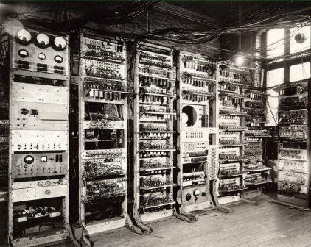
Manchester Small-Scale Experimental Machine (1948)

Slide 7
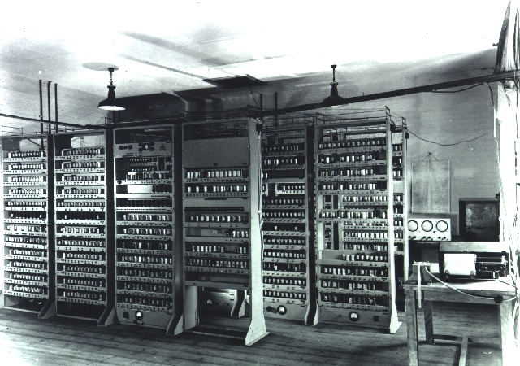
EDSAC (1949)

Slide 8
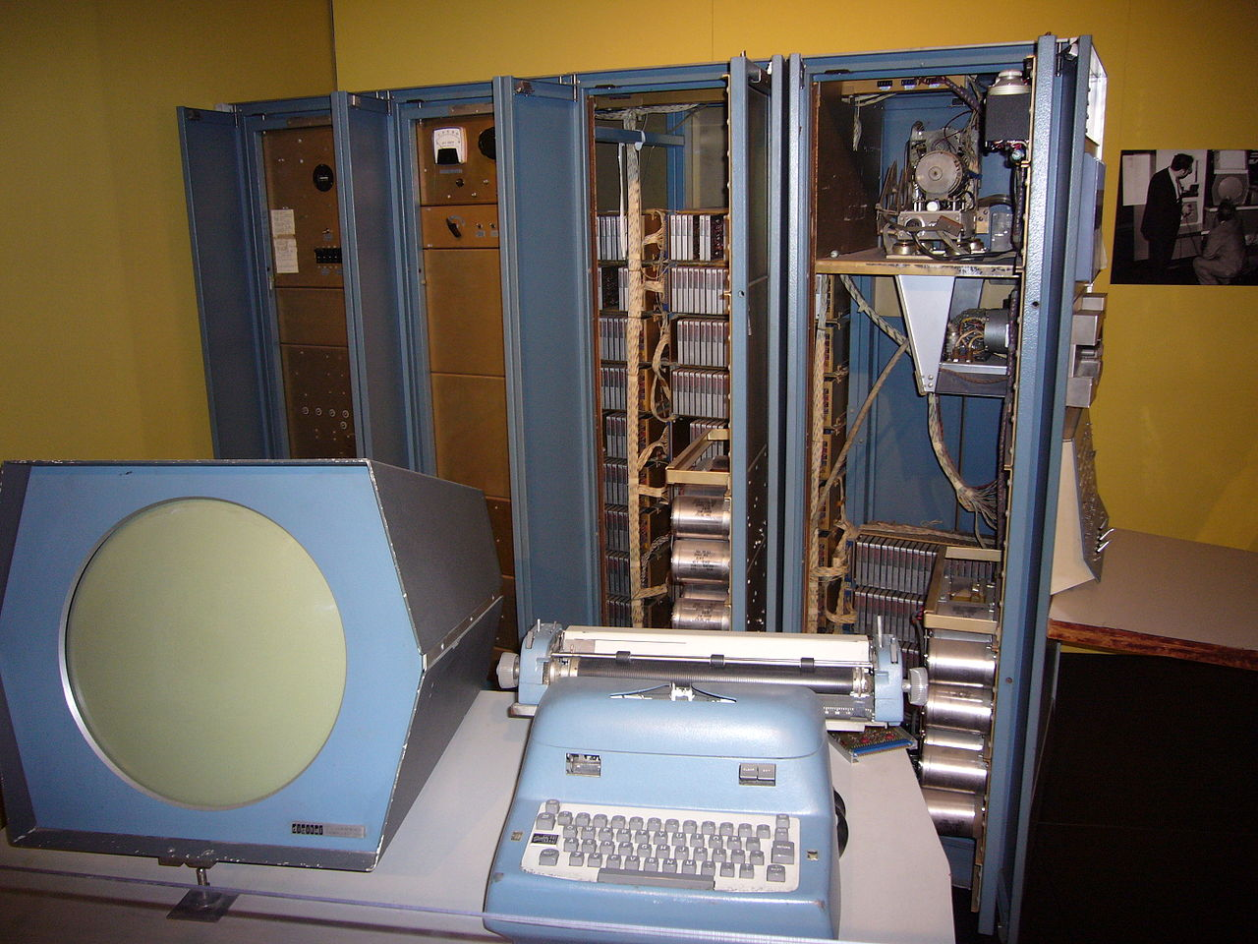
PDP-1 (1959)

Slide 9
First Computer Game?
Game Platform History

Slide 10
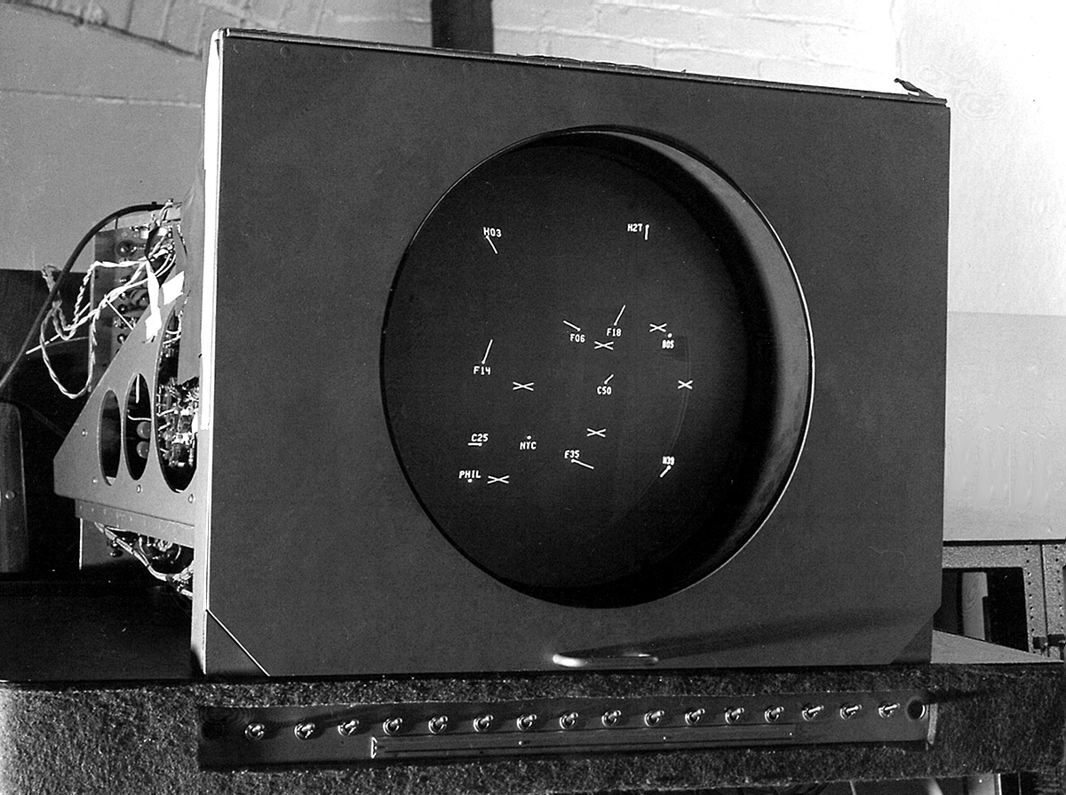
Cathode Ray Tube Amusement Device (1948)

Slide 11
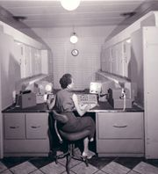
Chess AI on the Ferranti Mark I (1951)

Slide 12
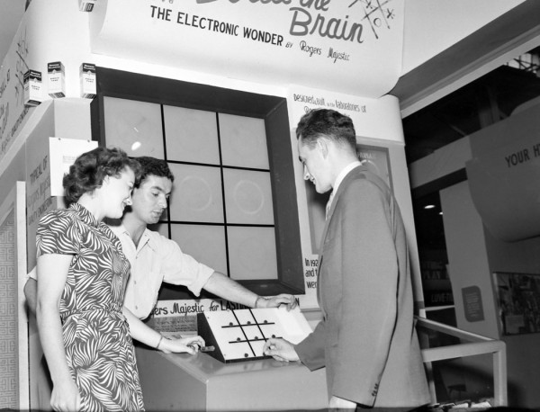
Bertie the Brain (1950)

Slide 13
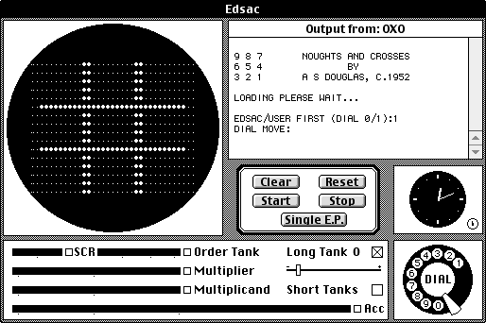
OXO (1951)

Slide 14
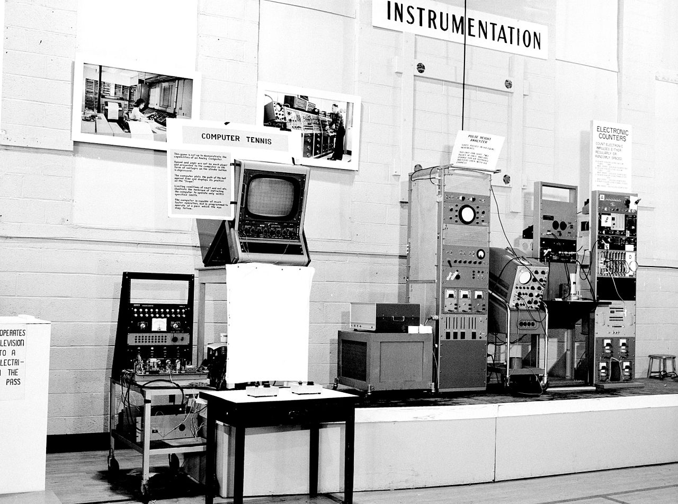
Tennis for Two (1959)

Slide 15
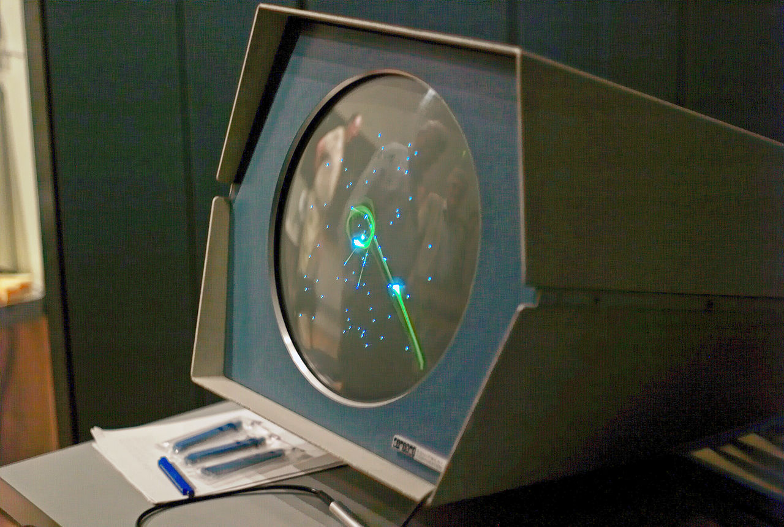
SpaceWar! (1962)

Slide 16
First Home Computer Game Platform?
Game Platform History

Slide 17
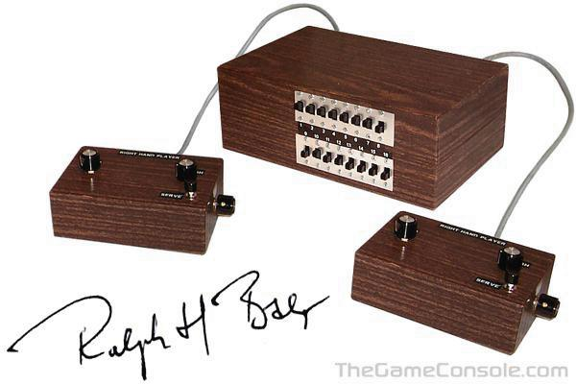
The Brown Box (1967)

Slide 18
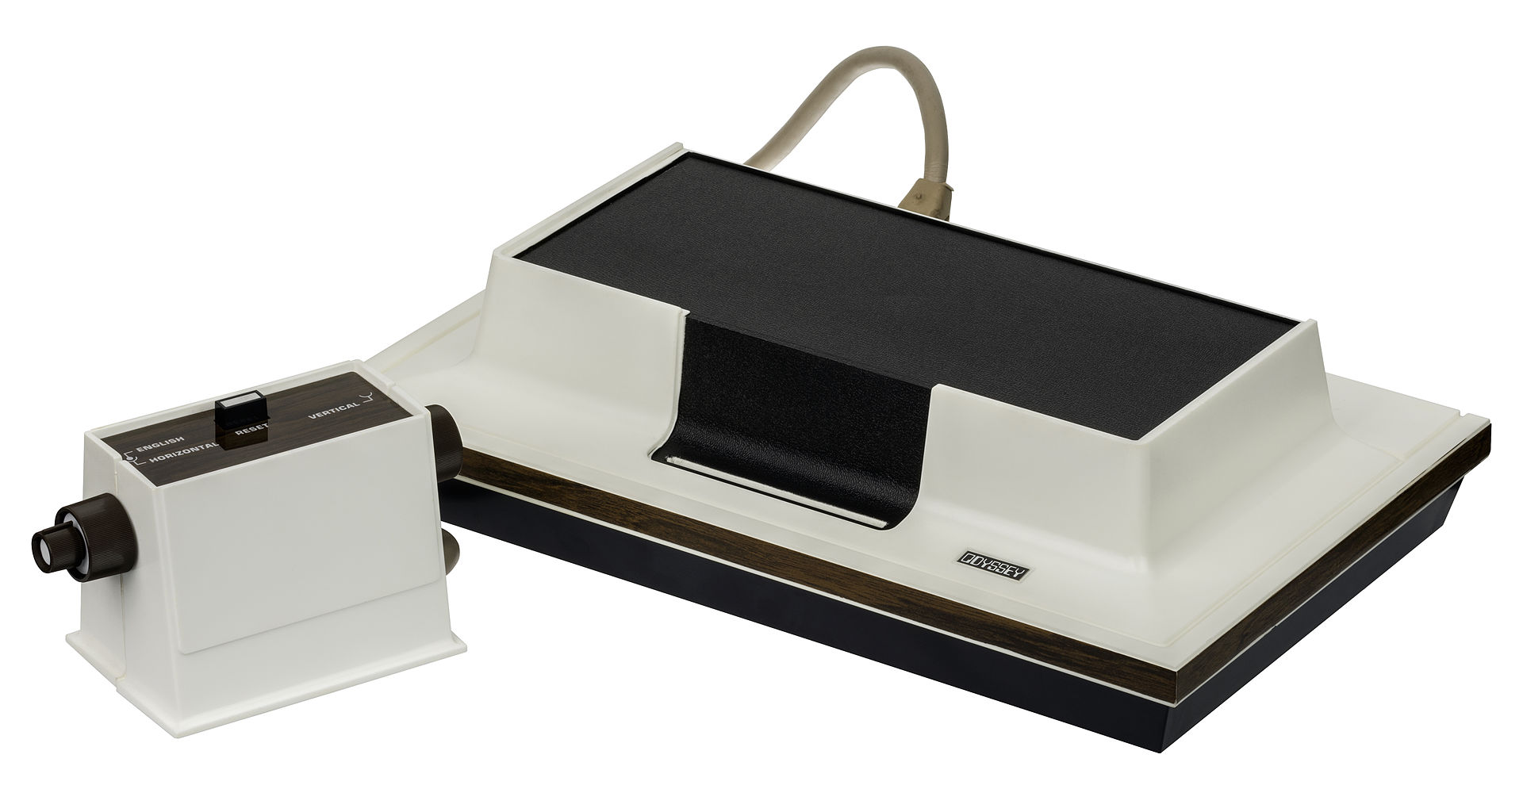
Magnavox Odyssey (1972)

Slide 19
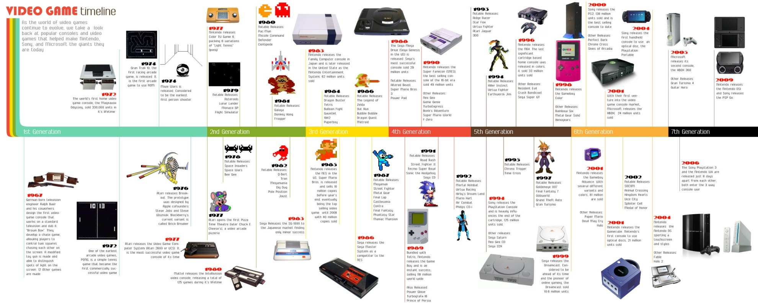
Game Console Timeline http://www.onlineeducation.net/videogame_timeline/video-game-timeline.jpg

