Slide 1
MCTS for games of imperfect information

Slide 2
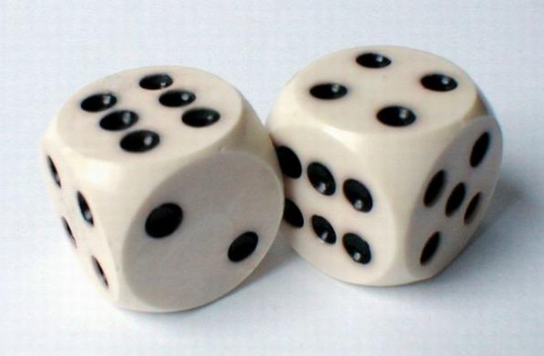

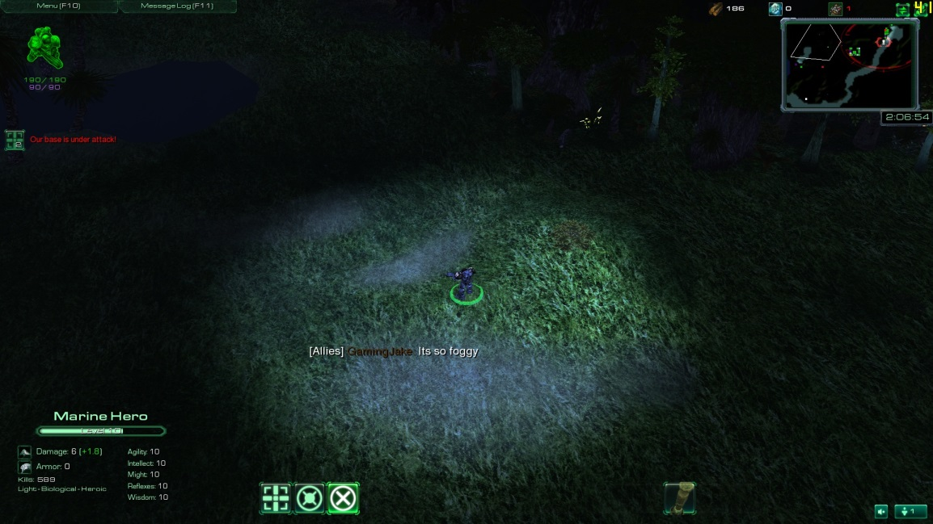
Imperfect information
Stochasticity
Information asymmetry
Partial observability

Slide 3
An explosion in branching factor
4 possible plays by me
50 possible random card draws
₄₀C₃ = 9880 different opponent plays
...

Slide 4











Information sets
Observation gives a set of possible states, one of which is the actual state of the game
Information set:
{
,
Actual state:
,
Observation:
, ...}

Slide 5
Determinization
“Averaging over clairvoyance” [Russell and Norvig 2009]

Slide 6
An explosion in branching factor
4 possible plays by me
50 possible random card draws
₄₀C₃ = 9880 different opponent plays
...

Slide 7
A reduction in branching factor
4 possible plays by me
1 guessed random card draw (determinization)
₄C₃ = 4 different opponent plays
...

Slide 8

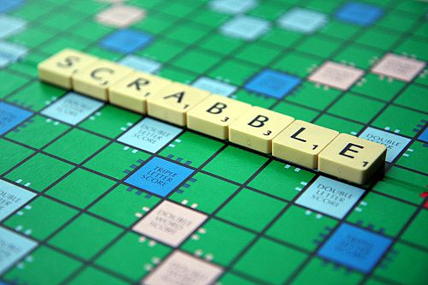
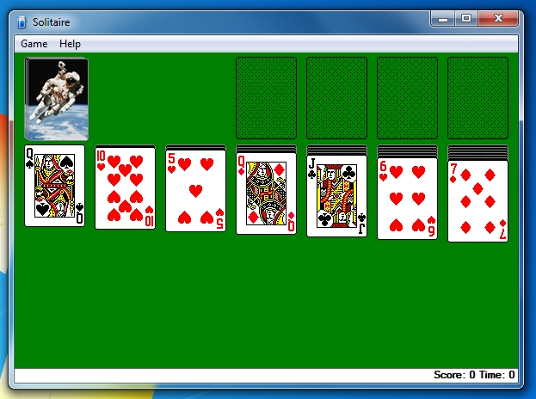

Successes for determinization

Slide 9
Strategy fusion
Minimax value = +1
+0.9
Expected value = 0
m₁
m₂
m₁
m₂
-1
+1
+1
-1

Slide 10
Non-locality
+1
-1
m₁
m₂
m₁
m₂
-0.5
+0.5
+0.5
-0.5

Slide 11
Cheating
Perfect inference
Clairvoyance
No strategy fusion

Slide 12
Information Set MCTS (ISMCTS)
P. I. Cowling, E. J. Powley, D. Whitehouse. Information Set Monte Carlo Tree Search. IEEE Transactions on Computational Intelligence and AI in Games, 4(2):120-143, 2012.

Slide 13
Information Set MCTS (ISMCTS)
P. I. Cowling, E. J. Powley, D. Whitehouse. Information Set Monte Carlo Tree Search. IEEE Transactions on Computational Intelligence and AI in Games, 4(2):120-143, 2012.

Slide 14
Multi-observer information set MCTS

Slide 15
Information Set MCTS (ISMCTS)
Does not suffer from strategy fusion
Beats determinization in
LOTR: The Confrontation
Phantom m,n,k games (noughts and crosses with hidden moves)
Hearts

Slide 16
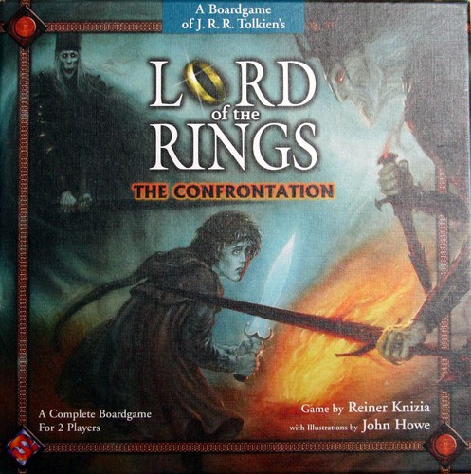
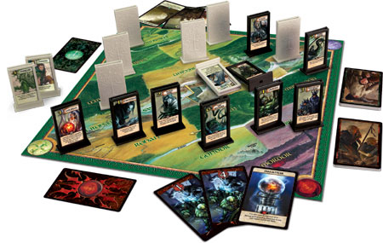

Slide 17
The Phantom 4,4,4 game
4x4 version of noughts and crosses
Opponent’s marks are hidden

Slide 18
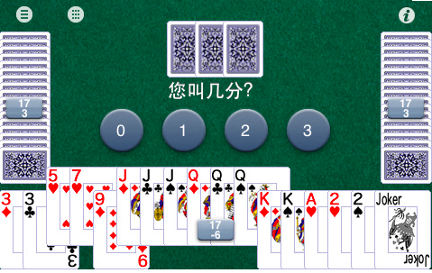
Dou Di Zhu
Popular in China and online
ISMCTS not a significant improvement on determinization
Hidden information is not as important as one might think…
In situations where hidden info is important, ISMCTS performs well

Slide 19

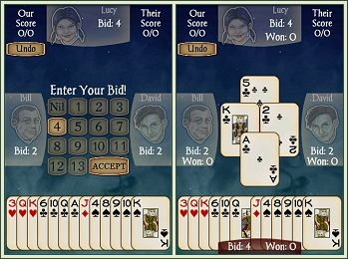
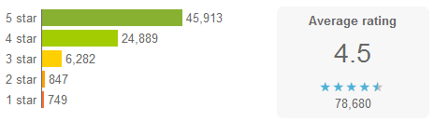
Spades by AI Factory
Android version of the popular card game
(Human + AI) vs (AI + AI)
2.5 million + downloads

Slide 20
Rule-based AI for Spades
Developed over 10 years
Uses determinization and Monte Carlo evaluation (no trees)
Heavily reliant on expert knowledge based rules
Generally well reviewed…
… but some deficiencies in play at highest difficulty levels

Slide 21
ISMCTS for Spades
Objectively strong…

Slide 22
Performance of ISMCTS for Spades

Slide 23
ISMCTS for Spades
Objectively strong…
… but makes choices which appear bad to a human player
Here plausibility is more important than win rate
Use the rule-based AI’s knowledge to bias ISMCTS towards plausible moves
No measurable effect on win rate…
… but fixes many instances of perceived bad play

Slide 24
Performance of ISMCTS for Spades

Slide 25
Other applications

Slide 26
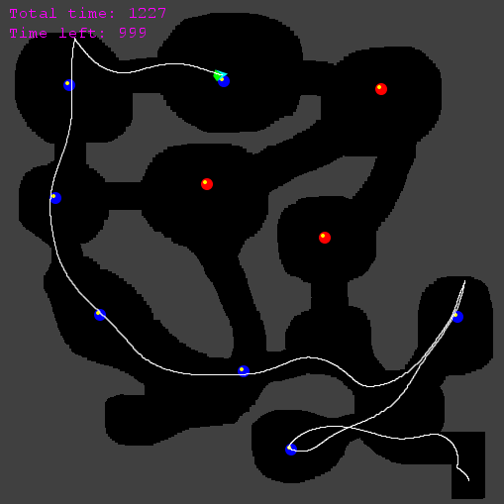
Physical Travelling Salesman Problem (PTSP)
Steer a spaceship to collect all waypoints
Asteroids-like controls
Newtonian physics
Map is unknown in advance
Controller has a few seconds of initialisation time, and then must make an input to the ship every 40ms

Slide 27
Demo

Slide 28
Key features of our PTSP controller
Hierarchical structure
Higher-level route planner chooses the waypoint order
TSP solver with heuristics for avoiding sharp turns
Lower-level steering controller executes the route
MCTS with macro-actions and heuristic evaluation
Depth limiting and heuristic evaluation
Guides the steering controller along the route
Macro-actions
Vastly reduce the state-action space for steering
E. J. Powley, D. Whitehouse, P. I. Cowling. Monte Carlo Tree Search with macro-actions and heuristic route planning for the Physical Travelling Salesman Problem. Proceedings of IEEE CIG 2012, pp 234-241.
E. J. Powley, D. Whitehouse, P. I. Cowling. Monte Carlo Tree Search with macro-actions and heuristic route planning for the Multiobjective Physical Travelling Salesman Problem. Proceedings of IEEE CIG 2013, to appear.

Slide 29
Beyond games
Security
“Red teaming”
Multi-agent models
Social, economic, biological
Planning for the worst case
E.g. emergency response
… ?

Slide 30
Conclusion
MCTS is a powerful general-purpose AI technique
Asymmetric, Anytime, Aheuristic
MCTS has proven successful in several challenging classes of games
Games of imperfect information
Commercial mobile games
Real-time games
It shows promise in many other games and non-game applications

Slide 31
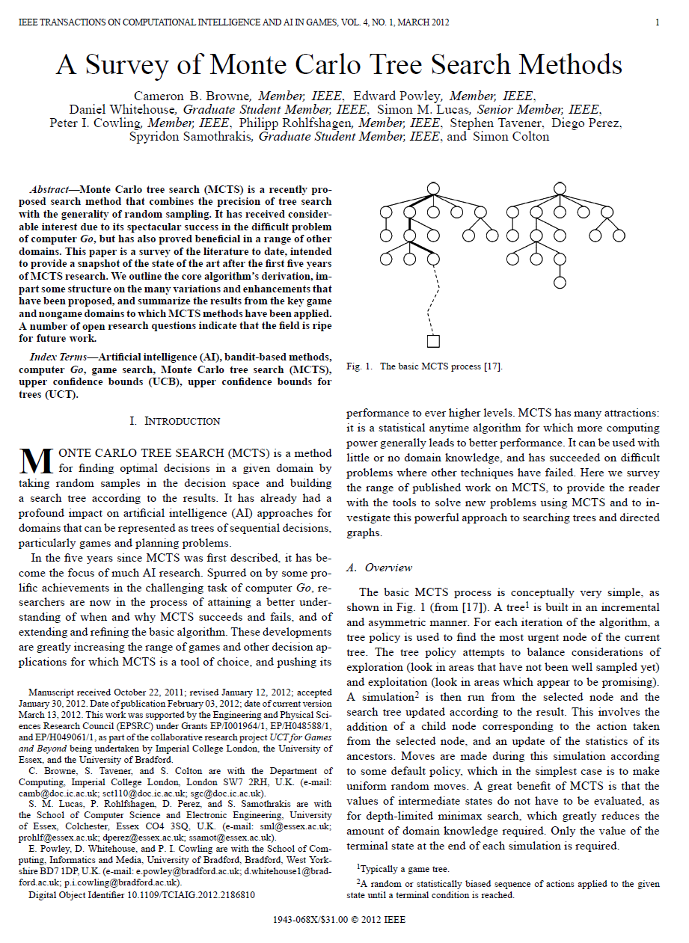
Further reading
C Browne, E Powley et al.
A Survey of Monte Carlo Tree Search Methods.
IEEE Transactions on Computational Intelligence and AI in Games, 4(1):1-43, 2012.
http://bit.ly/mcts-survey
http://www.mcts.ai
http://www-users.cs.york.ac.uk/~ed
edward.powley@york.ac.uk

