Slide 1



3: Software Architecture
GAM140: Individual Creative Computing Project

Slide 2
Reminder – This week!
Proposal Review
Describe the game design that will form the basis for your interface
Illustrate basic research into electronic component and physical form factors for controllers
Analyse the design of the controller in detail;
List the key electronic components of your controller
and List the key user stories.

Slide 3
Learning outcomes
Understand basic architecture of a video game
Understand what is meant by software quality
Develop your Game/Controller proposal

Slide 4
Introduction
Every game has a similar architecture
This is governed by the interactive nature of video games
But also the architecture of hardware
The GPU has to render something to the screen
We have to update the game state before this

Slide 5
The Game Loop
The most basic game loop does three things:
Handle Input
Update the state of the game
Render the game to the screen
It does these actions once per frame (30 or 60 times per second)

Slide 6
The Game Loop
bool running = true;
while (running)
{
handleInput();
update();
render(); }

Slide 7
Handling input
At this stage of the update you should grab the input from the user
Input.GetButtonDown(“Fire1”)
Input.GetKeyDown(KeyCode.Space)
Input.mousePosition
If you are using Input.GetButton* or Input.GetAxis, these have to be configured in the Input Manager
You can use the values from the input to update the state of the game
You should also consider checking out:
Rewired - https://guavaman.com/projects/rewired/
InControl - http://www.gallantgames.com/pages/incontrol-introduction
Unity New Input System - https://blogs.unity3d.com/2019/10/14/introducing-the-new-input-system/

Slide 8
Updating the game state
This is where your game logic is implemented
Physics, AI, Game play
In Unity the update is split in two, a physics update (FixedUpdate) and a game update (Update)

Slide 9
Rendering
This is where the current state of the game is drawn
Anything visual will be rendered to the backbuffer
When drawing is complete, the backbuffer and the frontbuffer is swapped
This will display the current state of the game to the player

Slide 10
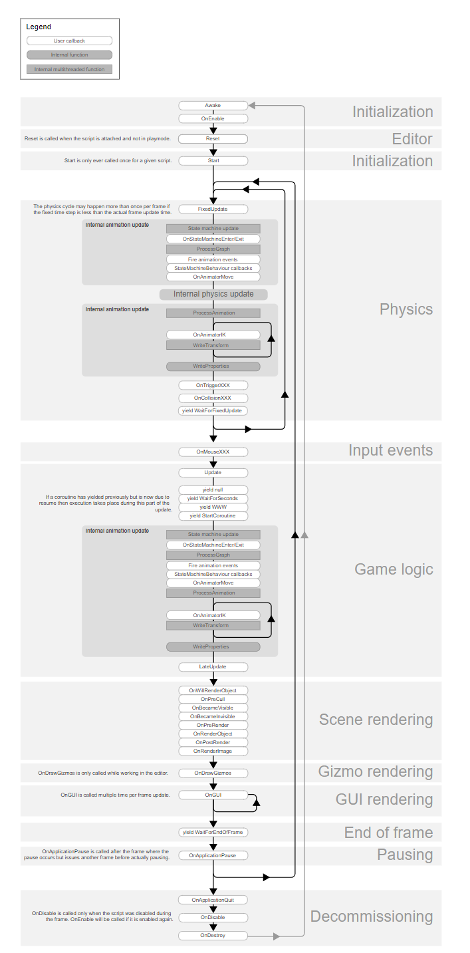
Unity Engine Architecture

Slide 11
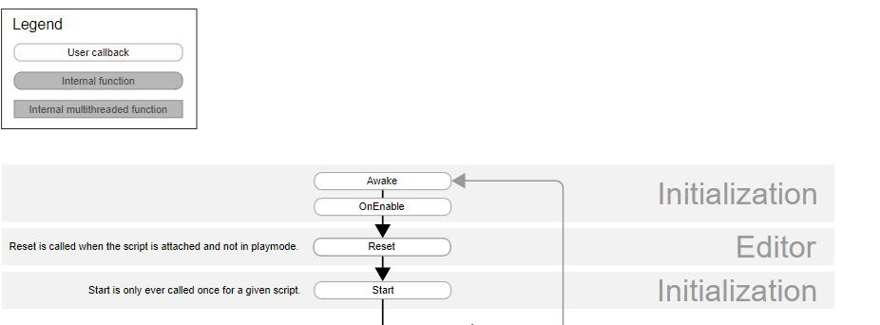
Unity Engine Architecture
On loading of a scene, the following gets called
Awake : Called before any Start
OnEnable : Called before any Game Object is enabled
OnLevelWasLoaded : Called when the level is loaded

Slide 12
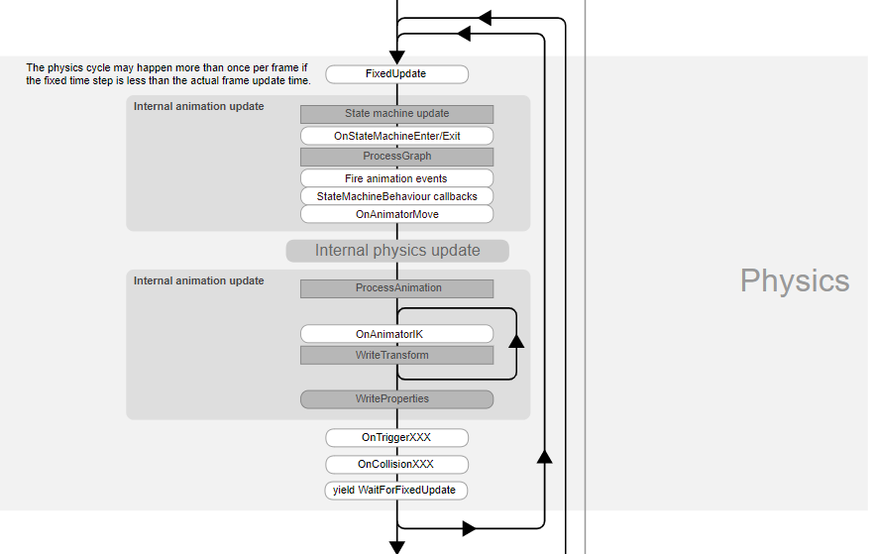
Unity Engine Architecture
You should perform all physics calculations in FixedUpdate
You don’t need to multiply any by deltaTime in FixedUpdate

Slide 13
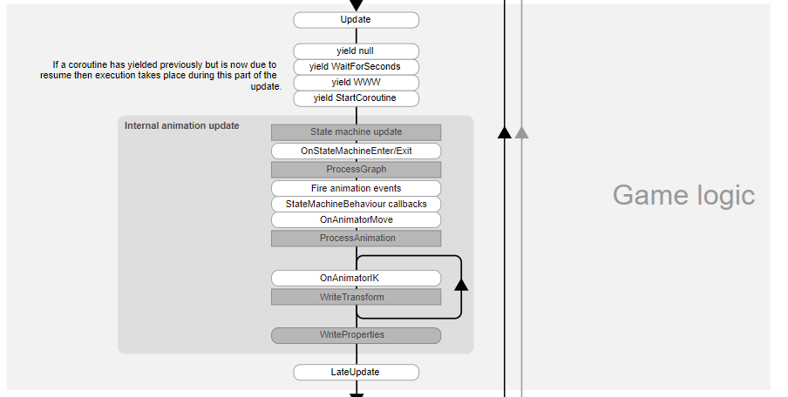
Unity Engine Architecture
One thing to note is that Update gets called before all Coroutines and Animation Updates
LateUpdate : This is called before any drawing occurs

Slide 14
Unity Engine Architecture - Notes
Under the hood, Unity adds all GameObjects to a list and then iterates through
Calling functions in the order mentioned above
However, there is no fixed order on how Update will be called on each Game Object in the scene
If you require some order, have a look at Script Execution order
Or consider using LateUpdate

