Slide 1


Week 7: 3D Computational Geometry I
COMP270: Mathematics for 3D Worlds & Simulations
BSc(Hons) Computing for Games

Slide 2
Vectors in 3D

Slide 3

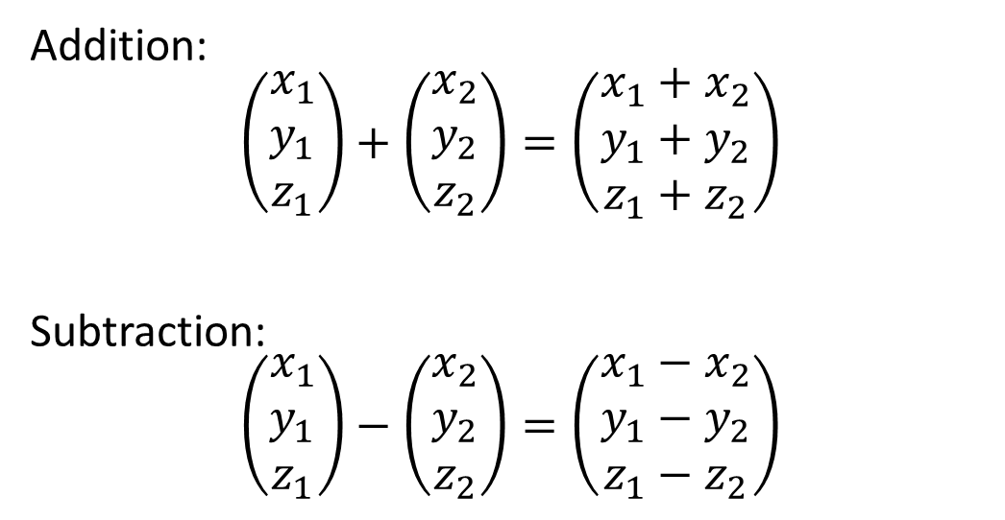
Addition and subtraction in 3D
Addition:
$$\left(\begin{matrix}x_{1} \\ y_{1} \\ z_{1}\end{matrix}\right)+\left(\begin{matrix}x_{2} \\ y_{2} \\ z_{2}\end{matrix}\right)=\left(\begin{matrix}x_{1}+x_{2} \\ y_{1}+y_{2} \\ z_{1}+z_{2}\end{matrix}\right)$$
Subtraction:
$$\left(\begin{matrix}x_{1} \\ y_{1} \\ z_{1}\end{matrix}\right)−\left(\begin{matrix}x_{2} \\ y_{2} \\ z_{2}\end{matrix}\right)=\left(\begin{matrix}x_{1}−x_{2} \\ y_{1}−y_{2} \\ z_{1}−z_{2}\end{matrix}\right)$$

Slide 4
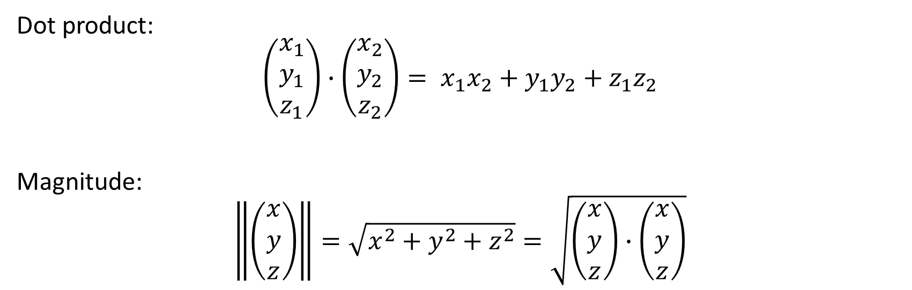
3D dot product and magnitude
Dot product:
$$\left(\begin{matrix}x_{1} \\ y_{1} \\ z_{1}\end{matrix}\right)∙\left(\begin{matrix}x_{2} \\ y_{2} \\ z_{2}\end{matrix}\right)= x_{1}x_{2}+y_{1}y_{2}+z_{1}z_{2}$$
Magnitude:
$$\left\|\left(\begin{matrix}x \\ y \\ z\end{matrix}\right)\right\|=\sqrt{x^{2}+y^{2}+z^{2}}=\sqrt{\left(\begin{matrix}x \\ y \\ z\end{matrix}\right)∙\left(\begin{matrix}x \\ y \\ z\end{matrix}\right)}$$

Slide 5

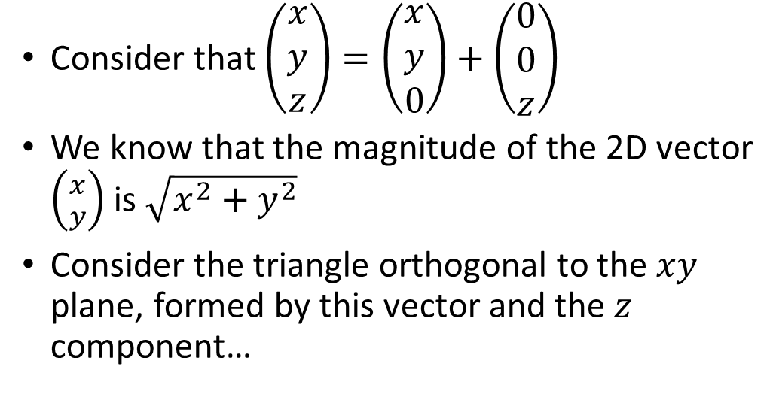


3D vector magnitude: proof
(x, y, z)
Consider that $\left(\begin{matrix}x \\ y \\ z\end{matrix}\right)=\left(\begin{matrix}x \\ y \\ 0\end{matrix}\right)+\left(\begin{matrix}0 \\ 0 \\ z\end{matrix}\right)$
We know that the magnitude of the 2D vector $\left({x \atop y}\right)$ is $\sqrt{x^{2}+y^{2}}$
Consider the triangle orthogonal to the $xy$ plane, formed by this vector and the $z$ component…
$$\sqrt{{\sqrt{x^{2}+y^{2}}}^{2}+z^{2}}$$
$$z$$
(0, 0, 0)
(x, y, 0)
$$\sqrt{x^{2}+y^{2}}$$

Slide 6

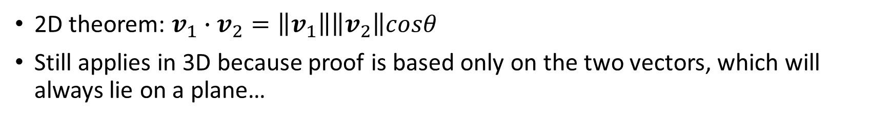

3D dot product: geometric interpretation
2D theorem: $v_{1}∙v_{2}=\left\|v_{1}\right\|\left\|v_{2}\right\|cosθ$
Still applies in 3D because proof is based only on the two vectors, which will always lie on a plane…
$$v_{1}$$
θ
$$v_{2}$$
For proof/derivation of the formula, see proofwiki.org/wiki/Cosine_Formula_for_Dot_Product

Slide 7

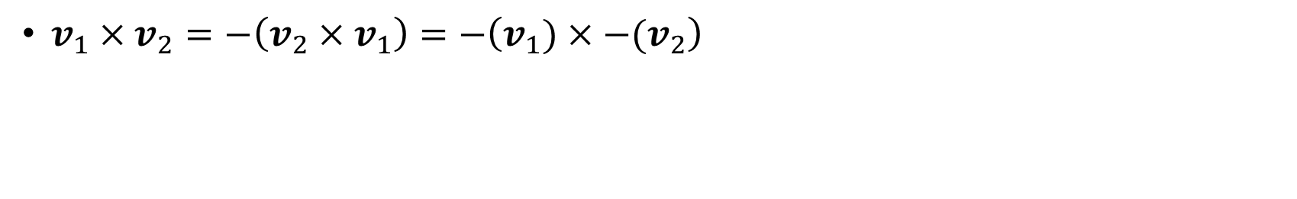
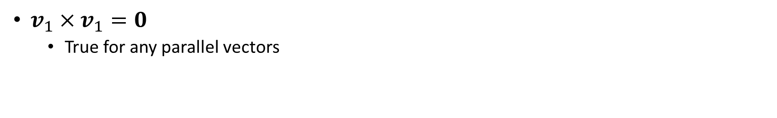
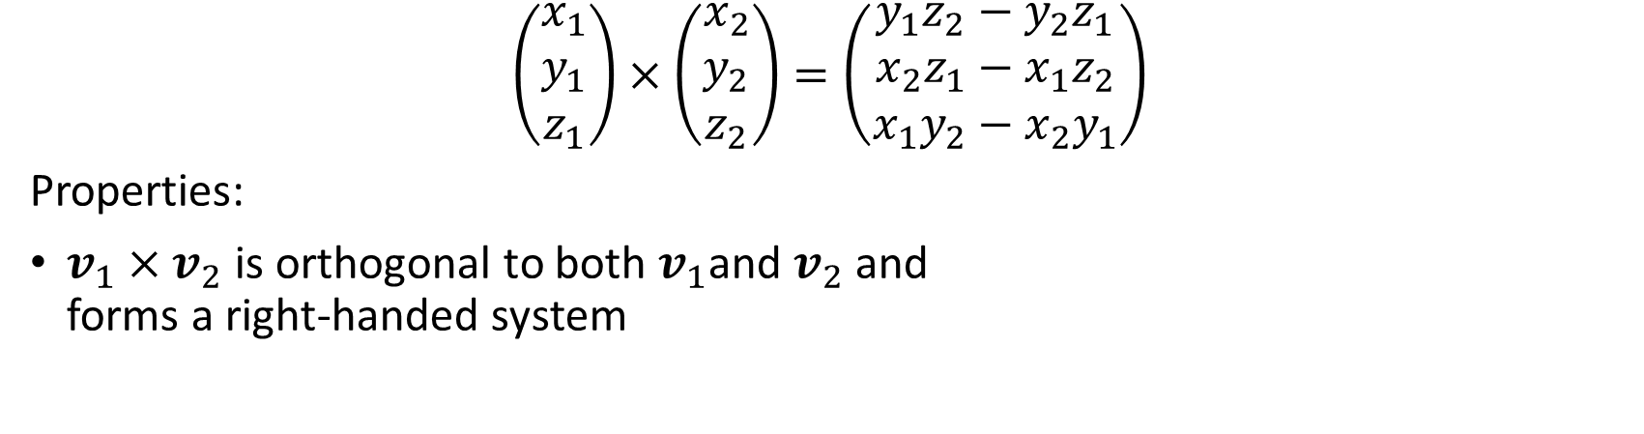



Vector cross product
$$\left(\begin{matrix}x_{1} \\ y_{1} \\ z_{1}\end{matrix}\right)×\left(\begin{matrix}x_{2} \\ y_{2} \\ z_{2}\end{matrix}\right)=\left(\begin{matrix}y_{1}z_{2}−y_{2}z_{1} \\ x_{2}z_{1}−x_{1}z_{2} \\ x_{1}y_{2}−x_{2}y_{1}\end{matrix}\right)$$
Properties:
$v_{1}×v_{2}$ is orthogonal to both $v_{1}$and $v_{2}$ and forms a right-handed system
$$v_{1}×v_{2}$$
$$v_{2}$$
$v_{1}×v_{2}=−\left(v_{2}×v_{1}\right)=−\left(v_{1})×−(v_{2}\right)$
$$v_{2}×v_{1}$$
$v_{1}×v_{1}=0$
True for any parallel vectors
$$v_{1}$$

Slide 8

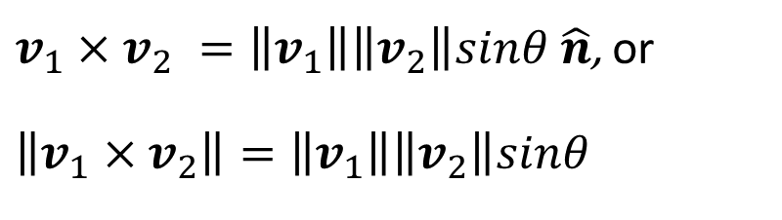
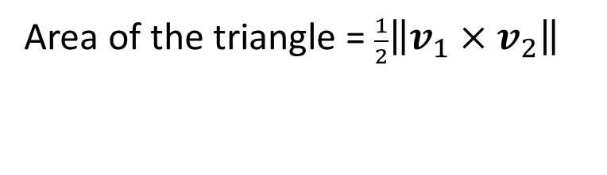


Vector cross product: geometric interpretation
$v_{1}×v_{2} =\left\|v_{1}\right\|\left\|v_{2}\right\|sinθ \hat{n}$, or
$$\left\|v_{1}×v_{2}\right\|=\left\|v_{1}\right\|\left\|v_{2}\right\|sinθ$$
$$v_{1}×v_{2}$$
$$v_{2}$$
θ
$$v_{1}$$
Area of the triangle = $\frac{1}{2}\left\|v_{1}{×v}_{2}\right\|$

Slide 9
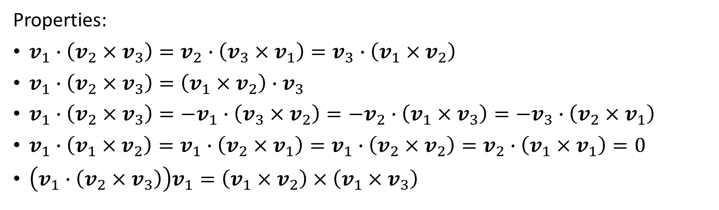
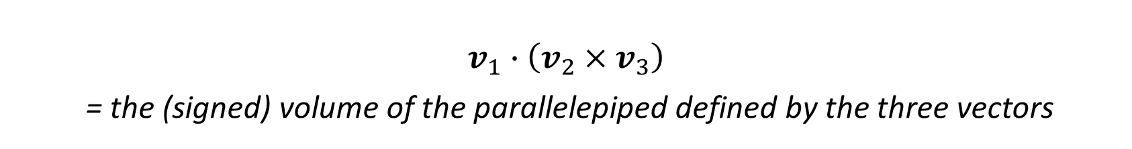
Scalar triple product
$$v_{1}∙\left(v_{2}{×v}_{3}\right)$$
= the (signed) volume of the parallelepiped defined by the three vectors
Properties:
$v_{1}∙\left(v_{2}{×v}_{3}\right)=v_{2}∙\left(v_{3}{×v}_{1}\right)=v_{3}∙\left(v_{1}{×v}_{2}\right)$
$v_{1}∙\left(v_{2}{×v}_{3}\right)=\left(v_{1}×v_{2}\right)∙v_{3}$
$v_{1}∙\left(v_{2}{×v}_{3}\right)=−v_{1}∙\left(v_{3}{×v}_{2}\right)=−v_{2}∙\left(v_{1}{×v}_{3}\right)=−v_{3}∙\left(v_{2}{×v}_{1}\right)$
$v_{1}∙\left(v_{1}{×v}_{2}\right)=v_{1}∙\left(v_{2}{×v}_{1}\right)=v_{1}∙\left(v_{2}{×v}_{2}\right)=v_{2}∙\left(v_{1}{×v}_{1}\right)=0$
$\left(v_{1}∙\left(v_{2}{×v}_{3}\right)\right)v_{1}=\left(v_{1}{×v}_{2}\right)×\left(v_{1}{×v}_{3}\right)$

Slide 10
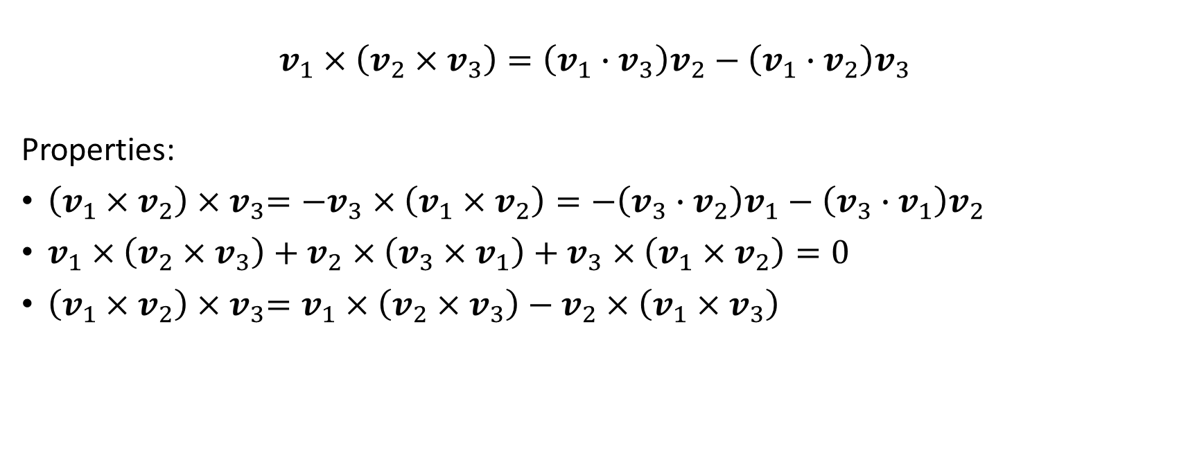
Vector triple product
$$v_{1}×\left(v_{2}{×v}_{3}\right)=\left(v_{1}{∙v}_{3}\right)v_{2}−\left(v_{1}{∙v}_{2}\right)v_{3}$$
Properties:
$\left(v_{1}{×v}_{2}\right){×v}_{3}={−v}_{3}×\left(v_{1}{×v}_{2}\right)=−\left(v_{3}{∙v}_{2}\right)v_{1}−\left(v_{3}{∙v}_{1}\right)v_{2}$
$v_{1}×\left(v_{2}{×v}_{3}\right)+v_{2}×\left(v_{3}{×v}_{1}\right)+v_{3}×\left(v_{1}{×v}_{2}\right)=0$
${\left(v_{1}{×v}_{2}\right){×v}_{3}=v}_{1}×\left(v_{2}{×v}_{3}\right)−v_{2}×\left(v_{1}{×v}_{3}\right)$

Slide 11
Lines and planes

Slide 12

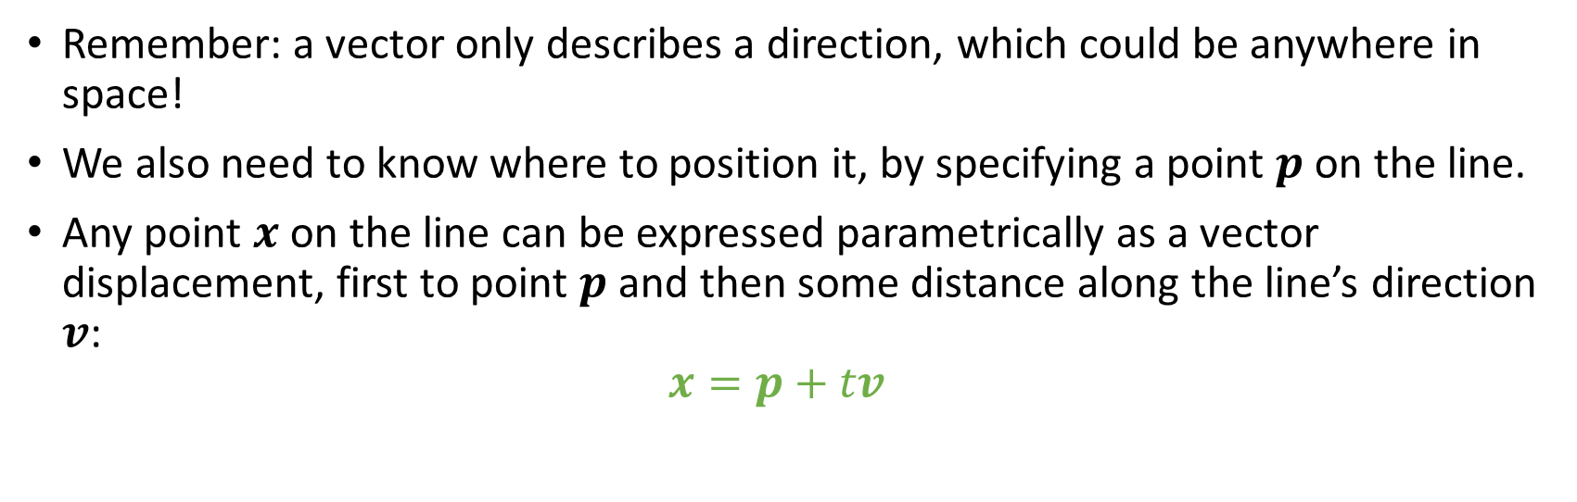



Vector equation of a line
Remember: a vector only describes a direction, which could be anywhere in space!
We also need to know where to position it, by specifying a point $p$ on the line.
Any point $x$ on the line can be expressed parametrically as a vector displacement, first to point $p$ and then some distance along the line’s direction $v$: $x=p+tv$
$$t$$
$$v$$
$$x$$
$$p$$

Slide 13



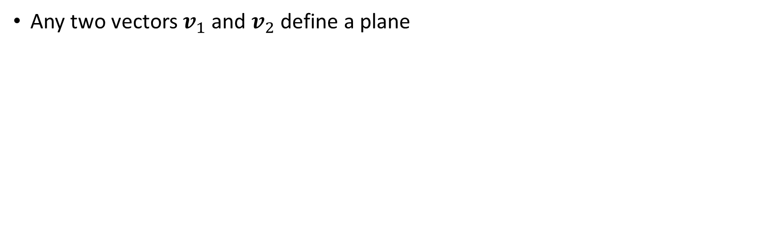



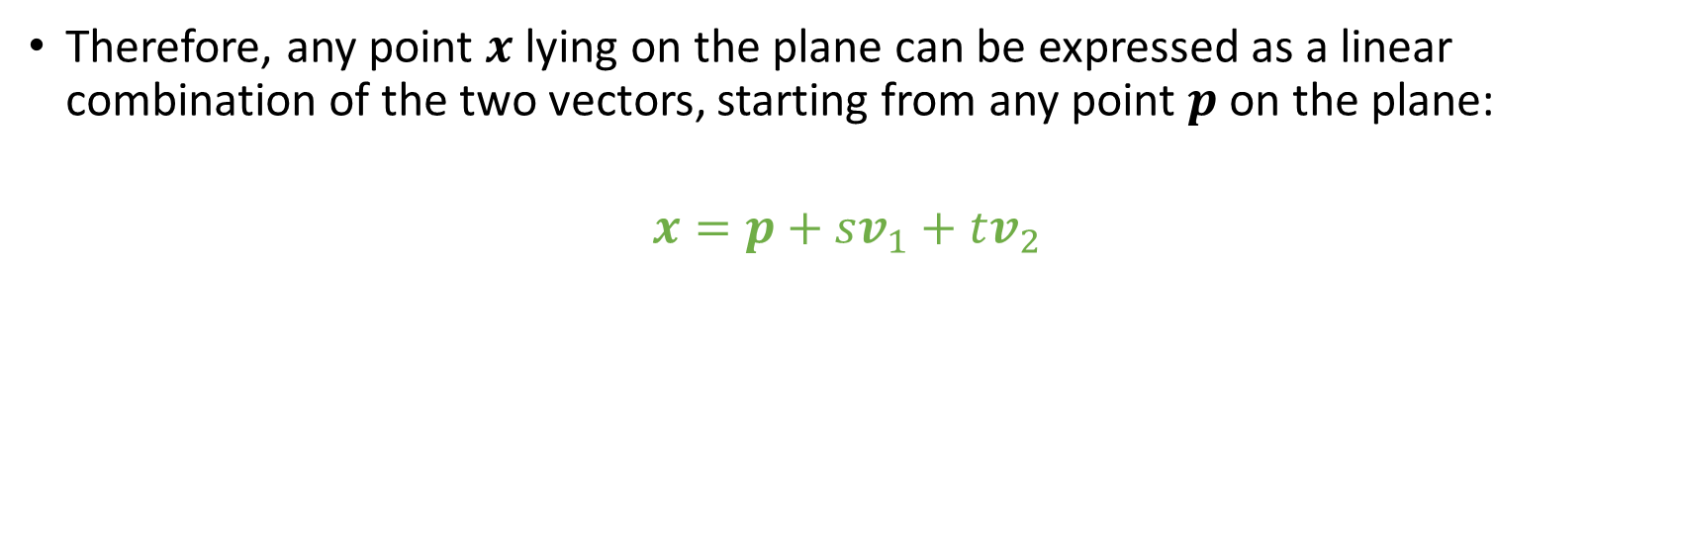
Vector equation of a plane
Any two vectors $v_{1}$ and $v_{2}$ define a plane
Therefore, any point $x$ lying on the plane can be expressed as a linear combination of the two vectors, starting from any point $p$ on the plane:
$$x=p+sv_{1}+tv_{2}$$
$$v_{2}$$
$$s$$
$$x$$
$$p$$
$$t$$
$$v_{1}$$

Slide 14
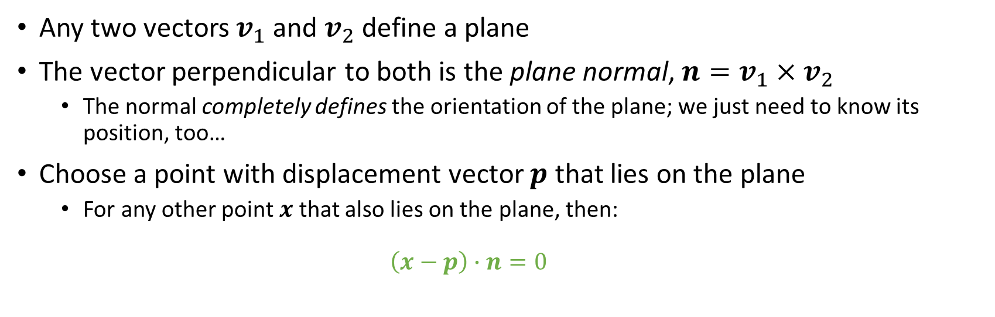
Implicit equation of a plane
Any two vectors $v_{1}$ and $v_{2}$ define a plane
The vector perpendicular to both is the plane normal, ${n=v}_{1}×v_{2}$
The normal completely defines the orientation of the plane; we just need to know its position, too…
Choose a point with displacement vector $p$ that lies on the plane
For any other point $x$ that also lies on the plane, then: $\left(x−p\right)∙n=0$

Slide 15

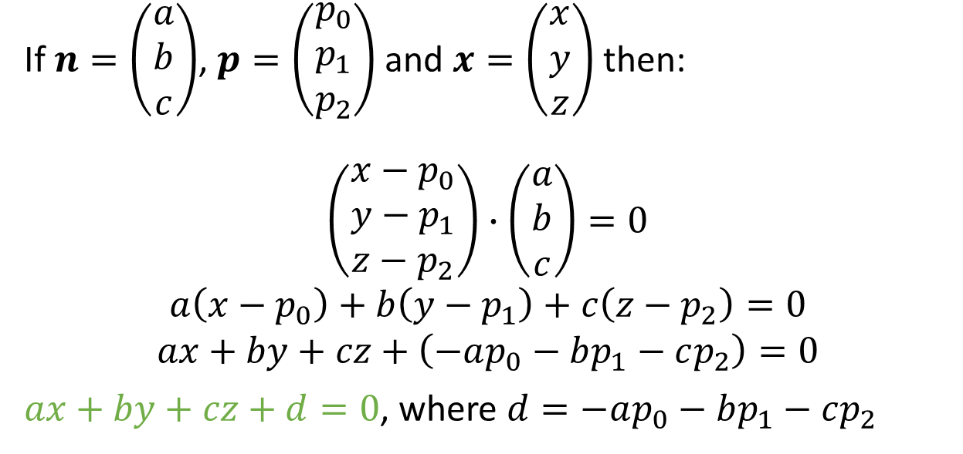



Geometric equation of a plane
$$n$$
If $n=\left(\begin{matrix}a \\ b \\ c\end{matrix}\right)$, $p=\left(\begin{matrix}p_{0} \\ p_{1} \\ p_{2}\end{matrix}\right)$ and $x=\left(\begin{matrix}x \\ y \\ z\end{matrix}\right)$ then:
$$\left(\begin{matrix}x−p_{0} \\ y−p_{1} \\ z−p_{2}\end{matrix}\right)∙\left(\begin{matrix}a \\ b \\ c\end{matrix}\right)=0$$
$$a\left(x−p_{0}\right)+b\left(y−p_{1}\right)+c\left(z−p_{2}\right)=0$$
$$ax+by+cz+\left(−ap_{0}−bp_{1}−cp_{2}\right)=0$$
$ax+by+cz+d=0$, where $d=−ap_{0}−bp_{1}−cp_{2}$
$$x$$
$$p$$
$$x−p$$

Slide 16






Distance of a plane from the origin
$$n$$
$$d= \left\|p\right\|cosθ$$
$$d=\left\|p\right\|\left\|\hat{n}\right\|cosθ$$
$$d=p∙\hat{n}$$
Since $\left(x−p\right)∙n=0⇒x∙n=p∙n$, then
$$d=p∙\hat{n}$$
$$p$$
$$d$$
$$x$$
$$θ$$
O

Slide 17


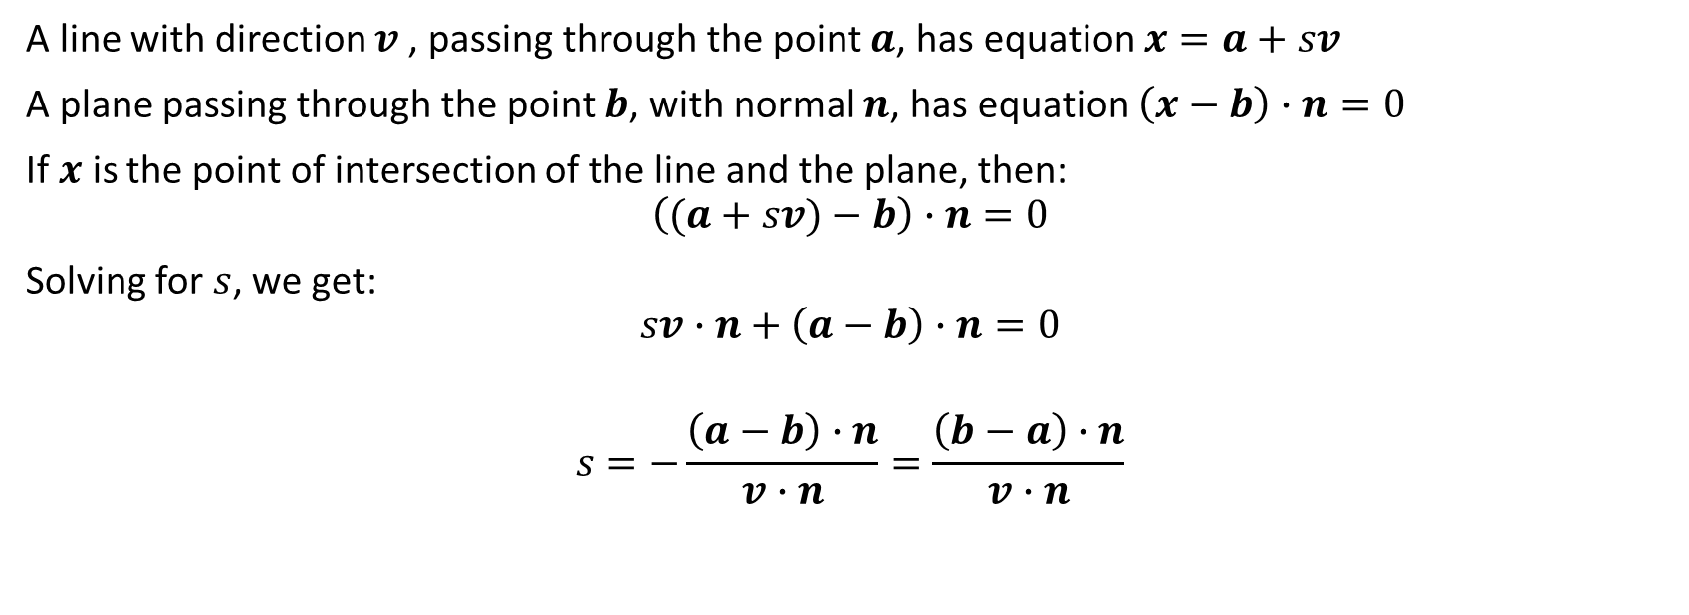



Intersection of a line and a plane
A line with direction $v$, passing through the point $a$, has equation $x=a+sv$
A plane passing through the point $b$, with normal $n$, has equation $\left(x−b\right)∙n=0$
If $x$ is the point of intersection of the line and the plane, then:
$$\left((a+sv)−b\right)∙n=0$$
Solving for $s$, we get:
$$sv∙n+\left(a−b\right)∙n=0$$
$$s=−\frac{\left(a−b\right)∙n}{v∙n}=\frac{\left(b−a\right)∙n}{v∙n}$$
$$n$$
$$v$$
$$x$$
$$b$$
$$a$$

Slide 18
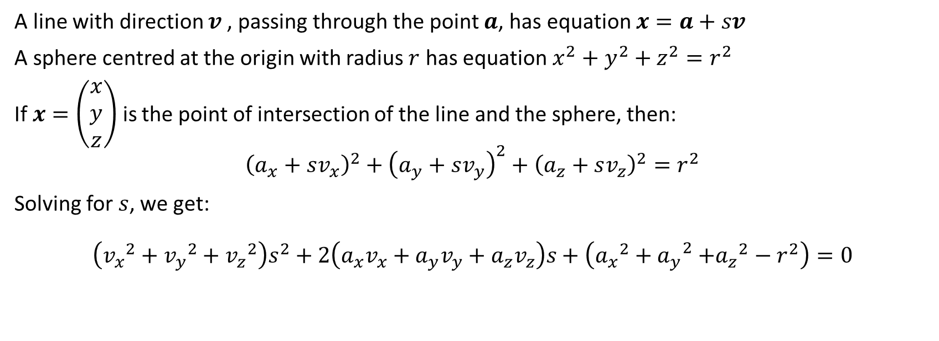
Intersection of a line and a sphere
A line with direction $v$, passing through the point $a$, has equation $x=a+sv$
A sphere centred at the origin with radius $r$ has equation $x^{2}{+ y}^{2}+ z^{2}=r^{2}$
If $x=\left(\begin{matrix}x \\ y \\ z\end{matrix}\right)$ is the point of intersection of the line and the sphere, then:
$${\left(a_{x}+sv_{x}\right)}^{2}+{\left(a_{y}+sv_{y}\right)}^{2}+{\left(a_{z}+sv_{z}\right)}^{2}=r^{2}$$
Solving for $s$, we get:
$$\left({v_{x}}^{2}+{v_{y}}^{2}+{v_{z}}^{2}\right)s^{2}+2\left(a_{x}v_{x}+a_{y}v_{y}+a_{z}v_{z}\right)s+\left({a_{x}}^{2}{+ a_{y}}^{2}+{a_{z}}^{2}−r^{2}\right)=0$$

Slide 19
Putting vectors to use: a simple camera model

Slide 20

The scene
y
z
Centre of Projection (COP)
View plane (screen)
x

Slide 21
The scene
y
z
Centre of Projection (COP)
View plane (screen)
x

Slide 22
Worksheet C: due Monday 18th November

