Slide 1

Week 1: Revision Numbers and Spaces
COMP270: Mathematics for 3D Worlds and Simulations

Slide 2
Objectives
Recall the most common number systems
Understand the relationships between the different number systems
Describe collections of numbers using set notation
Introduce coordinate systems as a mathematical concept

Slide 3

Counting
Humans first developed numbers as a way of counting things
How many sheep do I have? 1, 2, 3, 4, …
This gives us the natural numbers i.e. the counting numbers $ℕ=\left\{1, 2, 3, 4,…\right\}$
We use blackboard bold font for the standard number systems
Curly braces denote a set
“…” means “continue this sequence to infinity”

Slide 4

Counting
Humans first developed numbers as a way of counting things
How many sheep do I have? 1, 2, 3, 4, …
This gives us the natural numbers i.e. the counting numbers $ℕ=\left\{1, 2, 3, 4,…\right\}$
What if I have no sheep? This gives us the concept of zero
Some people include 0 in the natural numbers, some don’t
You may also see $ℕ_{0}=\left\{0, 1, 2, 3, 4, …\right\} ℕ_{+}=\{1, 2, 3, 4, …\}$

Slide 5
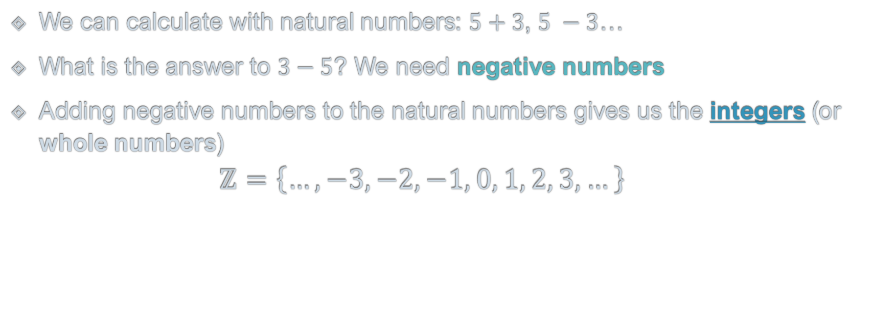
Integers
We can calculate with natural numbers: $5+3$, $5 −3$…
What is the answer to $3−5$? We need negative numbers
Adding negative numbers to the natural numbers gives us the integers (or whole numbers) $ℤ=\left\{…, −3, −2, −1, 0, 1, 2, 3, …\right\}$
Why Z? From the German Zahlen, meaning numbers
Infinite sequence to the left as well as to the right

Slide 6
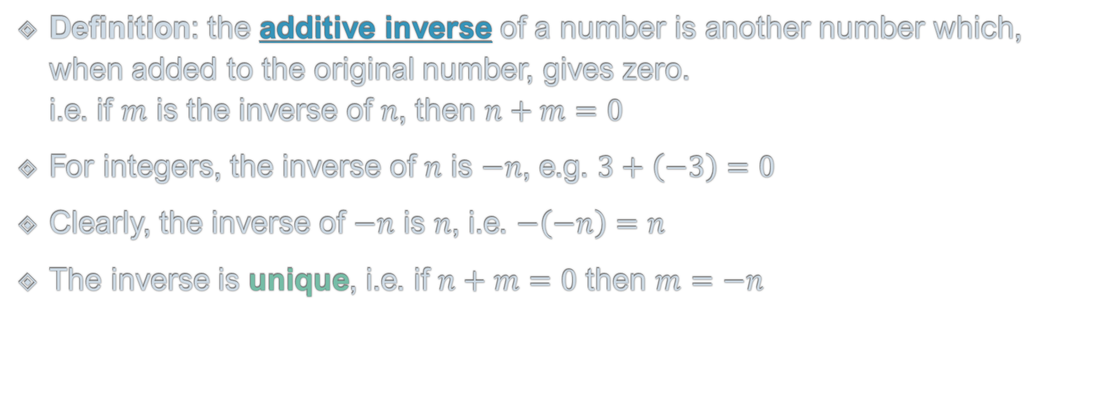
Negative Numbers and Inverses
Definition: the additive inverse of a number is another number which, when added to the original number, gives zero. i.e. if $m$ is the inverse of $n$, then $n+m=0$
For integers, the inverse of $n$ is $−n$, e.g. $3+\left(−3\right)=0$
Clearly, the inverse of $−n$ is $n$, i.e. $−\left(−n\right)=n$
The inverse is unique, i.e. if $n+m=0$ then $m=−n$
Zero is called the additive identity
Notes:
Now we’ve met the negative numbers, I’d like to introduce the concept of an inverse.

Slide 7

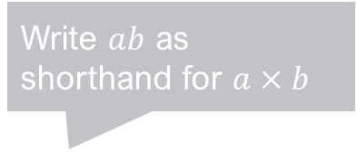
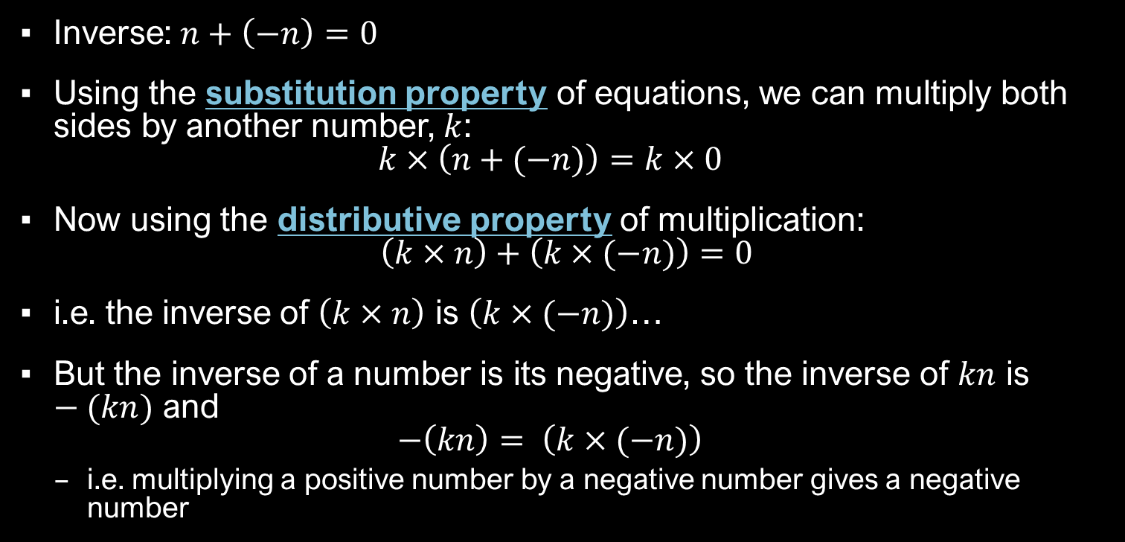
Multiplying Negative Integers
“Doing the same thing to both sides of the equation”
Inverse: $n+\left(−n\right)=0$
Using the substitution property of equations, we can multiply both sides by another number, $k$: $k×\left(n+(−n)\right)=k×0$
Now using the distributive property of multiplication: $\left(k×n\right)+\left(k×(−n)\right)=0$
i.e. the inverse of $\left(k×n\right)$ is $\left(k×(−n)\right)$…
But the inverse of a number is its negative, so the inverse of $kn$ is $−(kn)$ and $−\left(kn\right)= \left(k×(−n)\right)$
i.e. multiplying a positive number by a negative number gives a negative number
$$a×\left(b+c\right)=\left(a×b\right)+(a×c)$$
Write $ab$ as shorthand for $a×b$

Slide 8

Multiplying Negative Integers
What if we multiply by a negative number, $−k$? $(−k)×\left(n+(−n)\right)=0$
Again, using distributivity: $\left((−k)×n\right)+\left((−k)×(−n)\right)=0$
From the previous slide, we know that $\left((−k)×n\right)=−\left(kn\right)$, so: $−(kn)+\left((−k)×(−n)\right)=0$
i.e. $\left((−k)×(−n)\right)$ is the inverse of $−kn$
We know that the inverse of $−\left(kn\right)$ is $kn$, so that $kn=k×n=\left((−k)×(−n)\right)$
i.e. multiplying two negative numbers gives a positive number
Notes:
These are probably things you’ve known for a while and are familiar with using, but may not have given a lot of thought as to why, which is fine if you can remember how to get the right results. It’s useful to understand the concepts, though, for when we get onto more complex entities, such as matrices, which also have inverses and identities.

Slide 9

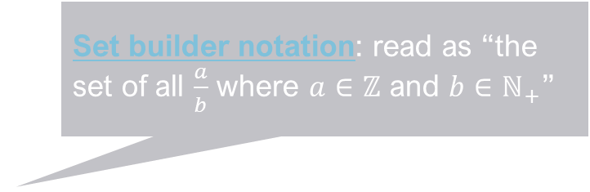
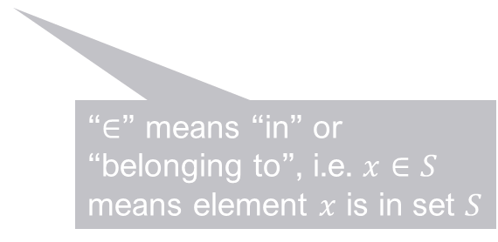
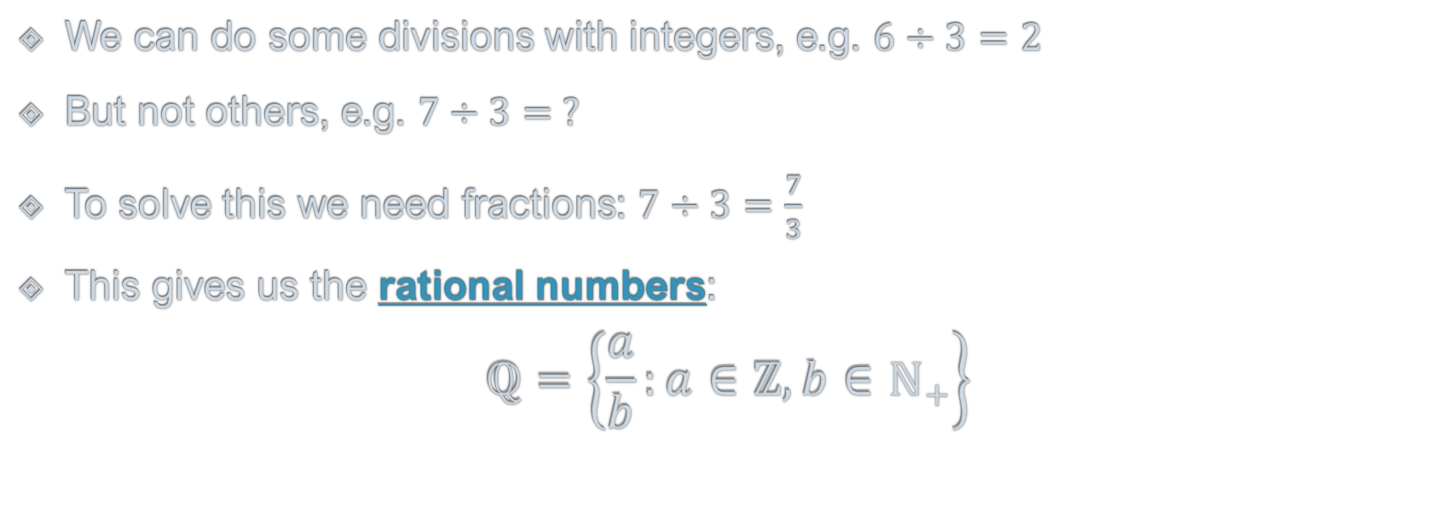
Division and Fractions
We can do some divisions with integers, e.g. $6÷3=2$
But not others, e.g. $7÷3= ?$
To solve this we need fractions: $7÷3=\frac{7}{3}$
This gives us the rational numbers: $ℚ=\left\{\frac{a}{b}:a∈ℤ, b∈ℕ_{+}\right\}$
Set builder notation: read as “the set of all $\frac{a}{b}$ where $a∈ℤ$ and $b∈ℕ_{+}$”
Note the restriction on $b$…
Why Q? From Quotient, meaning ratio or division
“$∈$” means “in” or “belonging to”, i.e. $x∈S$ means element $x$ is in set $S$
“:” means “where”
Notes:
For now, we’re going to look at what you might call the opposite of multiplication, which is division…
To handle subtraction, we had to include the negative numbers; to deal with division, we’ll need another new set of numbers

Slide 10

Fractions
We can do some divisions with integers, e.g. $6÷3=2$
But not others, e.g. $7÷3= ?$
To solve this we need fractions: $7÷3=\frac{7}{3}$
This gives us the rational numbers: $ℚ=\left\{\frac{a}{b}:a∈ℤ, b∈ℕ_{+}\right\}$
There are multiple ways to write the same fraction, e.g. $\frac{7}{3}=\frac{14}{6}=\frac{700}{300}$ Mathematically, they are all considered to be identical.

Slide 11

Decimals
In a fraction $\frac{a}{b}$ , $a$ is called the numerator and $b$ the denominator
Note that decimals are just fractions where the denominator is a power of 10
e.g. $0.7=\frac{7}{10}$ $12.345=\frac{12345}{1000}$
So the decimal numbers are a subset of $ℚ$ (or equal to $ℚ$ if we allow recurring decimals)

Slide 12

Reals
Some numbers cannot be written exactly as fractions, e.g. $π$, $\sqrt{2}$, $e$
Such numbers are called irrational
Putting together the rational and irrational numbers gives the real numbers $ℝ$
The real numbers can be thought of as the points on an infinite line (from $−∞$ to $+∞$)
Note however that all real numbers are finite

Slide 13


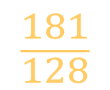






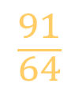

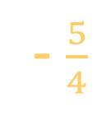

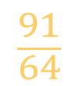


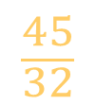


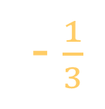
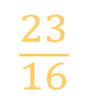
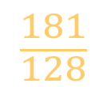






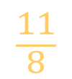
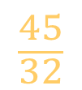


$$\sqrt{2}≈\frac{99}{70}$$
The Number Line
$$\frac{23}{16}$$
$$\frac{5}{4}$$
$$\frac{11}{8}$$
$$\frac{3}{2}$$
$$\frac{45}{32}$$
$$ℚ$$
$$1$$
$$\frac{91}{64}$$
- $\frac{5}{4}$
- $\frac{1}{3}$
$$\frac{1}{2}$$
$$\frac{3}{2}$$
$$\frac{45}{32}$$
$$\frac{181}{128}$$
$$\frac{91}{64}$$
$$\frac{181}{128}$$
$$ℝ$$
$$−4$$
$$−3$$
$$−2$$
$$2$$
$$e$$
$$3$$
$$−1$$
$$0$$
$$1$$
$$\sqrt{2}$$
$$π$$
$$4$$
$$ℕ$$
$$ℤ$$

Slide 14

The Cartesian Product
Named after René Descartes, 1596-1650, French mathematician
For two sets $S$ and $T$, the Cartesian product $S×T$ is defined as the set of all pairs of elements, the first from $S$ and the second from $T$: $S×T=\left\{\left(a,b\right):a∈S, b∈T\right\}$
Generalises to products of 3, 4, … sets
Cartesian products of a set with itself give Cartesian powers: $S^{2}=S×S=\left\{\left(a,b\right):a∈S, b∈S\right\}$ $S^{3}=S×S×S=\left\{\left(a,b,c\right):a∈S, b∈S, c∈S\right\}$
B
 | 1 | 2 | 3
x | (x,1) | (x,2) | (x,3)
y | (y,1) | (y,2) | (y,3)
z | (z,1) | (z,2) | (z,3)
A

Slide 15



















$$3$$
$$(4, 3)$$
$$ℤ×ℤ$$
$$(−3, 2)$$
$$2$$
$$1$$
$$(1, 1)$$
$$(0, 0)$$
$$−4$$
$$−3$$
$$−2$$
$$−1$$
$$1$$
$$2$$
$$3$$
$$4$$
$$(−4, −1)$$
$$−1$$
$$−2$$

Slide 16

Cartesian Coordinate Systems
Idea: use the elements from a Cartesian product as coordinates to specify positions in a space.
$ℝ^{1}=ℝ$ is 1-dimensional space, aka the space of scalars
$ℝ^{2}=ℝ×ℝ$ is 2-dimensional space, aka the 2D plane
$ℝ^{3}$ is 3-dimensional space
$ℝ^{n}$ is n-dimensional space…

