Slide 1
Week 2: Geometry I Part 1: Points, Lines and Triangles
COMP270: Mathematics for 3D Worlds and Simulations

Slide 2
Objectives
Define the basic geometric primitives
Recall the formulae that express relationships between the sides and angles of a right-angled triangle

Slide 3





What is a point?
Definition: a point is a 0-dimensional mathematical object that can be specified in $n$-dimensional space using an $n$-tuple $\left(x_{1},x_{2},…,x_{n}\right)$ consisting of $n$ coordinates.
0-dimensional because it has no measurements in any direction…
In 1D space, its coordinate is just the distance from an origin:
$$P$$
$$=(x)$$
$$O$$
$$x$$
Notes:
Not the point, that’s a bigger philosophical question; we’re just talking about a geometric definition here.
If we imagine this is our 1D space,
We can represent P using a distance from some defined origin point in the dimension, and that distance is P’s coordinate.
We can’t really do a lot with 1D space, in terms of graphics at least, so we usually have at least 2 dimensions,

Slide 4














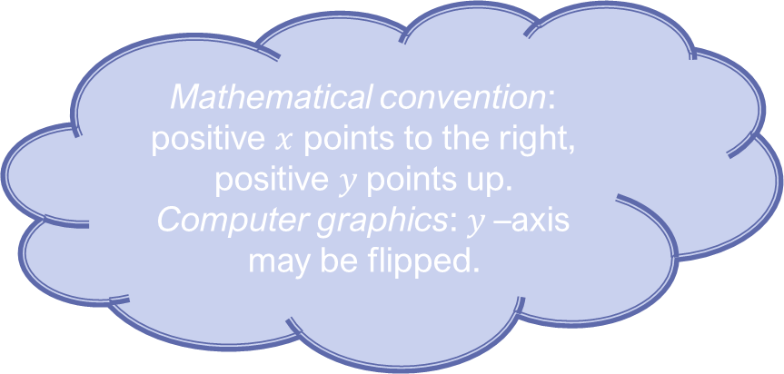






Points in 2D
$$y$$
$$3$$
$$(4, 2.5)$$
$$(−3, 2)$$
$$2$$
$$(1, 1)$$
$$1$$
$$0$$
$$x$$
$$−4$$
$$−3$$
$$−2$$
$$−1$$
$$1$$
$$2$$
$$3$$
$$4$$
Mathematical convention: positive $x$ points to the right, positive $y$points up.
Computer graphics: $y$–axis may be flipped.
$$−1$$
$$(−4, −1)$$
$$−2$$
Notes:
Which give us our familiar x and y coordinate axes. Note that in maths, we usually have the positive x-axis points to the right and positive y points up Now we have a bit more space to play with, we can add some more types of objects…

Slide 5



Lining up
Definition: a line is a straight one-dimensional figure having no thickness and extending infinitely in both directions.
Defines a 1D space
In a space of 2 or more dimensions, a line is uniquely determined by 2 points:
$$B=(x_{b}, y_{b})$$
$$A=(x_{a}, y_{a})$$
$$d=?$$
Notes:
… the next most obvious one being a line, which is …
This line also gives us the shortest distance between the two points, but before we can find out what that is, we need to consider another object, with one more dimension than the line…

Slide 6



Let’s try angles…
From Latin/Greek, “many-angled”; a shape with 3 or more straight sides.
Definition: a triangle is a polygon with three sides and three angles, some of which may be the same.
Uniquely determined by 3 points:
$$A=(x_{a}, y_{a})$$
$$B=(x_{b}, y_{b})$$
Acute
Obtuse
Angles add to 180°
Equilateral
Isosceles
$$C=(x_{c}, y_{c})$$

Slide 7







Right-angled triangles
Named after Pythagoras of Samos (c570-c495BC), Greek philosopher
$$A$$
The hypotenuse is the side opposite the right angle
Pythagorean Theorem: $a^{2}+b^{2}{=c}^{2}$
i.e. $$c=\sqrt{a^{2}+b^{2}}$$
Visual depiction: www.youtube.com/watch?v=ANR4g0lPrEQ
$$c$$
$$b$$
$$B$$
$$C$$
$$a$$
Notes:
So that’s established a relationship between the sides; what about the angles?

Slide 8





The Trigonometric Functions
SOHCAHTOA
$$\sin{θ}=\frac{\text{Opposite}}{\text{Hypotenuse}}$$
$$\cos{θ}=\frac{\text{Adjacent}}{\text{Hypotenuse}}$$
$$\tan{θ}=\frac{\text{Opposite}}{\text{Adjacent}}$$
$$Hypotenuse$$
$$Opposite$$
θ
$$Adjacent$$
$$=\frac{\sin{θ}}{\cos{θ}}$$
Silly Old Harry Caught A Herring Trawling Off America
Notes:
Invent a better way to remember?!

Slide 9
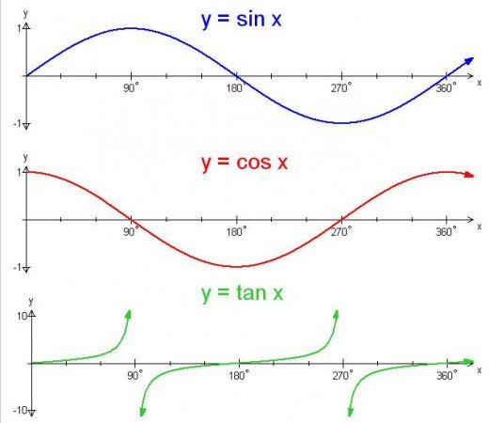
The Trigonometric Functions
Notes:
These may seem like arbitrary formulae, but there are reasons why these relationships exist; have a look at the resources under the link to this presentation on LearningSpace for a visual explanation.

Slide 10

Inverse trig. functions
$$\sin{θ}=\frac{\text{Opposite}}{\text{Hypotenuse}}$$
$$θ=\sin^{−1}\left(\frac{\text{Opposite}}{\text{Hypotenuse}}\right)$$
Also known as arcsin / arccos / arctan
In code: asin() / acos() / atan()
Notes:
We have the formulae for some trigonometric function of the angle, but to find the angle itself, we need to take the inverse of that function…

Slide 11












Lines and triangles
$$y$$
$$B=(x_{b}, y_{b})$$
$$y_{b}$$
$$−$$
$$A=(x_{a}, y_{a})$$
$$+$$
$$y=y_{a}$$
$$−x_{a}$$
$$x_{b}$$
$$y_{a}$$
$$x$$
$$x=x_{b}$$
Notes:
I said earlier that triangles could help us find information about lines and the points along them, so here is how:
Here’s our line from earlier. Now, if the points on it are coordinates, that mean’s they’re specified relative to a set of axes. You may notice that we can now see one of our new friends: a right-angled triangle, that’s formed with the axes. We can make a more useful triangle if we consider the lines parallel to the axes that intersect the points.
The lengths of its horizontal and vertical sides are given by the point coordinates

Slide 12
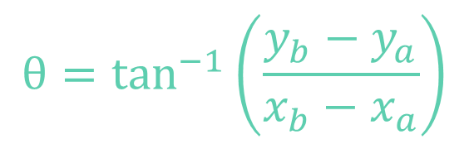
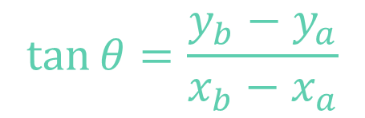
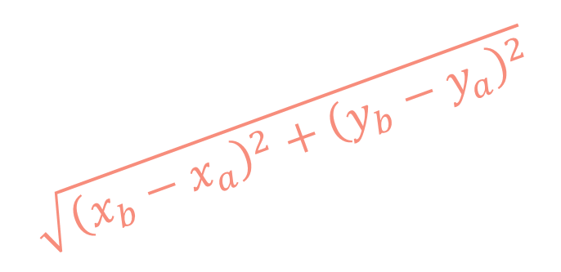


Lines and triangles
$$y$$
$$\tan{θ}=\frac{y_{b}−y_{a}}{x_{b}−x_{a}}$$
$$B=(x_{b}, y_{b})$$
$$θ=\tan^{−1}\left(\frac{y_{b}−y_{a}}{x_{b}−x_{a}}\right)$$
$$\sqrt{{\left(x_{b}−x_{a}\right)}^{2}+{\left(y_{b}−y_{a}\right)}^{2}}$$
$$y_{b}−y_{a}$$
$$A=(x_{a}, y_{a})$$
θ
$$y=y_{a}$$
$$x_{b}−x_{a}$$
$$x$$
$$x=x_{b}$$
Notes:
What if our points were the other way around?

Slide 13


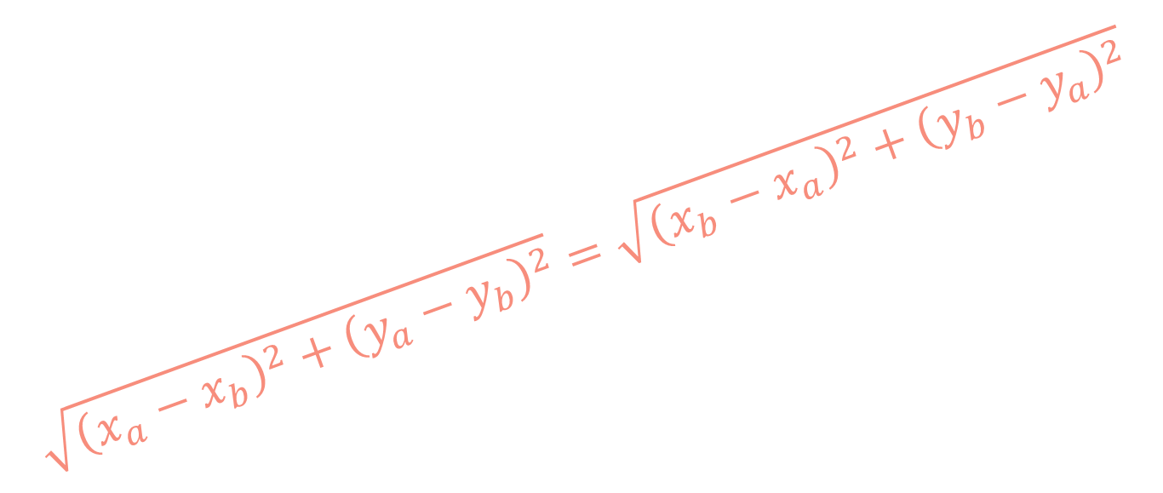



Line direction
$$y$$
$$\tan{θ}=\frac{y_{a}−y_{b}}{x_{a}−x_{b}}=\frac{−(y_{b}−y_{a})}{−(x_{b}−x_{a})} \\ =\frac{y_{b}−y_{a}}{x_{b}−x_{a}}$$
$$\sqrt{{\left(x_{a}−x_{b}\right)}^{2}+{\left(y_{a}−y_{b}\right)}^{2}}=\sqrt{{\left(x_{b}−x_{a}\right)}^{2}+{\left(y_{b}−y_{a}\right)}^{2}}$$
$$A=(x_{a}, y_{a})$$
$$y_{a}−y_{b}$$
$$B=(x_{b}, y_{b})$$
θ
$$y=y_{a}$$
$$x_{a}−x_{b}$$
$$x$$
$$x=x_{b}$$
Notes:
So, for these calculations, it doesn’t matter which order our points are in. But does it ever matter?
The answer is yes, if we’re talking about vectors, which is the subject of the next video.

