Slide 1
Week 2: Geometry I Part 2: Vector Basics
COMP270: Mathematics for 3D Worlds and Simulations

Slide 2
Objectives
Recall the definition of a vector and how it differs from a point or a line
Apply basic arithmetic operations to vectors in 2D

Slide 3




Recap
$$y$$
A point in 2D is a pair of values, or coordinates, specifying a position relative to a pair of perpendicular axes.
A line extends infinitely and can be uniquely defined by two points through which it passes.
$$B=(x_{b}, y_{b})$$
$$x$$
$$A=(x_{a}, y_{a})$$
Notes:
Often, we’re only interested in the section between the two points, which can be described by a vector:

Slide 4
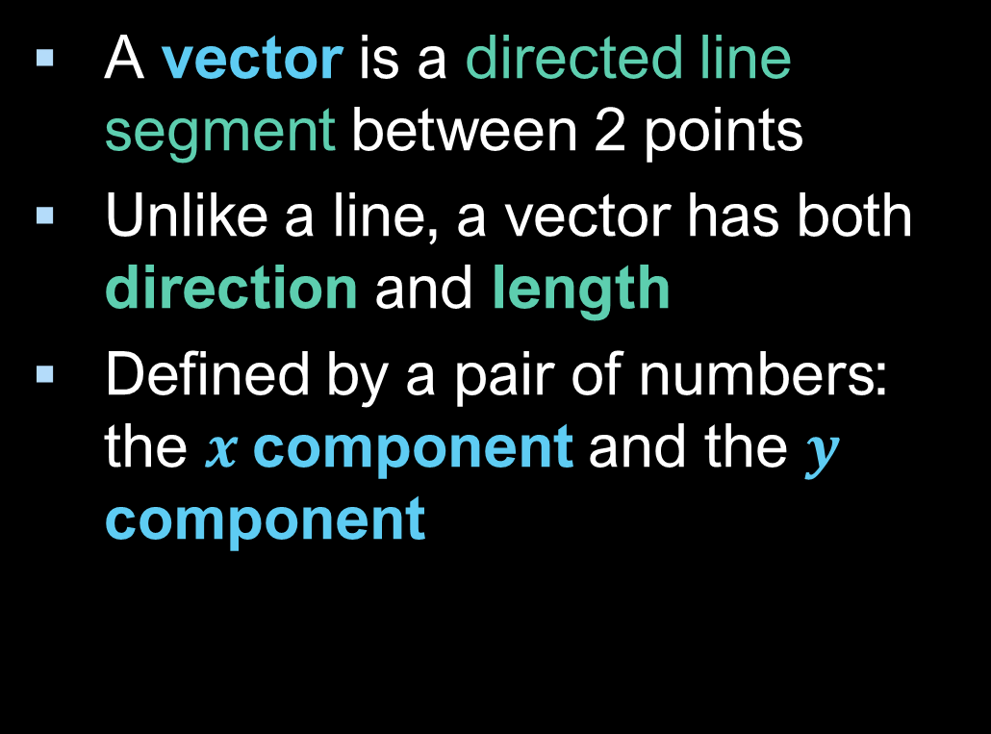




2D Vectors
A vector is a directed line segment between 2 points
Unlike a line, a vector has both direction and length
Defined by a pair of numbers: the $x$component and the $y$ component
$$B=(x_{b}, y_{b})$$
$$y=y_{b}−y_{a}$$
$$A=(x_{a}, y_{a})$$
$x=$ $x_{b}−x_{a}$
Notes:
This sounds a little like a point, and in fact

Slide 5






Vectors and points
A vector can represent a point relative to the origin:
… but a point is not the same as a vector!
$$y$$
$$B=(x_{b}, y_{b})$$
$$y=y_{b}−0$$
$$A=(0,0)$$
$x=$ $x_{b}−0$
$$x$$
(Except in some code…)
Notes:
Since they both are essentially pairs of values, some maths libraries use the same object to represent both, but there are situations where it’s important to remember the distinction between them (which we’ll look at later in the course), so it’s good to be clear from the start which you’re dealing with. We’ll be treating them separately in this module, including in the code for the assignments.

Slide 6







Writing vectors
For COMP270: this is a point
As a pair of numbers: $(x,y)$
As a column vector: $\left(\begin{matrix}x \\ y\end{matrix}\right)$
Variable representing a vector: written in bold i.e. $v=\left(\begin{matrix}x \\ y\end{matrix}\right)$
Other notations: $\vec{v},\underline{v}$
Vector from $A$ to $B$: $\vec{AB}$ Vector from $B$ to $A:$ $\vec{BA}$
Note: these are not the same, as the components will have opposite signs
$$B$$
$$B$$
$$\vec{AB}$$
$$\vec{BA}$$
$$A$$
$$A$$

Slide 7






Vector magnitude and direction
Recall: a vector is the hypotenuse of the triangle formed with lines through its end points, parallel to the axes
The other side lengths are the vector components, $x$ and $y$
The magnitude (or length) of a vector is given by: $\left\|v\right\|=\sqrt{x^{2}+y^{2}}$
The angle between $v$ and the positive $x$-axis is given by $\tan{θ}=\frac{y}{x}$ (with $\sin{θ}=\frac{y}{\left\|v\right\|}$ and $\cos{θ}=\frac{x}{\left\|v\right\|}$)
$$B$$
$$v$$
$$y$$
$$A$$
θ
$$x$$

Slide 8
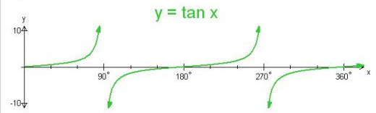





Inverse tangent
An asymptote is a line or curve that approaches a given curve arbitrarily closely
Care is needed when using $\tan^{−1}$:
$\tan^{−1}{\frac{y}{x}}=\tan^{−1}{\frac{−y}{−x}}$ so we need to be aware of which quadrant the vector is in (otherwise the result may be out by 180°)
If $x=0$ (the vector points vertically along the $y$-axis) then we’re dividing by zero
Most programming languages have an atan2(y, x) function which handles all of these cases for you
$$Q2$$
$$y$$
$$Q1$$
$$x$$
$$Q3$$
$$Q4$$
Notes:
Some things that don’t really matter if we’re just looking at ratios of side lengths and angles in triangles, but can give a wrong result when we’re considering vectors.

Slide 9
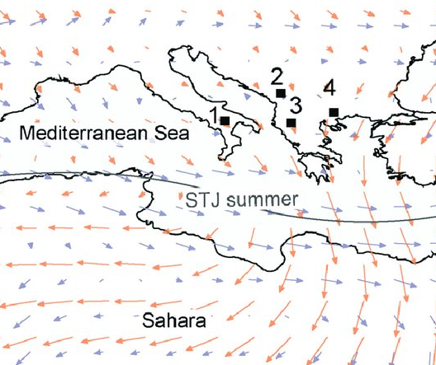



















Vector equivalence
Vectors are defined by their magnitude and direction, but not by their position in space
e.g. the vector from the origin to the point $(2, 1)$ is the same as the vector from the point $\left(−3, 2\right)$ to the point $(−1, 3)$
Used to represent more abstract quantities than just the difference between two points, e.g. wind
$$y$$
$$3$$
$$1$$
$$2$$
$$2$$
$$1$$
$$2$$
$$1$$
$$−4$$
$$−3$$
$$−2$$
$$−1$$
$$0$$
$$1$$
$$2$$
$$3$$
$$4$$
$$x$$

Slide 10






Vector addition
If $p$ and $q$ are vectors,
$p+q$ is obtained by putting $p$ and $q$ end to end
Performed component-wise, $\left(\begin{matrix}x_{1} \\ y_{1}\end{matrix}\right)+\left(\begin{matrix}x_{2} \\ y_{2}\end{matrix}\right)=\left(\begin{matrix}x_{1}+x_{2} \\ y_{1}+y_{2}\end{matrix}\right)$
Note: addition is commutative: $p+q=q+p$
$$p$$
$$p+q$$
$$q$$
$$p$$
$$q$$

Slide 11





Vector subtraction
If $p$ and $q$ are vectors representing points on the plane,
$q−p$ represents the vector from $p$ to $q$
Note the order of the subtraction!
$\left(\begin{matrix}x_{1} \\ y_{1}\end{matrix}\right)−\left(\begin{matrix}x_{2} \\ y_{2}\end{matrix}\right)=\left(\begin{matrix}x_{1}−x_{2} \\ y_{1}−y_{2}\end{matrix}\right)$
Note: subtraction is anticommutative: $q−p=−\left(p−q\right)$
i.e. $\vec{BA}=−\vec{AB}$
$$p$$
$$q−p$$
$$0$$
$$q$$

Slide 12




Scalar multiplication
If $v$ is a vector and $c$ is a positive number
$cv$ is a vector with the same direction as $v$, but $c$ times the magnitude
$c\left(\begin{matrix}x \\ y\end{matrix}\right)=\left(\begin{matrix}cx \\ cy\end{matrix}\right)$
If c is negative then $cv$ has the opposite direction to $v$
$$2v$$
$$v$$
$$−2v$$

