Slide 1
Week 2: Geometry I Part 4: Curves and Parameters
COMP270: Mathematics for 3D Worlds and Simulations

Slide 2
Objectives
Express a variety of shapes using parametric equations
Compute the vector equation of a straight line

Slide 3


Recap: drawing functions
Define a function $f :S→T$ as $f\left(s\right)∈T$ for $s∈S$
Represent the function as a graph by plotting the points $\left(x,f\left(x\right)\right)$against 2D axes
$$y={\frac{1}{4}x}^{2}−4$$
Notes:
Which gives some approximation of a curved line.
Euclid had a rather more poetic description of this, where he said that

Slide 4
What is a curve?
“The [curved] line is […] the first species of quantity, which has only one dimension, namely length, without any width nor depth, and is nothing else than the flow or run of the point which […] will leave from its imaginary moving some vestige in length, exempt of any width.”
Euclid, Elements (English translation from Wikipedia)
one dimension, namely length
flow or run of the point
leave from its imaginary moving some vestige
Notes:
So, you can imagine a curve as the trail left by a point as it moves through space, a little like when you write your name with a sparkler on bonfire night. We can represent the point’s motion using a function, which we can evaluate at various points to build up a picture of the overall path in as much detail as we require. The functions we looked at last time relate a distance along one axis of space to the distance along another, which works well for fairly simple curves, where each value of x gives only one y value, and can be extended to other shapes, too, for example a circle

Slide 5







Defining a circle
How do we define a circle of radius 1 (aka a unit circle)?
The set of points $(x, y)$ such that $x^{2}+y^{2}=1$
The pair of curves $y=±\sqrt{1−x^{2}}$
Or we can define it parametrically
$$y$$
1
$$(x, y)$$
$$1$$
$$y$$
-1
$$x$$
1
$$x$$
-1
Notes:
We have to draw two separate semicircles for the positive and negative roots.
There is a way we can describe curves like this as a single unit, which is to define it parametrically, where instead of relating the y value directly to the x, we relate both coordinates to some other value that changes over, say, time or distance. For this, we use

Slide 6

Parametric equations
Definition: parametric equations express a set of quantities as explicit functions of a number of independent variables, known as “parameters”
e.g. a curve defined by two functions $f :ℝ→ℝ$ and $g :ℝ→ℝ$, with points $(x, y)$ with $x=f\left(t\right)$ and $y=g\left(t\right)$ for $t$ in some range
$t$ is the parameter
Equivalently, defined by a single function $h : ℝ→ℝ^{2}$ which takes a scalar parameter and returns a vector
$$h\left(t\right)=\left(\begin{matrix}f\left(t\right) \\ g\left(t\right)\end{matrix}\right)$$

Slide 7








Vector equation of a line
For a line defined by two points, we can represent any point on the line as a scalar multiple of the vector between the points, plus the vector to first point from the origin
$$p_{2}$$
$$v$$
$$1.25v$$
$$p_{1}$$
$$p_{1}+0.5v$$
$$0.5v$$
$$−0.5v$$
$$O$$
Notes:
The simplest example of this is the vector equation of a line.

Slide 8






Vector equation of a line
For a line defined by two points, we can represent any point on the line as a scalar multiple of the vector between the points, plus the vector to first point from the origin
$p= p_{1}+tv$
$f(t)= p_{1}+t\left(p_{2}−p_{1}\right)=\left(1−t\right)p_{1}+tp_{2}$
$$p_{2}$$
A function of t, $f(t)$
$$v=p_{2}−p_{1}$$
$$tv$$
$$p$$
$$p_{1}$$
$$O$$

Slide 9


Vector equation of a line
For a line defined by two points, we can represent any point on the line as a scalar multiple of the vector between the points, plus the vector to first point from the origin
$p= p_{1}+tv$
$f(t)= p_{1}+t\left(p_{2}−p_{1}\right)=\left(1−t\right)p_{1}+tp_{2}$
$$p_{2}$$
$$v=p_{2}−p_{1}$$
$${tp}_{2}$$
$$p$$
$${(1−t)p}_{1}$$
$$p_{1}$$
$$O$$

Slide 10






Vector equation of a line
For a line defined by two points, we can represent any point on the line as a scalar multiple of the vector between the points, plus the vector to first point from the origin
$p= p_{1}+tv$
$f(t)= p_{1}+t\left(p_{2}−p_{1}\right)=\left(1−t\right)p_{1}+tp_{2}$
$t=0⇒f(0)=1p_{1}+0p_{2}=p_{1}$ $t=1⇒f(1)=0p_{1}+1p_{2}=p_{2}$
For $0≤t≤1$, this is a linear interpolation (lerp)
$$p_{2}$$
$$v=p_{2}−p_{1}$$
$$t=1$$
$$1−t$$
$$t=0$$
$$p$$
$$t$$
$$p_{1}$$
$$O$$

Slide 11












Parameterising a line
$f(t)= \left(1−t\right)p_{1}+tp_{2}$
$x=f\left(t\right)=\left(1−t\right)x_{1}+tx_{2}$ $y=g\left(t\right)=\left(1−t\right)y_{1}+ty_{2}$
i.e. performing a(n identical) linear interpolation along both axes
$$y$$
$$t>0$$
$$t=1$$
$$(x_{2},y_{2})$$
$$(x,y)$$
$$t=0$$
$$p=f(t)$$
$$p_{2}$$
$$(x_{1},y_{1})$$
$$t<0$$
$$p_{1}$$
$$x$$
$$O$$

Slide 12

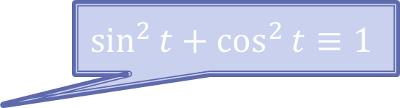


Parametric definition of a unit circle
$$\sin^{2}{t}+\cos^{2}{t}≡1$$
$$y$$
$$x=\cos{t}$$
$$y=\sin{t}$$
For $0≤t<2π$
1
-1
1
$$x$$
-1
Notes:
Here, rather than the linear displacement from the starting point, t is the angle with the positive x-axis

Slide 13
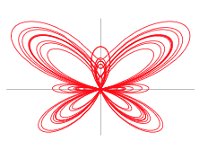

Parametric definition of a butterfly
$$x=\sin{t}\left[e^{\cos{t}}−2\cos\left(4t\right)+{\left(\sin{(\frac{1}{12}t)}\right)}^{5}\right]$$
$$y=\cos{t}\left[e^{\cos{t}}−2\cos\left(4t\right)+{\left(\sin{(\frac{1}{12}t)}\right)}^{5}\right]$$
https://mathworld.wolfram.com/ButterflyCurve.html

Slide 14
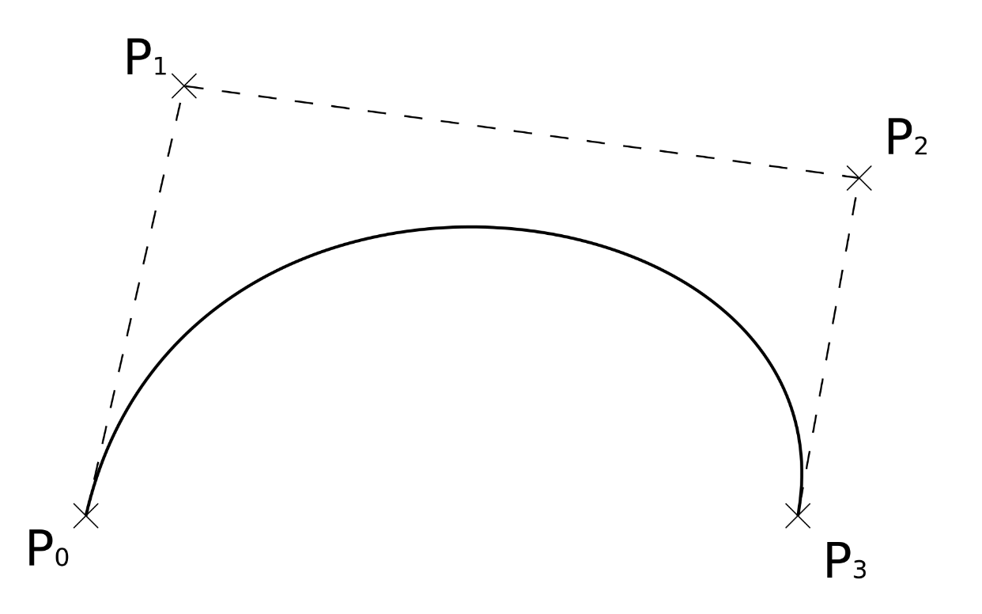
Bézier curves
Named after Pierre Bézier, 1910-1999, French engineer
Defined by a weighted blend of a number of control points
Commonly used in computer graphics and game development, as allows artists/designers good control over the precise shape of the curve
See worksheet A…

