Slide 1
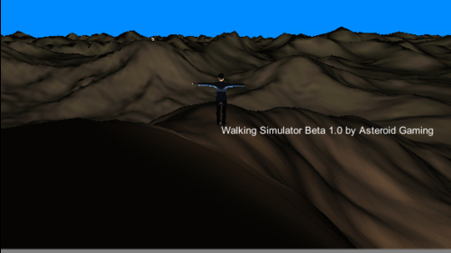
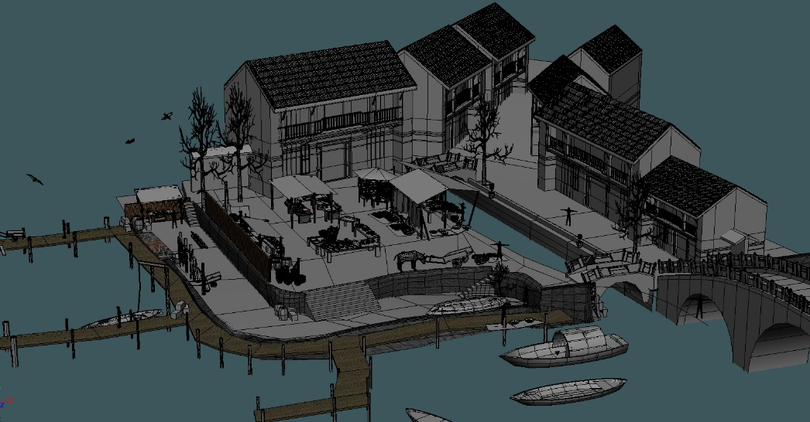
3D Maps “A Walking Simulator” By James Hellman
My “Demo” will be a basic walking simulator that can load in 3D models that you can explore. The models will typically be buildings more than natural landscapes, as a building would be more interesting to wander around.
Sourced from gamejolt.com
Sourced from polycount.com
Included into this will be basic movement, and a possibility of collision. As required by the contract there will be a light source. The buildings will have basic textures.

Slide 2
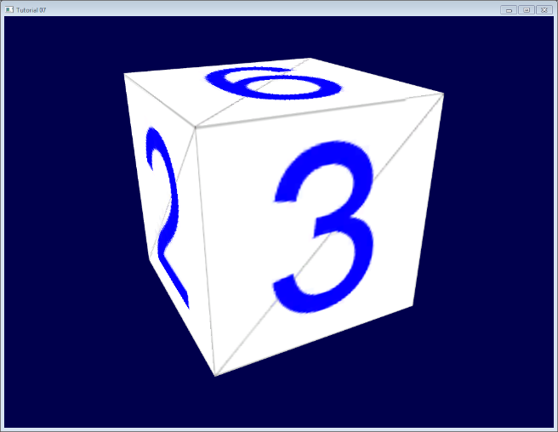
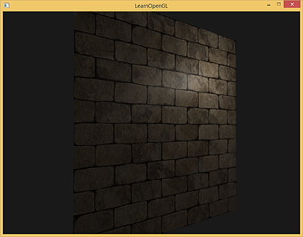
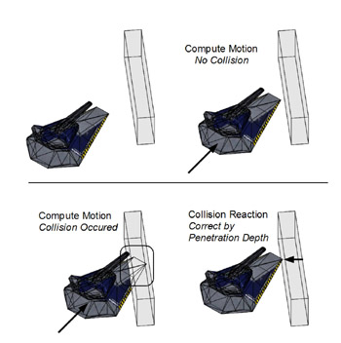
The Graphical Effects
If this program goes to plan without sudden difficulties arising, then theoretically it should be within scope.
The two main components that my demo will include are the following.
Loading meshes from a standard 3D file format. The program will be using .mb(Maya) or .fpx files to load into the demo. This will provide the bulk of the demo as the models will be premade to load.
Sourced from opengl-tutorial.org
“Realistic” rendering of rough surfaces, using normal mapping to achieve this. The textures will add to the game by providing “some” emersion for the simulator.
Sourced from learnopengl.com
As a stretch goal the program could use simple collision to prevent the player form walking through the walls. Collision will help the player explore more efficiently as they will not be able to just pass through everything.
Sourced from flylib.com

