Slide 1

5: Monte Carlo Tree Search
COMP702: Classical Artificial Intelligence

Slide 2
Paper Club
For next week’s seminar, please read:
Pepels, T, Winands, M.H.M., Lanctot, M. (2014). Real-Time Monte Carlo Tree Search in Ms Pac-Man. IEEE Transactions on Computational Intelligence and AI in Games, 6(3):245-257.
(PDF Link on LearningSpace)

Slide 3
Monte Carlo methods

Slide 4
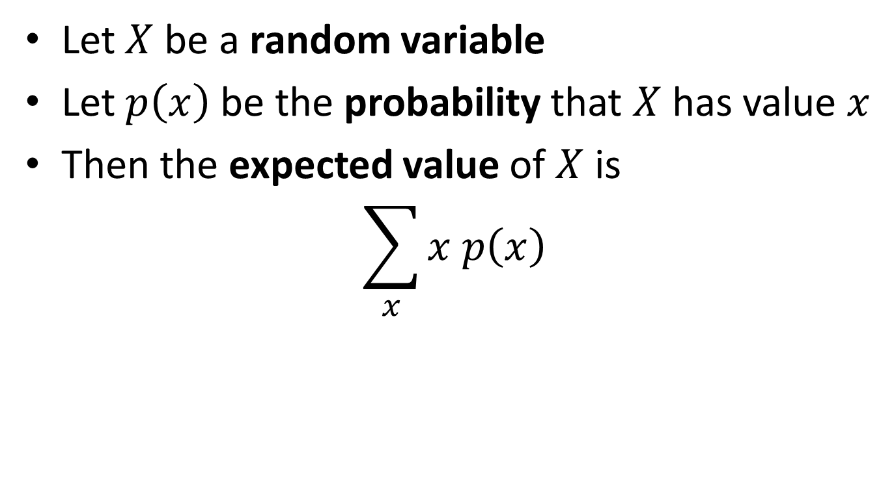
Expected value
Let $X$ be a random variable
Let $p\left(x\right)$ be the probability that $X$ has value $x$
Then the expected value of $X$ is $\sum_{x}{x p\left(x\right)}$

Slide 5
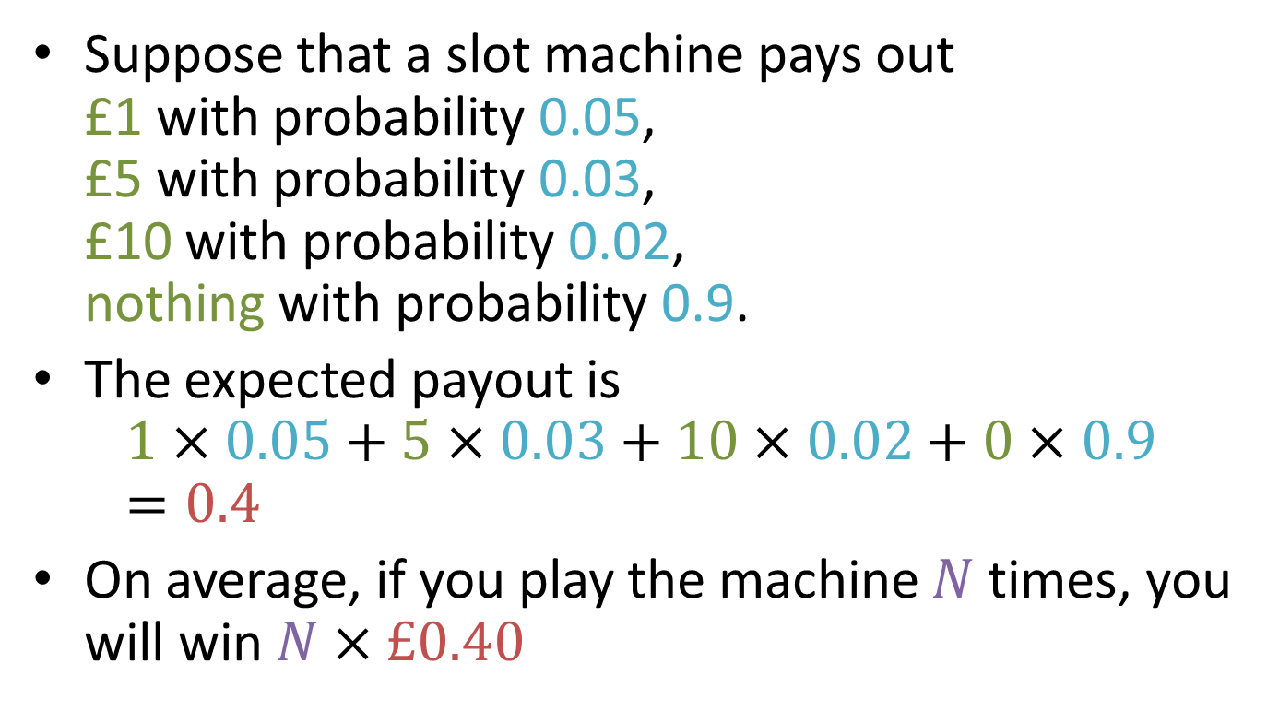
Expected value – example
Suppose that a slot machine pays out £1 with probability 0.05, £5 with probability 0.03, £10 with probability 0.02, nothing with probability 0.9.
The expected payout is $1×0.05+5×0.03+10×0.02+0×0.9$ $=0.4$
On average, if you play the machine $N$ times, you will win $N×£0.40$

Slide 6
“Randomness” in computing
Digital computers are deterministic, so there's no such thing as true randomness
Cryptographically secure systems use an external source of randomness e.g. atmospheric noise, radioactive decay
What we actually have are pseudo-random number generators (PRNGs)
A PRNG is an algorithm which gives an unpredictable sequence of numbers based on a seed
Sequence is uniformly distributed, i.e. all numbers have equal probability
Seed is generally based on some source of entropy, e.g. system clock, mouse input, electronic noise

Slide 7
Monte Carlo methods
In computing, a Monte Carlo method is an algorithm based on averaging over random samples
The average over a large number of samples is a good approximation of the expected value
Used for quickly approximating quantities over large domains
Generally designed to converge in the limit
An infinite number of samples would give an exact answer
As the number of samples increases, the accuracy of the answer improves
Applications in physics, engineering, finance, weather forecasting, graphics, ...

Slide 8
Monte Carlo Tree Search

Slide 9
Game decisions revisited
Current position
Move A
Move B
Move C
Position
after move A
Position
after move B
Position
after move C
Reward signal for move B
“Oracle” policy
Value of move B
Win=1, Loss=0
Playout policy
Terminal position
Win=1, Loss=0

Slide 10
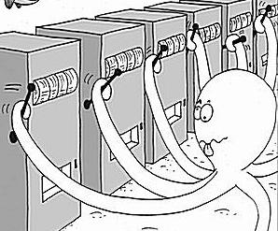
The multi-armed bandit problem
At each step pull one arm
Noisy/random reward signal
In order to:
Minimise regret
Maximise expected return
(Find the best arm)

Slide 11

Upper Confidence Bound (UCB1)
Balance exploitation with exploration
Select the arm that maximises
Total number of trials so far
Total reward from this arm so far
$$\frac{V_{a}}{n_{a}}+k\sqrt{\frac{\log{n}}{n_{a}}}$$
Number of times this arm has been selected so far
Exploitation
Exploration
Tuning constant
P Auer, N Cesa-Bianchi, P Fischer. Finite-time analysis of the multiarmed bandit problem. Machine Learning. 47(2):235-256, 2002.
Notes:
Important to make the simple point that there are two reasons for pulling an arm – that it looks good based on the evidence so far (=exploitation) and that you don’t know enough to know whether it might be good (exploration).

Slide 12
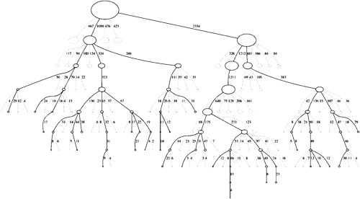
Monte Carlo Tree Search (MCTS)
Iteratively build a partial search tree, one node per iteration
Monte Carlo evaluation (random playouts) for nonterminal states
Asymmetric
balance exploitation with exploration
Anytime
can do as many (or as few) iterations as we want
Aheuristic
Monte Carlo evaluation requires only a forward model

Slide 13
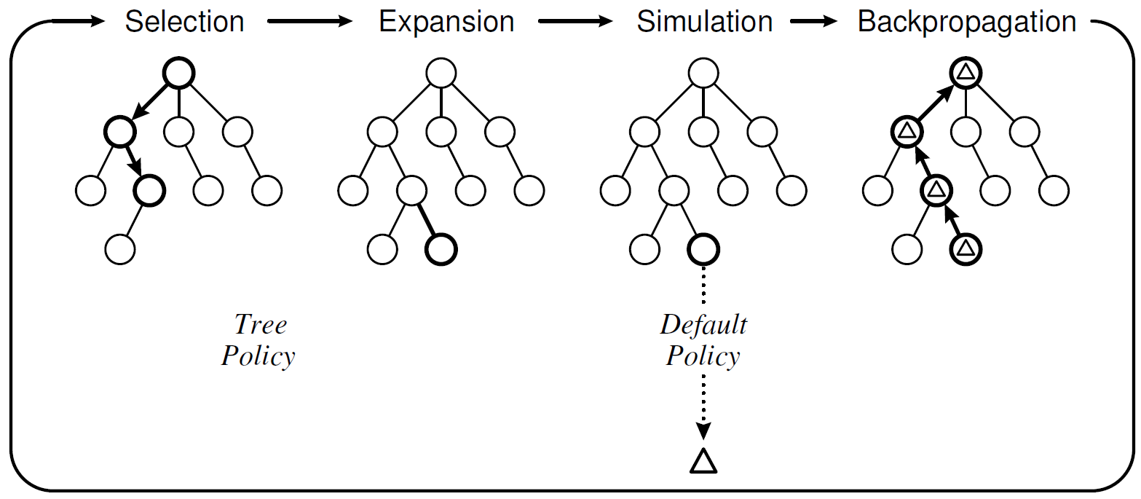
Monte Carlo Tree Search (MCTS)
Choose a node with unexpanded children
Add a child to the selected node
Do a Monte Carlo simulation
Update statistics for the visited nodes
Repeat

Slide 14
Game Decisions
Current position
Move A
Move B
Move C
Position
after move A
Position
after move B
Position
after move C
Reward signal for move B
Win=1, Loss=0
Playout policy
Terminal position
Win=1, Loss=0

Slide 15
Monte Carlo Tree Search (MCTS)
Current position
Move A
Move B
Move C
Position
after move A
Position
after move B
Position
after move C
Tree policy
Move D
Position
after moves B,D
Playout policy
Reward signal
Win=1, Loss=0
Default policy
Terminal position
Win=1, Loss=0
Notes:
Tree policy is learned
Default policy is unlearned e.g. random
As search progresses, tree policy improves, and makes up more of the playout policy => closer approximation to oracle policy

Slide 16

Upper Confidence bound for Trees (UCT)
$$\frac{V_{a}}{n_{a}}+k\sqrt{\frac{\log{n}}{n_{a}}}$$
Tree policy: UCB1
Default policy: uniform random
L Kocsis, C Szepesvári. Bandit based Monte-Carlo planning. In Machine Learning: ECML 2006, vol 4212 of Lecture Notes in Artificial Intelligence, 282-293, 2006.

Slide 17
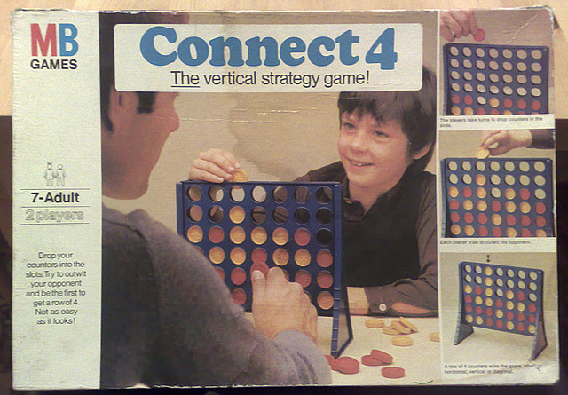
Demo

Slide 18
MCTS for games of imperfect information
Peter I. Cowling, Edward J. Powley and Daniel Whitehouse.
Information Set Monte Carlo Tree Search.
IEEE Transactions on Computational Intelligence and AI in Games, 4(2):120–143, 2012.

Slide 19
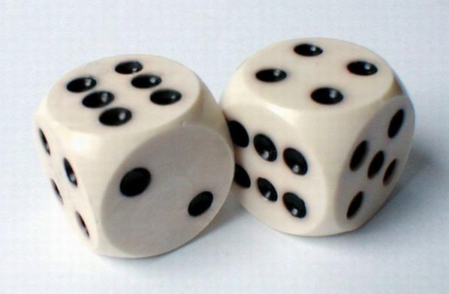

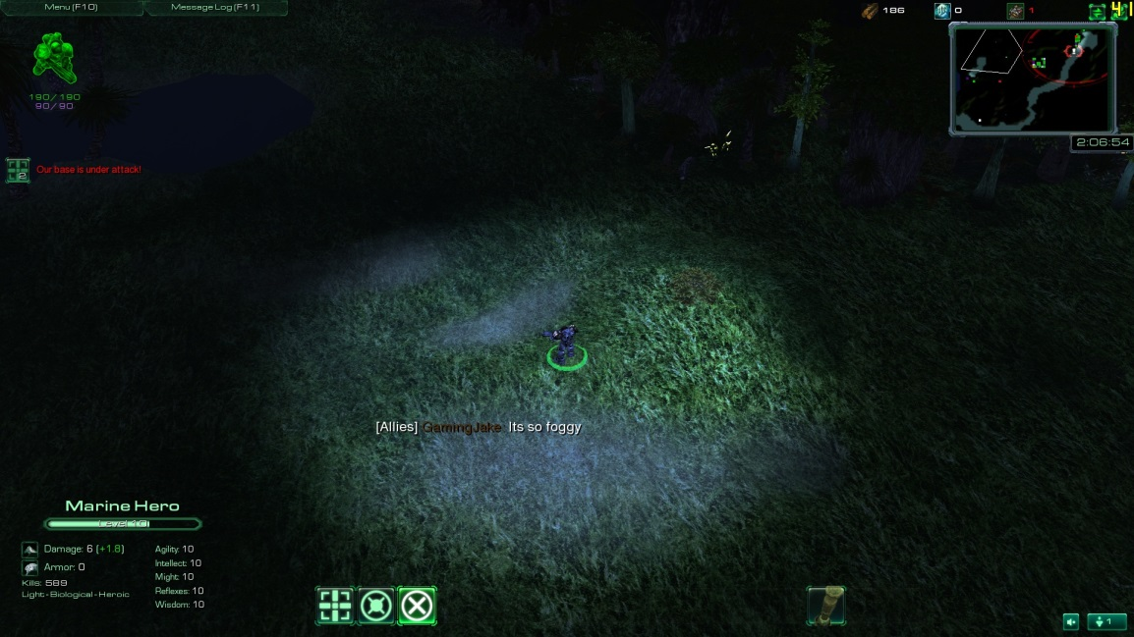
Imperfect information
Stochasticity
Information asymmetry
Partial observability

Slide 20
An explosion in branching factor
4 possible plays by me
50 possible random card draws
₄₀C₃ = 9880 different opponent plays
...

Slide 21











Information sets
Observation gives a set of possible states, one of which is the actual state of the game
Information set:
{
,
Actual state:
,
Observation:
, ...}

Slide 22
Determinization
“Averaging over clairvoyance” [Russell and Norvig 2009]

Slide 23
An explosion in branching factor
4 possible plays by me
50 possible random card draws
₄₀C₃ = 9880 different opponent plays
...

Slide 24
A reduction in branching factor
4 possible plays by me
1 guessed random card draw (determinization)
₄C₃ = 4 different opponent plays
...

Slide 25

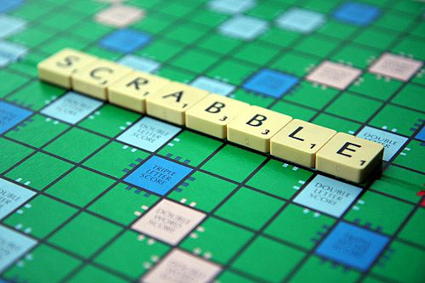
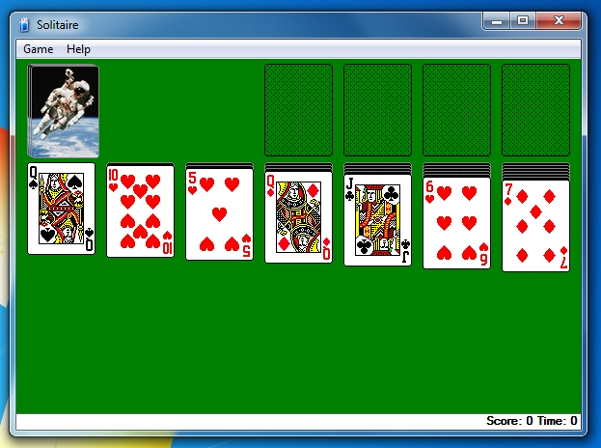

Successes for determinization

Slide 26
Strategy fusion
Minimax value = +1
+0.9
Expected value = 0
m₁
m₂
m₁
m₂
-1
+1
+1
-1

Slide 27
Non-locality
+1
-1
m₁
m₂
m₁
m₂
-0.5
+0.5
+0.5
-0.5

Slide 28
Cheating
Perfect inference
Clairvoyance
No strategy fusion

Slide 29
Information Set MCTS (ISMCTS)
P. I. Cowling, E. J. Powley, D. Whitehouse. Information Set Monte Carlo Tree Search. IEEE Transactions on Computational Intelligence and AI in Games, 4(2):120-143, 2012.

Slide 30
Information Set MCTS (ISMCTS)
P. I. Cowling, E. J. Powley, D. Whitehouse. Information Set Monte Carlo Tree Search. IEEE Transactions on Computational Intelligence and AI in Games, 4(2):120-143, 2012.

Slide 31
Multi-observer information set MCTS

Slide 32
Information Set MCTS (ISMCTS)
Does not suffer from strategy fusion
Beats determinization in
LOTR: The Confrontation
Phantom m,n,k games (noughts and crosses with hidden moves)
Hearts

Slide 33

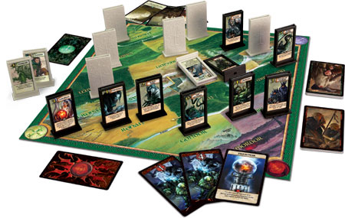

Slide 34
The Phantom 4,4,4 game
4x4 version of noughts and crosses
Opponent’s marks are hidden

Slide 35
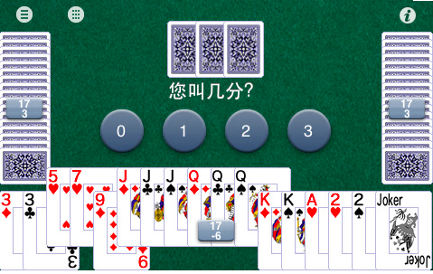
Dou Di Zhu
Popular in China and online
ISMCTS not a significant improvement on determinization
Hidden information is not as important as one might think…
In situations where hidden info is important, ISMCTS performs well

Slide 36
ISMCTS for Spades
Daniel Whitehouse, Peter I. Cowling, Edward J. Powley and Jeff Rollason.
Integrating Monte Carlo Tree Search with knowledge-based methods to create engaging play in a commercial mobile game.
Proceedings of AAAI Conference on Artificial Intelligence and Interactive Digital Entertainment (AIIDE), 2013.

Slide 37

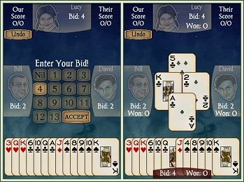
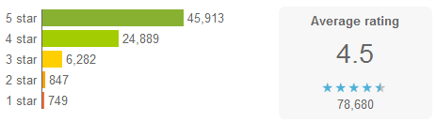
Spades by AI Factory
Android version of the popular card game
(Human + AI) vs (AI + AI)
7.5 million + downloads

Slide 38
Rule-based AI for Spades
Developed over 10 years
Uses determinization and Monte Carlo evaluation (no trees)
Heavily reliant on expert knowledge based rules
Generally well reviewed…
… but some deficiencies in play at highest difficulty levels

Slide 39
ISMCTS for Spades
Objectively strong…

Slide 40
Performance of ISMCTS for Spades

Slide 41
ISMCTS for Spades
Objectively strong…
… but makes choices which appear bad to a human player
Here plausibility is more important than win rate
Use the rule-based AI’s knowledge to bias ISMCTS towards plausible moves
No measurable effect on win rate…
… but fixes many instances of perceived bad play

Slide 42
I've bid nil. My partner over trumps opponent's three with Queen and then leads a ten. He should have used the ten and led the Queen.
Version = 0F9
Seed = 1755444836
Play Levels (S,W,N,E): N/A, 28, 28, 28
Play Styles (S,W,N,E): N/A, 128, 0, 0
AI Type (S,W,N,E): N/A, 129, 129, 129
...
E Play: 7C
S Play: 4C
W Play: 3S
N Play: QS
N Play: 10S
E Play: 6S

Slide 43
Performance of ISMCTS for Spades

Slide 44
MCTS for a real-time game
Edward J. Powley, Daniel Whitehouse and Peter I. Cowling. Monte Carlo Tree Search with macro-actions and heuristic route planning for the Physical Travelling Salesman Problem. Proceedings of IEEE Conference on Computational Intelligence in Games (CIG), 234–241, 2012.
Diego Perez, Edward J. Powley, Daniel Whitehouse, Philipp Rohlfshagen, Spyridon Samothrakis, Peter I. Cowling and Simon M. Lucas. Solving the Physical Travelling Salesman Problem: tree search and macro-actions. IEEE Transactions on Computational Intelligence and AI in Games, 6(1):31–45, 2014.

Slide 45
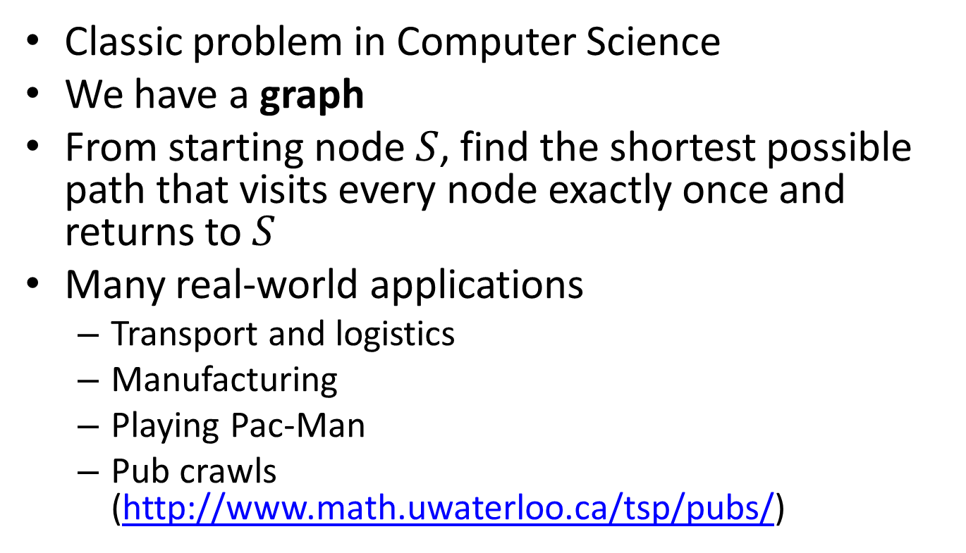
Travelling Salesman Problem (TSP)
Classic problem in Computer Science
We have a graph
From starting node $S$, find the shortest possible path that visits every node exactly once and returns to $S$
Many real-world applications
Transport and logistics
Manufacturing
Playing Pac-Man
Pub crawls (http://www.math.uwaterloo.ca/tsp/pubs/)

Slide 46
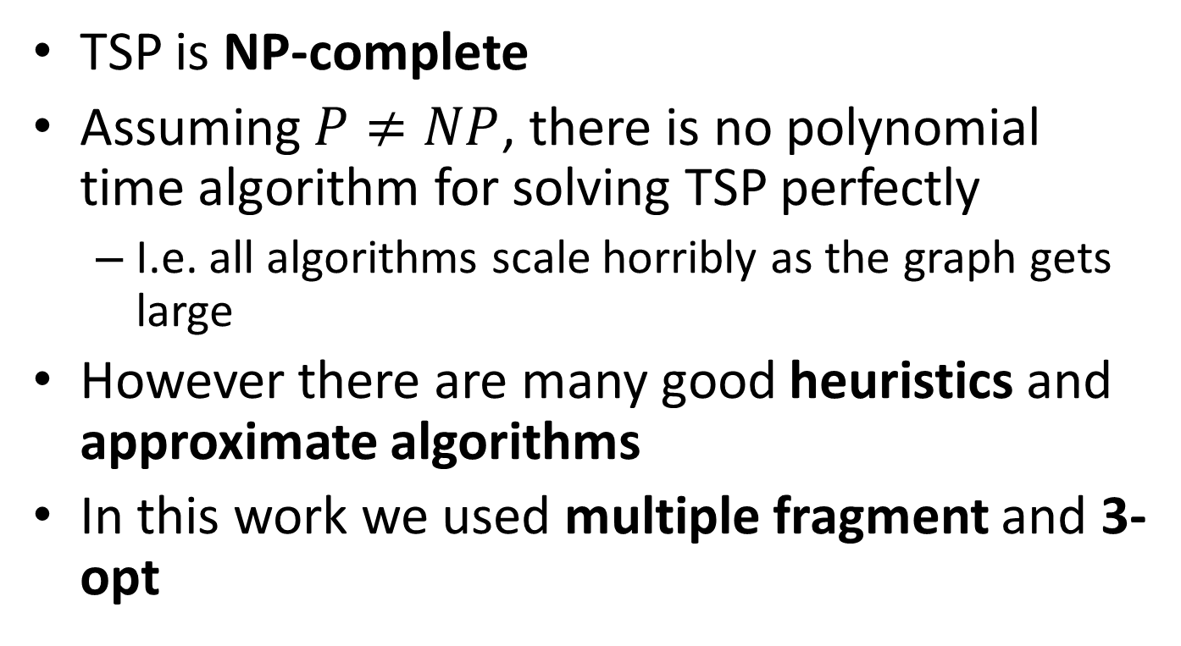
Solving TSP
TSP is NP-complete
Assuming $P≠NP$, there is no polynomial time algorithm for solving TSP perfectly
I.e. all algorithms scale horribly as the graph gets large
However there are many good heuristics and approximate algorithms
In this work we used multiple fragment and 3-opt

Slide 47
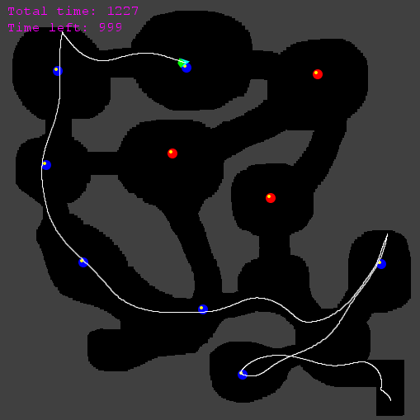
Physical Travelling Salesman Problem (PTSP)
Steer a spaceship to collect all waypoints
Asteroids-like controls
Newtonian physics
Map is unknown in advance
Controller has a few seconds of initialisation time, and then must make an input to the ship every 40ms

Slide 48
Demo
Our PTSP controller in action

Slide 49
Challenges for tree search in real-time domains
Many more decisions per game than most turn-based games
Hence state space is enormous even if branching factor is small
PTSP has of the order 10¹⁵⁵⁶ states
19×19 Go has of the order 10¹⁷¹ states
Time budget is restricted (milliseconds per decision)

Slide 50
Key features of our PTSP controller
Hierarchical structure
Higher-level route planner chooses the waypoint order
TSP solver with heuristics for avoiding sharp turns
Lower-level steering controller executes the route
MCTS with macro-actions and heuristic evaluation
Depth limiting and heuristic evaluation
Guides the steering controller along the route
Macro-actions
Vastly reduce the state-action space for steering

Slide 51
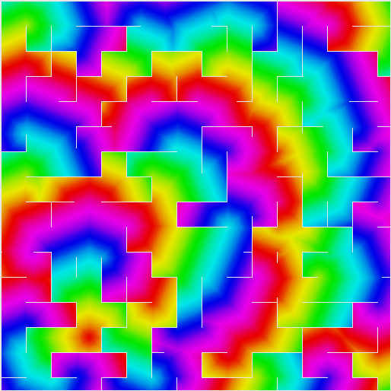
Heuristic evaluation
Based on “A* path” distance to next waypoint
Precomputed using a flood-fill algorithm

Slide 52
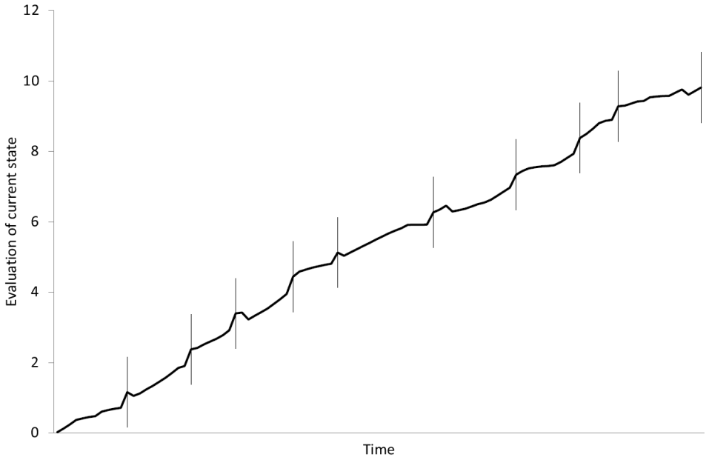
Heuristic evaluation
Guides the ship towards the current waypoint
Sharp increase in score for collecting the waypoint…
… At which point the distance to the next waypoint takes over

Slide 53
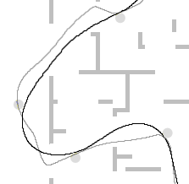
Macro-actions
Choosing a different action every time step is an unnecessary level of granularity
Instead, choose an action to be executed for the next T time steps
T=90
T=30

Slide 54
Benefits of macro-actions
Vastly reduce size of state space
Original state space size: ≈10¹⁵⁵⁶
Macro-action state space size (T=15): ≈10¹⁰³
A reduction of ≈1453 orders of magnitude
Size of macro-action space is comparable to 9×9 Go
See T times further into the future for the same tree depth
Have T times longer to make each decision
MCTS is not only anytime but also interruptible

Slide 55
Conclusion
MCTS is a powerful general-purpose AI technique
Asymmetric, Anytime, Aheuristic
MCTS has proven successful in several challenging classes of games
Games of imperfect information
Commercial mobile games
Real-time games
It shows promise in many other games and non-game applications

Slide 56
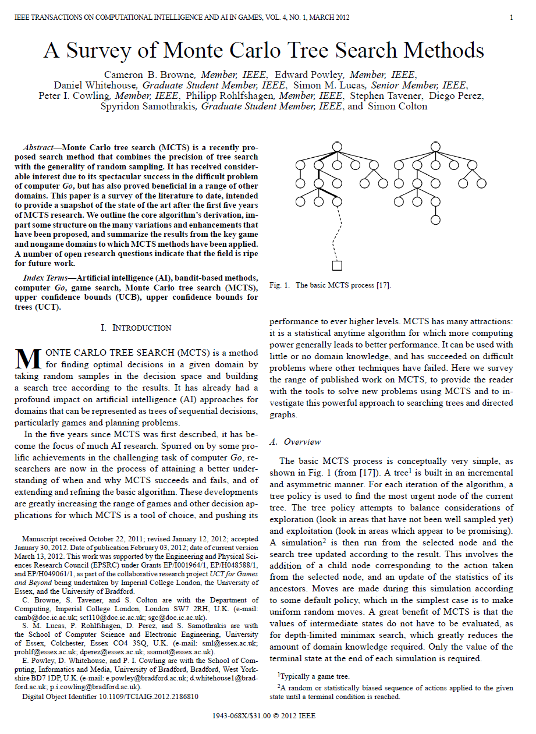
Further reading
C Browne et al.
A Survey of Monte Carlo Tree Search Methods.
IEEE Transactions on Computational Intelligence and AI in Games, 4(1):1-43, 2012.

